Slide 1
INHERITANCE
Prepared By
SAI KIRAN BEKKANTI

Slide 2
Contents
01
What is Inheritance and multiple Inheritance
02
Multiple Inheritance possible in csharp ?
03
Reason behind not supporting of Multiple Inheritance in classes
04
Why Multiple Inheritance supports in Interfaces

Slide 3
Multiple Inheritance
Inheritance is the process by which genetic information is passed on from parent to child.
Multiple Inheritance means that a subclass can inherit from two or more superclasses.
A subclass, also known as a derived class, is a class that inherits properties and methods from another class, known as the base class or superclass.
Father and children relation is the real life example.

Slide 4
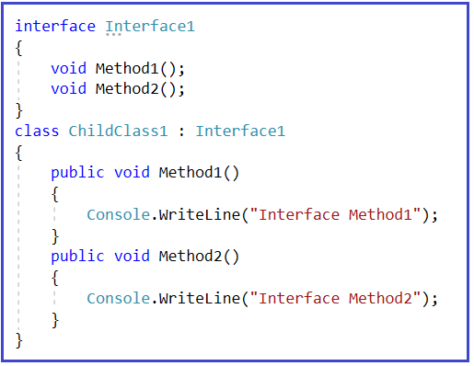
Multiple Inheritance Possible in Csharp ?
C# does not support multiple class inheritance.
To overcome this problem we use interfaces to achieve multiple class inheritance.

Slide 5
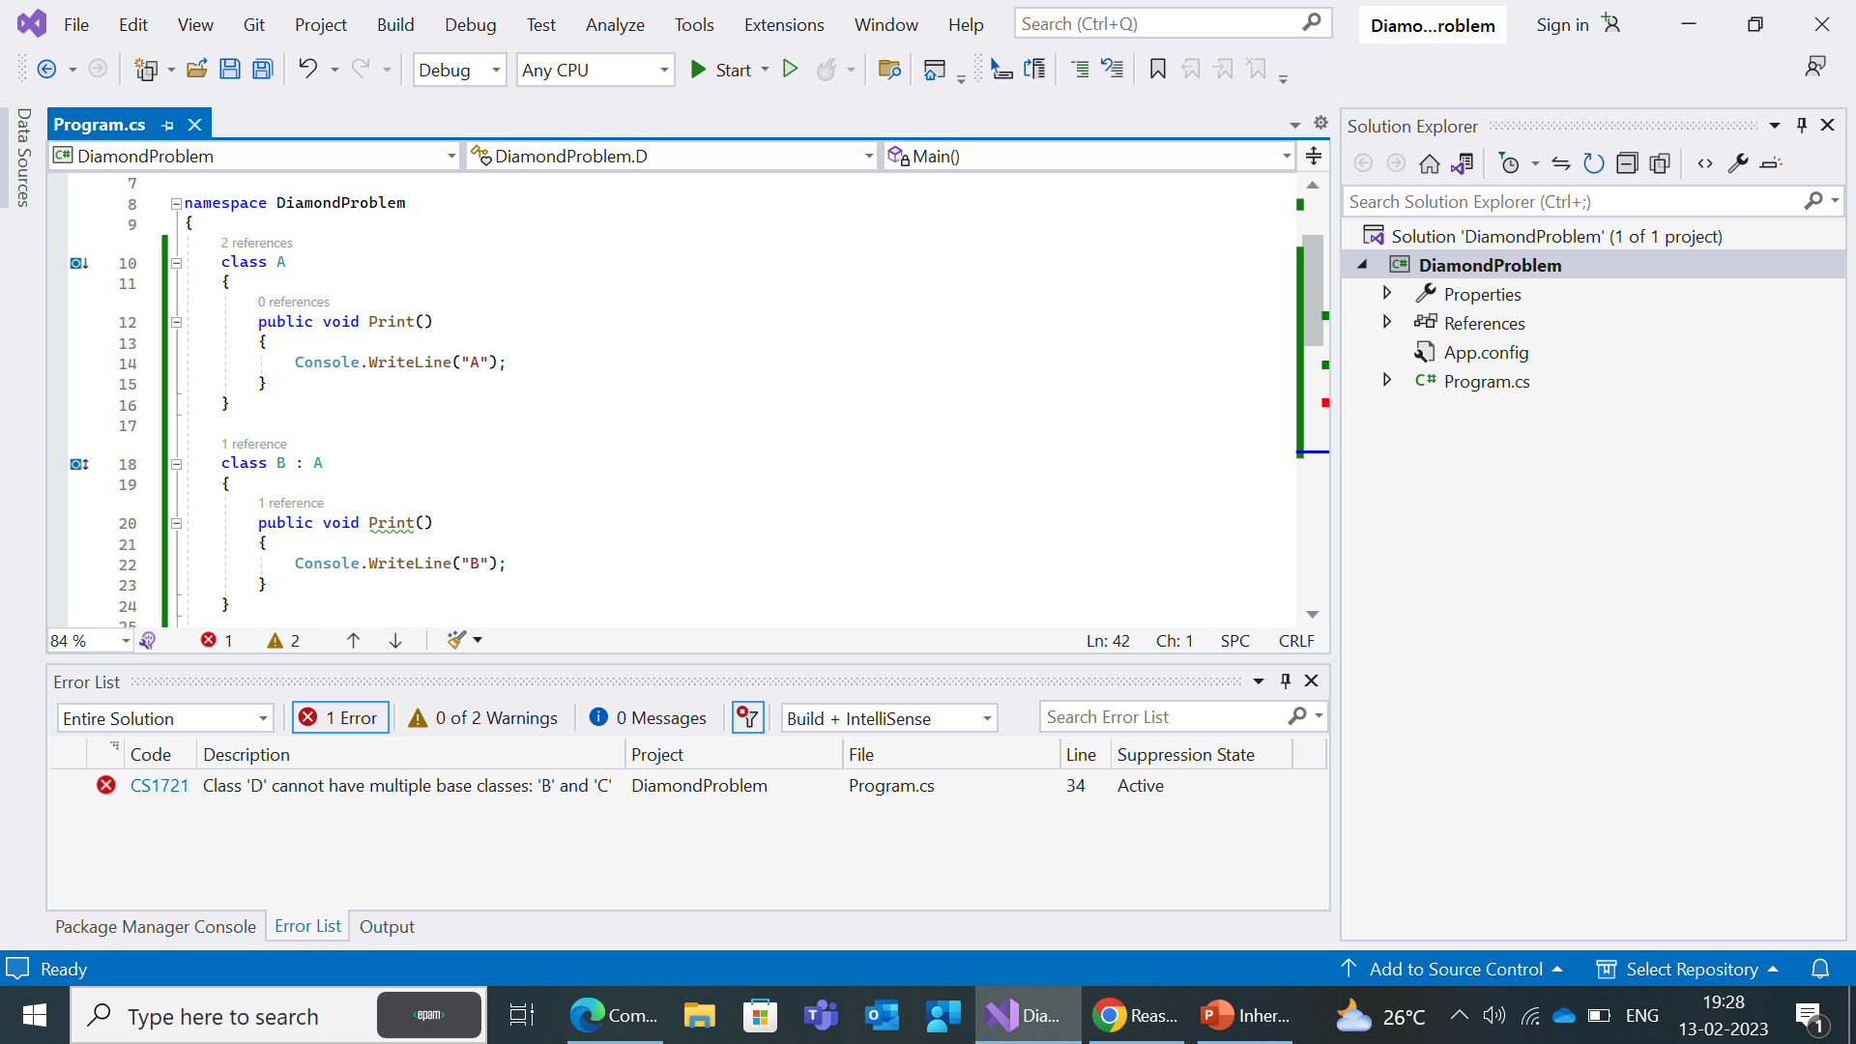
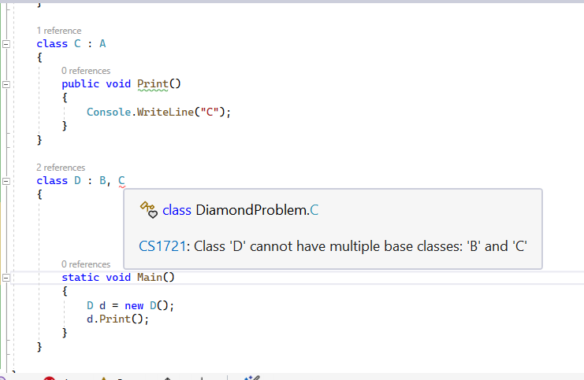
Reason behind not supporting of Multiple Inheritance in classes
C# compiler is designed not to support multiple inheritence because it causes ambiguity of methods from different base class.
This is Cause by diamond Shape problems of two classes If two classes B and C inherit from A, and class D inherits from both B and C.

Slide 6
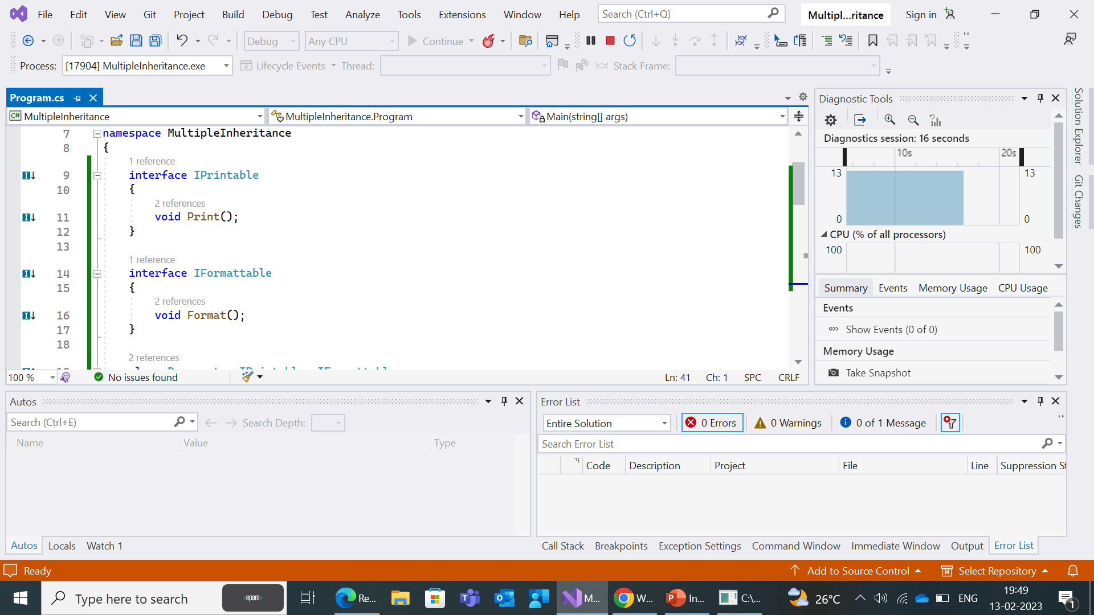
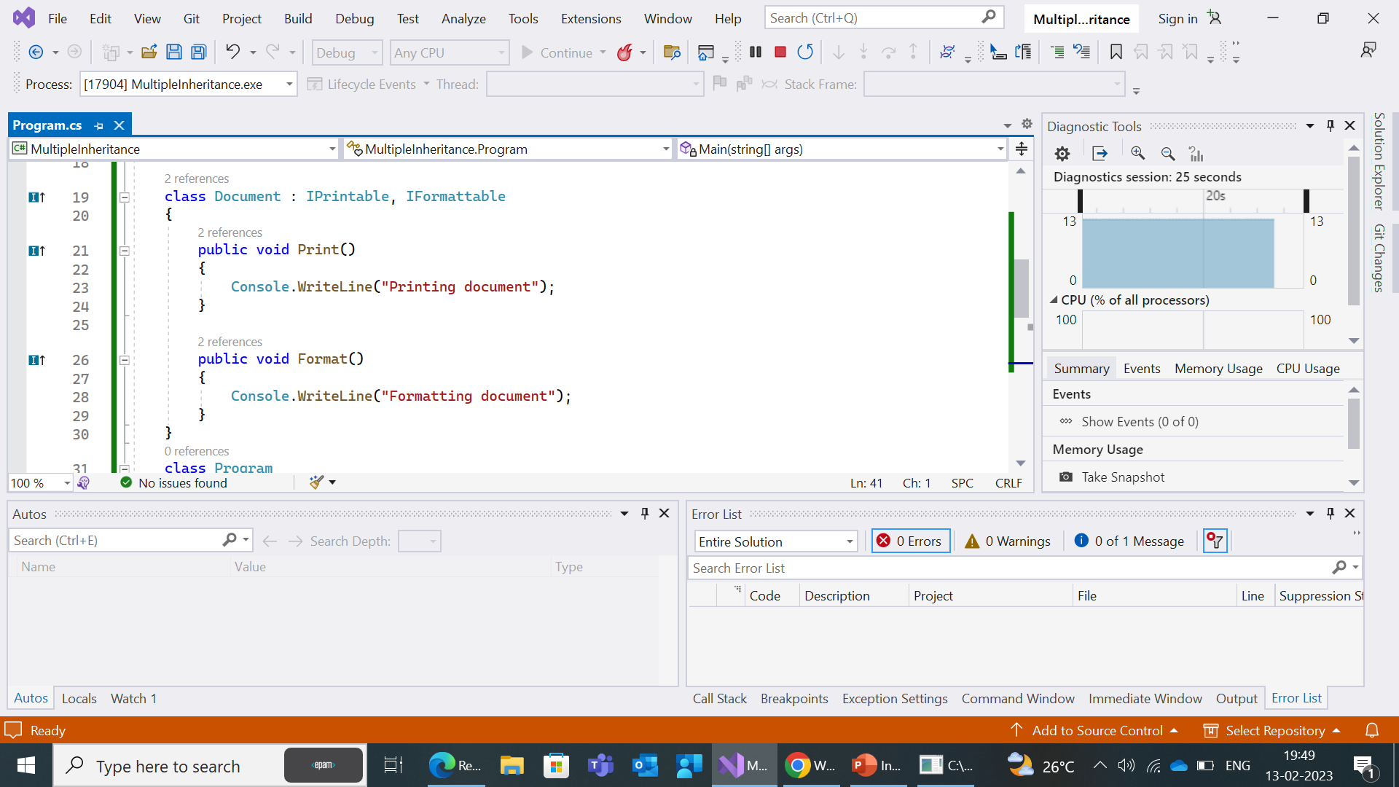
Why Multiple Inheritance supports in Interfaces
In C#, multiple inheritance is supported in interfaces because it provides a way for a class to inherit the contract (method signatures and property names) from multiple sources, without having to inherit the implementation.
This allows a class to implement multiple interfaces, each of which defines a separate set of methods and properties that the class must implement.

Slide 7
