Slide 1

Remote Client Copy
Sai Kiran
April 2, 2020

Slide 2
Procedure details
Procedure ID: ACE11023
Procedure description: HEC-ABAP Client- Remote copy
If technically possible the Add-on CLOUDLM will be installed in the target system (not in the source system)
The Client Copy will be executed automatically. If not approved by the customer, the Add-on will be deleted from the system after the client copy Is completed.

Slide 3
TQS
Acknowledge and qualify the ticket.
Check the ticket description & additional comments (if any)
Check if below information is provided in ticket (If any of the below information is not available revert to customer requesting for the same)
Target System number for the copy
Source and Target client for the copy
Profile to be used for the copy
Check if Source system credentials are maintained in secure area and its working
If all the above details are available, proceed with scheduling the activity with all mandatory parameters
Procedure ID: ACE11023
Ticket is created using source system number.

Slide 4
Requirements from Customer:
Source Client
Target Client
Source Client Profile
Source Client User Credentials
Downtime

Slide 5
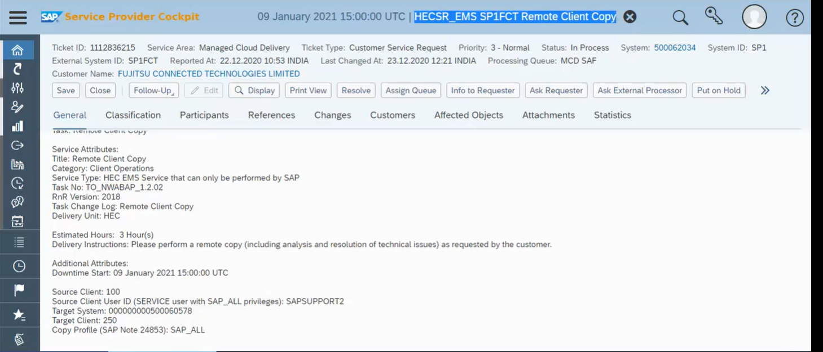

Slide 6
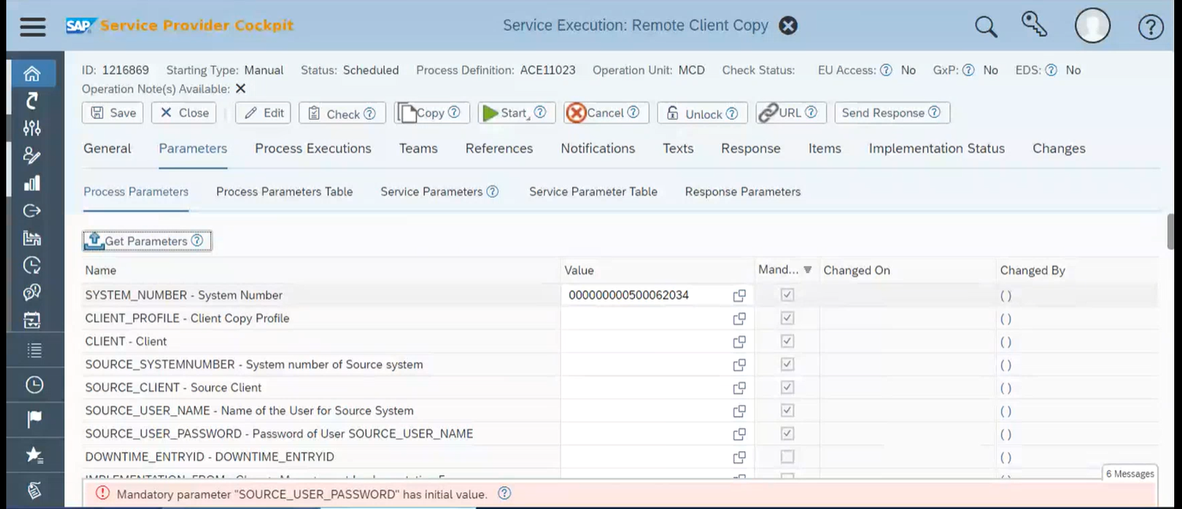

Slide 7
Pre-Checks:
RFC connection creation and checking will be performed during prechecks phase by procedure.
In case of inconsistency, request customer to clear the inconsistencies or confirm with customer if we can exclude the inconsistency.
Once activity is scheduled and prechecks are completed make sure Process ID is on HOLD for execution.

Slide 8
Post Execution
Process will delete temporary RFC connection created between source and target system.

