Slide 1
High Cloud Airlines
Data Analytics Project
Presented by:
Avala Sai Kiran
Pannerselvam Rahul Kumar
Neha Devarashetty
Shaik.Ameer shareef
D.Mohan Kali Prasad
Pepakayala Santhosh
Data Analytics Course — Project 2

Slide 2
High Cloud Airlines — Project Overview
This project involved processing, analyzing, and visualizing data from High Cloud Airlines to uncover operational insights and performance trends across flights, passengers, routes, and load factors.
110.85K
243.53M
187.02M
76.80%
279.71M HRS
Total Flights
Total Seats
Total Passengers
Load Factor
Total Airtime
Objectives
Analyze flight, seat, and passenger data across airlines, routes, and time periods
Calculate and compare Load Factor (efficiency of seat utilization) by carrier, route, and day type
Identify top-performing carriers, busiest routes, and seasonal demand patterns
Build interactive dashboards in Excel, Power BI, and Tableau for actionable insights

Slide 3
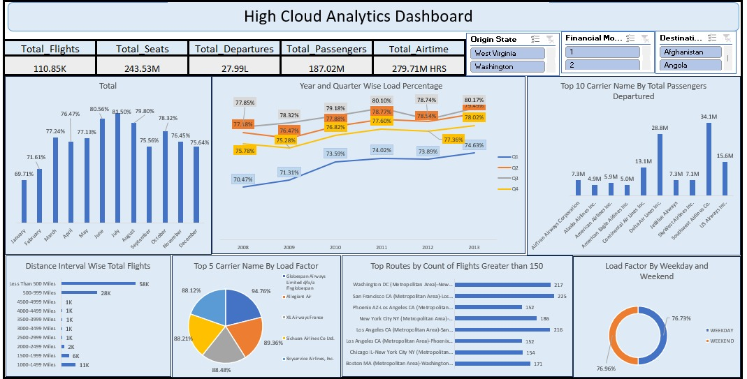
Excel Dashboard
Key Insights
Monthly load factor peaks at 81.5% (July)
Year/Quarter wise trend shows steady growth 2008–2013
Top 10 carriers: Southwest leads with 34.1M passengers
WDC–NYC & LA–NYC are busiest routes (200+ flights)
Business Interpretation
Excel dashboard provides quick KPI monitoring with slicers for origin state and financial class filters enabling dynamic analysis.
Tool: Microsoft Excel | Charts: Bar, Line, Pie, Donut

Slide 4
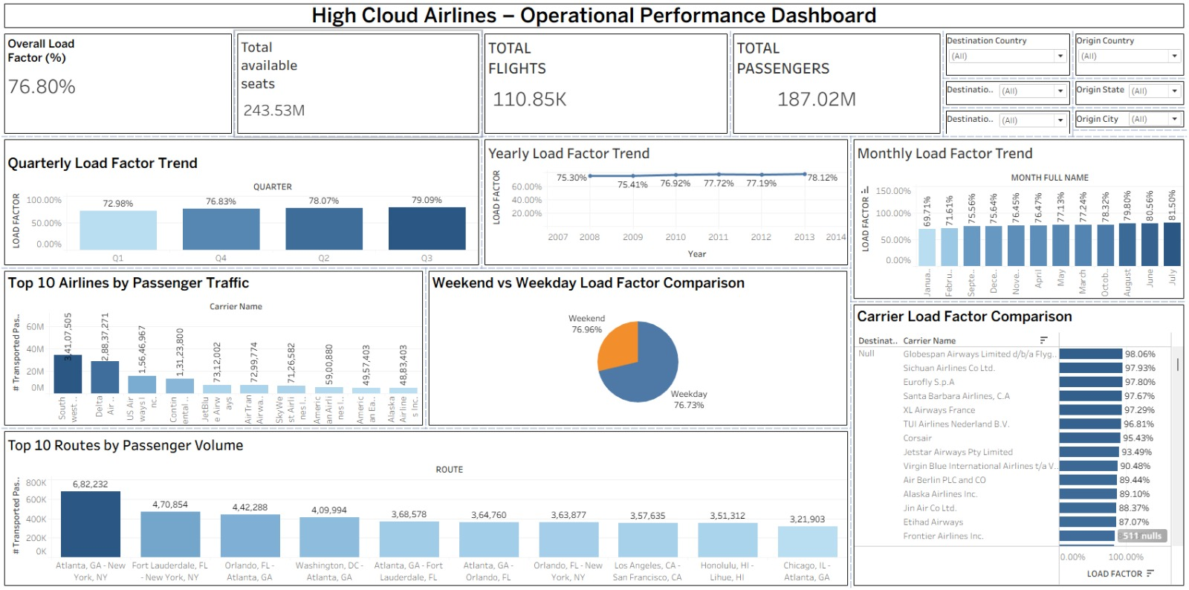
Tableau — Operational Performance Dashboard
Key Insights
Overall Load Factor: 76.80%
Q3 highest load factor at 79.09%
Yearly trend grows from 75.30% (2007) to 78.12% (2014)
Atlanta–New York top route with 6.82M passengers
Business Interpretation
Power BI enables deep-drill analysis with multi-level filters across destination country, origin state and city for granular performance tracking.
Tool: Microsoft Power BI | Filters: Country, State, City

Slide 5
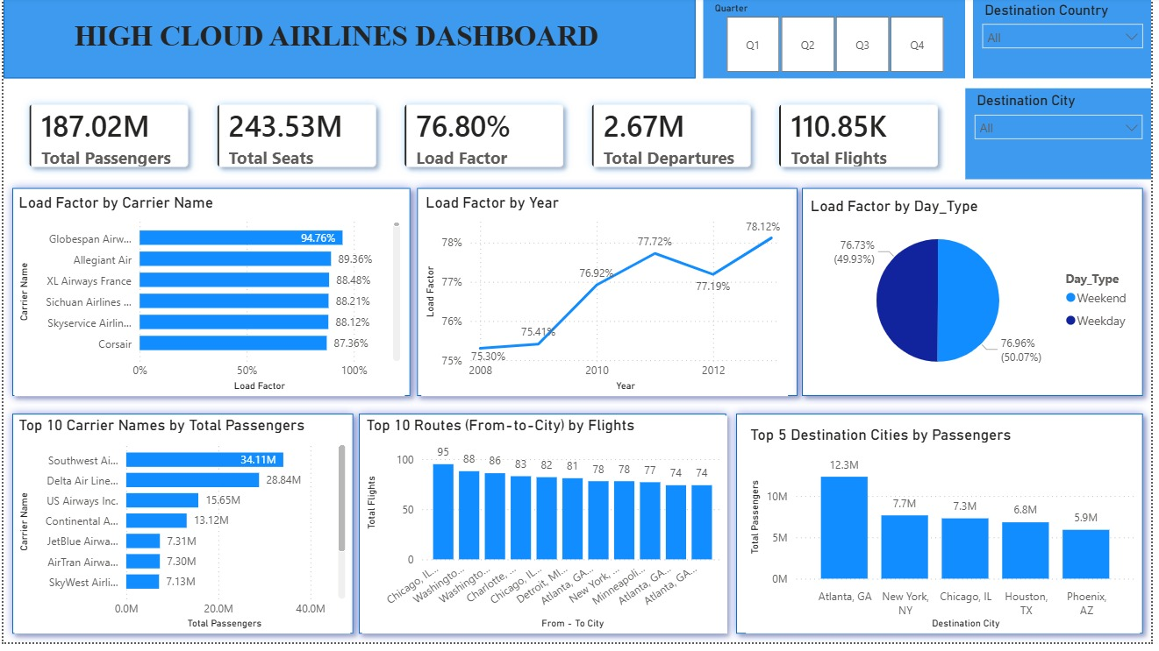
Power Bi — High Cloud Airlines Dashboard
Key Insights
Globespan Airways tops load factor at 94.76%
Load factor by year shows consistent growth trend
Weekend (76.73%) vs Weekday (76.96%) nearly equal
Atlanta GA is top destination city with 12.3M passengers
Business Interpretation
Tableau's interactive filters for Quarter and Destination City enable flexible drill-downs into route-level and carrier-level performance.
Tool: Tableau Desktop | Filters: Quarter, Destination Country & City

Slide 6
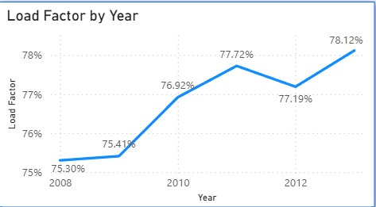
Load Factor by Year
Key Insights
Lowest: 75.30% in 2008
Dip in 2012 to 77.19%, then strong recovery
Highest: 78.12% in 2013
Overall upward trend over 6 years
Business Interpretation
Consistent growth in load factor from 2008–2013 indicates improving airline efficiency and rising demand. The 2012 dip may reflect economic conditions or increased capacity additions. The strong 2012–2013 recovery signals healthy passenger demand.

Slide 7
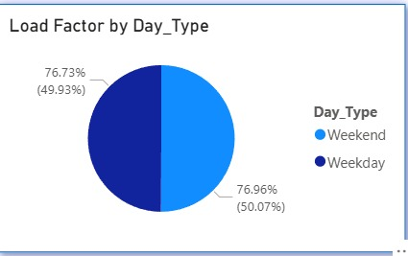
Load Factor by Day Type
Key Insights
Weekday load factor: 76.96% (50.07% of flights)
Weekend load factor: 76.73% (49.93% of flights)
Near-equal split between weekday and weekend
Weekdays marginally outperform weekends
Business Interpretation
The minimal difference between weekday (76.96%) and weekend (76.73%) load factors suggests consistent demand across the week. Airlines can leverage this stability for uniform pricing while introducing weekend leisure promotions to push utilization above 77%.

Slide 8
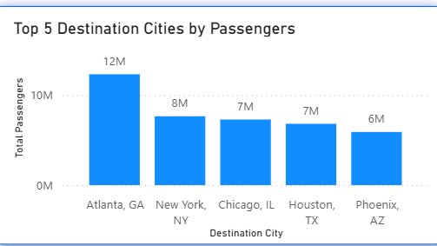
Top 5 Destination Cities by Passengers
Key Insights
Atlanta, GA leads with 12.3M passengers
New York, NY second at 7.7M
Chicago, IL third at 7.3M (tooltip: 7,299,206)
Houston, TX and Phoenix, AZ at 6.8M & 5.9M
Atlanta handles ~2x more passengers than #2
Business Interpretation
Atlanta's dominance as a hub reflects its role as a major airline connection point. New York and Chicago as major business/leisure hubs confirm high traffic. Targeted capacity investment in these cities could yield significant revenue returns.

Slide 9
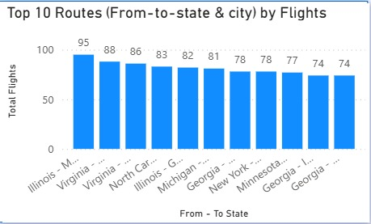
Top 10 Routes by Flights
Key Insights
Illinois–M route leads with 95 flights
Virginia routes rank #2 (88) and #3 (86)
Georgia appears 3 times in top 10
Midwest & East dominate high-frequency routes
Business Interpretation
High-frequency routes in Illinois, Virginia, and Georgia reflect dense travel corridors driven by business activity and population centers. These routes present opportunities for capacity optimization and targeted pricing strategies.

Slide 10
Key Takeaways & Conclusion
Load Factor Growth
Top Carriers
Load factor improved steadily from 75.30% (2008) to 78.12% (2014), reflecting better capacity utilization and growing demand.
Southwest Airlines leads with 34.1M passengers, followed by Delta (28.8M). Globespan Airways tops load factor at 94.76%.
Key Hub Cities
Consistent Demand
Atlanta, New York, and Chicago are the busiest destinations. These hubs represent the highest revenue and passenger opportunity.
Weekday vs. Weekend load factors are nearly identical (76.96% vs 76.73%), indicating steady demand with no major day-type bias.
Tools Used: Excel | Power BI | Tableau • Skills Demonstrated: Data Cleaning, Analysis, Visualization, Dashboard Design

