Slide 1
MADSC301 — BUSINESS INTELLIGENCE | EU BUSINESS SCHOOL MUNICH
Crypto Market Intelligence
End-to-end ETL pipeline — CoinGecko API · MySQL · Streamlit · Random Forest
Student Saikiran Gaddam
Student ID 25060844
Course MADSC301 — Business Intelligence
Lecturer Hachem Sfar
Term Term III — Academic Year 2025/26
GitHub github.com/saikiranSai-art/crypto-pipeline

Slide 2


Slide 3
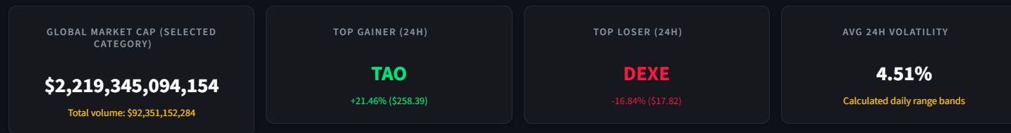
BUSINESS CASE & DATA SOURCE
Crypto Market Intelligence
An end-to-end BI pipeline for tracking crypto market movement, volatility, and liquidity.
CoinGecko API
Top 100 Coins
24h Market Metrics
ML Direction Signals
Decision problem
Live dashboard KPIs
● Identify daily winners, losers, and risky outliers.
● Compare volume against market cap to spot liquidity concentration.
● Classify price direction using engineered market features.
GLOBAL MARKET CAP
TOP GAINER
TOP LOSER
$2.21T+
BDX +16.96%
DEXE -18.58%
● Support a live demo with repeatable ETL runs and dashboard refresh.
Selected category
24h movement
24h movement
API → clean metrics → local SQL storage → dashboard + ML prediction layer
Notes:
Speaker notes: Start by framing the business problem: crypto markets move quickly, so the goal is to turn raw market data into decision-ready BI metrics. The pipeline collects the top 100 assets from CoinGecko and tracks price, market cap, volume, 24-hour price movement, and calculated volatility. The dashboard answers practical questions: which assets are moving the most, which are most volatile, and where liquidity is concentrated. I also added a simple machine-learning layer to classify price direction, which extends the BI dashboard beyond descriptive reporting.

Slide 4
SOLUTION ARCHITECTURE
From raw API data to BI dashboard
A modular ETL/ELT workflow designed for reproducibility, scheduling, and live demonstration.
🌐
🐼
🗄️
📊
🤖
EXTRACT
TRANSFORM
LOAD
ANALYZE
PREDICT
NO
SQLite
CoinGecko
/coins/markets
Pandas
feature engineering
Local SQL DB
PostgreSQL / MySQL
SQL queries
Streamlit dashboard
Random Forest
price direction
Real database
used for the
final project
EXTRACTED PER RUN
STORAGE MODEL
CALCULATED METRICS
AUTOMATION
ETL logs support
live demo proof
100 coins
3 tables
Volatility + Liquidity
Task Scheduler / Cron
Top assets by market cap
dim_coin, fact_snapshot, etl_log
Business-ready fields
Repeatable ETL job
Notes:
Speaker notes: This slide explains the complete architecture. The extract stage calls the CoinGecko markets endpoint and saves the raw JSON. The transform stage converts the payload into structured DataFrames, handles duplicates and missing values, and calculates volatility, liquidity ratio, market-cap brackets, and price direction. The load stage stores the data in a real local SQL database, not SQLite, with separate dimension, fact, and ETL log tables. The analytics layer includes SQL queries, a Streamlit dashboard, and a Random Forest classifier. The project can be scheduled with Windows Task Scheduler or cron, which satisfies the workflow orchestration requirement.

Slide 5
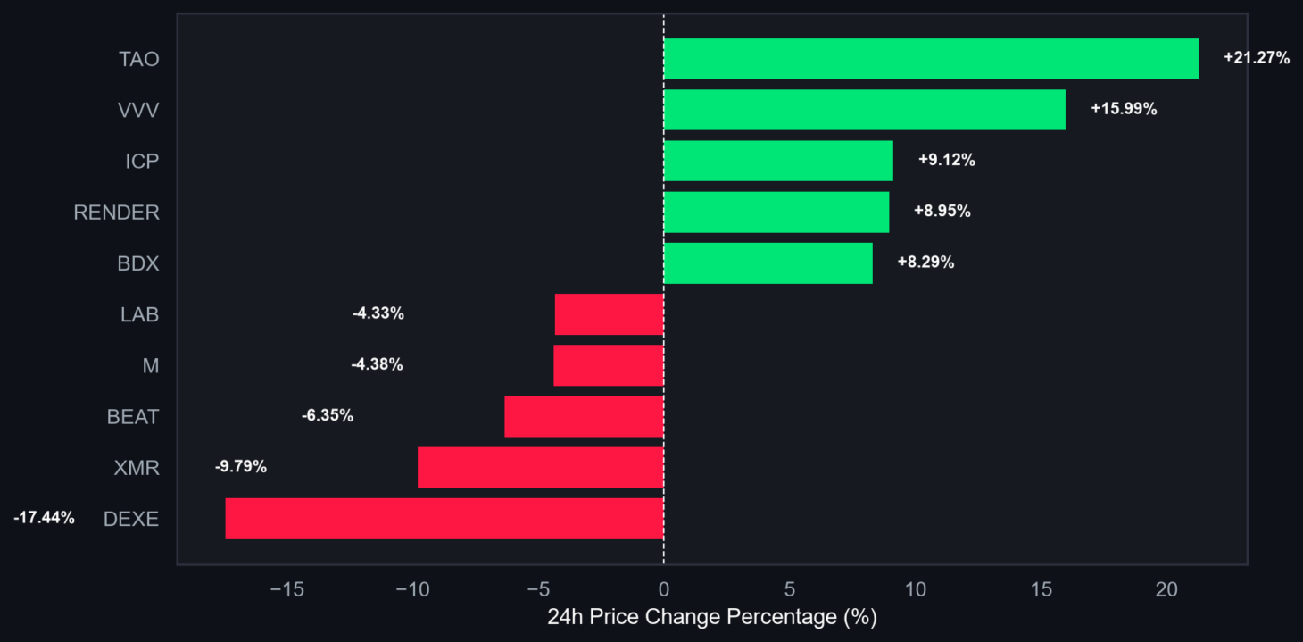
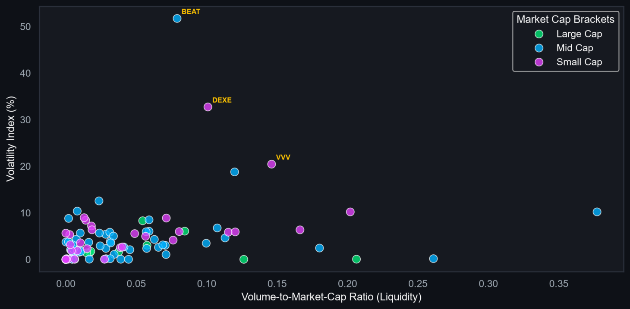
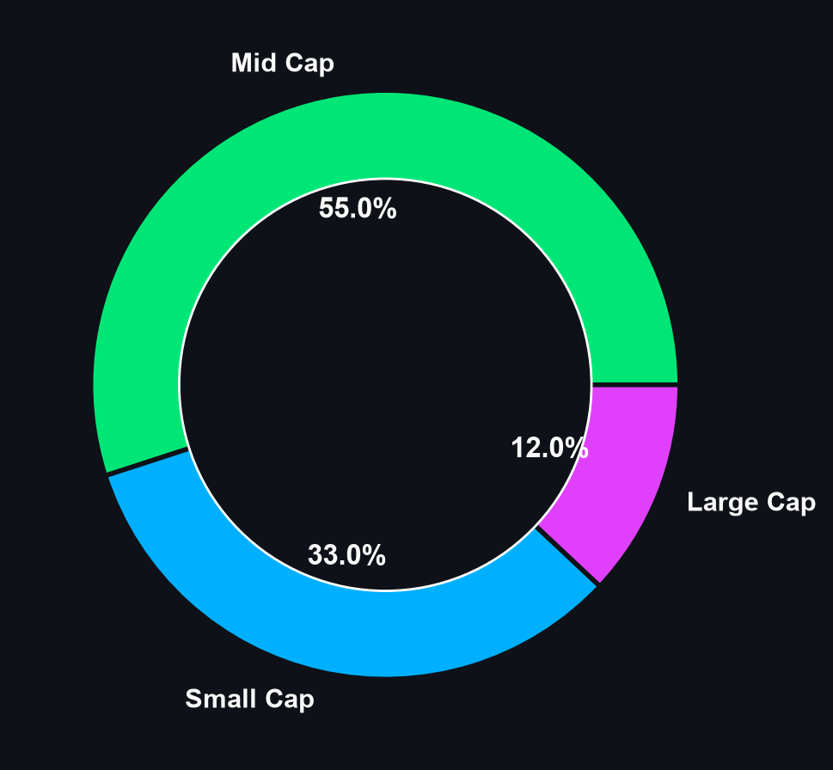
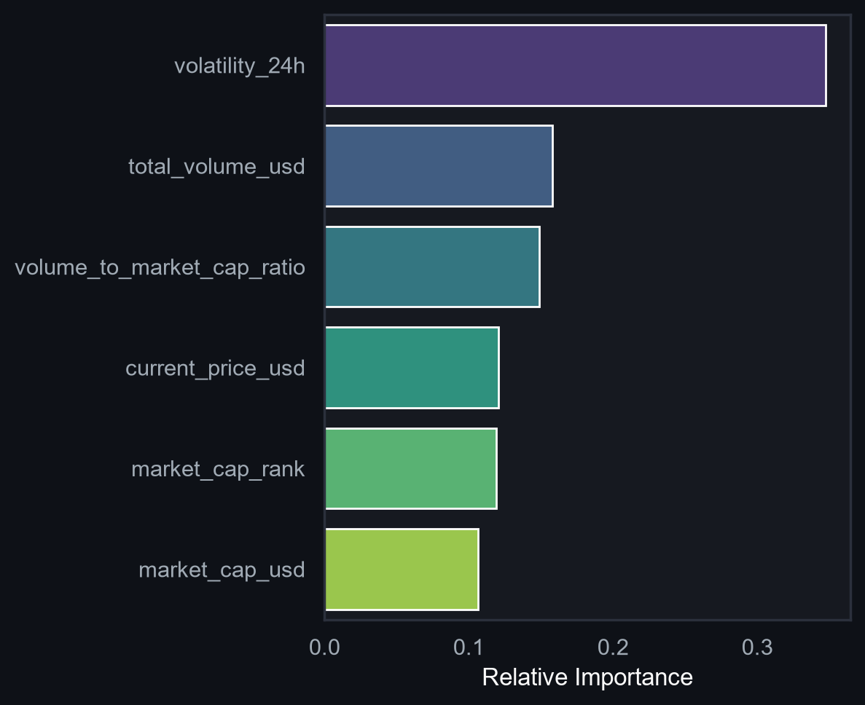
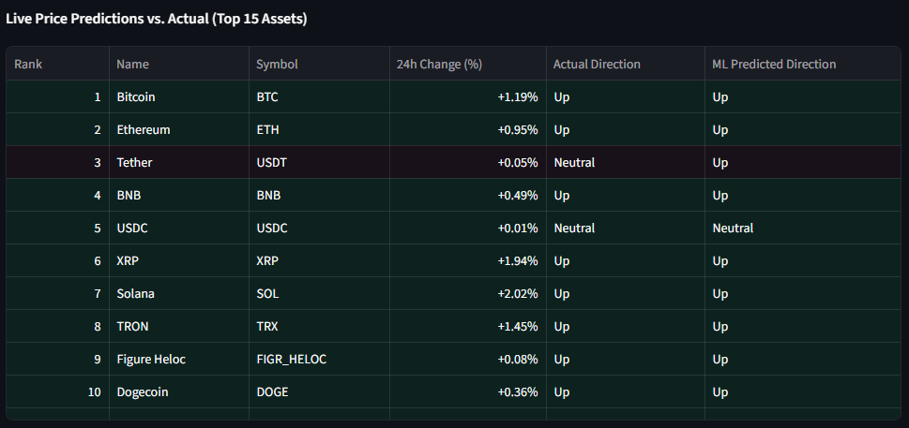
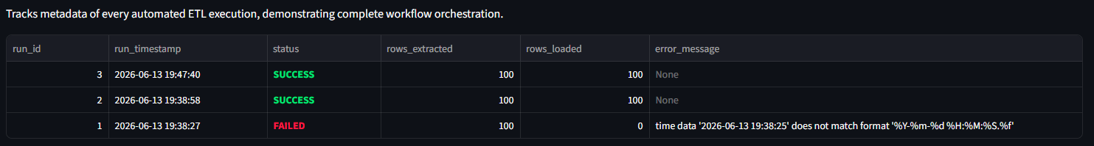
BI DASHBOARD & INSIGHTS
What the pipeline reveals
Dashboard visuals convert market snapshots into explainable business intelligence.
Key results from the dashboard
BDX +16.96% top gainer
DEXE -18.58% top loser
Mid Cap = 54% of selected category
ML accuracy: 86.7%
Top performers and losers
Volatility vs. liquidity
Market-cap category share
Presentation insight story
The dashboard starts with KPI cards, then moves to comparative charts: gainers/losers, volatility outliers, liquidity concentration, and ML drivers. Volatility is the strongest model signal, so the dashboard links descriptive BI with a simple predictive layer.
Feature importance
Notes:
Speaker notes: This final slide is the dashboard story. The KPI cards summarize the market quickly: BDX is the top 24-hour gainer and DEXE is the top loser in the current snapshot. The bar chart makes those movements immediately visible, while the scatter plot compares volatility against liquidity. The market-cap donut shows that mid-cap assets form the largest share of the selected category at 54 percent. The Random Forest classifier adds a predictive layer; on the exported sample it correctly classified 13 out of 15 records, or about 86.7 percent accuracy. I would be careful to present this as an exploratory model, not a production trading signal. Future improvements include collecting more historical snapshots, deploying the scheduler continuously, and adding alerts when volatility crosses a threshold.

