Slide 1
SPEECH
EMOTION RECOGNITION
Presented By :
19K41A0592
19K41A0507
19K41A0531
18K41A0532
ANUGAM SAI KIRAN GADDAM HULDAH GRACE
ALUGUVELLI ANIRUDH REDDY
NISHANTH KIRAN
GUIDED BY : DR. SAMPATH KUMAR
Associate professor

Slide 2
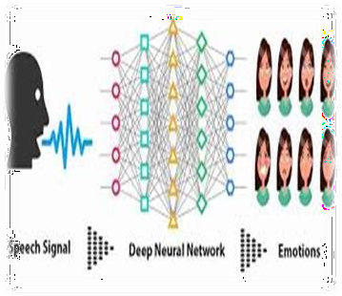
CONTENTS
Introduction
Abstract
Literature Survey
Design
Datasets
Methodologies
Application demonstration
Results
Conclusion
2

Slide 3
INTRODUCTION
Speech emotion recognition is an act of recognizing human emotions and pitch. By using this system we can predict emotions such as sad, angry, surprised, calm, fearful, neutral, regret, and many more using some audio files.
Recognition of emotion from speech signals is called speech emotion recognition. Extracting features from speech dataset we can train a machine learning model to recognize the emotion of the speech we can make speech emotion recognizer (SER).
3

Slide 4
ABSTRACT
The Objective of the proposed model is to build a deep learning model for speech emotion recognition that can predict the emotion of a person based on input voice file.
A model that can be used for sensing the emotions of people for providing better services and Human Machine interactions.
The data used for this is a large sample of people and their emotion controlled speeches.
Speech Emotion Recognition, abbreviated as SER, is the act of attempting to recognize human emotion and affective states from speech. This is capitalizing on the fact that voice often reflects underlying emotion through tone and pitch. This is also the phenomenon that animals like dogs and horses employ to be able to understand human emotion.
4

Slide 5
LITERATURE SURVEY
SNO | Date of publication | Authors | Title | Methodology | Accuracy | Article ID | Link
1 | 14-19 March 2010 | Björn Schuller; Felix Burkhardt | Learning with synthesized speech for automatic emotion recognition | Txt2Pho and openMary are used with Emofilt and Mbrola for emotional speech synthesis | 66% | 11540638 | Schuller, B., & Burkhardt, F. (2010). Learning with synthesized speech for automatic emotion recognition. 2010 IEEE International Conference on Acoustics, Speech and Signal Processing. doi:10.1109/icassp.2010.549501
2 | 21-24 September 2015 | J.C. Vásquez-Correa; N. García. | Emotion recognition from speech under environmental noise conditions using wavelet decomposition | WPT,GMM, SVM | 93.3% | 15729675 | "Emotion recognition from speech under environmental noise conditions using wavelet pp. 247-252, doi: 10.1109/CCST.2015.7389690.
3 | 22-24 March 2017 |  | Speech based human emotion recognition using MFCC | MFCC | 87.3% | 17598385 | M. S. Likitha, S. R. R. Gupta, K. Hasitha and A. U. Raju, "Speech based human emotion recognition using MFCC," 2017 International Conference on Wireless Communications, Signal Processing and Networking (WiSPNET), Chennai, India, 2017, pp. 2257-2260, doi: 10.1109/WiSPNET.2017.8300161.
5

Slide 6
LITERATURE SURVEY
SNO | Date of publication | Authors | Title | Methodology | Accuracy | Article ID | Link
4 | 1-3 November 2020 | Danai Styliani Moschona. | An Affective Service based on Multi-Modal Emotion Recognition, using EEG enabled Emotion Tracking and Speech Emotion Recognition | EEG |  | 20257698 | https://doi.org/10.1109/ICCE-Asia49877.2020.9277291
5 | 20-25 March 2016 | Linlin Chao,Jianhua Tao. | Long short term memory recurrent neural network based encoding method for emotion recognition in video | Neural network | 46.38% | 16021057 | https://doi.org/10.1109/ICASSP.2016.7472178
6 | 2008 | Woo-Seok Lee, Yong-Wan Roh, Dong-Ju Kim | Speech Emotion Recognition Using Spectral Entropy | FFT, delta FFT spectral entropy, Mel-frequency Filter Bank (MFB) spectral entropy | 67.1% |  | https://doi.org/10.1007/978-3-540-88518-4_6
6

Slide 7
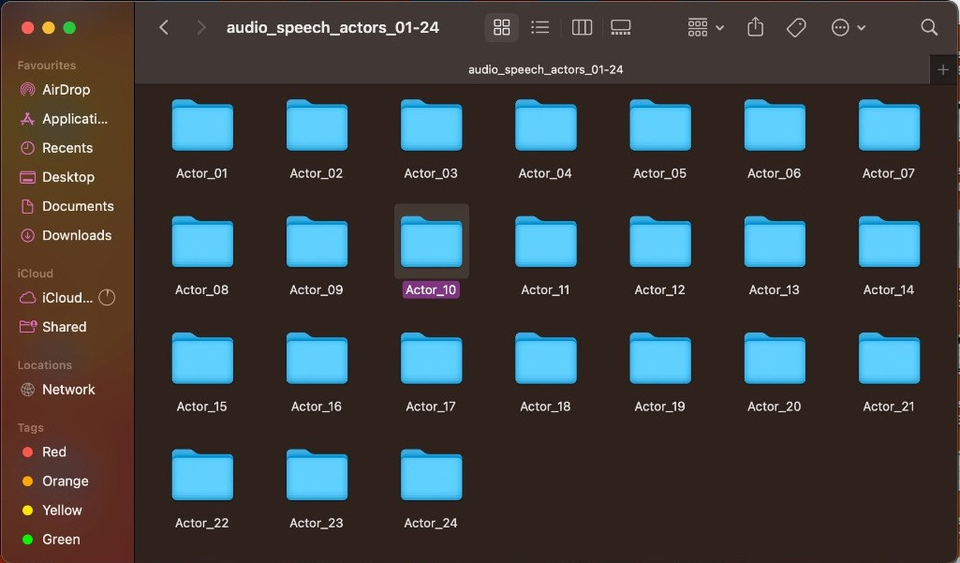
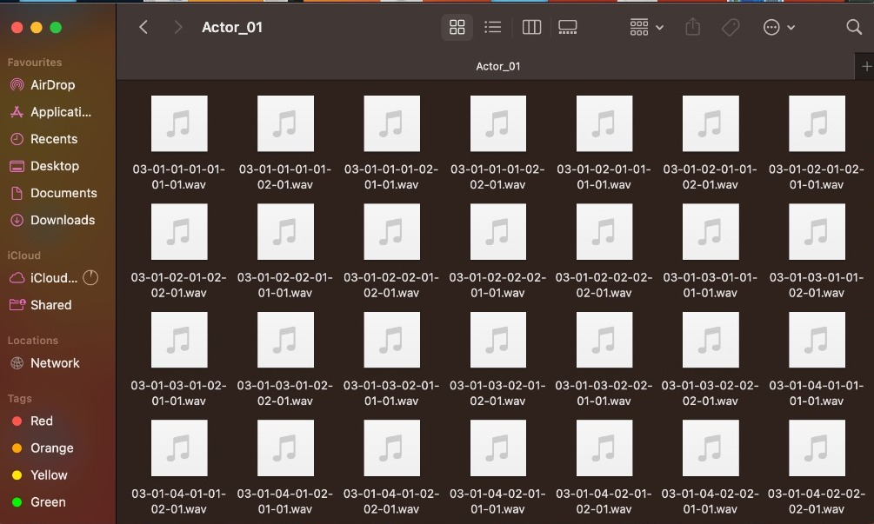
DATASET
These are the audio files of emotions like calm, fearful, happy, disgust etc.
These audio files are used to train the algorithm.
7

Slide 8
Modality (01 = full-AV, 02 = video-only, 03 = audio-only).
Vocal channel (01 = speech, 02 = song).
Emotion (01 = neutral, 02 = calm, 03 = happy, 04 = sad, 05 = angry, 06 = fearful, 07 = disgust, 08 = surprised).
Emotional intensity (01 = normal, 02 = strong). NOTE: There is no strong intensity for the 'neutral' emotion.
Statement (01 = "Kids are talking by the door", 02 = "Dogs are sitting by the door").
Repetition (01 = 1st repetition, 02 = 2nd repetition).
Actor (01 to 24. Odd numbered actors are male, even numbered actors are female).
Filename example: 02-01-06-01-02-01-12.mp4

Slide 9
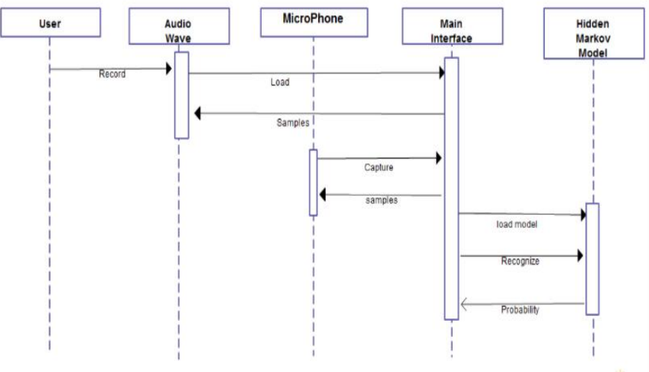
SEQUENCE DIAGRAM
9

Slide 10
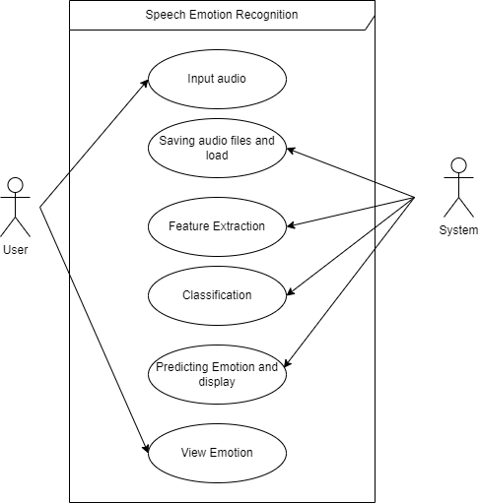
USE CASE DIAGRAM
10

Slide 11
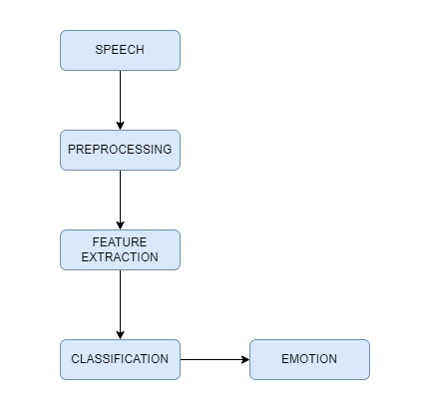
FLOWCHART
PRE-PROCESSING:
NOISE REMOVAL
SILENCE REMOVAL
NORMALIZATION
WINDOWING
11

Slide 12
MODEL USED
“
For getting the best accuracy for the model we have
used MLP Classifier Model.
A Multi layer perceptron is a feed forward artificial
network that generates a set of output from a set of inputs. An MLP is characterized by several layers of input nodes connected as a directed graph between
the input and output layers.
MLP uses back propagation for training the network.
From Sklearn Neural Networks we use MLP.

Slide 13
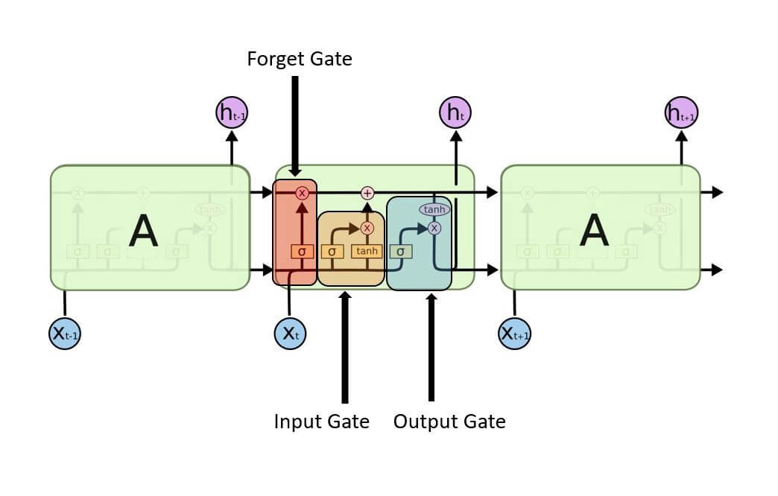
LSTM(LONGEST SHORT TERM MEMORY)
The Long Short-Term Memory (LSTM) algorithm is a type of recurrent neural network that is used for sequence modeling and prediction tasks, such as natural language processing, speech recognition, and stock price prediction. The LSTM algorithm is designed to overcome the vanishing gradient problem that can occur with standard recurrent neural networks, which makes it difficult to learn long-term dependencies in the input sequence.

Slide 14
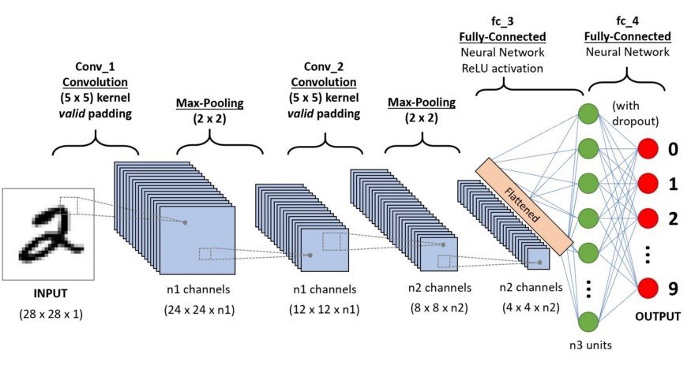
CNN (CONVOLUTIONAL NEURAL NETWORKS)
A Convolutional Neural Network (CNN) is a type of neural network that is commonly used in computer vision tasks, such as image and video recognition.

Slide 15
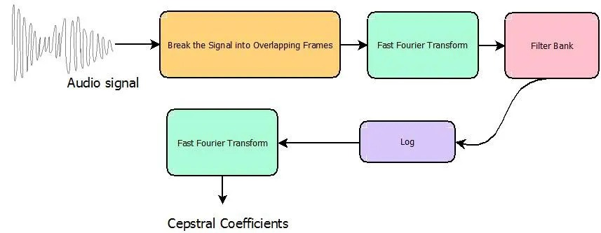
MFCC
MFCC (Mel Frequency Cepstral Coefficients) is a widely used feature extraction technique in audio signal processing, especially in speech recognition and speaker identification. It is a representation of the short-term power spectrum of a sound, based on the human auditory system's response to different frequencies. The following points detail the key aspects of MFCC:

Slide 16
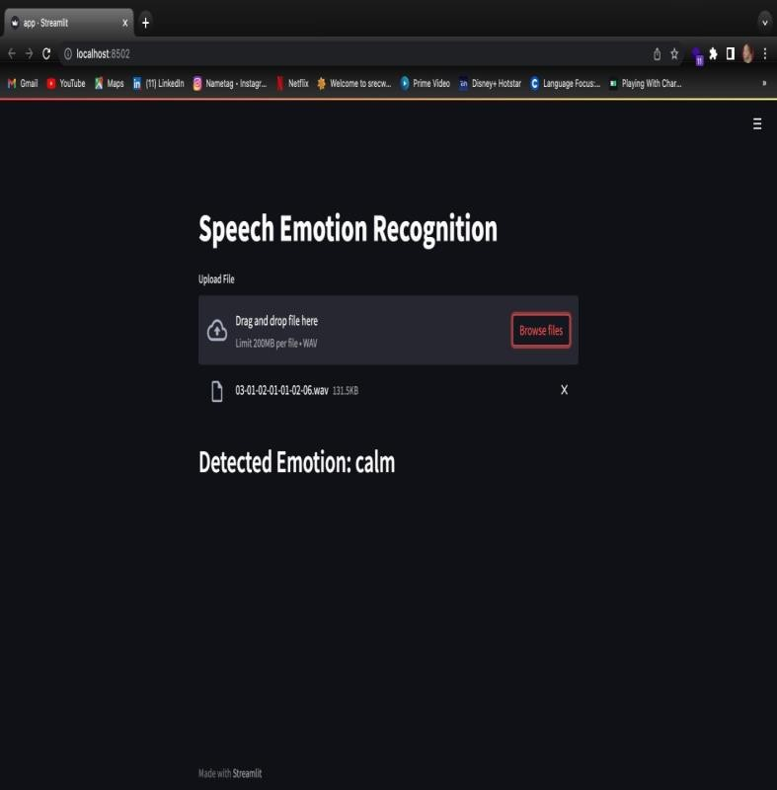
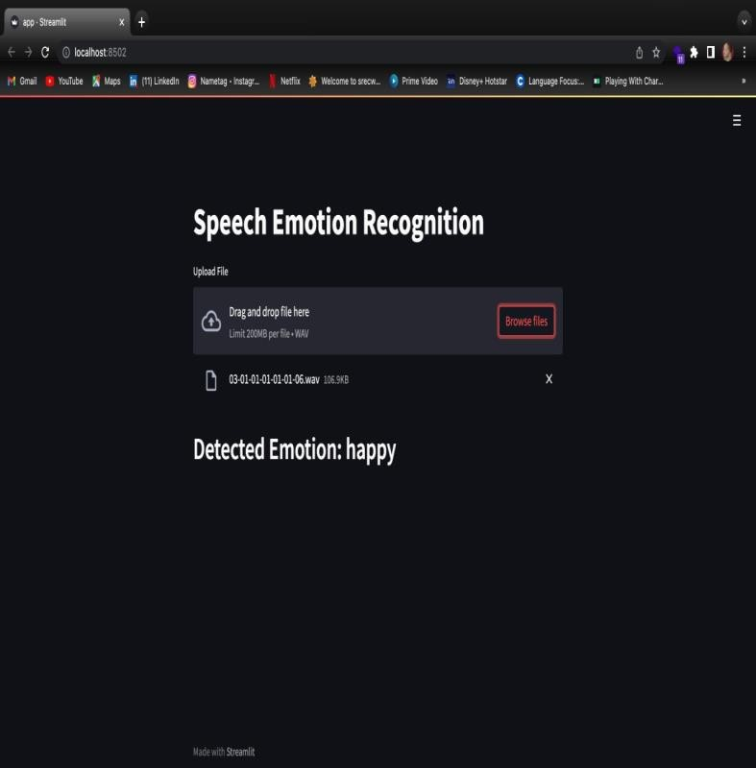
APPLICATION DEMONSTRATION
CALM
HAPPY

Slide 17


FEARFUL
DISGUST

Slide 18
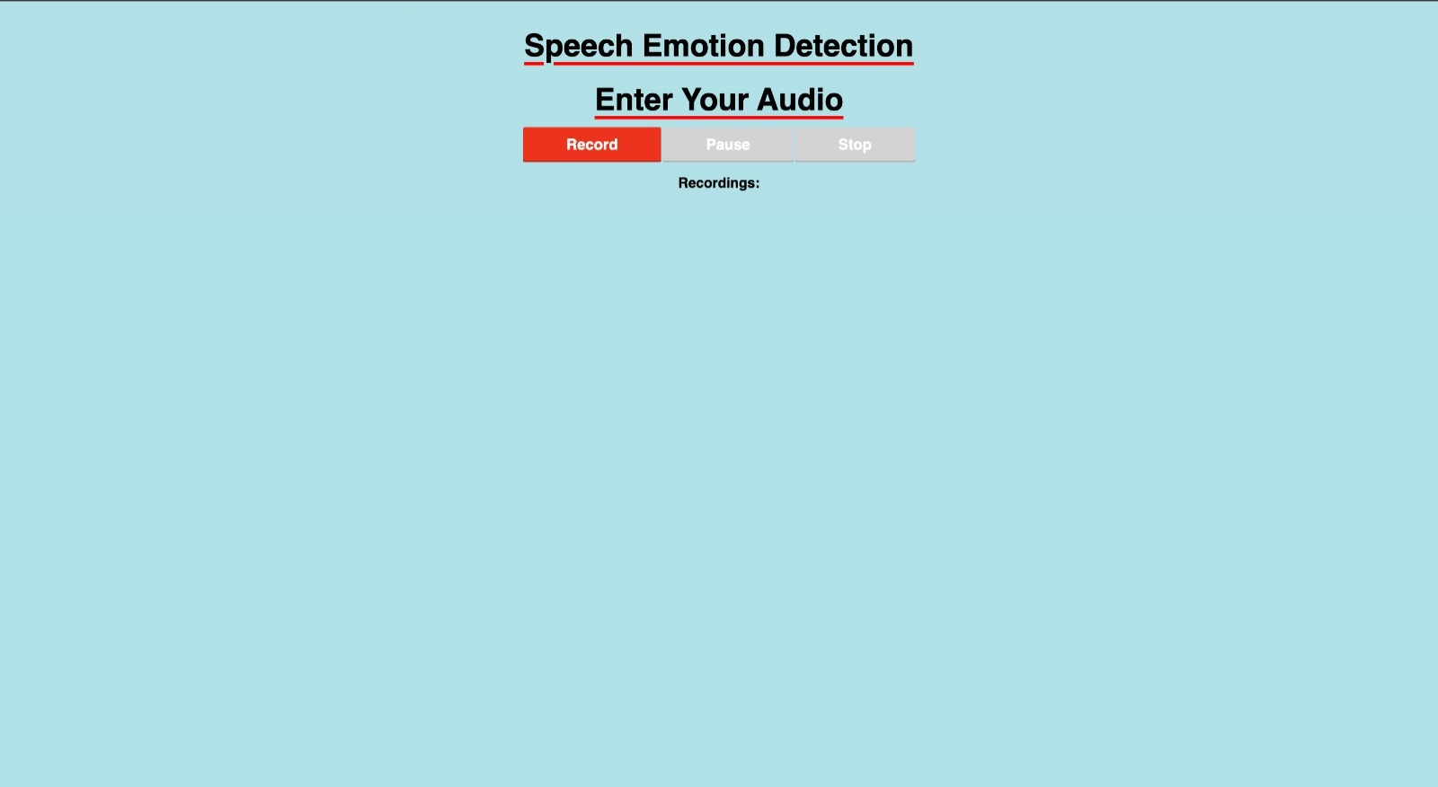
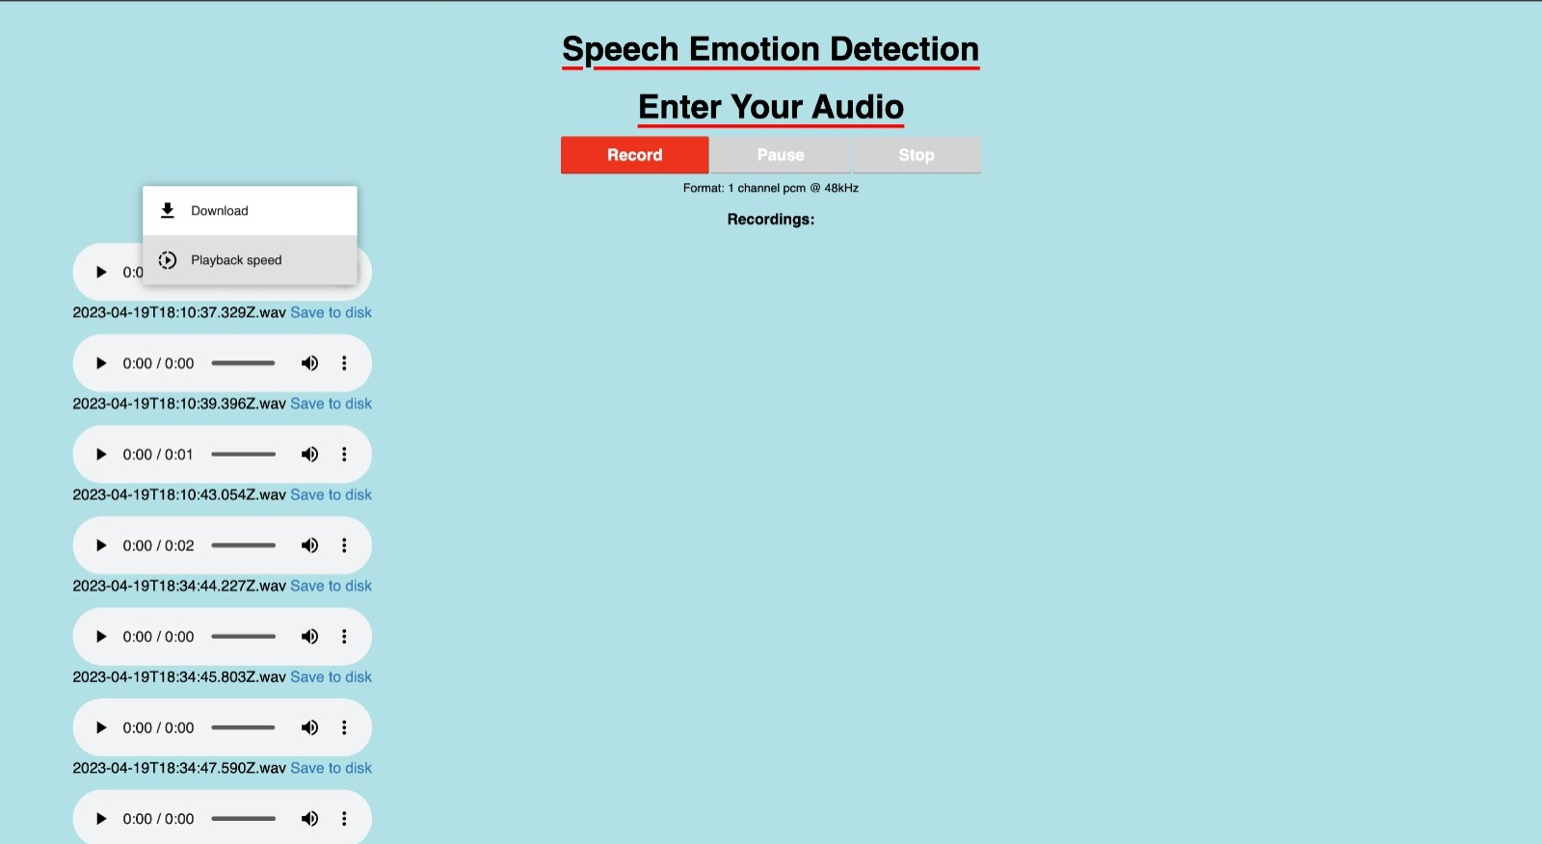
USER INTERFACE
The User Interface which takes the input audio .wav format file.After submitting the audio file in.wav format via the user interface, we will receive the result of the identified emotion.
The maximum size of the audio file to be dropped is upto 200Mb .

Slide 19
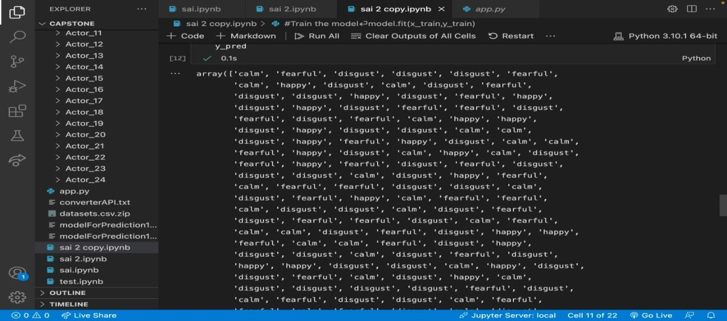
RESULT
The proposed MLP Model for Speech Emotion Recognition performs by achieving an average accuracy around 91%.It gives an accurate analysis of emotions by speech provided through Datasets.

Slide 20
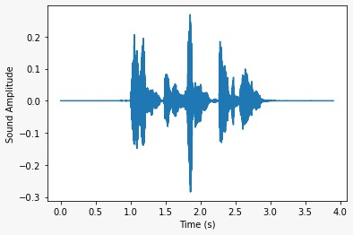
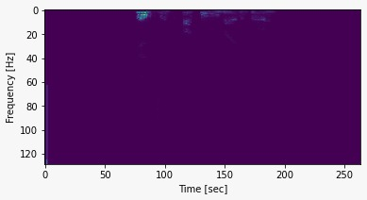
Graph of frequency vs time
Graph of sound amplitude vs time

Slide 21
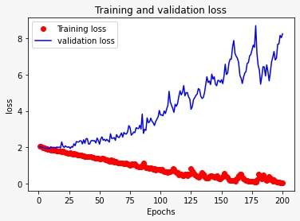
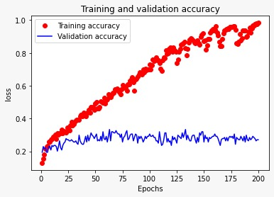
It is a graph displaying training and validation loss where epochs are taken on X-axis and loss is taken on Y-axis.Here training accuracy is represented by red dot and validation accuracy is represented in blue line.

Slide 22
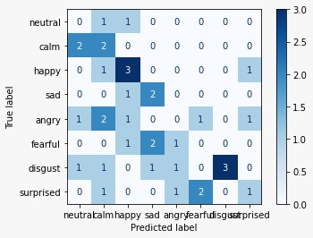
This is the confusion matrix , it visualizes and summarizes the performance of a classification algorithm where the Predicted label is on the x-axis and True label is on the y-axis

Slide 23
FUTURE SCOPE & CONCLUSION
To understand the emotions of people will help in achieving
greater success in the lives of people.
The Proposed Model is used to detect emotion of a person based on his speech. In this process the model was trained with different emotions to make sure it gives the proper results. The model used is MLP. This could help communicate and build good relationship with people. Because emotions in a speech play a vital role in analyzing the actual message of the speaker.

Slide 24
THANK YOU

