Slide 1
Workflow-Engine
Microservices Orchestration Service using Camunda Platform

Slide 2
Agenda
What has been done till now
Camunda Platform
Camunda Process (Workflow)
Integration of a Vault Microservice
Demo
Dependencies
References

Slide 3
What has been done till now
Dec-2020: Evaluation of Third-Party Workflow-Engines
Aug-2021: Evaluation of Camunda Workflow Automation Platform
Sep-2021: New workflow approach - Review Meeting with Fernando Mesa and Andre
Q4-2021: New service workflow-engine-svc created using Camunda

Slide 4
Camunda Platform
Execution
Design
Camunda Modeler
Monitoring
Cockpit
Workflow Engine
common-capabilities service with embedded Camunda engine
Tools provided by Camunda will be used initially, but own UI will be developed in later phases

Slide 5
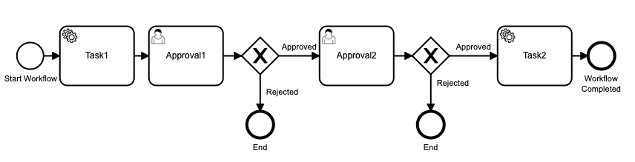
Camunda Process (Workflow)
Workflow
User Task
Service Task
Other features like Decision Node, Timeout

Slide 6
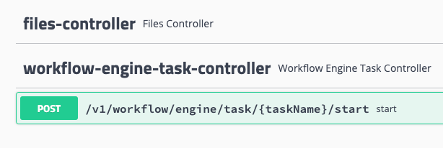
Integration of a Vault Microservice
Workflow Engine Task Controller: a rest endpoint for starting a given task
WorkflowEngineRestTask: An interface to define a Task
WorkflowEngineClient: A Rest Client to communicate back with workflow-engine service

Slide 7
Integration of a Vault Microservice
Generic Java Task Delegate: Delegate a service task to a Vault microservice
WorkflowEngineTaskClient: Generic Rest client to communicate with Workflow Engine Task Controller of another Vault microservice
Camunda Receive Task: Task to wait for the completion of a Service task

Slide 8
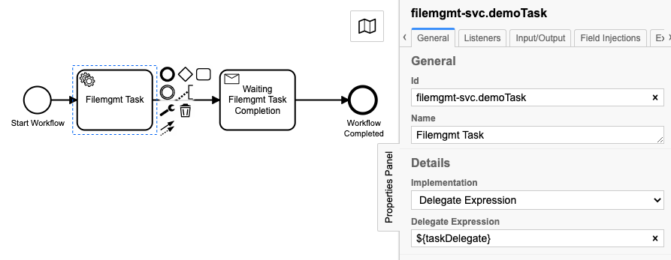
Integration of a Vault Microservice

Slide 9
Demo
Service Task delegation to Vault Microservice (svc-filemgmt Task)
4-Eye Approval Workflow

Slide 10
Dependencies
Architecture Review
License
UI

Slide 11
References
Evaluation of Third-Party Workflow-Engines https://eagleinvsys.atlassian.net/wiki/spaces/M2/pages/1814070221/Evaluation+of+Third-Party+Workflow-Engines
Evaluation of Camunda Workflow Automation Platform https://eagleinvsys.atlassian.net/wiki/spaces/M2/pages/3125806385/Camunda+Evaluation
Integration with Vault Authentication and Authorization https://eagleinvsys.atlassian.net/wiki/spaces/M2/pages/3157765349/Mapping+Vault+Entitlement+to+Camunda+Group
Integration of a Vault Microservice https://eagleinvsys.atlassian.net/wiki/spaces/M2/pages/3254288598/Camunda+Service+Task+in+Workflow

Slide 12
Thanks !!!

