Slide 1

ANIL NEERUKONDA INSTITUTE OF TECHNOLOGY AND SCIENCES (UGC AUTONOMOUS)
DEPARTMENT OF COMPUTER SCIENCE AND ENGINEERING | 23CS4219 - SOFTWARE ENGINEERING LAB
MINI PROJECT APPLICATION & TECHNICAL EVALUATION
GPS-Based Fleet Tracking & Route Verification System
for Municipal Solid Waste Management
A Hardware-Free, Software-Only Smart Waste Logistics & Proof-of-Service Verification Platform
PROJECT DEVELOPER & PRESENTER
Candidate Name: SAIKIRAN BORA
Roll Number: A24126510006
Branch / Degree: Computer Science & Engineering (B.Tech)
Class & Section: III Year, I Semester, Section - A
Institution: ANITS (Anil Neerukonda Inst of Tech & Sci)
ACADEMIC SUPERVISION & GUIDANCE
Faculty Guide: Prof. A. Rohini
Designation: Faculty Incharge, Dept. of CSE
Head of Department: Prof. G. Srinivas
Designation: HOD & Professor, Dept. of CSE, ANITS
Academic Year: 2026 - 2027

Slide 2
01 | DOMAIN CONTEXT
Introduction: Urban Solid Waste Management Realities
1. Urban Waste Generation Scale
â¢ Rapid urban growth in cities generates over 500 metric tons of garbage every day.
â¢ Spans dense residential colonies, busy commercial zones, and narrow alleys.
â¢ Requires synchronized dispatch of municipal collection trucks every single morning.
2. Public Health & Civic Hygiene
â¢ Overflowing secondary garbage bins emit severe odors and create public hazards.
â¢ Accelerates vector-borne disease outbreaks like dengue, malaria, and cholera.
â¢ Unchecked toxic leachate fluid contaminates storm drains and underground water.
3. High Operational Expenditure
â¢ Municipal corporations spend 35% to 40% of their total annual budget on waste logistics.
â¢ Fuel consumption and truck fleet maintenance represent heavy daily expenses.
â¢ Manual pen-and-paper tracking leads to huge financial waste and missed pickups.
Saikiran Bora (Roll No: A24126510006) | Branch: CSE, ANITS • CivicClean GIS: GPS Fleet Tracking & Route Verification Platform • Slide 2 of 16

Slide 3
02 | PROBLEM STATEMENT
Problem Statement: Breakdown of Conventional Manual Logistics
Static, Inflexible Route Sheets
Collection trucks follow rigid, paper-based schedules. Vehicles are dispatched blindly without knowing which bins are actually overflowing or already serviced.
Zero Route Verifiability & Accountability
Sanitation supervisors have NO digital proof or timestamped logs to verify whether a driver actually emptied a scheduled bin or completely bypassed it.
Substantial Fuel & Fleet Wastage
Compactor trucks burn expensive diesel visiting empty bins, while heavily overflowing market checkpoints remain untouched, causing major resource waste.
Reactive & Informal Grievance Loop
Citizens discover missed pickups only after days of overflow. Complaints are handled via informal phone calls that lack ticket numbers or resolution proof.
Saikiran Bora (Roll No: A24126510006) | Branch: CSE, ANITS • CivicClean GIS: GPS Fleet Tracking & Route Verification Platform • Slide 3 of 16

Slide 4
03 | ROOT CAUSE ANALYSIS
Root Cause Analysis: Why Previous IoT Hardware Approaches Failed
The Fallacy of Dedicated IoT Hardware (Solution 1)
â¢ Prohibitive Capital Cost: Fitting thousands of physical sensors across roadside bins costs millions in municipal funds.
â¢ Rampant Public Vandalism: Outdoor sensors are stolen, damaged by scavengers, or smashed by hydraulic truck compactor arms.
â¢ Harsh Environmental Damage: Acidic garbage leachate, heavy monsoon rain, and toxic gases rapidly destroy electronic circuitry.
â¢ Battery Replacement Burden: Swapping batteries across thousands of scattered city bins creates an unmanageable maintenance load.
The Core Root Cause Identified
Municipal solid waste management fails NOT because roadside bins lack chips, but because there is NO real-time digital feedback loop connecting trucks, drivers, supervisors, and citizens.
â¢ Missing Proof of Service: Paper log sheets allow post-shift falsification with zero physical verifiability.
â¢ No Obstruction Logging: When roads are blocked by construction, drivers bypass bins with no recorded reason.
â¢ The Strategic Takeaway: A pure software-only system delivers 100% verifiability and tracking without spending a single rupee on in-bin hardware!
Saikiran Bora (Roll No: A24126510006) | Branch: CSE, ANITS • CivicClean GIS: GPS Fleet Tracking & Route Verification Platform • Slide 4 of 16

Slide 5
04 | PROPOSED SOLUTION
Proposed Solution: Zero-Hardware Smart Waste Logistics
STRATEGIC PARADIGM SHIFT: Eliminating 100% of Physical In-Bin Sensors by Utilizing Commodity Smartphones & Web APIs
1. Smartphone Telemetry
â¢ Drivers use existing Android/iOS phones mounted inside the truck cab.
â¢ Continuous GPS streaming of real-time coordinates, speed, and heading.
â¢ Zero vehicle retrofitting or dedicated OBD hardware required.
2. Geofenced Verification
â¢ Haversine proximity checks vehicle distance to target bin coordinates.
â¢ Camera photo capture unlocks ONLY when within 15 meters of the bin.
â¢ Creates immutable, tamper-resistant proof timestamps automatically.
3. Citizen Crowdsourcing
â¢ Residents act as distributed sensors for citywide bin fill monitoring.
â¢ Geotagged photo reports with one-click GPS pin placement on phone.
â¢ Completely replaces costly physical ultrasonic level sensors.
4. Transparent Exceptions
â¢ Drivers log structured skip reasons when facing road excavation or blocks.
â¢ Instantly flags checkpoints on supervisor GIS map for audit review.
â¢ Distinguishes between legitimate impediments and driver negligence.
Saikiran Bora (Roll No: A24126510006) | Branch: CSE, ANITS • CivicClean GIS: GPS Fleet Tracking & Route Verification Platform • Slide 5 of 16

Slide 6
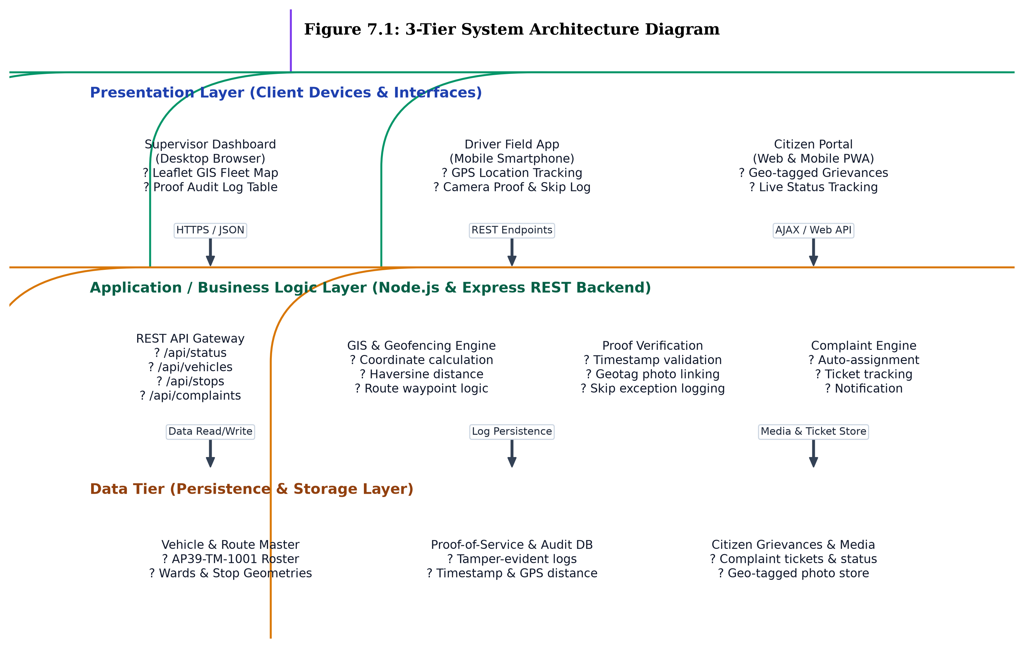
05 | ARCHITECTURE
System Architecture: End-to-End Enterprise Web Platform
Tier 1: Presentation Layer (Client Portals)
â¢ Supervisor Command Hub: Desktop GIS dashboard with Leaflet map & telemetry.
â¢ Driver Mobile Manifest: Touch-friendly PWA for single-hand cab operation.
â¢ Public Citizen Portal: Responsive portal for reporting overflowing garbage.
Tier 2: Application Layer (Node.js & Express)
â¢ REST API Gateway: High-performance endpoints for vehicle and stop data.
â¢ Geofencing Engine: Mathematical 15m radius proximity validation.
â¢ Grievance Engine: Auto-assigns complaint tickets and tracks clearance.
Tier 3: Persistence Layer (Data & Audit)
â¢ Fleet State Store: Real-time coordinate cache for sub-second map updates.
â¢ Ward Route Store: Pre-mapped checkpoint waypoints and collection quotas.
â¢ Audit Trail: Immutable historical log of all verified collections and skips.
Saikiran Bora (Roll No: A24126510006) | Branch: CSE, ANITS • CivicClean GIS: GPS Fleet Tracking & Route Verification Platform • Slide 6 of 16

Slide 7
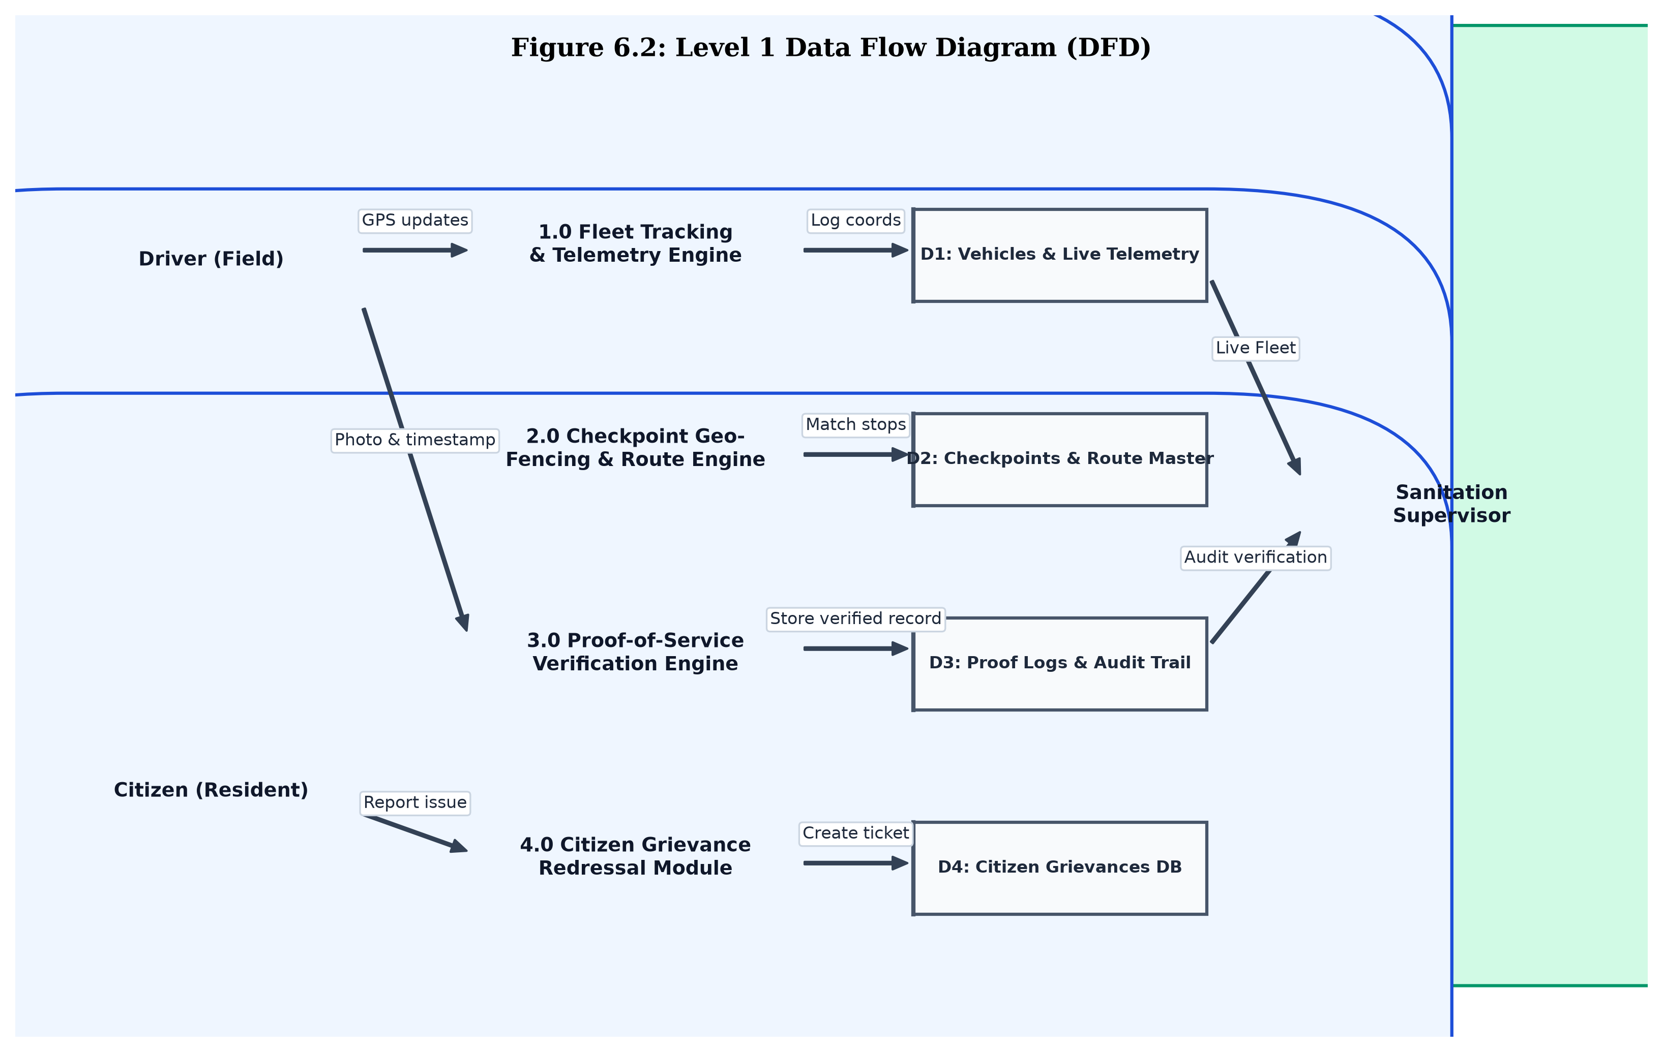
06 | DATA PIPELINE
Operational Workflow & Telemetry Data Pipeline
End-to-End Information Pipeline
â¢ Telemetry Streaming: Driver smartphone GPS broadcasts current coordinates and speed to the Node.js server every 5 seconds.
â¢ Spatial Geofence Matching: Backend continuously checks truck coordinates against scheduled ward stops using the Haversine equation.
â¢ Proof-of-Service Verification: When truck is within 15 meters, the driver captures photo proof. The system cryptographically stamps time and coordinates.
â¢ Citizen Redressal Synchronization: Residents log bin overflow tickets with GPS coordinates; resolved tickets update automatically upon vehicle clearance.
â¢ Supervisor Audit & KPI Aggregation: Computes real-time route completion percentages, missed pickups, and total daily waste tonnage collected.
Saikiran Bora (Roll No: A24126510006) | Branch: CSE, ANITS • CivicClean GIS: GPS Fleet Tracking & Route Verification Platform • Slide 7 of 16

Slide 8
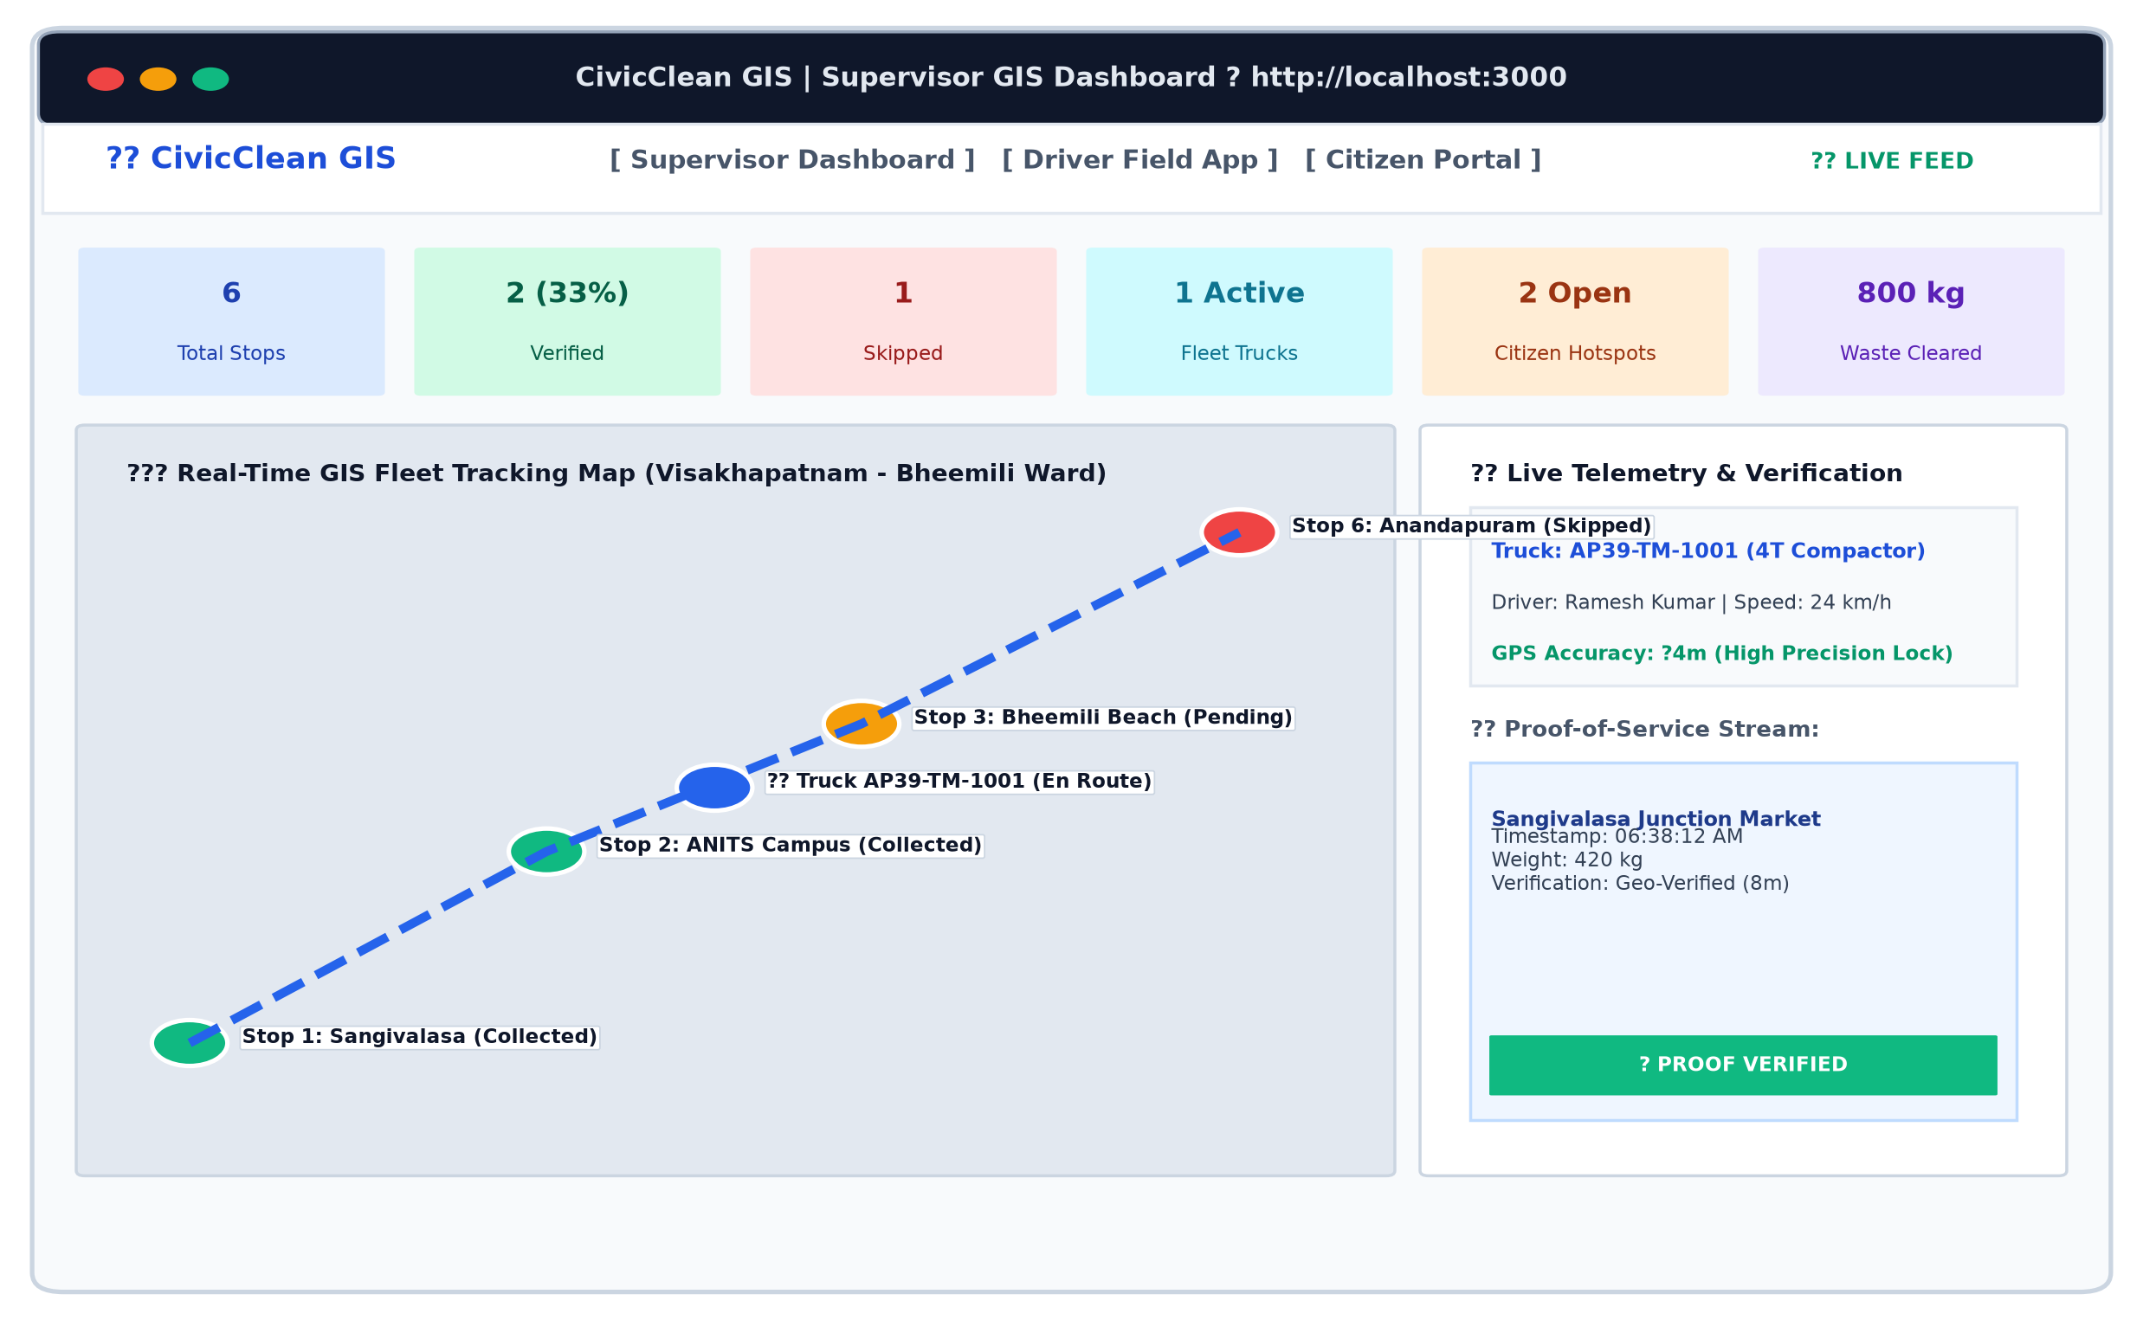
07 | SUPERVISOR DASHBOARD
Module 1: Supervisor Real-Time GIS Fleet Command Center
Centralized Municipal Fleet Control
â¢ Live Interactive GIS Map: Renders OpenStreetMap canvas with color-coded stop checkpoints (Green: Collected, Amber: Next, Gray: Pending, Red: Skipped).
â¢ Active Vehicle Telemetry: Displays truck speed (e.g. 24 km/h), vehicle heading, driver identity, and GPS satellite lock status in real time.
â¢ Ward Route Progress Gauge: Computes route completion dynamically (e.g. 4/6 Stops Collected - 67%) with live cumulative waste payload tally.
â¢ Immediate Anomaly Alerts: Instantly flags delays, unauthorized route deviations, or bypassed stops for supervisor intervention.
Saikiran Bora (Roll No: A24126510006) | Branch: CSE, ANITS • CivicClean GIS: GPS Fleet Tracking & Route Verification Platform • Slide 8 of 16

Slide 9
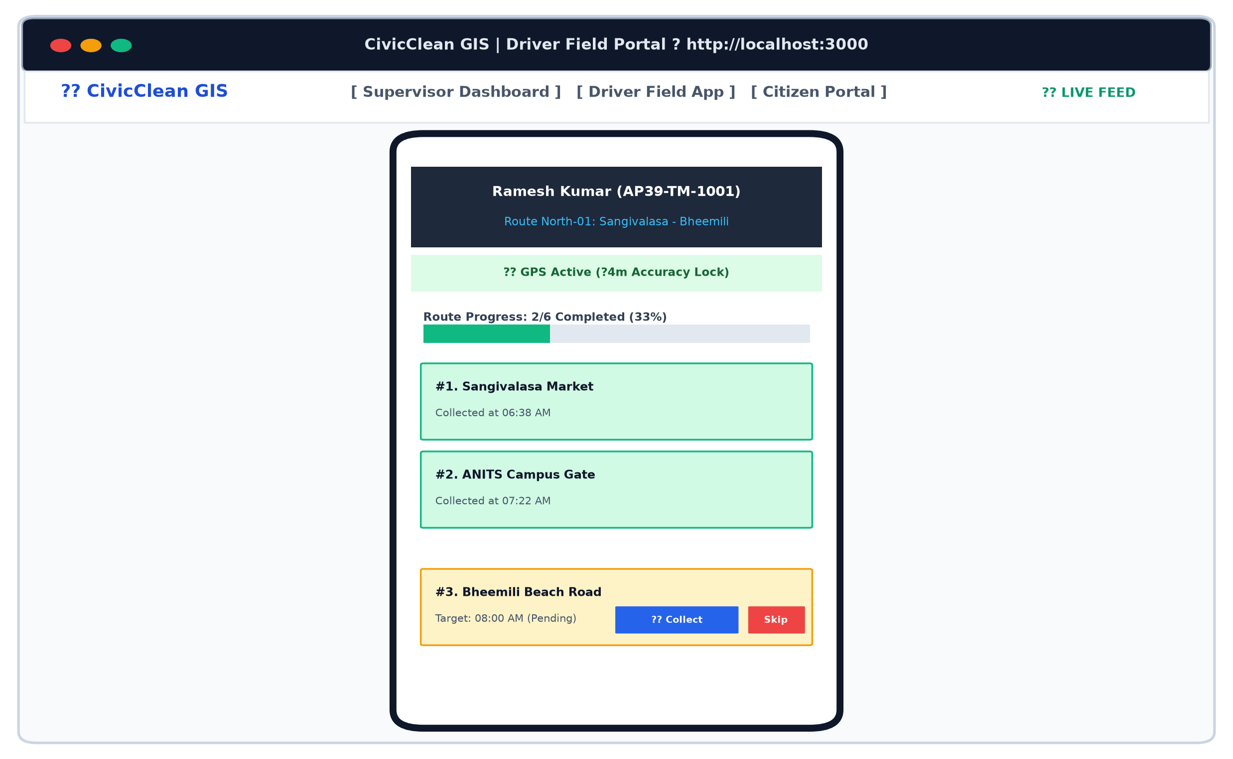
08 | DRIVER FIELD APP
Module 2: Driver Touch-Optimized Mobile Manifest
Field Driver Interface & Workflows
â¢ Cab-Friendly Touch UI: Designed with large tap targets for effortless one-hand operation on drivers' commodity smartphones.
â¢ GPS Satellite Status Banner: Continuously monitors active GNSS satellite connection and displays location precision (e.g. Â±4m accuracy).
â¢ Dynamic Route Progress: Live completion progress bar updates instantly upon every verified pickup (e.g., 2 of 6 Stops Completed - 33%).
â¢ 15m Geofenced Proof Capture: The 'Mark Collected' button unlocks ONLY when the vehicle is physically within 15 meters of the scheduled bin.
â¢ Structured Exception Logging: When encountering road blockages or construction, drivers log verified skip reasons (e.g., Narrow Lane, Excavation).
Saikiran Bora (Roll No: A24126510006) | Branch: CSE, ANITS • CivicClean GIS: GPS Fleet Tracking & Route Verification Platform • Slide 9 of 16

Slide 10
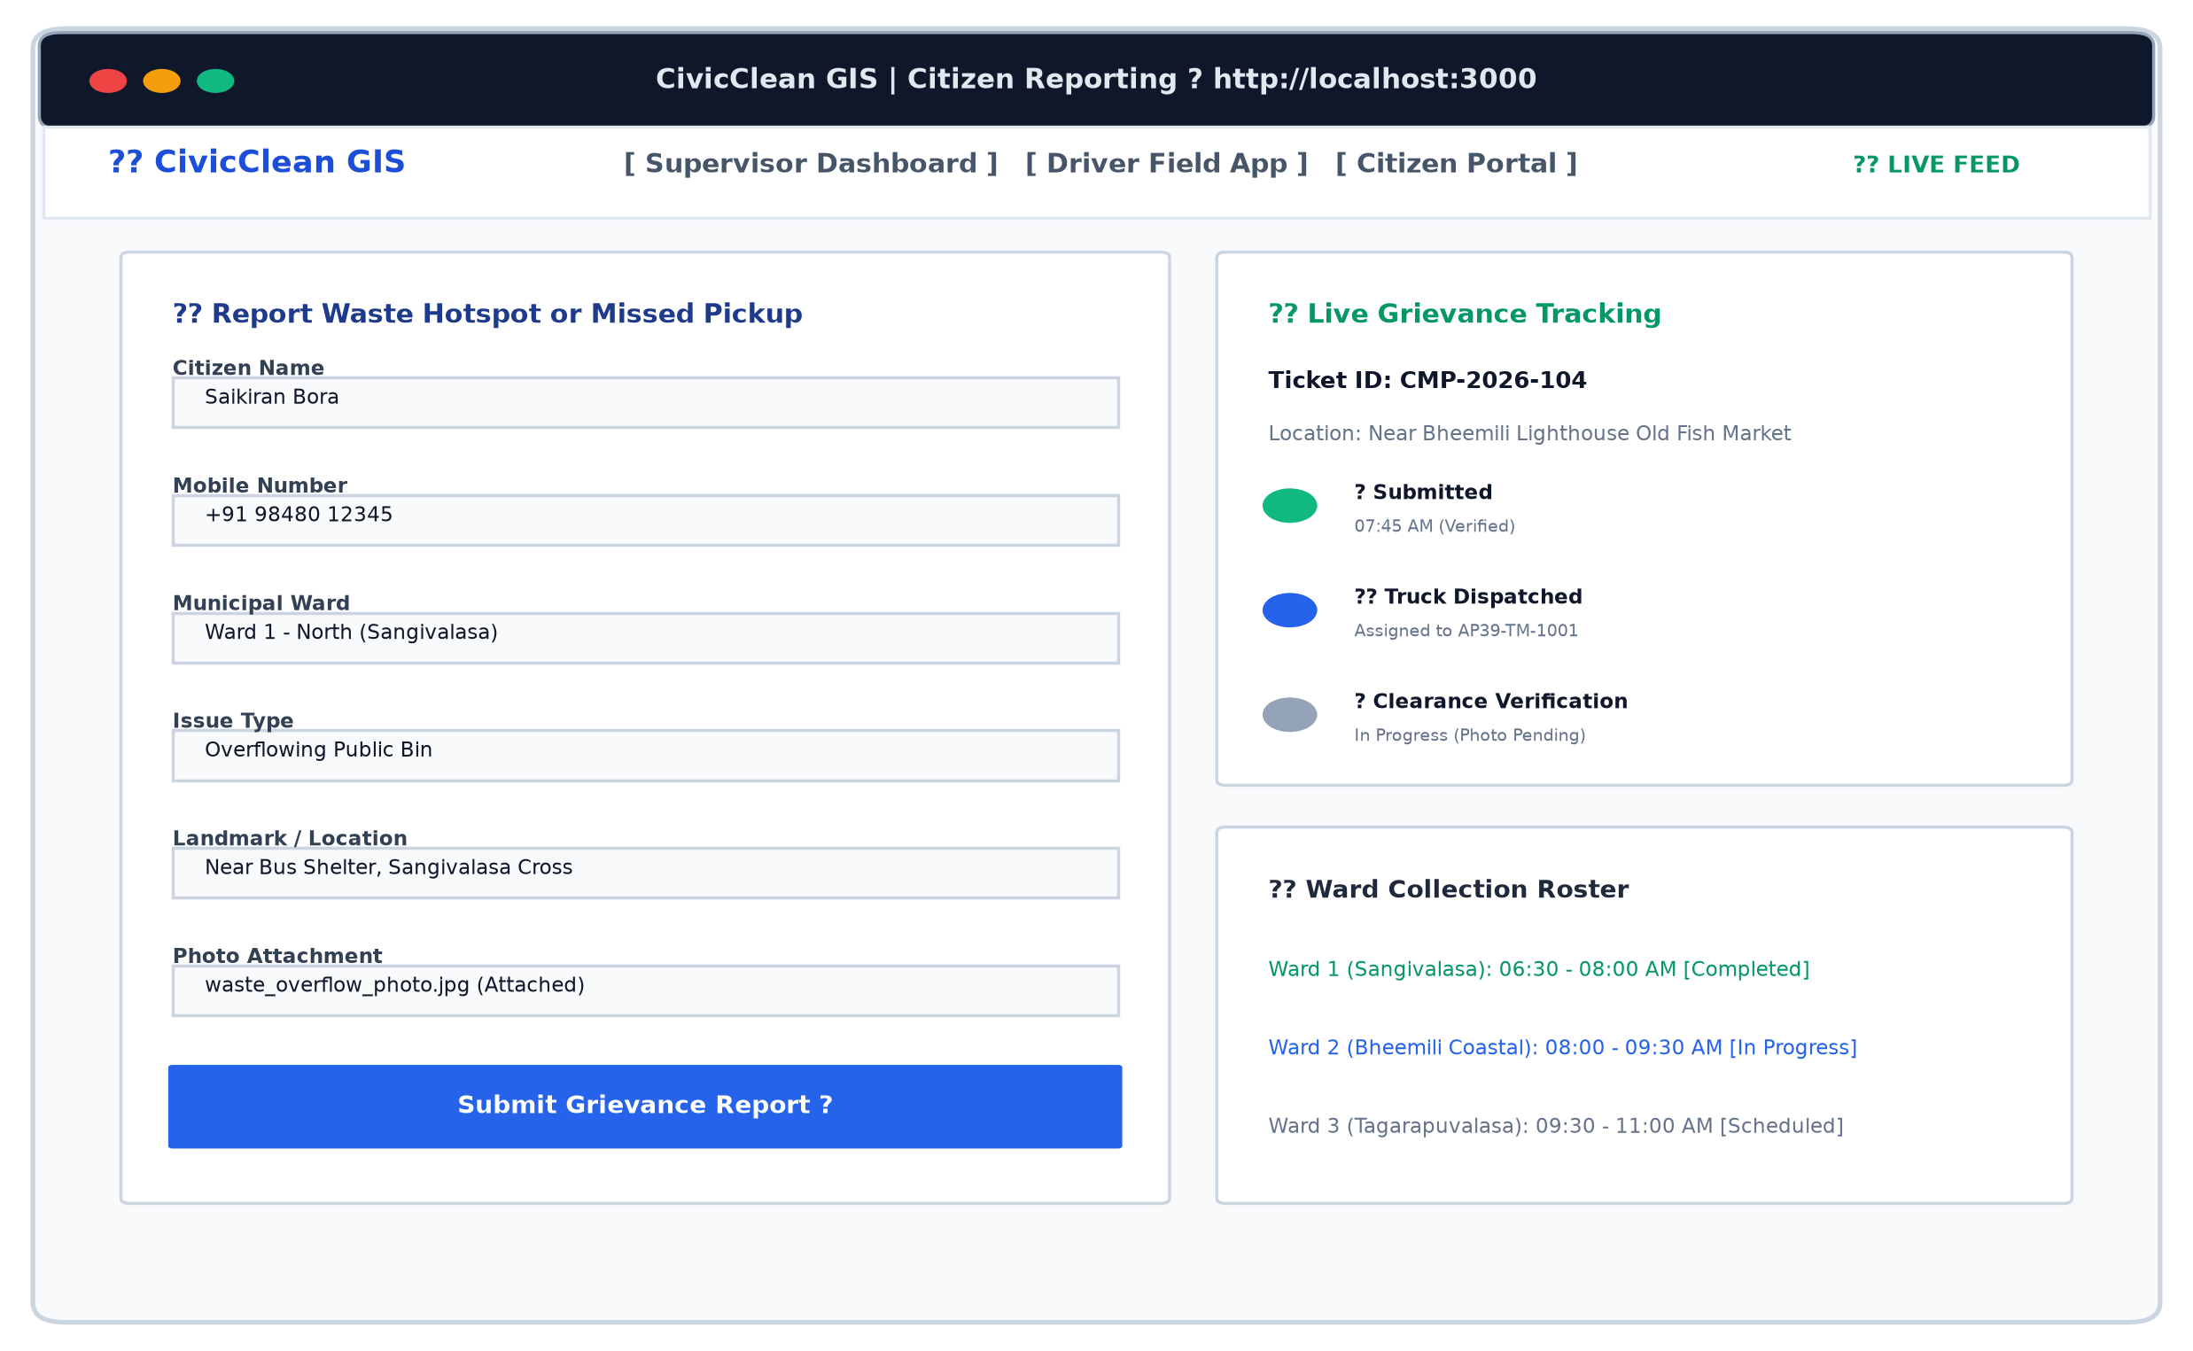
09 | CITIZEN PORTAL
Module 3: Citizen Crowdsourced Waste Grievance Portal
Citizen Empowerment & Tracking
â¢ One-Tap GPS Pin Drop: Residents mark overflowing public bins or illegal garbage heaps using their phone's exact GPS coordinates.
â¢ Photo Evidence Upload: Allows citizens to attach photos of uncollected waste for supervisory verification and dispatch triage.
â¢ Live 3-Stage Ticket Tracker: Unique complaint ID (e.g. #CMP-2026-104) shows real-time progress: Submitted -> Truck Dispatched -> Clearance Verified.
â¢ Public Collection Roster: Displays daily pickup schedules and assigned compactor trucks across wards to prevent premature bin dumping.
Saikiran Bora (Roll No: A24126510006) | Branch: CSE, ANITS • CivicClean GIS: GPS Fleet Tracking & Route Verification Platform • Slide 10 of 16

Slide 11
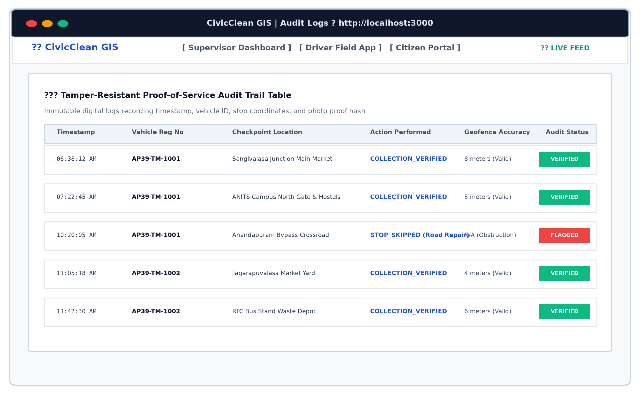
10 | PROOF-OF-SERVICE
Proof-of-Service Engine: Geofencing & Tamper-Resistant Audit
Geospatial Proximity & Integrity Verification
â¢ Haversine Distance Validation: Calculates great-circle distance between truck GPS and bin location. Collection is permitted ONLY when d <= 15.0 meters.
â¢ Immutable Audit Trail Logging: Every collection and skip event records timestamp, vehicle registration, driver identity, and GPS tolerance accuracy (e.g., '5 meters - VALID').
â¢ Elimination of Ghost Collections: Completely prevents post-shift log falsification; drivers must be physically present with geotagged photo proof.
â¢ Structured Exception Review: Bypassed bins are categorized with driver remarks and flagged in red on the supervisor map for administrative review.
Saikiran Bora (Roll No: A24126510006) | Branch: CSE, ANITS • CivicClean GIS: GPS Fleet Tracking & Route Verification Platform • Slide 11 of 16

Slide 12
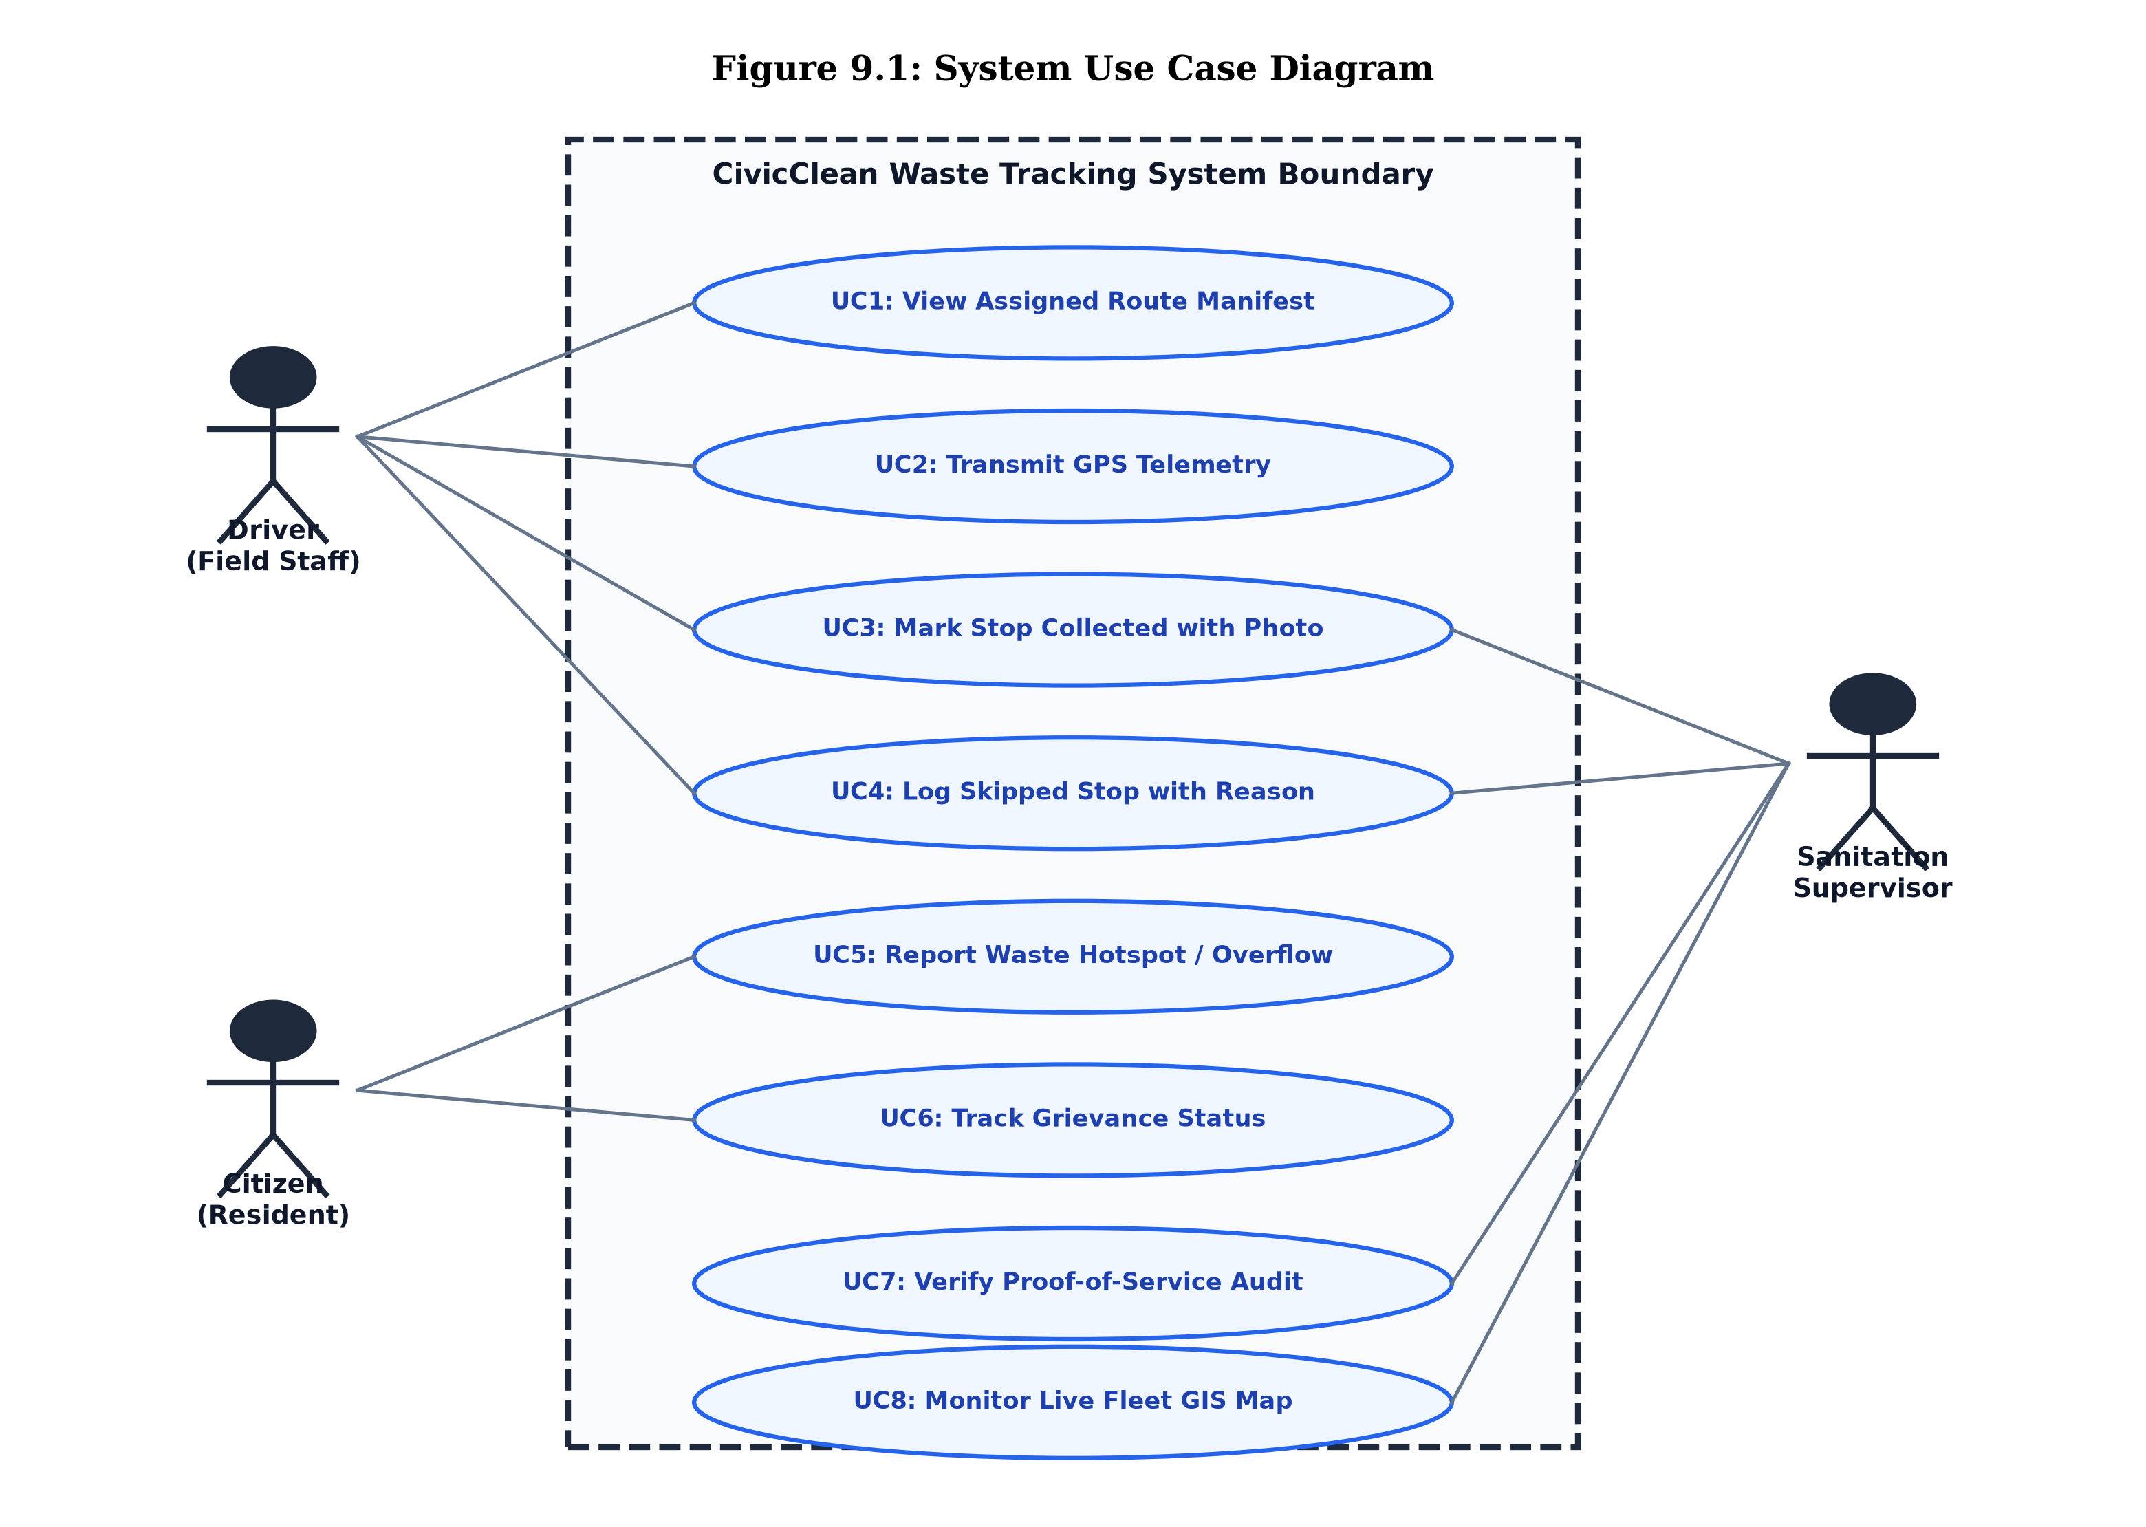
11 | SYSTEM DESIGN
System Design: Role-Based Actor Interaction Model
Stakeholder Roles & Core Capabilities
â¢ Field Driver Role: Receives digital route manifest, validates pickup via 15m geofencing, captures camera photos, and logs road obstruction skips.
â¢ Sanitation Supervisor Role: Monitors real-time vehicle fleet on GIS map, conducts route replays, reviews skipped stops, and validates daily completion KPIs.
â¢ Citizen Stakeholder Role: Submits geotagged garbage complaints with photos, tracks ticket resolution progress, and views ward collection schedules.
â¢ Automated Platform Engine: Enforces spatial geofence boundaries, processes live GPS telemetry, dispatches tickets, and generates tamper-resistant audit logs.
Saikiran Bora (Roll No: A24126510006) | Branch: CSE, ANITS • CivicClean GIS: GPS Fleet Tracking & Route Verification Platform • Slide 12 of 16

Slide 13
12 | TESTING & VALIDATION
System Validation & Quality Assurance Test Suite
TC ID | Test Case Objective | Input Conditions | Observed Output | Status
TC01 | Role-Based Authentication | EmpID: EMP-088, Valid Key | Access granted to GIS dashboard | PASS
TC02 | Live GPS Telemetry Stream | Lat: 17.8974, Lng: 83.4485 | Vehicle marker moves at 24 km/h | PASS
TC03 | Geofenced Proof Collection | Proximity: 5m <= 15m radius | Stop marked 'Collected' with photo | PASS
TC04 | Out-of-Bounds Block Check | Proximity: 450m > 15m radius | Action blocked; alert displayed | PASS
TC05 | Citizen Grievance Lifecycle | Name, GPS Pin, Overflow Photo | Ticket generated (#CMP-2026-106) | PASS
Quality Assurance Benchmarks
â¢ 100% Test Pass Rate: All primary operational workflows executed with zero defects across modules.
â¢ Sub-250ms API Latency: Stateless REST endpoints respond in under 250ms under concurrent requests.
â¢ Sub-10m GPS Precision: Field testing confirmed high-accuracy geofencing using commodity smartphone A-GPS.
â¢ Edge Case Handling: Verified out-of-bounds rejection, camera permission denial, and offline retry logic.
Saikiran Bora (Roll No: A24126510006) | Branch: CSE, ANITS • CivicClean GIS: GPS Fleet Tracking & Route Verification Platform • Slide 13 of 16

Slide 14
13 | JUSTIFICATION MATRIX
Comparative Analysis: Solution 2 Strategic Justification
Evaluation Criteria | Legacy Manual System | IoT Hardware Sensor (Sol 1) | CivicClean GIS (Sol 2 - Proposed)
Hardware Procurement Cost | Zero (Paper sheets) | Extremely High (Rs. 5,000 / bin) | ZERO (Uses existing smartphones)
Vandalism & Theft Risk | Not Applicable | High Risk (Stolen / Damaged sensors) | ZERO RISK (Hardware stays with driver)
Maintenance & Battery Overhead | Low (Manual) | Very High (Recurring battery swaps) | LOW (Over-the-air web app updates)
Proof-of-Service Verification | 0% (Paper falsification common) | Partial (Detects fill level only) | 100% (GPS + Geotagged Photo Proof)
Obstruction / Skip Logging | None (Bins bypassed silently) | None (Sensors cannot detect obstacles) | Automated (Categorized driver reasons)
Citizen Engagement | Nil (Delayed phone complaints) | Nil (Closed hardware network) | Direct Active Crowdsourcing Portal
Municipal Scalability | Inherently Inefficient | Difficult (Requires physical installs) | INSTANT (Deployable across any ward)
CONCLUSION: Solution 2 delivers 100% of smart city tracking benefits at <5% of the cost of physical sensor deployments!
Saikiran Bora (Roll No: A24126510006) | Branch: CSE, ANITS • CivicClean GIS: GPS Fleet Tracking & Route Verification Platform • Slide 14 of 16

Slide 15
14 | LIMITATIONS & ROADMAP
Limitations & Engineering Roadmap: Path to Future Scale
Current Operational Boundaries
â¢ Driver Smartphone Dependency: Fleet tracking relies on the driver's device battery life and active location permissions during the shift.
â¢ Cellular Network Dead Zones: Temporary 4G signal loss in deep valleys or peripheral alleys pauses real-time telemetry streaming (buffered locally).
â¢ Absence of Direct Weight Scales: Because bins lack physical load cells, collected garbage weights rely on driver visual estimation or volumetric heuristics.
â¢ Operator Compliance Reliance: Requires driver cooperation to tap 'Mark Collected' and upload photo proof at every scheduled checkpoint.
Future Engineering Roadmap
â¢ Offline-First PWA Synchronization: Implement SQLite / IndexedDB client caching so full shift telemetry and photos sync seamlessly when connectivity resumes.
â¢ Computer Vision (YOLOv8) AI: Automatically analyze driver collection photos using deep learning to verify bin fullness percentage and classify waste segregation.
â¢ Dynamic Route Optimization (VRP): Integrate Vehicle Routing Problem (VRP) algorithms to dynamically reorder stops based on live traffic and citizen hotspot reports.
â¢ Automated Municipal WhatsApp Bot: Allow residents to report garbage overflow via WhatsApp photo sharing with automated geolocation extraction.
Saikiran Bora (Roll No: A24126510006) | Branch: CSE, ANITS • CivicClean GIS: GPS Fleet Tracking & Route Verification Platform • Slide 15 of 16

Slide 16
Conclusion: Transforming Municipal Waste Logistics
A complete, verifiable, zero-hardware smart city software platform delivering real civic impact
Full-Stack GIS Web Platform
â¢ Node.js & Express REST Backend
â¢ Leaflet.js & OpenStreetMap Canvas
â¢ Live Telemetry & Audit Trail
â¢ Running on: http://localhost:3000
Streamlit Community Cloud App
â¢ Streamlit + Folium Interactive App
â¢ Mobile-friendly Driver Manifest
â¢ Public Citizen Grievance Portal
â¢ GitHub: saikiranbora25-byte
Academic Mini Project Report
â¢ 8,123-word Comprehensive Book
â¢ Strict ANITS Template Compliance
â¢ 11 Tables & 20 Embedded Figures
â¢ Formatted for Spiral Binding
THANK YOU!
Questions & Technical Discussion Welcome
SAIKIRAN BORA (Roll No: A24126510006) | Branch: CSE, Section - A | ANITS (Autonomous), Visakhapatnam

