Slide 1
Artificial Intelligence
From History to Generative and Agentic AI
D. Sai Kiran
CSE Department

Slide 2
Learning Outcomes
Understand the major milestones in the history of Artificial Intelligence.
Explain AI, Machine Learning and Deep Learning using simple real-world examples.
Identify the main types of Machine Learning: supervised, unsupervised and reinforcement learning.
Understand how neural networks and deep learning learn complex patterns.
Explain Generative AI, Large Language Models (LLMs), prompts and hallucinations.
Differentiate Generative AI from Agentic AI and understand the AI agent workflow.
Key takeaway: By the end of the class, you should be able to explain the complete relationship: AI → ML → Deep Learning → GenAI → Agentic AI.

Slide 3
Class Roadmap
History
AI
Machine Learning
Deep Learning
Generative AI
Agentic AI
→
→
→
→
→

Slide 4
A Brief History of AI
1943–50
Foundations
1956
AI is named
1970s
AI Winter
1980s
Expert Systems
1990s–2000s
Machine Learning
2010s+
Deep & GenAI
→
→
→
→
→
AI developed through cycles of optimism, setbacks, new computing power, better algorithms and larger datasets.

Slide 5
Important AI Milestones
Early Foundations – 1940s–1950s
1943: Warren McCulloch and Walter Pitts proposed a mathematical model of an artificial neuron.
1950: Alan Turing introduced the idea of testing machine intelligence through the Turing Test in his paper “Computing Machinery and Intelligence.”
1956: The term “Artificial Intelligence” was officially introduced at the Dartmouth Conference, organized by John McCarthy and other researchers. This period is generally considered the birth of AI as an academic field.

Slide 6
The Turing Test is a method proposed by Alan Turing in 1950 to determine whether a machine can demonstrate human-like intelligence.
How does it work?
A human evaluator communicates with two participants through text:
👤 Human
🤖 Machine (AI)
The evaluator does not know which participant is the machine.
If the evaluator cannot reliably determine which one is the machine based on their conversations, the machine is considered to have passed the Turing Test.
Passing the Turing Test does not necessarily mean that a machine truly thinks or understands like a human. It mainly tests whether the machine can convincingly imitate human conversation.

Slide 7
Early AI Programs – 1950s–1960s
Researchers developed programs that could solve mathematical problems and play games.
1956–1957: Logic-based AI programs were developed.
1957: Frank Rosenblatt developed the Perceptron, an early neural-network model.
AI research focused heavily on symbolic reasoning, logic, and problem solving.
First AI Boom – 1960s–1970s
AI systems became more sophisticated.
ELIZA (1966): Developed by Joseph Weizenbaum, it simulated a conversation with humans.
Shakey the Robot: One of the first robots capable of reasoning about its actions and environment.
Researchers explored natural language processing, robotics, and expert systems.

Slide 8
AI Winter – 1970s–1980s
AI progress slowed because:
Computers had limited processing power.
Available data was insufficient.
AI systems were expensive and difficult to maintain.
Many ambitious AI predictions were not achieved.
This period is known as the AI Winter, when funding and interest in AI declined.
Expert Systems – 1980s
AI became popular again through expert systems.
Expert systems used a collection of rules and knowledge from human experts to make decisions.
Examples:
MYCIN: Medical diagnosis.
XCON: Configuration of computer systems.

Slide 9
Second AI Winter – Late 1980s–1990s
Expert systems proved expensive to maintain and difficult to scale. As a result, AI investment again declined.
However, important developments in machine learning, neural networks, and statistical methods continued.
Machine Learning Era – 1990s–2000s
AI shifted from manually programmed rules toward learning from data.
Important developments included:
Decision trees
Support Vector Machines (SVM)
Bayesian networks
Neural networks
Reinforcement learning
1997: IBM's Deep Blue defeated world chess champion Garry Kasparov, demonstrating the power of specialized AI systems.

Slide 10
Deep Learning Revolution – 2010s
The availability of large datasets, powerful GPUs, and improved neural-network algorithms led to rapid progress.
2012: AlexNet achieved a major breakthrough in image recognition.
2016: Google's AlphaGo defeated Go champion Lee Sedol.
Speech recognition, computer vision, recommendation systems, and autonomous vehicles improved significantly.
Generative AI – 2020s
AI moved beyond prediction and classification toward generating new content.
Examples include:
Text generation
Image generation
Code generation
Music and audio generation
Video generation
Large Language Models (LLMs) such as GPT-based models demonstrated powerful capabilities in natural language understanding and generation.

Slide 11
Modern AI – 2025–2026
Modern AI increasingly combines:
Generative AI
Large Language Models
Multimodal AI
AI agents
Computer vision
Robotics
Reasoning systems
AI-assisted software development
AI is now being applied in education, healthcare, finance, cybersecurity, manufacturing, transportation, scientific research, and many other fields.

Slide 12
What is Artificial Intelligence (AI)?
What is AI?
Artificial Intelligence is the broader field of computer science that aims to make machines perform tasks that normally require human intelligence.
Human intelligence includes:
👁️ Seeing and recognizing objects
👂 Understanding speech
🧠 Reasoning and problem-solving
📚 Learning from experience
🗣️ Understanding language
🎯 Making decisions
🗺️ Planning actions
AI tries to give computers some of these capabilities.
Key takeaway: AI = making a machine perform an intelligent task.

Slide 13
AI Examples Around Us
Google Maps: predicts traffic and finds efficient routes.
Face recognition: identifies faces in images.
Spam filtering: decides whether an email is spam.
Chess programs: evaluate moves and choose actions.
Voice assistants: understand speech and respond.
Recommendation systems: suggest movies, music or products.
Chatbots: understand user requests and generate responses.

Slide 14
Example 1: Google Maps
Suppose you want to travel from Hyderabad to Vijayawada.
Google Maps can:
Identify your current location.
Find possible roads.
Calculate distances.
Estimate travel time.
Consider traffic.
Suggest the best route.
Recalculate the route if there is a traffic jam.
This involves several AI techniques for search, prediction, decision-making, and optimization.

Slide 15
Example 2: Chess AI
A chess-playing AI:
Looks at the current board.
Identifies possible moves.
Predicts possible responses.
Evaluates different positions.
Selects a good move.
The machine is performing a task that traditionally requires human reasoning and decision-making.

Slide 16
Example 3: ChatGPT
When you ask: "Explain cloud computing to me.“
An AI language model can:
Understand your question.
Identify the topic.
Generate an appropriate explanation.
Adjust the explanation based on your level of understanding.
This is an example of AI applied to natural language.

Slide 17
Main types of AI: AI is often discussed in terms of capability:
Narrow AI (Weak AI)
Designed for a particular task.
Examples:
Face recognition
Spam detection
Google Maps
Recommendation systems
General AI (AGI)
A hypothetical AI that could perform a very broad range of intellectual tasks at human-like capability. It has not been achieved.

Slide 18
The Big Relationship
Artificial
Intelligence
Machine
Learning
Deep
Learning
Generative
AI
Agentic
AI
→
→
→
→
Machine Learning is a major approach inside AI. Deep Learning is a type of ML.
Generative and agentic systems often use deep-learning models and LLMs.

Slide 19
What is Machine Learning (ML)?
What is Machine Learning?
Machine Learning is a subset of AI. Instead of programming every rule manually, we provide the computer with data, and an algorithm learns patterns from that data.
Traditional programming
Imagine we want to identify spam emails.
We could manually create rules:
IF email contains "WIN MONEY"
→ SPAM
IF email contains "FREE PRIZE"
→ SPAM
IF email contains "CLICK HERE NOW"
→ SPAM
But spammers can change their messages.
There could be thousands of rules.

Slide 20
Traditional Programming vs Machine Learning
Rules + Data
Program
Output
→
→
Traditional programming: humans explicitly specify the rules.

Slide 21
Machine Learning approach
Instead, we give the computer many examples:
Email Label
--------------------------------------------------
"Win $1000 now!" Spam
"Free lottery prize" Spam
"Meeting at 3 PM" Not Spam
"Submit your assignment" Not Spam
The ML algorithm analyzes these examples and learns patterns. Then, when a new email arrives:
"Congratulations! You have won a prize."
The model predicts: Spam
Important idea
The programmer does not necessarily write a rule saying "prize = spam."
Instead Training Data → Learning Algorithm → Trained Model
Then: New Data → Trained Model → Prediction

Slide 22
Machine Learning approach
Example: House Price Prediction
Suppose we have historical data:
Area (sq.ft) | Bedrooms | Location | Price
1000 | 2 | Hyderabad | ₹50L
1500 | 3 | Hyderabad | ₹75L
2000 | 3 | Hyderabad | ₹1Cr
2500 | 4 | Hyderabad | ₹1.3Cr
The ML algorithm studies relationships between:
House size
Number of bedrooms
Location
Price
Now you give it: 1800 sq.ft, 3 bedrooms, Hyderabad
The model might predict: Estimated price = ₹90 lakh
This is Machine Learning because the model learned from historical examples.

Slide 23
Machine Learning approach
Example: House Price Prediction
Suppose we have historical data:
Area (sq.ft) | Bedrooms | Location | Price
1000 | 2 | Hyderabad | ₹50L
1500 | 3 | Hyderabad | ₹75L
2000 | 3 | Hyderabad | ₹1Cr
2500 | 4 | Hyderabad | ₹1.3Cr
The ML algorithm studies relationships between:
House size
Number of bedrooms
Location
Price
Now you give it: 1800 sq.ft, 3 bedrooms, Hyderabad
The model might predict: Estimated price = ₹90 lakh
This is Machine Learning because the model learned from historical examples.

Slide 24
Machine Learning Workflow
Training Data
Learning Algorithm
Trained Model
New Data
Prediction
→
→
→
→
Example: past house prices → model → estimate the price of a new house.

Slide 25
Types of Machine Learning
There are three major categories you should know.
Supervised Learning
The computer learns from labeled data.
That means we already know the correct answer for training examples
Example: Student Result Prediction
Suppose we have:
Attendance | Internal Marks | Study Hours | Result
90% | 85 | 3 | Pass
75% | 65 | 2 | Pass
50% | 35 | 1 | Fail
45% | 30 | 1 | Fail

Slide 26
The model learns the relationship between the inputs and result.
For a new student:
Attendance = 80%
Internal marks = 70
Study = 2 hours/day
The model may predict: Pass, Because the training data contains the correct labels, this is supervised learning.
Other examples
Spam / not spam
Disease / no disease
Fraud / not fraud
Pass / fail
House price prediction

Slide 27
Unsupervised Learning
Here, the computer receives data without predefined labels. The algorithm tries to discover patterns or groups by itself.
Example: Customer Segmentation, An online store has information about thousands of customers:
Age
Amount spent
Number of purchases
Frequency of visits
We don't tell the computer which customer belongs to which group. The ML algorithm may discover:
Group 1 → Frequent high-spending customers
Group 2 → Frequent low-spending customers
Group 3 → Occasional high-spending customers
Group 4 → Occasional low-spending customers
This is called clustering. The business can then provide different offers to different customer groups.

Slide 28
Other examples
Customer segmentation
Finding unusual patterns
Grouping similar documents
Grouping similar products

Slide 29
ML Type 3: Reinforcement Learning
Agent observes
Takes action
Gets reward/penalty
Learns better action
→
→
→
Example: A game-playing AI receives a positive reward for winning and gradually learns strategies that increase its reward.

Slide 30
Reinforcement Learning
This is learning through interaction, rewards, and penalties.
Think about how a child learns to play a game.
The child:
Takes an action.
Gets a result.
Receives a reward or penalty.
Learns from the experience.
Tries another action.

Slide 31
Example: Game-playing AI
Suppose an AI is learning to play a game.
If it wins:
+100 reward
If it loses:
−100 reward
The AI plays many times and gradually learns which actions produce better results.
Example: AlphaGo
Google DeepMind's AlphaGo learned to play the complex board game Go and famously defeated top human players.
Reinforcement learning was an important part of its development.
Other examples
Robot learning to walk
Game-playing AI
Robot navigation
Resource optimization

Slide 32
What is Deep Learning?
Deep Learning is a subset of Machine Learning that uses artificial neural networks with many layers.
Each layer transforms information into increasingly useful representations.
The term “deep” refers to multiple hidden layers.
It is especially useful for complex data such as images, audio, video and natural language.
Examples: face recognition, speech recognition, medical-image analysis and modern large language models.
Neural Network
A neural network contains:
Input Layer → Hidden Layers → Output Layer
Key takeaway: Deep Learning = learning complex patterns with multi-layer neural networks.

Slide 33
A Simple Neural Network
Input Layer
Hidden Layer 1
Hidden Layer 2
Hidden Layer 3
Output
→
→
→
→
Example: pixels of a handwritten digit enter the network; the final output predicts 0, 1, 2, … or 9.

Slide 34
Deep Learning Examples
Image recognition: identify cats, cars or diseases in medical images.
Face recognition: learn complex facial features.
Speech recognition: convert voice into text.
Language models: understand and generate human language.
Self-driving systems: detect lanes, vehicles, signs and pedestrians.
Recommendation systems: learn complex relationships between users and content.

Slide 35
A self-driving car has cameras and other sensors.
The AI system needs to identify:
🚗 Cars
🚶 Pedestrians
🚦 Traffic lights
🛑 Stop signs
🛣️ Road lanes
🚲 Bicycles
Deep learning can process camera images and recognize these objects.

Slide 36
AI vs ML vs Deep Learning
AI: Broad goal of creating intelligent systems. Example: a chess-playing system.
ML: Learns from data. Example: predicting house prices.
Deep Learning: ML using multi-layer neural networks.
Example: image and speech recognition.
Relationship: Deep Learning ⊂ Machine Learning ⊂ Artificial Intelligence.
Key takeaway: Think: AI is the umbrella, ML is a learning approach, DL is a powerful ML approach.

Slide 37
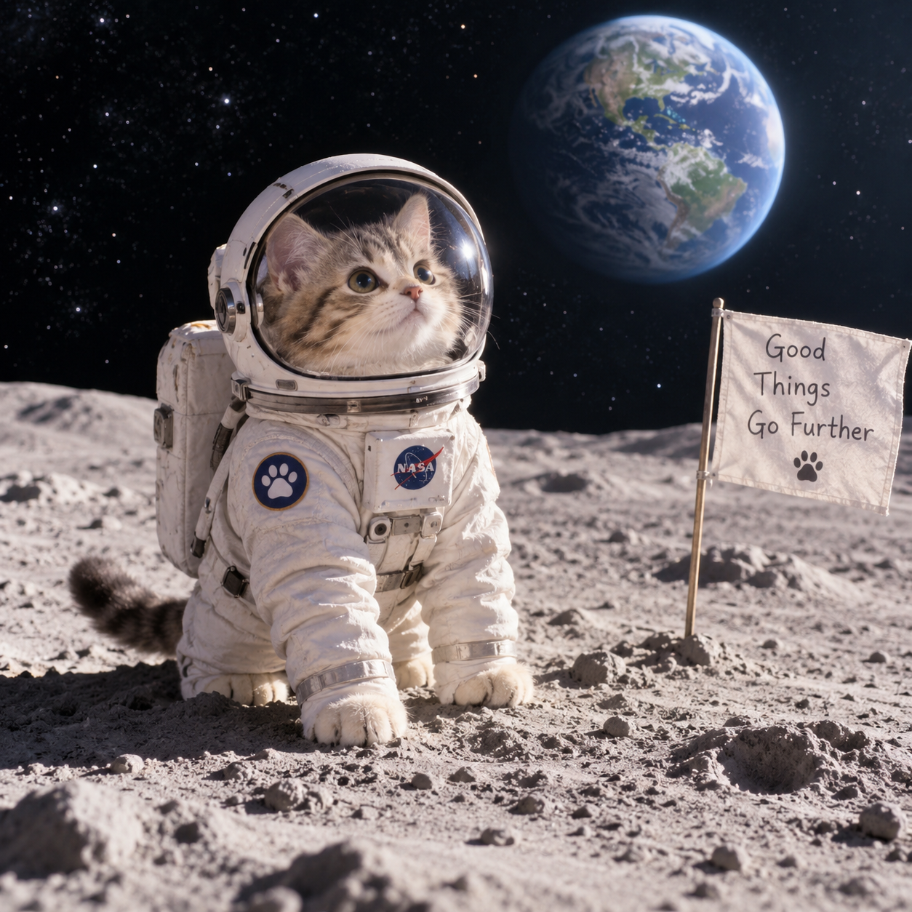
What is Generative AI (GenAI)?
Generative AI creates new content based on patterns learned during training.
It can generate:
📝 Text
🖼️ Images
🎵 Music
🎤 Audio
🎥 Videos
💻 Computer code
Unlike a classifier that answers “Is this a cat?”, GenAI can answer “Create a picture of a cat on the moon.”
Examples include AI writing assistants, image generators, code assistants and music generators.

Slide 38
How an LLM Generates Text
User Prompt
Understand Context
Predict Next Token
Predict Again
Complete Response
→
→
→
→
Example: “Artificial Intelligence is …” → the model repeatedly predicts the next token based on the context.

Slide 39
Key GenAI Concepts for Beginners
A Large Language Model (LLM) generates text by predicting one token at a time based on the context it has received.
If you type:
“The sun rises in the ___”
The LLM predicts that the next word is likely “east.”
It then uses that new word as part of the context to predict what comes next.

Slide 40
Main Steps
1. Input Text
You enter a prompt such as: “Explain cloud computing.”
2. Tokenization
The text is divided into small pieces called tokens.
For example: Explain cloud computing → Explain | cloud | computing
3. Convert Tokens into Numbers
Each token is converted into numerical representations called embeddings. These numbers help the model understand relationships between words and concepts.
4. Transformer Processes the Context
The LLM uses a Transformer neural network. Its attention mechanism determines which parts of the input are important when predicting the next token.
For example:
“The student opened the book because he wanted to study.”
The model uses attention to understand that “he” refers to the student.

Slide 41
5. Predict the Next Token
The model calculates probabilities for possible next tokens:
The model selects a token based on these probabilities and its generation settings.
6. Repeat the Process
The newly generated token is added to the context, and the model predicts the next token again.
Input → Predict token → Add token → Predict next token → Repeat
7. Final Text
The generated tokens are converted back into readable text and displayed as the response.
Possible token | Probability
“cloud” | 45%
“internet” | 20%
“computer” | 10%
“technology” | 8%
Other | 17%

Slide 42
In One Line
Prompt → Tokenization → Embeddings → Transformer + Attention → Next-token prediction → Repeat → Final response
Important Point
An LLM does not simply search a database for a ready-made answer. It generates a response by using patterns learned during training and predicting what token should come next given the context.
Example:
User: “Artificial Intelligence is”
LLM might generate:
“Artificial Intelligence is a field of computer science that focuses on creating systems capable of performing tasks that normally require human intelligence.”
It produces this step by step, token by token.

Slide 43
Generative AI Examples and Use Cases
Education: notes, explanations, quizzes and study guides.
Software: generate code, explain errors and create documentation.
Business: emails, reports and meeting summaries.
Design: images, product concepts and marketing content.
Customer support: conversational assistants.
Research: summarize and compare information — while checking factual accuracy.

Slide 44
What is Agentic AI?
Agentic AI refers to AI systems that can understand a goal, make decisions, plan steps, use tools, and take actions autonomously to achieve that goal.
Generative AI creates content. Agentic AI takes action to achieve a goal.
Example goal: “Plan a 3-day trip within my budget.”
The agent may search options, compare prices, calculate the budget, revise the plan and present an itinerary.
Key takeaway: Agentic AI = goal → plan → act → observe → adapt.

Slide 45
Simple Example: Suppose you tell an AI agent: “Plan a trip to Goa for 3 days within ₹30,000.”
An Agentic AI system could:
Understand your requirements.
Search for suitable flights/trains.
Find hotels within the budget.
Compare prices.
Create an itinerary.
Calculate the total cost.
Ask for your approval before making bookings.
Make the booking if authorized.
Send the final itinerary to you.
Key takeaway: Agentic AI = goal → plan → act → observe → adapt.

Slide 46
Core Components of an AI Agent
Goal
Planning
Reasoning
Tools
Action
Observation/Feedback
→
→
→
→
→
Tools may include search, calendars, databases, code execution, email and document systems.

Slide 47
Example: AI Agent for Coding
User goal: “Create a student management application.”
Step 1: Understand requirements.
Step 2: Plan the project structure.
Step 3: Create files and generate code.
Step 4: Build and run the application.
Step 5: Observe errors and test results.
Step 6: Fix problems and repeat until the task is complete.
Key takeaway: A normal GenAI system mainly generates the code; an agentic system can work through the broader workflow.

Slide 48
Generative AI vs Agentic AI
Generative AI: primarily generates content in response to a prompt.
Agentic AI: focuses on completing an objective through a sequence of decisions and actions.
GenAI example: “Write an email to students.”
Agentic example: “Organize the workshop” → check schedule, prepare announcement, create reminders and track progress.
Agentic systems often use Generative AI or LLMs as the reasoning/language component.

Slide 49
How GenAI and Agentic AI Work Together
Goal
LLM understands
Agent plans
Uses tools
Observes results
Final outcome
→
→
→
→
→
GenAI can provide language and reasoning capabilities; the agent layer adds workflows, tools, actions and feedback.

Slide 50
One Complete Example: Exam Preparation Assistant
GenAI request: “Create notes on Deep Learning.” → generates the requested notes.
Agentic goal: “Help me prepare for my AI exam.”
Agent workflow: analyse syllabus → create study plan → generate notes → create quizzes → evaluate answers → identify weak topics → give additional practice.
This demonstrates the shift from generating one answer to working toward a broader objective.

Slide 51
Complete Summary
AI: Make machines perform intelligent tasks.
Machine Learning: Learn patterns from data.
Supervised Learning: Learn from labelled examples.
Unsupervised Learning: Discover hidden patterns in unlabelled data.
Reinforcement Learning: Learn through rewards and penalties.
Deep Learning: Learn complex patterns using multi-layer neural networks.
Generative AI: Create new text, images, code, audio and more.
Agentic AI: Plan and act across multiple steps to achieve a goal.

Slide 52
Quick Knowledge Check
1. Which is broader: AI, ML or Deep Learning?
2. Give one classification and one regression example.
3. Why is image recognition commonly associated with Deep Learning?
4. What is the difference between supervised and unsupervised learning?
5. What is the main purpose of Generative AI?
6. Give one example where Agentic AI is more suitable than simple GenAI.
Key takeaway: Discussion activity: Ask students to classify real applications as AI, ML, Deep Learning, GenAI or Agentic AI.

Slide 53
From Data to Action
AI → ML → Deep Learning → Generative AI → Agentic AI
Understand the problem. Choose the right AI approach. Evaluate the output responsibly.

