Slide 1
Course Scheduling Assistant by Sigma
Team members:
Gandham Saikiran
Kandepu Sravya
Kotagiri Niteesha
Malempati Harika
Vemula Nikil kumar

Slide 2
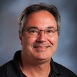
Course Scheduling Assistant
Client & Mentor: Dr. Michael Oudshroon
Associate professor in the School of Computer Science and Information System

Slide 3
Agenda
Project Briefing
Requirements
Project Management plan
Issues
Use cases
Test plan and Test case
User manual and Installation guide
User Interface
Lines of code
Status

Slide 4
Project Briefing
Goal is to Automatically schedule courses and rooms for faculty.
Current System is a manual process.
Faculty schedule is provided in an excel sheet.
Tedious task for the faculty and chances of class room collisions are more. This project would reduce such collisions and make it easy for the faculty.
We are using agile methodology for our project development.

Slide 5
Requirements
Automatic scheduling should be done for the faculty by the admin and it should be viewed in calendar format.
Collisions between the faculty teaching the same subject in the same room should be avoided.
Admin should be given the flexibility to view the available time of all the faculty in calendar format.
Admin should be able to Add and Delete professor to the list of faculties.

Slide 6
Project Management plan
Determined the Scope and the limitations of the project.
Updating Gantt chart periodically.
Documentation phase:
Requirement Specification
Test plan
User Manual
Cost Estimation plan
Development phase:
User Interface
Database management
Server maintenance

Slide 7
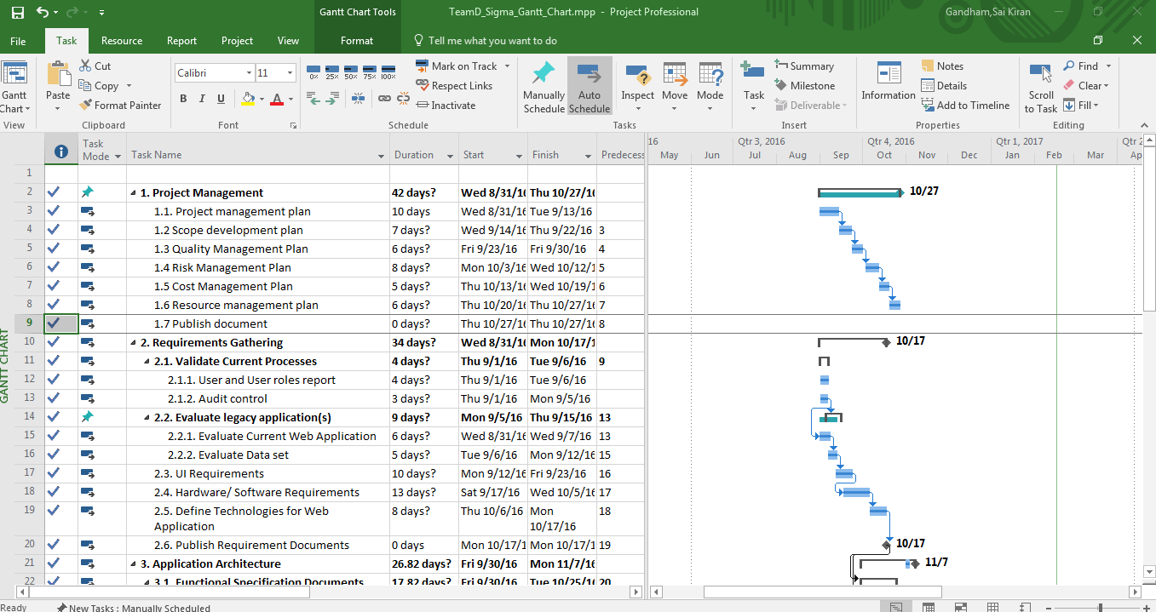
Project Management plan (cont’d):

Slide 8
Issues
Generating time slots dynamically.
Displaying calendar view for all the registered professors.
Integrating code was a major issue.
Time management with in the team members.
Notes:
Difficulty in generating time slots dynamically as one of the column in the calendar view.

Slide 9
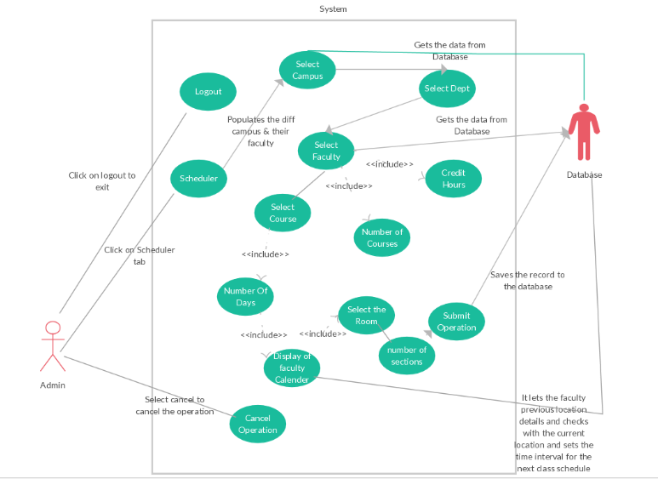
Use cases:
Fig: Admin Scheduler

Slide 10
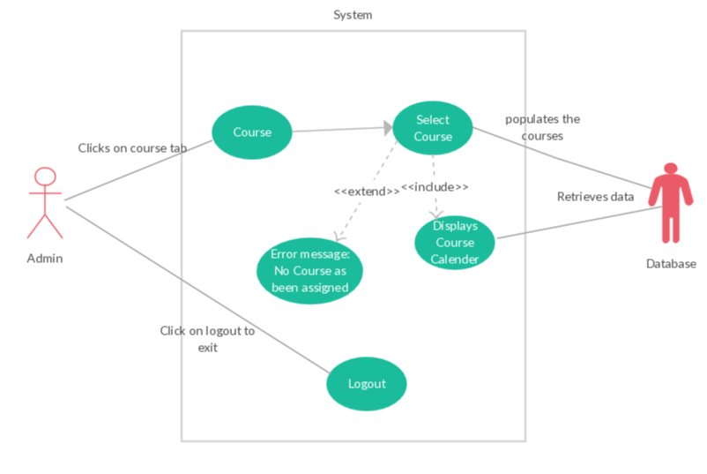
Use case (cont’d):
Fig: Admin Course page

Slide 11
Test plan and Test cases
We performed unit testing to check the navigation of the pages.
Based on the number of days entered by the user, we tested the time slots generated are appropriate.
Database integration was tested.
Test results was successful.

Slide 12

User Interface
Fig: User login

Slide 13
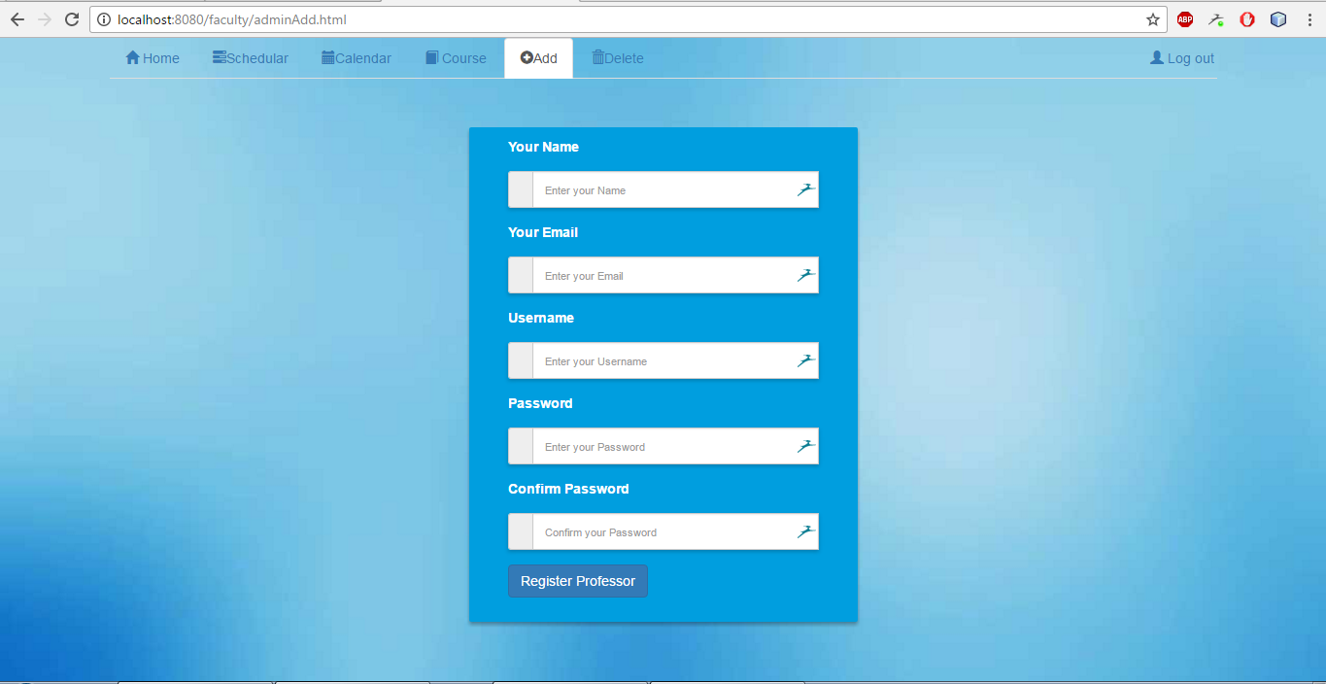
User interface (cont’d):
Fig: Faculty Add page

Slide 14
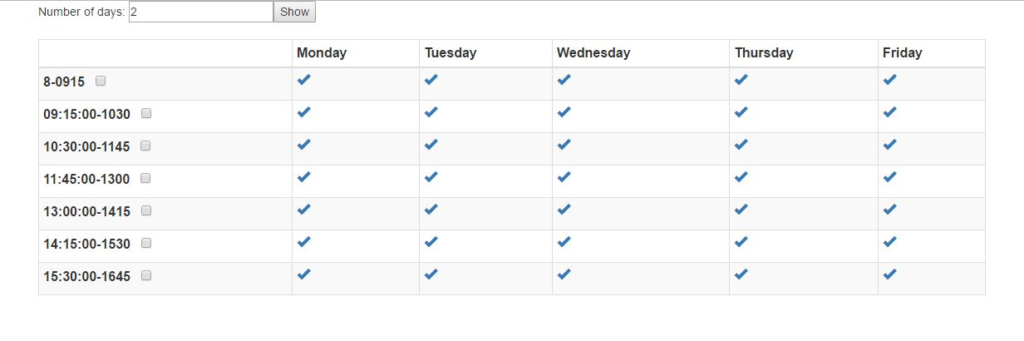
User interface (cont’d):
Fig: Dynamically generating time slots

Slide 15
User manual
We have provided necessary instructions to follow while navigating through pages.
We are trying to implement in such a way that even a novice user can identify the fields easily at the first look.

Slide 16
Lines of code
Completed lines = 1786
Approximate lines = 3200
Approximately each member of our team are working for 15 hours a week.

Slide 17
Status
Based on task completed, as per the iteration plan we have completed 39% of the development phase of the project.
We are currently in progress to push the data into database.

Slide 18
Minutes of meeting
Documented each and every outcome of the discussion.

Slide 19


