Slide 1

INT 213 PROJECT REPORT ARCHERY KING
DONE BY: ISA SAIKIRAN,
A SIVA POLI REDDY,
CHRISTIANA KRAMPAH MENSAH.
SECTION: K19PT
ROLL NO:07,61,28

Slide 2
CONTENTS
1 INTRODUCTION
2 PROCESS
Game Algorithm
Rectification
Circle detection
Target detection

Slide 3
INTRODUCTION:
Archery is a growing sport around the world, with competitors from the junior level to the collegiate and Olympic levels. During a competition, archers line up at a measured distance from a target and attempt to fire arrows into the target center.
Archery is a fitness activity that benefits areas from muscle development to mental health. The sport of archery requires precision, control, focus, physical ability and determination.
Archery is the art, sport, practice, or skill of using a bow to shoot arrows. Historically, archery has been used for hunting and combat. In modern times, it is mainly a competitive sport and recreational activity.

Slide 4
PROCESS:
Our current algorithm has two distinct stages, the second of which relies heavily upon the first. The first task is rectifying the target face and finding the circles. We then analyze the arrows afterwards.
There are 4 process in archery king
Game Algorithm
Rectification
Circle detection
Target detection

Slide 5
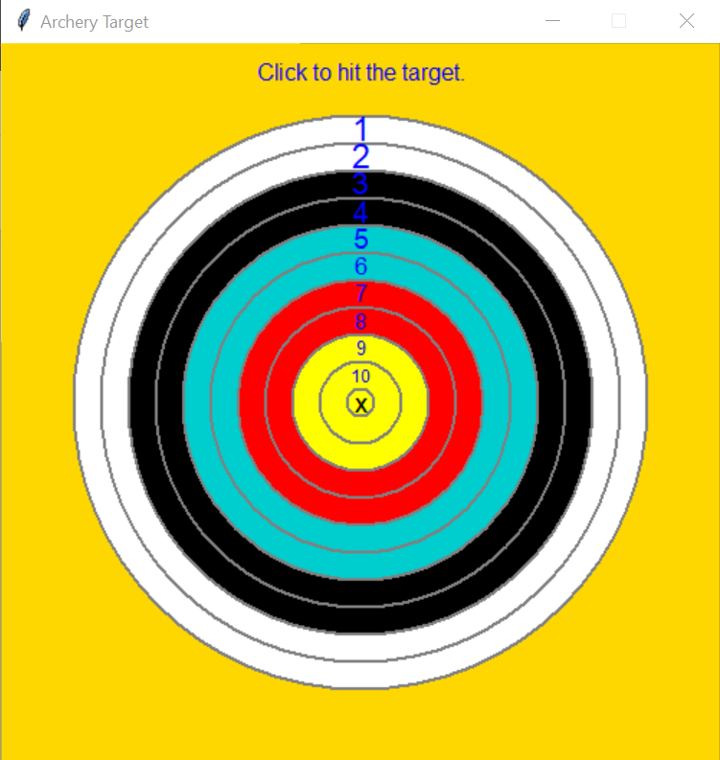
Output

Slide 6
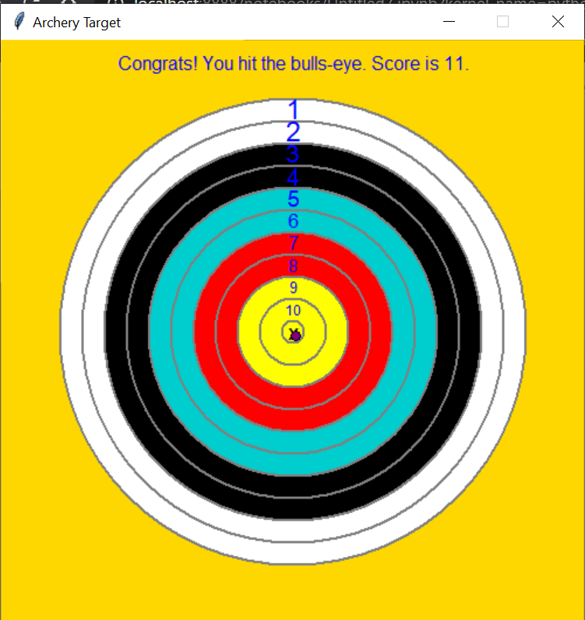

Slide 7
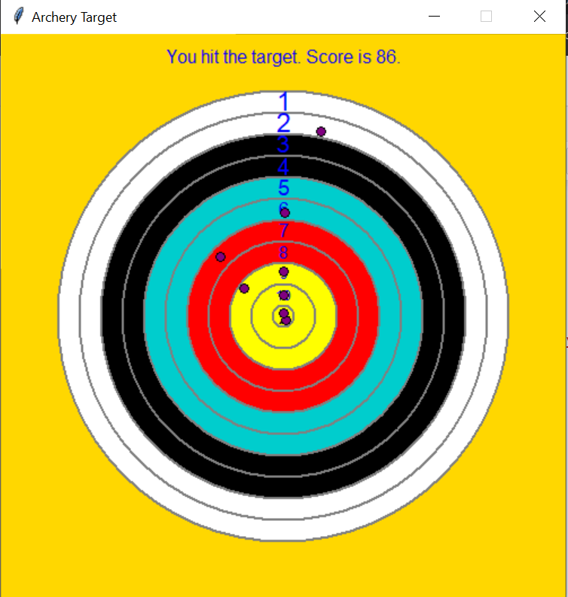

Slide 8
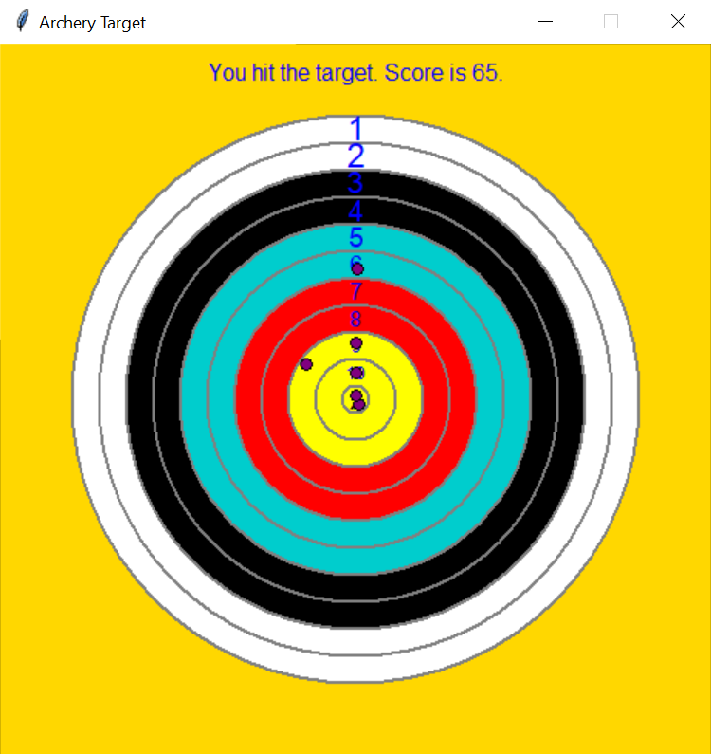
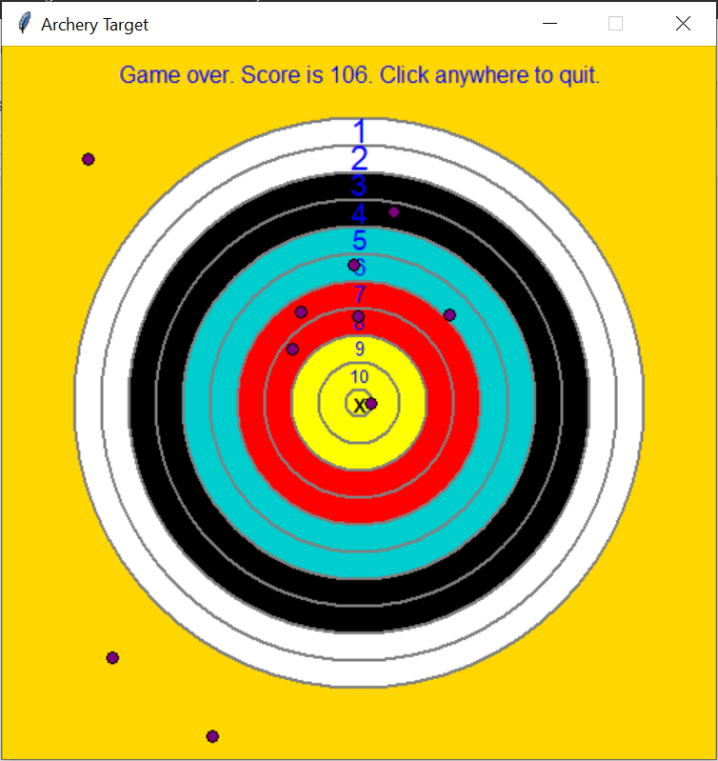
After hitting 10 arrows the game ends with the score being displayed

