Slide 1
Credit Card Fraud Detection
A Machine Learning Approach
Prepared by Saikiran Lagumsani

Slide 2
Introduction
Credit card fraud is a major issue in financial transactions.
This project uses machine learning to detect fraudulent transactions.
Data preprocessing, model selection, and evaluation are key steps.

Slide 3
Dataset Description
The dataset contains transaction details with fraud labels 0 and 1.
0: Legitimate Transactions (Non-Fraud)
1: Fraudulent Transactions
Features include transaction amount, time, class and anonymized variables(v1-v28).
Class imbalance is handled using resampling techniques.

Slide 4
Data Visualization
Feature correlations and importance analysis.
Low correlations
- Most features show very low correlation with each other, as seen from
the predominantly blue color.
- This suggests that there are no strong linear dependencies among the features.
Fraud and non-fraud transactions distribution.
The dataset contains a total of **284,807** transactions, with:
- 284,315 legitimate (normal) transactions
- 492fraudulent transactions
Which is highly imbalanced dataset. To address this, we apply Synthetic Minority
Over-sampling Technique(SMOTE) to generate synthetic fraud samples.

Slide 5
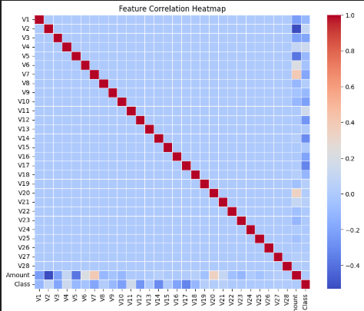
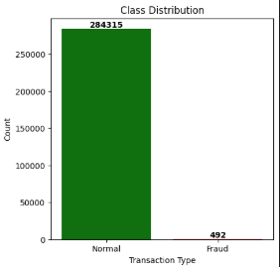
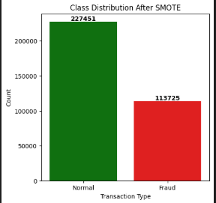

Slide 6
Model Selection
Evaluated models include:
- Logistic Regression
- Decision Trees
- Random Forest
- Best model selection based on accuracy, precision, and recall.

Slide 7
Evaluation Metrics
Performance metrics include:
- Accuracy
- Precision
- Recall
- F1-score
Confusion matrix used for fraud detection analysis.

Slide 8
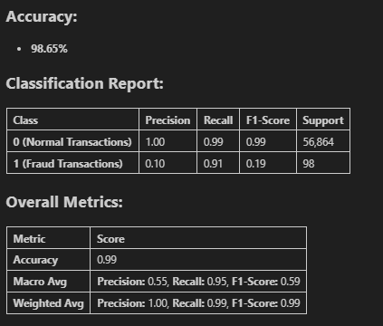
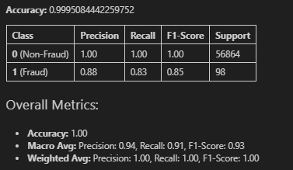
Logistic Regression
Random Forest

Slide 9
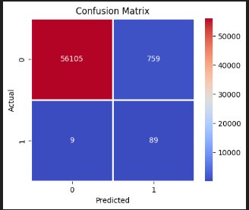
Cofusion matrix for Logistic Regression

Slide 10
Conclusion
🔍 Conclusion – Credit Card Fraud Detection Project
✅ Effective Fraud Detection: The machine learning models successfully identified fraudulent
transactions with high accuracy (99%) and a ROC-AUC score of 0.969, ensuring reliable fraud
detection.
✅ Precision-Recall Trade-off: By fine-tuning the decision threshold, we optimized the balance
between precision (reducing false positives) and recall (capturing more fraud cases) to minimize
financial loss.
✅ Hyperparameter Tuning: optimized hyperparameters led to improved
fraud detection
capabilities, demonstrating its effectiveness in handling complex patterns.
🚀 Future Enhancements:
Implement real-time fraud detection using streaming data.
🔹 Final Takeaway: By leveraging machine learning techniques, data
preprocessing, and model tuning, this project provides a robust framework for
detecting fraudulent transactions, reducing financial risks, and improving
transaction security.

Slide 11
THANK YOU

