Slide 1
Superstore Sales Dashboard
Task 4 – Data Analyst Internship
Sai Kiranmai Manthripragada
Tool Used: Tableau

Slide 2
OBJECTIVE
• Provide key business insights on sales and profit trends.
• Help stakeholders monitor performance across regions, product categories, and customer segments.
• Enable interactive exploration through filters and visuals.

Slide 3
Dataset Overview
Dataset: Superstore Sales Dataset
Source: Kaggle
Key Fields Used:
- Order Date
- Sales
- Profit
- Region
- Segment
- Category / Sub-Category

Slide 4
Dashboard Overview
Dashboard Features:
- KPI Cards: Total Sales, Profit, Profit Margin
- Line Chart: Sales trend over time
- Bar Charts: Sales by Region, Profit by Category
- Treemap: Sub-Category breakdown
- Pie Chart: Segment share
- Interactive Filters: Date, Region, Segment, Category

Slide 5
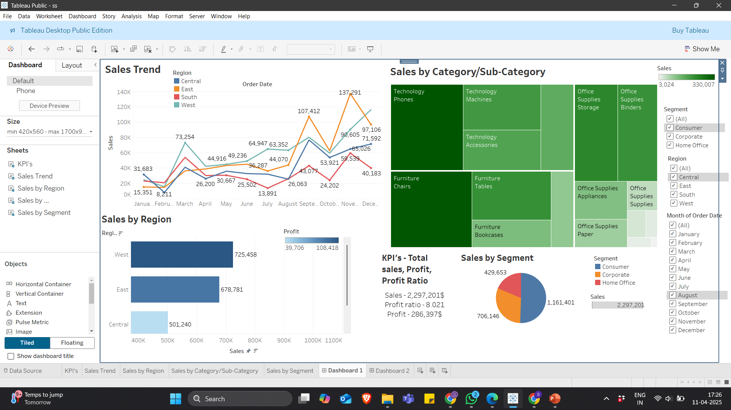
Dashboard Overview Image

Slide 6
Key Insights
1. The West region consistently generates the highest profit.
2. Q4 tends to have the highest sales volume.
3. The technology category performs best in terms of profit margins.
4. Corporate Segment shows higher average order value.

Slide 7
Tools & Techniques Used
Tool: Tableau Public
Techniques Applied:
- Filters and Slicers
- KPI Cards
- Calculated Fields (e.g., Profit Margin)
- Time Series Analysis
- Interactive Dashboard Layout with Containers

Slide 8
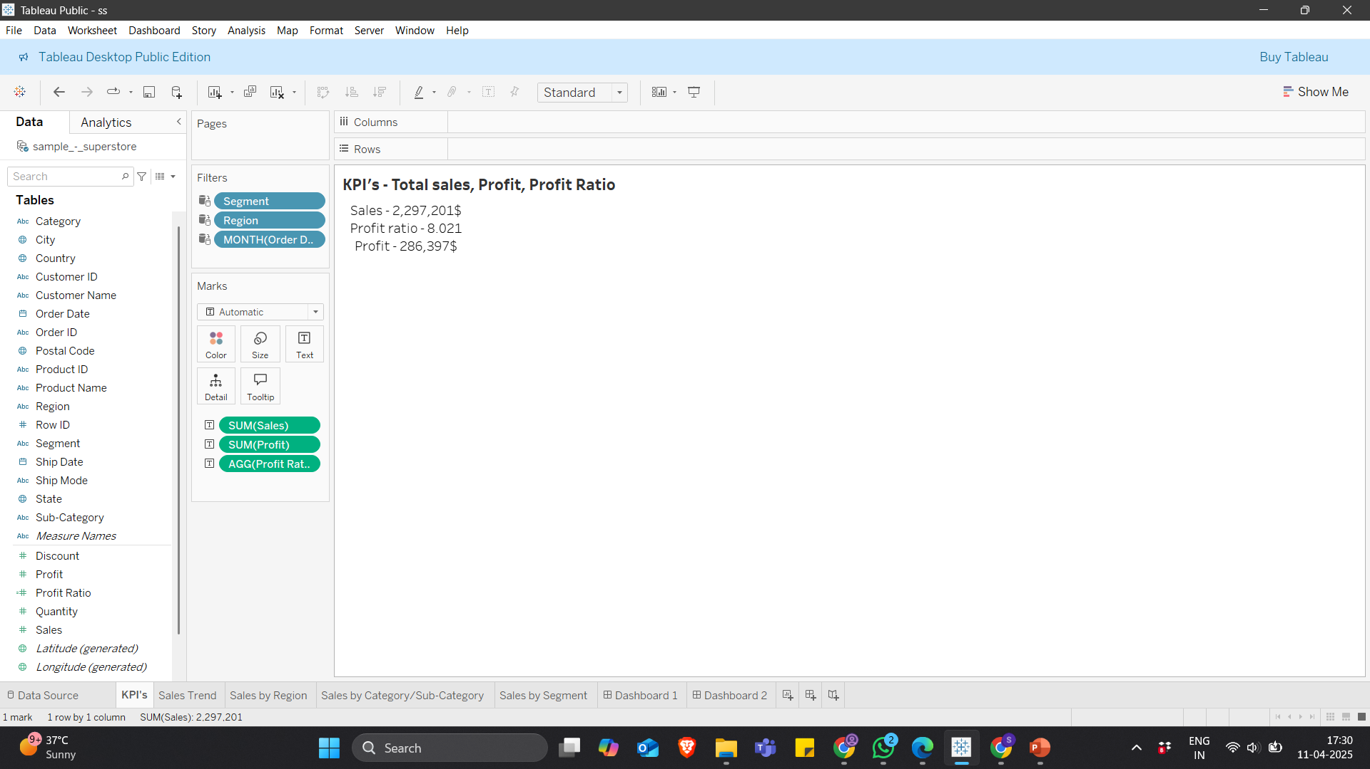
KPI Cards

Slide 9
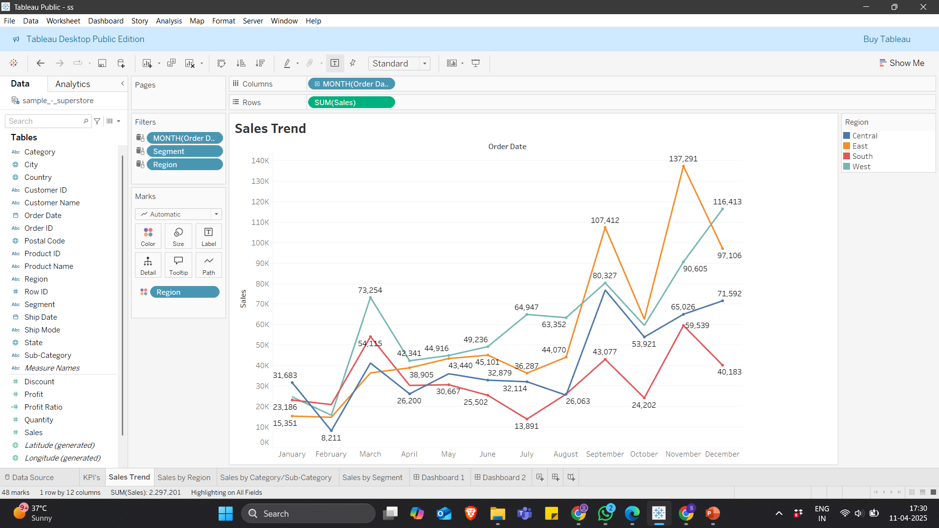
Sales Trend Over Time

Slide 10
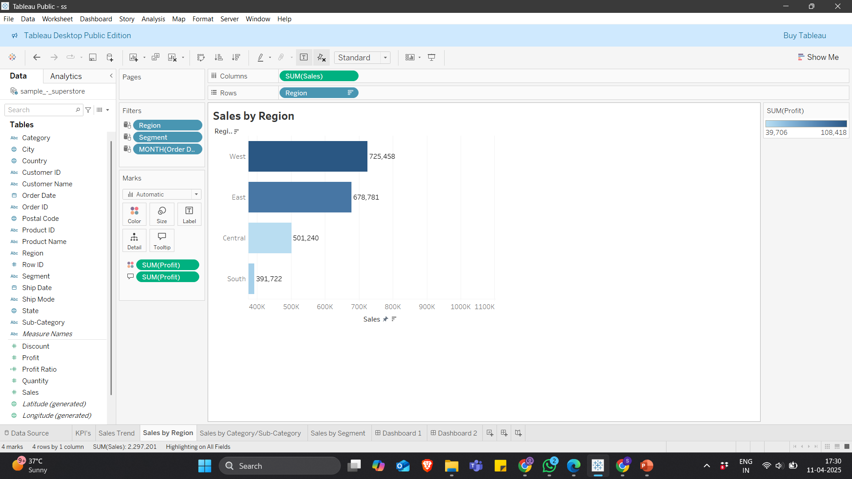
Sales by Region

Slide 11
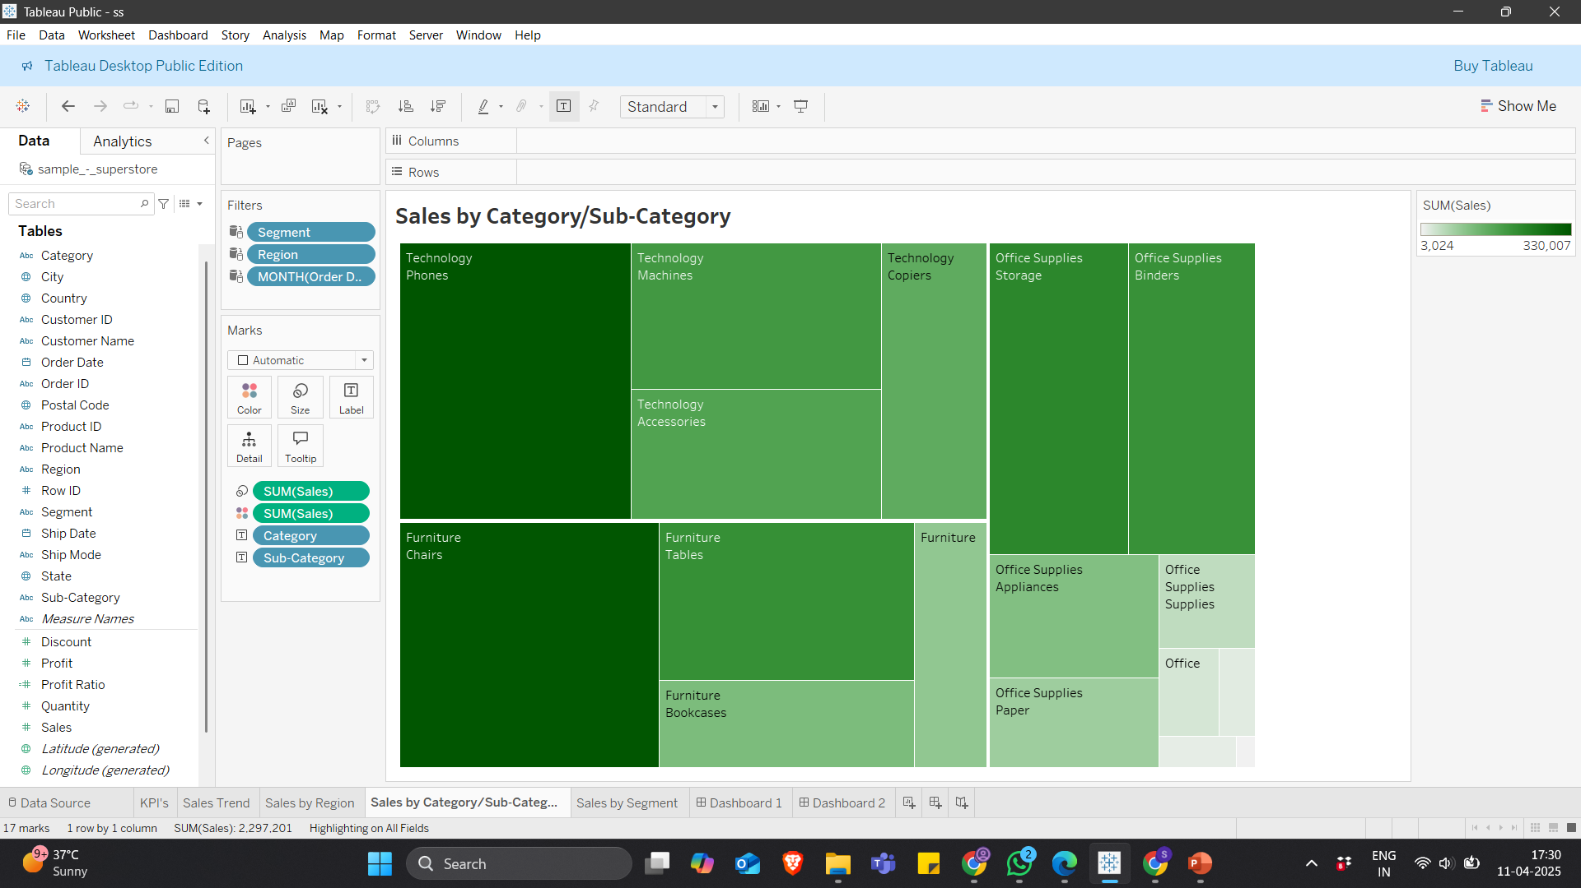
Sales byCategory/Sub-Category

Slide 12
THANK YOU

