Slide 1
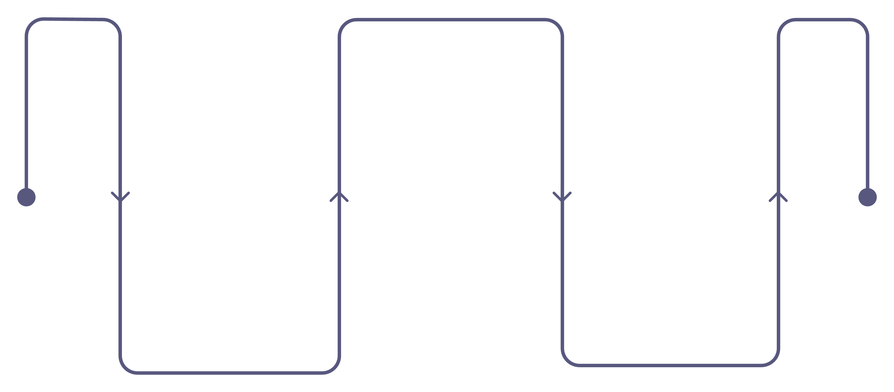
Customer Churn Prediction System
Using Historical Service Usage, Customer Support Interactions, and Behavioral Analytics
ML Prediction
Generate churn risk scores
Data Collection
Retention Action
Aggregate usage and support logs
Trigger targeted interventions
Mr.MULLU SAI KIRAN
324129510037
M.TECH / B.TECH PROJECT PRESENTATION
MACHINE LEARNING · PREDICTIVE ANALYTICS · BUSINESS INTELLIGENCE

Slide 2
Introduction & Problem Statement
What is Customer Churn?
Why Machine Learning?
Customer churn is the rate at which customers discontinue services or subscriptions. In subscription-based industries — telecom, banking, insurance, and SaaS — churn directly erodes recurring revenue and increases customer acquisition costs, making early detection a critical business priority.
Automation
Replaces manual, rule-based analysis with automated pattern recognition across thousands of customer records simultaneously.
The Core Challenge
Subscription businesses struggle to identify at-risk customers before they leave. Traditional manual analysis of large customer datasets is time-consuming, reactive, and fundamentally cannot scale to the volume and velocity of modern customer data.
Prediction
Shifts the organization from reactive response to proactive identification of customers likely to churn before they act.
Business Impact
Early detection enables targeted retention strategies — personalized offers, support escalation, and engagement campaigns — reducing revenue loss.

Slide 3
Project Objectives
This system is designed to deliver six interconnected capabilities that together form a complete churn intelligence platform.
1
Binary Churn Prediction
Predict whether an individual customer is likely to churn using historical behavioral, transactional, and support data.
2
Probability Scoring
Estimate a continuous churn probability score (0–100%) for each customer to enable prioritization of retention efforts.
3
Factor Identification
Identify the key behavioral patterns and features most strongly contributing to customer attrition across the customer base.
4
Risk Segmentation
Classify customers into Low, Medium, and High risk tiers to enable differentiated, targeted retention strategies.
5
Analytics Dashboard
Provide actionable insights through an interactive visualization dashboard accessible to business and operations teams.
6
Decision Support
Enable data-driven decision-making to reduce customer attrition, protect recurring revenue, and improve retention ROI.

Slide 4
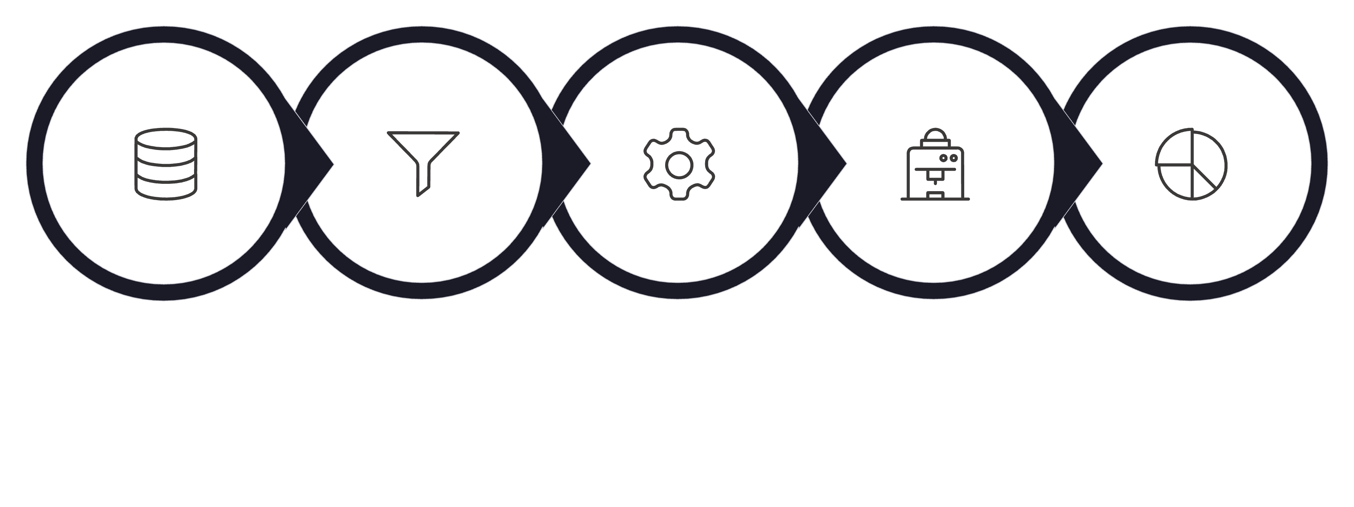
System Architecture & Data Pipeline
Prediction & Segmentation
Data Processing
Feature Engineering
Data Sources
ML Training
Upstream: Data Ingestion & Processing
Downstream: Modeling & Output
Data Sources
Machine Learning
CRM systems, billing platforms, support ticketing systems, and service usage logs feed raw customer records into the pipeline.
Train and evaluate multiple classification models — Logistic Regression, Decision Tree, Random Forest, SVM, and Gradient Boosting — on labeled historical data.
Data Processing
Prediction & Segmentation
Cleaning, validation, handling missing values, and encoding categorical variables to produce a consistent, analysis-ready dataset.
Generate individual churn probability scores and classify each customer into Low, Medium, or High risk categories for operational use.
Feature Engineering
Dashboard & Insights
Derive meaningful predictive features: tenure, usage patterns, support interaction frequency, payment behavior, and engagement metrics.
Visualize predictions, surface retention recommendations, and provide business teams with actionable, customer-level intelligence.

Slide 5

Key Customer Data & Features
The predictive model draws on six categories of customer data, each capturing a distinct dimension of customer behavior and engagement.
Subscription Data
Service Usage
Tenure & subscription duration
Plan type & service tier
Contract terms
Access frequency & volume
Feature utilization rate
Usage trend over time
Support Interactions
Payment Behavior
Complaint frequency
Issue resolution time
Unresolved problem count
Payment history & delays
Failed transactions
Billing consistency
Engagement Metrics
Behavioral Indicators
Login frequency
Feature adoption rate
Days since last activity
Usage volatility
Plan downgrades
Complaint escalation patterns
Feature Engineering Principle: Raw data fields are transformed into derived behavioral signals — e.g., "rate of usage decline over 90 days" or "ratio of unresolved to total support tickets" — which carry stronger predictive power than raw counts alone.

Slide 6
Machine Learning Approach
Classification Algorithms
Training & Prediction Workflow
01
Logistic Regression
Decision Tree
Prepare Labeled Data
Baseline model. Interpretable coefficients, fast training, establishes performance floor.
High interpretability. Produces human-readable rules for business stakeholder communication.
Historical records with known churn outcomes (churned = 1, retained = 0) form the supervised training set.
02
Random Forest
SVM
Train / Test Split
Ensemble of trees. Strong accuracy, robust to overfitting, provides feature importance rankings.
Effective in high-dimensional feature spaces. Suitable when feature count is large relative to samples.
Separate features and target variable; split dataset (typically 80/20) to enable unbiased performance evaluation.
03
Model Training & Evaluation
Gradient Boosting
Train all candidate models; evaluate on held-out test set using Precision, Recall, F1-Score, and ROC-AUC.
Sequential ensemble method. Typically highest accuracy; XGBoost/LightGBM variants preferred for production.
04
Inference & Risk Assignment
Apply best model to new customers: generate probability score → assign risk tier: Low (0–33%), Medium (33–67%), High (67–100%).

Slide 7

Exploratory Data Analysis & Feature Importance
Key Analytical Dimensions
Feature Importance Framework
Churn Distribution Analysis
Support Signals
Tenure Effect
Examine the proportion of churned vs. retained customers. Class imbalance — common in churn datasets — must be addressed via oversampling (SMOTE), undersampling, or class-weight adjustment before model training.
High complaint frequency and unresolved issue counts are among the strongest churn predictors — customers experiencing repeated unresolved problems are significantly more likely to leave.
Churn risk is typically highest in early subscription months and declines with tenure, reflecting switching costs and habit formation over time.
Correlation & Pattern Analysis
Identify statistical relationships between individual features and the churn label. Key patterns examined: tenure vs. churn rate, service usage volume vs. churn, support ticket frequency vs. churn, and payment delay frequency vs. churn.
Engagement Decay
Payment Irregularity
Declining feature adoption and increasing days-since-last-activity are leading indicators of disengagement preceding churn.
Failed transactions and payment delays signal financial friction or reduced commitment, correlating with elevated churn probability.
Behavioral Signal Detection
Usage decline over trailing periods, reduced login frequency, subscription downgrades, and payment irregularities are consistently strong early-warning behavioral signals across subscription industries.
Feature importance rankings from Random Forest or Gradient Boosting models provide business teams with interpretable, prioritized drivers of churn for strategic action.

Slide 8




Dashboard & Retention Strategy
Dashboard Metrics & Visualizations
Retention Action Framework
Portfolio-Level KPIs
Identify
Total active customers, overall churn rate, risk distribution across Low / Medium / High tiers, and average churn probability across the customer base.
Flag high-risk customers (probability >67%) from daily model inference runs.
Prioritize
Segmentation Views
Rank by churn probability score and customer lifetime value to focus retention resources efficiently.
Customer segmentation by risk tier, behavioral trend charts, service usage analysis, and support interaction pattern visualizations.
Engage
Customer-Level Drill-Down
Deliver personalized offers, address unresolved complaints, and escalate support quality for at-risk accounts.
Individual prediction results showing risk score, contributing factors ranked by importance, and recommended retention actions for each high-risk customer.
Monitor
Track customer response to retention actions; adjust strategies based on observed behavioral changes.
The system functions as a decision support tool — it surfaces intelligence and recommendations, while human business teams retain authority over final retention decisions and customer communications.

Slide 9
Technology Stack & Implementation
The system is built on a modern, open-source Python-centric stack with cloud-ready deployment architecture.
3
Data Processing
Machine Learning
Visualization
Python · Pandas for data manipulation and transformation · NumPy for numerical processing and array operations
Scikit-learn for classification algorithms, cross-validation, hyperparameter tuning, and model evaluation metrics
Matplotlib & Seaborn for EDA · Plotly / Dash for interactive, web-based analytics dashboard
4
5
6
Backend API
Frontend
Database
Flask or FastAPI for RESTful API development, model serving, and integration with frontend and database layers
HTML, CSS, JavaScript for the user interface layer; dashboard accessible to non-technical business users
PostgreSQL or MySQL for structured customer data storage, prediction history, and audit logging
7
Deployment
AWS / Azure / GCP cloud platforms for scalable, production-grade deployment with containerization support

Slide 10
Advantages, Limitations & Future Enhancements
Advantages
Limitations
Future Enhancements
Early Detection — Identifies at-risk customers before churn occurs, enabling proactive intervention
Data Quality Dependency — Prediction quality is bounded by the completeness and accuracy of input data
Real-Time Prediction — Stream processing for live churn scoring as events occur
Deep Learning — LSTM/Transformer models for sequential behavioral pattern recognition
Reduced Manual Effort — Automates analysis that would otherwise require significant analyst time
Behavioral Unpredictability — Customer behavior can change due to external factors not captured in historical data
Explainable AI — SHAP/LIME integration for transparent, auditable prediction explanations
Better Segmentation — Risk-tiered customer classification enables differentiated retention strategies
Class Imbalance — Imbalanced churn/non-churn ratios can bias model performance if not addressed
CRM Integration — Direct API integration with Salesforce, HubSpot for automated workflow triggers
Revenue Protection — Proactive retention reduces attrition-driven revenue loss
Probabilistic Output — Predictions indicate likelihood, not certainty; false positives incur retention costs
CLV Prediction — Extend model to predict customer lifetime value alongside churn probability
Scalable Architecture — Cloud-ready design handles growing customer volumes without redesign
Model Drift — Customer behavior patterns evolve; models require periodic retraining to maintain accuracy
Auto-Retraining — Continuous model retraining pipeline to combat model drift automatically

Slide 11

Conclusion & Expected Outcomes
System Summary
Strategic Business Impact
The Customer Churn Prediction System integrates historical service usage, customer support interactions, payment behavior, and behavioral analytics into a unified machine learning pipeline. By combining rigorous data engineering with multiple classification algorithms, the system delivers individual-level churn probability scores and risk segmentation that enable organizations to act before customers leave.
The system transforms raw customer data into actionable intelligence, enabling organizations to move decisively from reactive to predictive retention strategies.
Reduced Manual Analysis
Data-Driven Culture
Expected Outcomes
Automated pipeline eliminates repetitive analyst work, freeing teams for higher-value strategic tasks.
Embeds evidence-based decision-making into retention operations, replacing intuition-driven approaches.
Improved At-Risk Identification
Systematic, automated identification of high-risk customers that manual processes would miss or identify too late.
Competitive Advantage
Prioritized Retention Effort
In competitive subscription markets, superior churn intelligence directly supports sustainable revenue growth and customer lifetime value maximization.
Churn probability scores enable retention teams to allocate resources to the customers most likely to leave and most valuable to retain.
Churn Factor Revelation
Core Contribution: This project demonstrates the end-to-end application of supervised machine learning to a high-impact business problem — from raw data ingestion through actionable prediction and visualization.
Feature importance analysis surfaces the root behavioral drivers of attrition, informing product, support, and pricing strategy.
Measurable Attrition Reduction
Proactive engagement of high-risk customers, guided by model insights, is expected to produce measurable reduction in churn rate and associated revenue loss.

