Slide 1
Geographic Information System (GIS) Analysis of coffee shop
Pravallika Challa (U01939539) pc94436n@pace.edu
Sandeep Malyala (U01935264) sm86925n@pace.edu
Chetan Kumar Reddy Vaddi (U01883016) CV33511N@pace.edu
Ramadugu Bhavitha (U01915121) br31457n@pace.edu
Sai Kiran Nunna (U01920311) sn01516n@pace.edu

Slide 2
Introduction
Spatial data, the backbone of Geographic Information Systems (GIS), plays a pivotal role in understanding and interpreting our world. As technology advances, the need for effective spatial data analysis becomes increasingly crucial. In this project, we embark on a journey to create a Geographic Information System (GIS) Analysis, utilizing the robust capabilities of databases, specifically PostgreSQL with PostGIS, to handle and process spatial data types.

Slide 3
Objective
The primary goal of this project is to leverage spatial data and various database techniques to perform GIS analysis. The tasks involve retrieving specific information, calculating distances, areas of interest, optimizing queries, and presenting the results.

Slide 4
Goal
The stated goal is to create a Geographic Information System (GIS) Analysis project, focusing on the analysis of geographic data, maps, and spatial information. To achieve this goal, the project requires the use of a database that supports spatial data types, with PostgreSQL and its spatial extension, PostGIS, being specifically mentioned as a suitable choice.

Slide 5
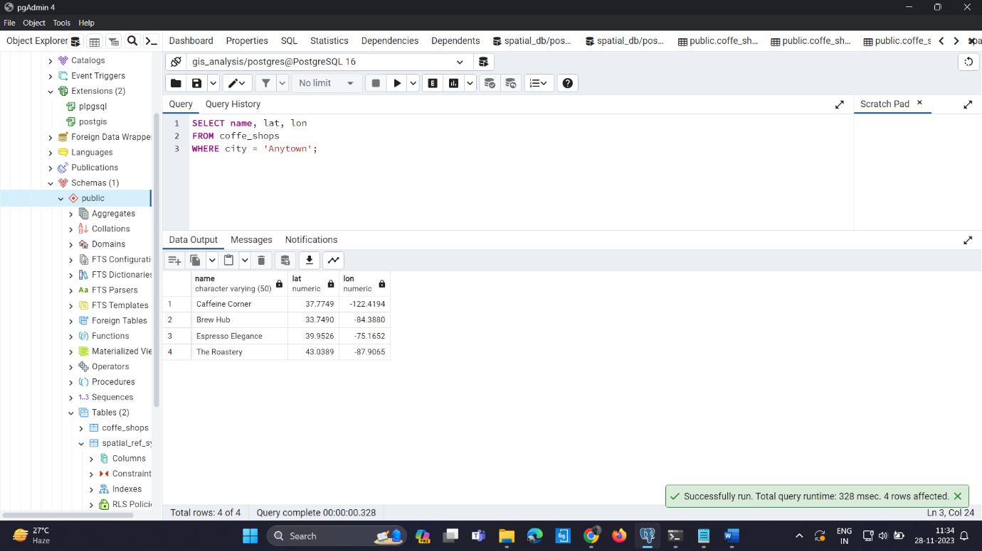
Retrieve Locations of specific features
Query:
SELECT name, lat, lon FROM coffe_shops WHERE city = 'Anytown’;
Explain:
This query is designed to extract information about coffee shops located in the city of 'Anytown' from the 'coffe_shops' table. will include the name of each coffee shThe result op, along with their respective latitude and longitude coordinates. This kind of query is fundamental for obtaining specific location-based information from a dataset, which is essential in GIS analysis and other applications where geographic data plays a crucial role.

Slide 6
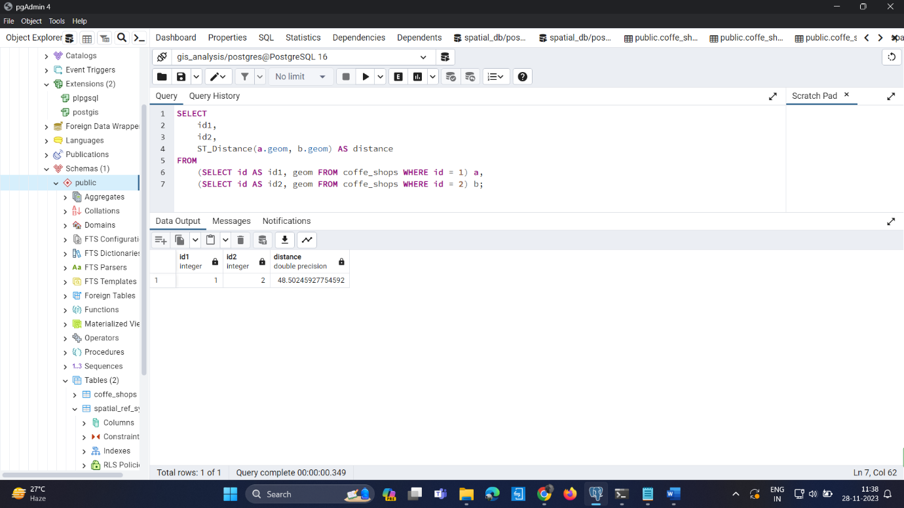
Calculate Distance between points
Query:
SELECT id1,id2, ST_Distance(a.geom, b.geom) AS distance FROM
(SELECT id AS id1, geom FROM coffe_shops WHERE id = 1) a,
(SELECT id AS id2, geom FROM coffe_shops WHERE id = 2) b;
Explain:
This query calculates the spatial distance between two coffee shops (specified by their IDs 1 and 2) using the ST_Distance function. The result includes the identifiers of the two coffee shops and the calculated distance between them. Such distance calculations are fundamental in GIS analysis, aiding in tasks like route optimization, proximity analysis, and location-based decision-making. This query showcases the capability of spatial functions in determining distances between points in a spatial dataset.
Query Output:

Slide 7
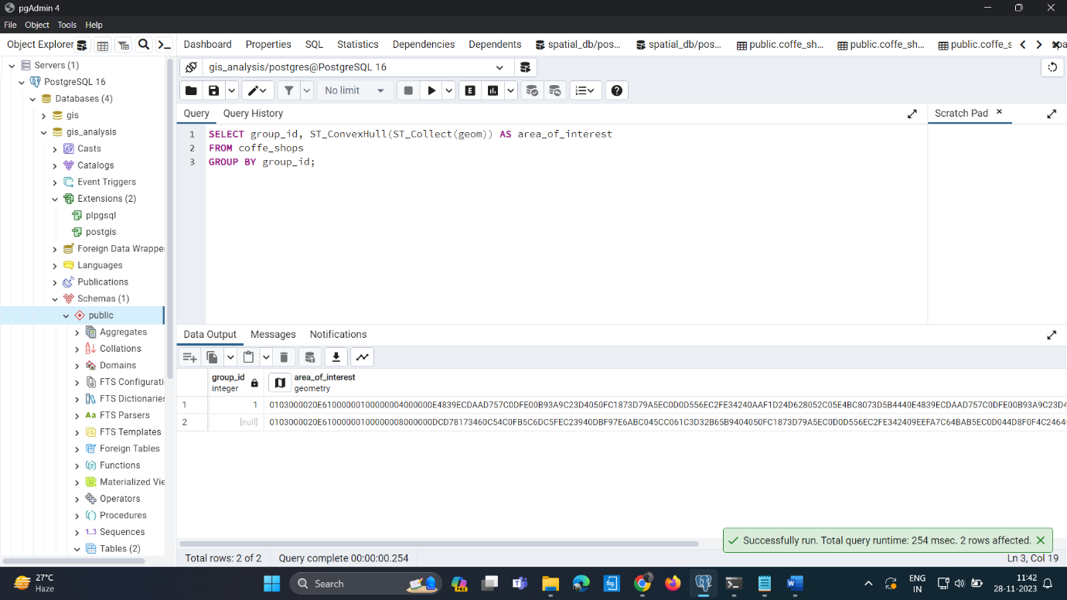
Calculate Areas of Interest
Query1: Add Group Column :
ALTER TABLE coffe_shops ADD COLUMN group_id INTEGER;
Query2: Assign Group ID to Selected Coffee Shops:
UPDATE coffe_shops SET group_id = 1 WHERE id IN (1, 2, 3);
Explain:
Query 1: The first set of queries adds a new column group_id to the 'coffe_shops' table and assigns a group identifier (in this case, 1) to specific coffee shops.
Query 2: The second query calculates the areas of interest for each group. It aggregates the spatial geometries of coffee shops within each group using ST_Collect and then calculates the convex hull of the collected geometries using ST_ConvexHull. The result is a set of polygons representing the areas of interest for each coffee shop group.
Data Output:

Slide 8
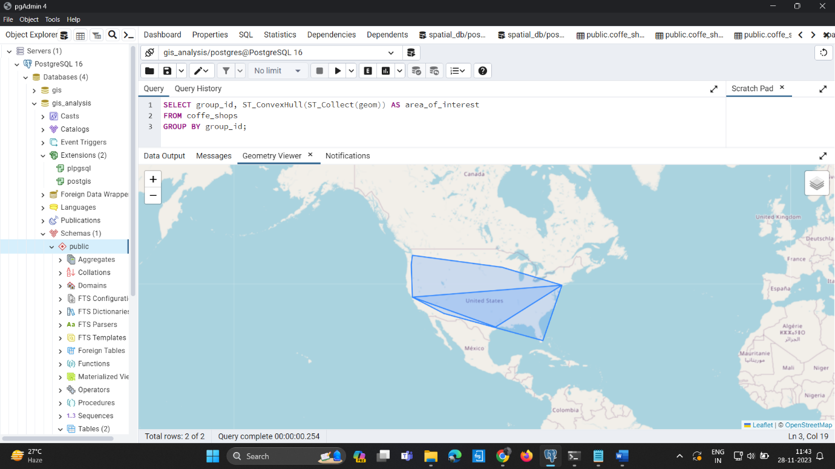
Output of Geometric Map:

Slide 9
Analyze the queries
1) Create Table Query:
Query:
CREATE TABLE (255), city VARCHAR(255), state VARCHAR(2),zip INTEGcoffe_shops (id SERIAL PRIMARY KEY name VARCHAR(255),address VARCHARER, lat DOUBLE PRECISION,lon DOUBLE PRECISION);
Explaination:
This query creates a table named coffe_shops with the following columns: id, name, address, city, state, zip, lat, and lon.
The id column is an auto-incrementing primary key.
The state column is defined as VARCHAR(2), assuming it's a two-letter state abbreviation.
The zip column is an INTEGER, assuming it represents a ZIP code.
The lat and lon columns are DOUBLE PRECISION, presumably representing latitude and longitude.
2)Insert Data Query:
Query:
INSERT INTO public.coffe_shops (id, name, address, city, state, zip, lat, lon) VALUES
(1, 'Caffeine Corner', '123 Main St', 'Anytown', 'CA', 12345, 37.7749, -122.4194),
(40, 'Buzz Brews', '3737 Cedar Street', 'Nowherenew', 'CA', 97531, 37.7749, -122.4194);
Explaination:
This query inserts data into the coffe_shops table.
It inserts 40 rows of data, each representing a coffee shop with its attributes.
The data includes information such as name, address, city, state, ZIP code, latitude, and longitude.

Slide 10
Analyze the queries
3)Distance Calculation Query:
SELECT id,name,ST_Distance(ST_SetSRID(ST_MakePoint(lon, lat), 4326),ST_SetSRID(ST_MakePoint(-122.4194, 37.7749), 4326)) AS distance_from_referenceFROMcoffe_shops;
Explaination:
This query calculates the distance of each coffee shop from a reference point with longitude -122.4194 and latitude 37.7749.
It uses the ST_Distance function with the reference point and the coffee shop coordinates.
4)Insert Geom Column Query:
ALTER TABLE coffe_shops ADD COLUMN geom geometry(POINT, 4326);
Explaination:
This query adds a new column named geom to the coffe_shops table, representing a point geometry in the SRID 4326 (WGS 84).
5)Update Geom Column Query:
UPDATE coffe_shops SET geom = ST_SetSRID(ST_MakePoint(lon, lat), 4326);
Explaination:
This query updates the geom column for each row in the coffe_shops table with the corresponding point geometry based on the lat and lon values.

Slide 11
Analyze the queries
6)Distance Calculation (Geom) Query:
SELECT id,name,ST_Distance(geom,ST_SetSRID(ST_MakePoint(-122.4194, 37.7749), 4326)) AS distance_from_referenceFROMoffe_shops;
Explaination:
This query calculates the distance of each coffee shop from a reference point using the geom column, which contains point geometries.
7)Calculate Areas of Interest Query (Assuming Grouping):
SELECT group_id, ST_Area(ST_Union(geom)) AS total_area_of_interest FROM coffe_shops GROUP BY group_id;
Explaination:
This query calculates the total area of interest for each group based on the coffee shop locations.
It assumes the existence of a group_id column in the coffe_shops table.

Slide 12
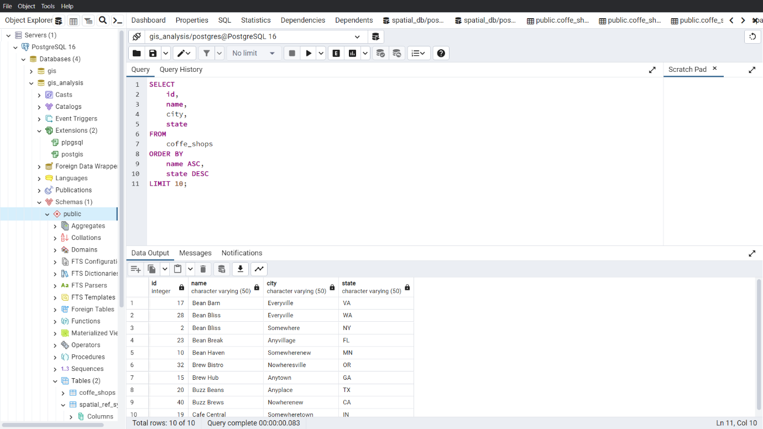
Sorting and Limit Executions
Query:
SELECT id, name, city, state FROM coffe_shops ORDER BY name ASC, state DESC LIMIT 10;
Explain:
The query is designed to retrieve information about coffee shops from the 'coffe_shops' table, specifically the unique identifier (id), name, city, and state. The results are then sorted based on the coffee shop name in ascending order and the state in descending order. Finally, the LIMIT clause ensures that only the first 10 rows, following the specified sorting order, are included in the output
Output:

Slide 13
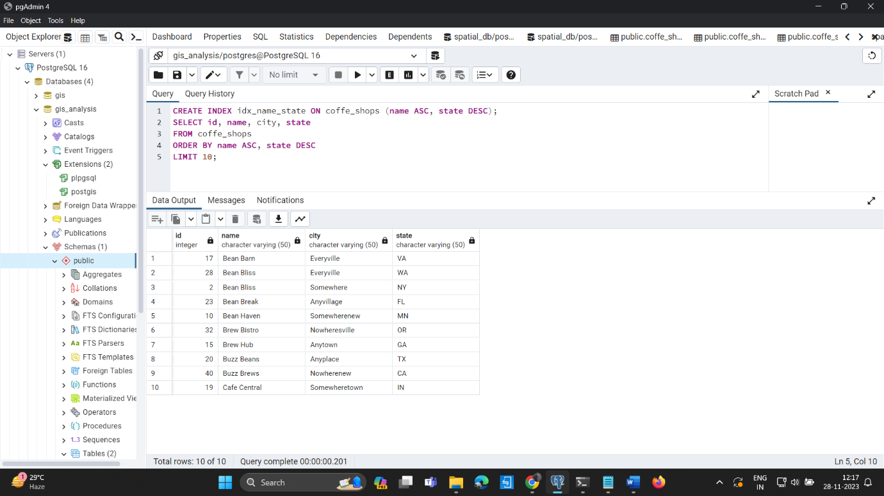
Optimize the queries to speed up execution time
Query:
CREATE INDEX idx_name_state ON coffe_shops (name ASC, state DESC);
SELECT id, name, city, state FROM coffe_shops ORDER BY name ASC, state DESC LIMIT 10;
Explain:
The first query creates an index named 'idx_name_state' on the 'coffe_shops' table, specifically on the 'name' column in ascending order and the 'state' column in descending order. This index is designed to optimize the sorting operation specified in the subsequent SELECT query.
The second query retrieves information about coffee shops, similar to the previous example. However, the index created in the first query is expected to speed up the retrieval process, especially when sorting by the 'name' and 'state' columns.
Output:

Slide 14
N-Optimization
Optimizing queries for performance involves various strategies, and the specific optimizations depend on the structure of the database, the nature of queries, and the underlying hardware. Here are some general tips for optimizing queries:
Indexing: Ensure that appropriate indexes are created on columns used in WHERE clauses and JOIN conditions. For example:
Query:
CREATE INDEX idx_name ON coffe_shops (name);
CREATE INDEX idx_group_id ON coffe_shops (group_id);
**Avoid SELECT ***: Only select the columns you need. This reduces the amount of data that needs to be processed.
Limit the Result Set: Use LIMIT and OFFSET to restrict the number of rows returned, especially for paginated results.
Query Optimization: Make sure your queries are well-optimized. Use the EXPLAIN command to analyze query plans.

Slide 15
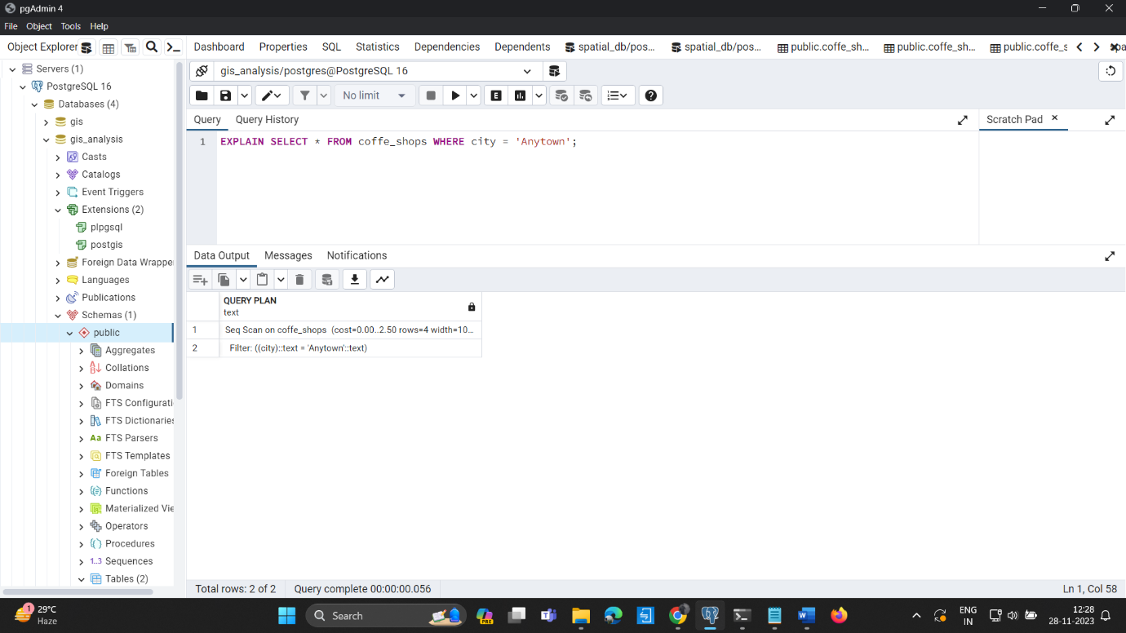
N-Optimization
Query:
EXPLAIN SELECT * FROM coffee_shops WHERE city = 'Anytown';
Normalization: Ensure that your database is normalized to an appropriate degree. This can reduce redundancy and improve query performance.
Caching: Consider caching frequently used queries or results.
Partitioning: If your table is very large, consider partitioning it based on a key. This can improve query performance.
Hardware and Server Optimization: Ensure that your database server has enough resources (RAM, CPU) to handle the workload.
Output:

