Slide 1
ROBOTIC
PROCESS
AUTOMATION
Course Id :INT 346

Slide 2
INTRODUCTION
Progress well into the world environment led by the introduction of emerging technology allows companies to be more flexible and to adapt rapidly to their consumer's desires, expectations and demands.
In turn, economic and financial demands push companies to be more effective, while constantly pursuing innovative innovations and processes that can allow them to become more profitable, save money and contribute positively to their company.

Slide 3
INTRODUCTION
Some of the technologies that arise as advanced technology is RPA that can substitute and optimize people on regular activities, thereby allowing workers to participate in more complex roles that can provide more value to the company.
RPA is known as an innovative and transformative platform that already provides benefits, according to the studies of consultancy organizations.

Slide 4
INTRODUCTION
Imagine performing routine and tedious things every day in your workspace including copying from various websites to an Excel file to perform a data processing or send mail on daily schedules.
Performing these things on a monthly or annual basis would be slightly tedious so RPA makes the thing very easy.

Slide 5

We are entering the fourth industrial revolution, the era of comprehensive automation. RPA, as a driver of this revolution, inherits cloud deployment features and mimics human cognition with unattended automation mechanics. Thousands of enterprises across the globe have already implemented the technology. To better see why it happened, let’s trace back the significant stages of the RPA development that made the technology what it is today.

Slide 6
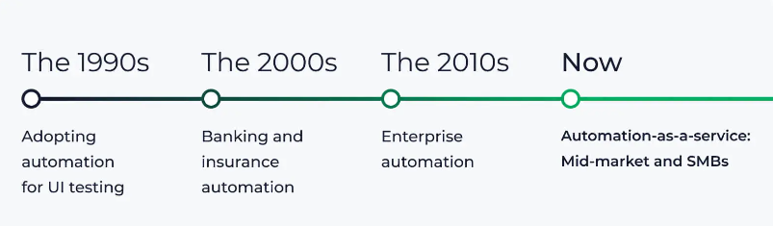

Slide 7

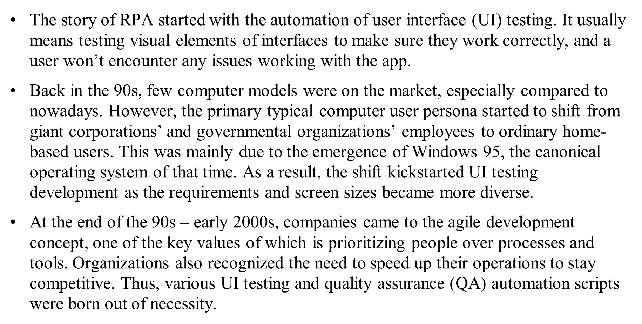

Slide 8

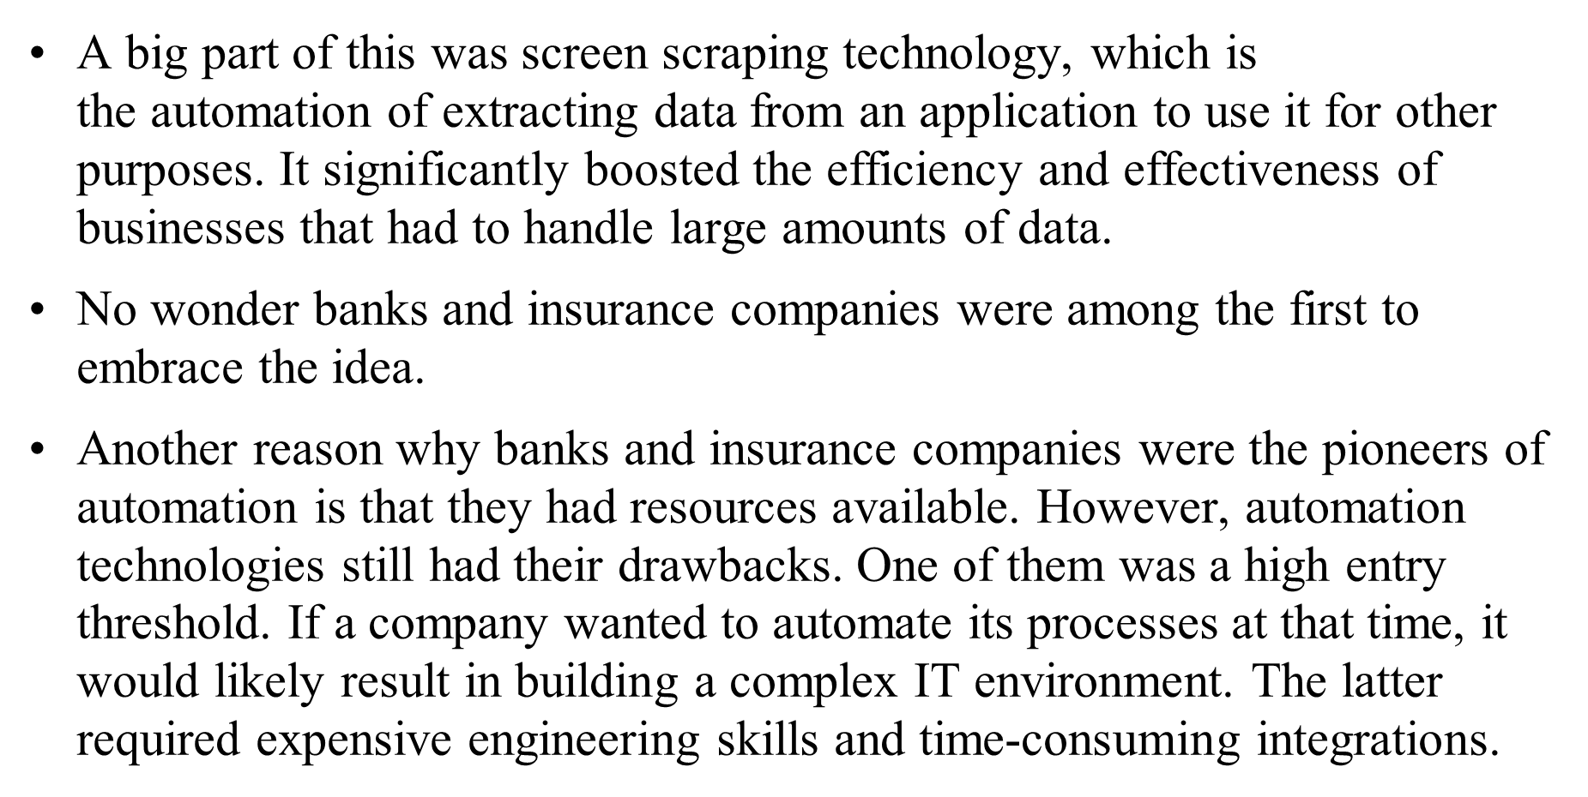

Slide 9
The 2010s: Enterprise automation
The real pivotal point for the RPA technology occurred around 2012, when the technology was finally officially recognized by large-scale businesses. There was a combination of factors that made it possible, such as:
Due to the recent financial crisis, businesses sought ways to reduce expenses.
Businesses realized the need for digital transformation, and RPA was considered an easy and affordable (in corporate rates, of course) solution for going digital.
These factors led to RPA taking the world by storm as more and more enterprises started adopting RPA for their mission-critical tasks.

Slide 10
Now: Mid-market and SMB automation
The 2020s are truly the time of RPA democratization and the growing impact of RPA on all segments of economics. The democratization is possible through the gradual departure from costly licensing fees previously only affordable to enterprises to building partnerships with managed service providers to enable the RPA-as-a-service model. It allows RPA technology to expand to smaller businesses, providing SMBs with massive productivity outcomes.
We already see more and more evidence of RPA in SMBs moving from pilots and proof of concepts to real-time production in much shorter times than Enterprises do. According to the 2021 report by Xerox, one of the largest ElectroNeek partners, 80% of SMB leaders saw automating tasks and processes as crucial to their survival, with two-thirds planning on upgrading their automation tools.

Slide 11
RPA
Robotic process automation (RPA) is the process of programming business operations using robots (bots) to reduce human intervention.
Let me explain RPA by breaking down the abbreviation:
Robotic: Represents a machine which mimics human actions
Process: A step-by-step sequence which can complete a task
Automation: Without any human intervention

Slide 12
RPA
Keeping the above facts in mind, let us now define RPA.
“Imitating human actions to perform a sequence of steps without any human intervention is known as RPA”.

Slide 13
Why RPA?
In a business organization, there are a lot of repetitive and time-consuming tasks that are performed daily. It wasn’t too long before it was realized that it would be beneficial for these organizations if the time spent on these tasks can be used for doing something more productive.
To get all these tasks done with more precision and accuracy than ever before, that too in record speed, the concept of RPA came into the picture.
With RPA, all these redundant tasks that a human does regularly are automated by a robot. It follows the exact steps that are defined by a human to complete a task and do it without any human intervention.

Slide 14
Why RPA?
For instance, at the data entry level, the data entry clerk visits the same source every day, gets the data from there and fills it, say, in an Excel sheet.
This process has some defined steps like visiting the website, extracting data from there, and adding it in a sheet. If a robot can be trained to do this by just giving it a few simple commands, then why not, right?
The robot follows those commands and completes the work faster and more accurately.
This is just one of the millions of tasks that can be done using RPA technology. Most of the organizations use RPA for end-to-end automation of everyday business operations.

Slide 15
RPA vs Automation
Regular Automation | RPA
The user should have a deep understanding of the target application. | As long as RPA knows the right actions to perform, the user needn’t bother about the complexity of the underlying application.
Regular Automation is completely dependent on coding and relies on methods to integrate different systems. | RPA involves little or no coding.
Automation requires the invention of a technology or a software program. | In RPA, we don’t invent anything new; instead, we train the technology to perform the tasks that are done manually.
For example, when we had to automate the process of calculating numbers, we invented a calculator. | RPA can be used to enter the numbers automatically on a calculator and do the calculations.

Slide 16
Types of RPA
We have two kinds of RPA automation that are based on how the RPA tool helps you automate.
One of them is like an assistant that you call upon to help you complete the tasks, while the other is a kind of automation that's mostly used for back-office work.

Slide 17
Attended Automation
These are the assistants that run on your computer and help you complete parts of the tasks that you are performing.
For example, if you usually copy and paste data from one application to multiple applications, you can invoke an attended RPA to take over just these sets of activities. The control is then returned to you by RPA to carry out the next set of tasks.

Slide 18
Attended Automation
You would use attended bots for the following reasons:
Tasks that need real-time human-system interaction
To augment your employee's day-to-day work, enabling them to do it faster and better
To help your employees understand and embrace automation

Slide 19
Unattended Automation
If you don't need a representative or worker interaction to execute a process, you can usually run the process on a backend server. This is known as unattended automation, which can be used to automate back-office work.
In unattended automation, workflows are self-triggered and run on servers. They usually run to a predetermined schedule and are available 24/7. For example, you can batch your invoices and process them at certain times during the day. The bot would later send you a report, indicating the invoices that could not be processed automatically. You can review the report and only work on the invoices that need your intervention.

Slide 20
Unattended Automation
These automated tasks can be scheduled or started through control rooms. You can allocate tasks, adjust priorities, manage queues, and intervene, in the case of performance issues, through the control room.
Usually, unattended automation gives you more control over the automation process. It follows your rules to complete a process automatically.

Slide 21
Unattended Automation
. You would use unattended automation for the following reasons.
Tasks that are structured and can be fully mapped
To replace entire roles where possible
To gather, sort, analyze, and distribute large amounts of data
You can use both unattended and attended automation either by themselves or together to implement use cases that give your business a distinct advantage. Most of the top tools give you the capability to implement both types of RPA.

Slide 22
Components of RPA
Recorder
Development Studio
Plugin/Extension
Bot Runner
Control Center:

Slide 23
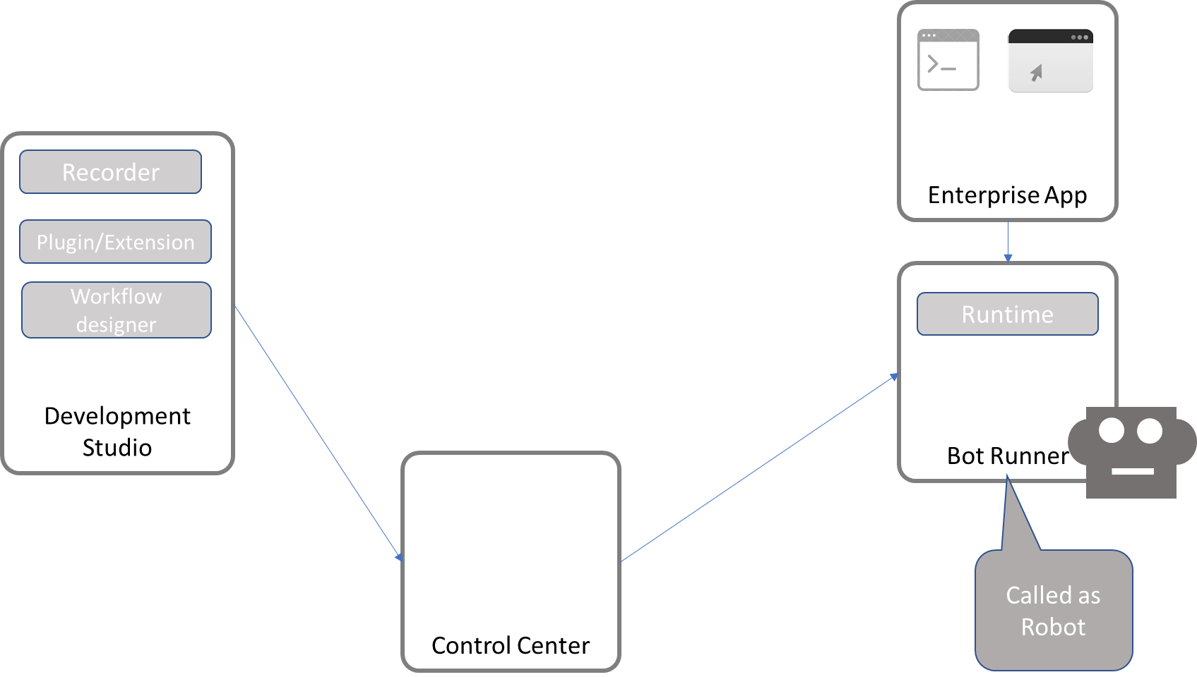
Components of RPA

Slide 24
Benefits of RPA
The benefits of RPA are as follows:
Improved productivity: More than 60% to 90% of the repetitive effort can be removed, with RPA increasing the output for each of your employees.
Rapid results and in-year benefits: Rapid implementation and results are a key promise of RPA as you can conceive, design, develop, and deploy in weeks, not months or years.

Slide 25
Benefits of RPA
Low startup costs: Each of the bot licenses is less costly compared to other software tools and the bot can perform the work of about two to three Full Time Equivalent (FTE), ensuring the startup costs are low.
Reduced processing costs: The costs of processing are reduced drastically as the bot costs around one third to one fifth the cost of an employee, depending on location.
Improved quality and accuracy: Your bots perform assigned work with 100% accuracy, thereby reducing any rework that may have been required.

Slide 26
Benefits of RPA
Improved compliance: RPA activities are logged and can be reviewed at any time. This gives you a greater degree of oversight and control over your operations

Slide 27
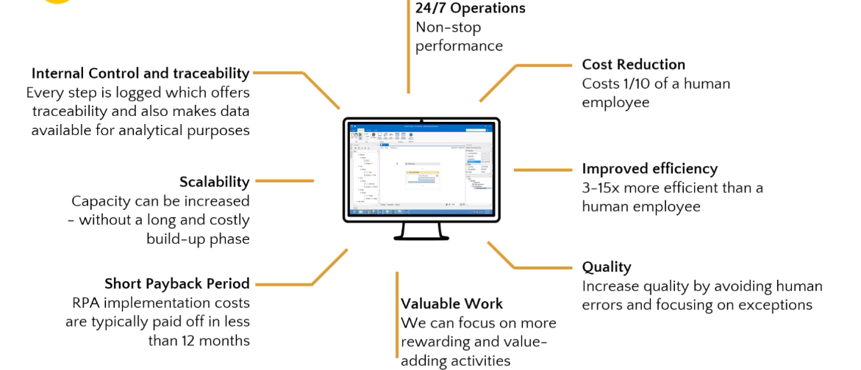
Pros of RPA

Slide 28
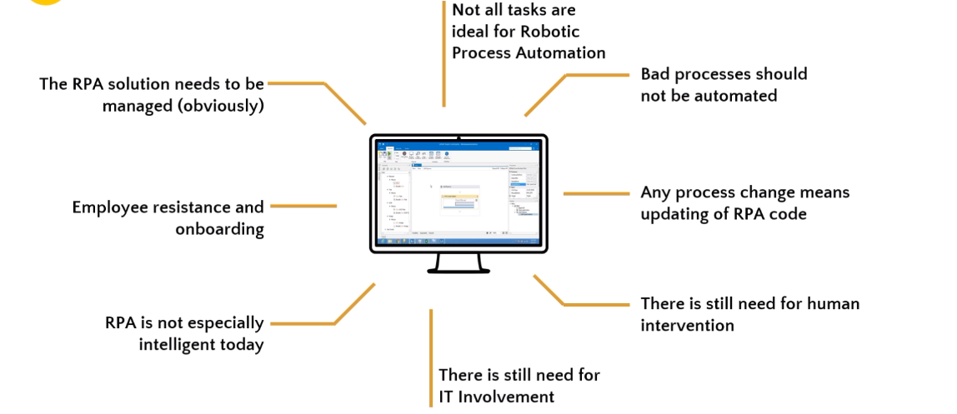
Cons of RPA

Slide 29
RPA VS SCRIPT VS MACROS
Before RPA, similar automations were implemented via scripts and macros. However, one was extremely limited to what was possible to achieve.
These scripts were working relatively well when interacting with a single app (think Selenium for web automation), but when it comes to interacting within multiple applications, things tend to get a lot more complicated.

Slide 30
RPA VS SCRIPT VS MACROS
Further, leading RPA tools include functionality that goes beyond the capability of scripts and macros, such as optical character recognition (OCR) and the ability to include artificial intelligence. These tools have built in access to functionality through Google Cloud such as Cloud Vision, Cloud Translation and Cloud Natural Language. We believe that RPA is a foundation with the capability for organizations to master and then build upon, adding cognitive and AI capabilities. This is not possible with macros and scripts.

Slide 31
RPA vs Web Scraping
You can do more than just basic Web Scraping with Robotic Process Automation. You could even teach it how to clean data by performing certain steps manually first and then letting it take over. RPA tools are also used for automating quality and assurance testing, sending the same emails to multiple people, and hundreds of other similar tasks that are repetitive and boring.
Web scraping with Robotic Process Automation is one of the growing uses of RPA. An entire web scraping team can be replaced by a single RPA expert who can train the scraping system to collect data from various types of webpages. And the best part is, it can be customized for any complex use cases of web scraping.

Slide 32
Gathering Social Media Data
Social media data collection has become more and more important as companies try to analyze their customers and understand their mindset. The problem is that most social media websites do not allow you to gather data automatically and doing so in a manual fashion would require too much time, too many personnel and would be prone to errors. Using an RPA based web scraping solution to perform this task would be much simpler and a favoured choice.

Slide 33
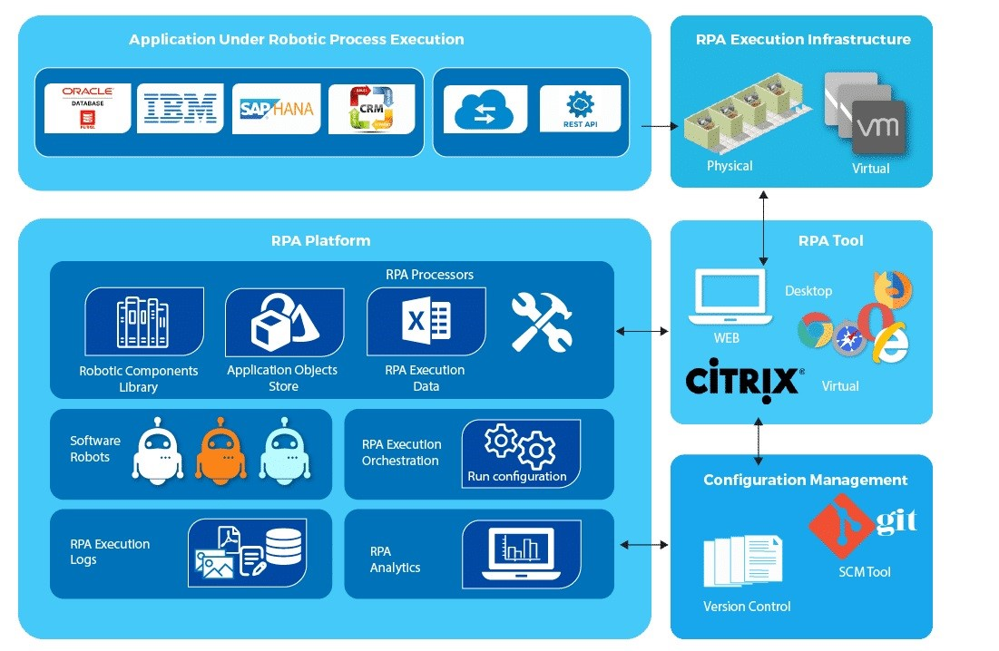
RPA ARCHITECTURE

Slide 34
RPA ARCHITECTURE
Applications under robotic process execution – It is ideally suited for applications in companies such as ERP, SAP or some other program for data management. These applications are information-intensive and have routine tasks to load.
RPA Tool – Build robots for apps to simplify programs in the Windows, Internet and Citrix world. Error management, ability to write and create modular modules from/to disparate sources of data.

Slide 35
RPA ARCHITECTURE
RPA Platform – RPA bots can be placed in a centralized folder, and exchanged through repositories with software robots. RPA platform is capable of providing practical insights into the bots and implementation process.
RPA Execution Infrastructure – They function as a bank of physical or virtual lab devices in conjunction that is managed based on trends of use. It is also possible to execute system scaling in conjunction to accomplish the automation.
Configuration management – The Bots are upgraded to a newer edition. RPA bots are also branched and combined, as they are modular in the libraries.

Slide 36
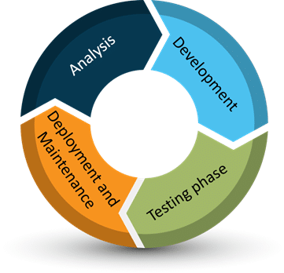
RPA LIFE CYCLE

Slide 37
RPA LIFE CYCLE
Analysis:
The analysis is the start of the life cycle of an RPA. A team of business analysts and an RPA architect work together to develop a plan for why they need RPA and how it could be of assistance to them. We are using a systematic approach and creating a technique for automating processes to eliminate manual labour as far as possible. A timetable to bring this program to action is determined by the RPA chief. They continue the production process after the documentation.

Slide 38
RPA LIFE CYCLE
Development of the Bot:
The project team begins work on the automation task needs. There may or may not be coding involved, based on the form of automation needed. There is usually no encryption. Nevertheless, exceptions may be made.
Testing Phase:
The bot is tested either by the production department itself or by a different testing department, which is equivalent to the normal software testing, based on the type of automation built and the organization.

Slide 39
RPA LIFE CYCLE
Deployment and Maintenance:
It is ready for launch, after the satisfactory production and validation of the bot. When installed, if there happens to be a problem, then the engineering team reviews it and tests it again. It undergoes servicing and upgrading each time the bot is deployed.

Slide 40
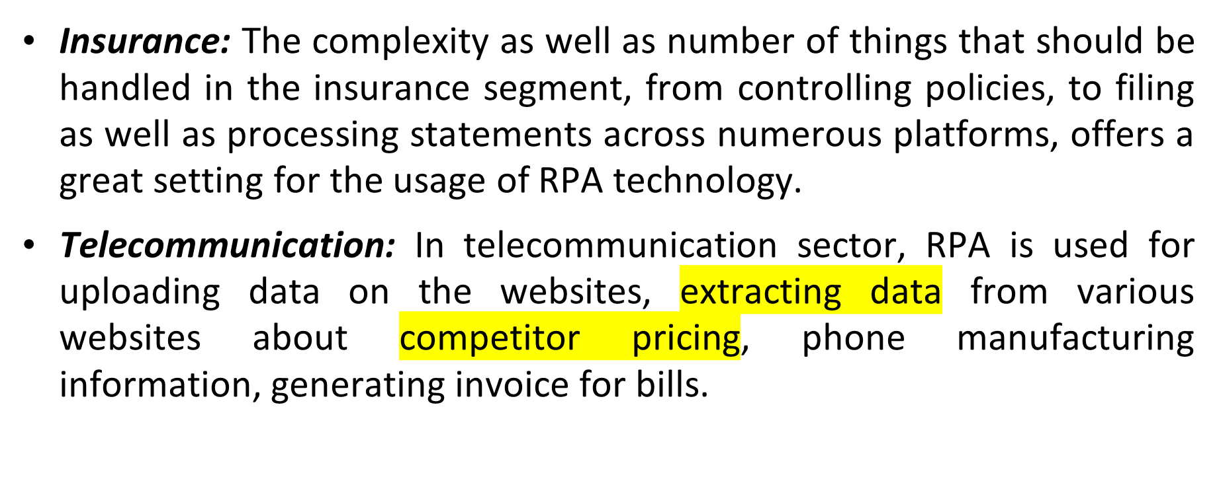
Applications in Industries

Slide 41
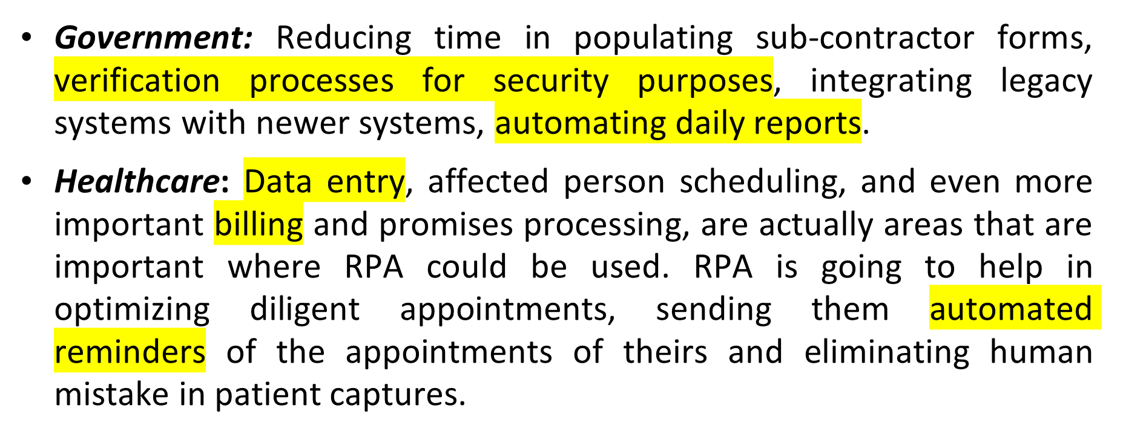
APPLICATIONS

Slide 42
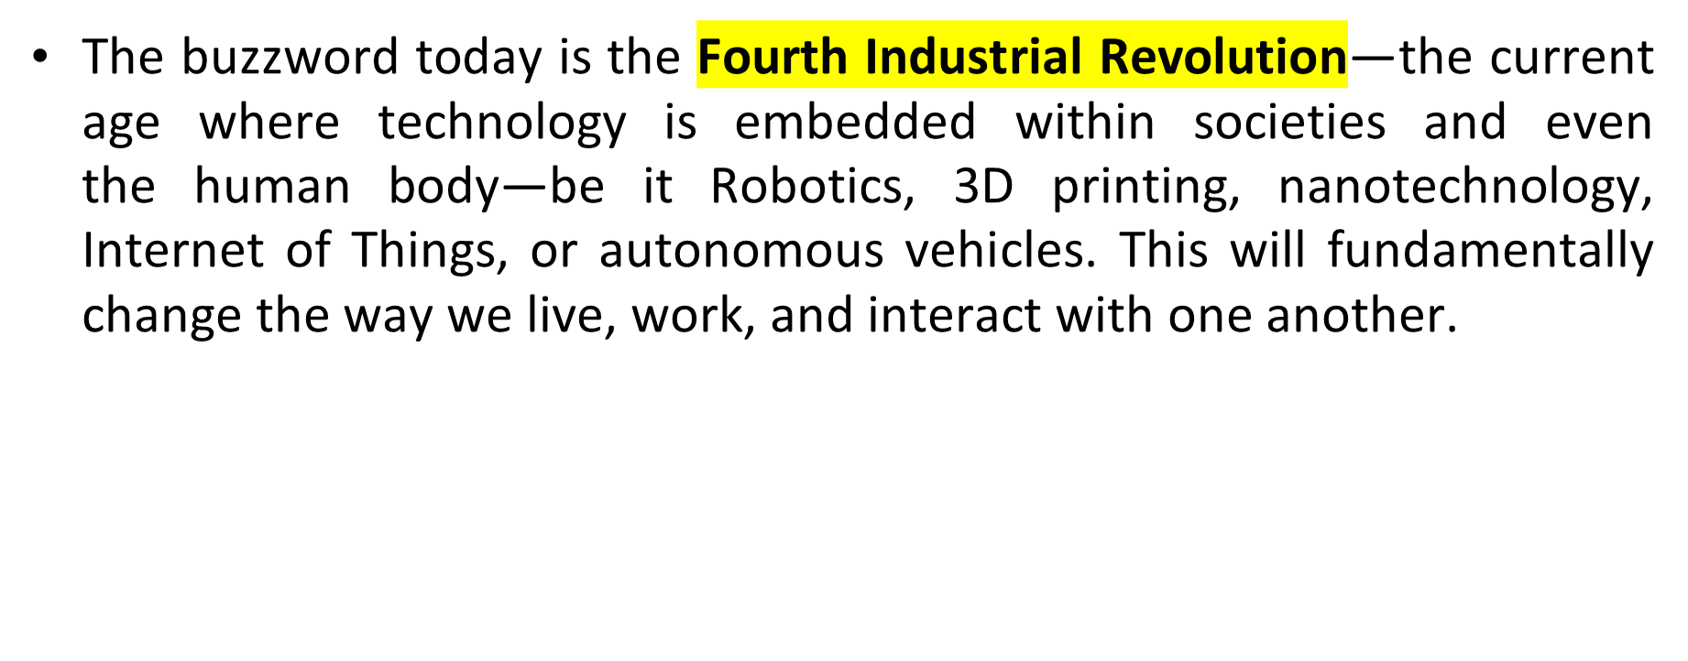
RPA IN FUTURE

Slide 43
RPA IN FUTURE
The prediction for the future is that by the 2021 there will be more than 4 million robots doing office and administrative work as well as sales and related tasks. The enterprise RPA market is growing with a compound annual growth rate (CAGR) of 65%, from nascent in 2016 to the forecasted nearly $3 billion in 2021 .

Slide 44
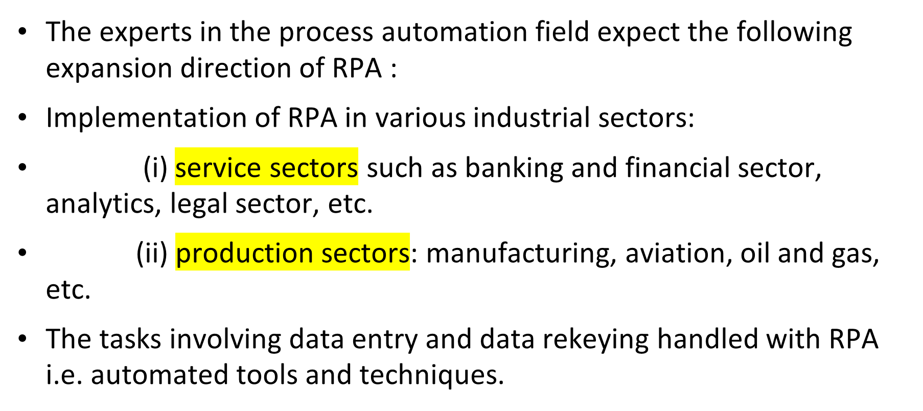
RPA IN FUTURE

Slide 45
RPA IN FUTURE
The tasks that are computer-aided are governed with a set of protocols managed with by RPA application.
The formatting tasks handled with the help of RPA, since they are based on a set of rules.

Slide 46
RPA IN FUTURE
As a Grand View Research, the RPA industry which was estimated at 357.5 million worldwide is likely to produce 8.75 billion dollars by 2024 in a CAGR of 31%. It's been anticipated that the Automation will be one of the best technology fashions in the coming yrs.

Slide 47
RPA IN FUTURE
Furthermore, by the conclusion of the season 2022, 80 % of the big and extremely big organizations will have used RPA in any type. You will find a whole lot of businesses which deals in business procedure outsourcing. But as a prediction for RPA, it’s definitely seen that RPA will ultimately change outsourcing. As a report, 60 % of the Indians function in outsourcing organizations.

Slide 48
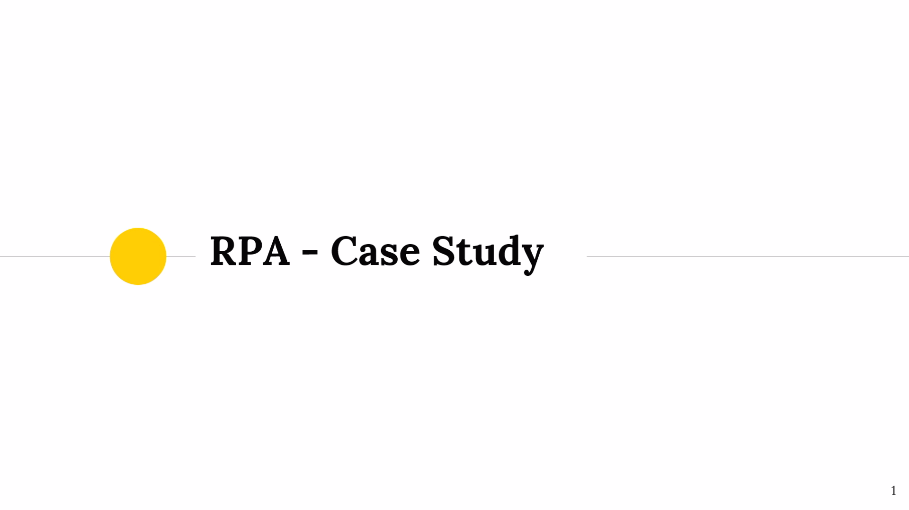
A Case Study

Slide 49
CASE STUDY

