Slide 1
ROBOTIC
PROCESS
AUTOMATION
Course Id :INT 346

Slide 2
What should be automated?
There are a few aspects that have to be taken into consideration for choosing automation candidates. The following processes should be automated:
Repetitive steps
Time-consuming steps
High-risk tasks
Tasks with a low-quality yield
Tasks involving multiple people and multiple steps
And everything else!

Slide 3
What can be automated?
In order to automate something, it needs to have the following characteristics:
Well defined and rule-based steps
Logical
An input to the task can be diverted to the software system
Input can be deciphered by software systems with available techniques
The output system is accessible
Benefits are more than the cost

Slide 4
Techniques of automation
There are various techniques available for automation and programmers have been using them for years to increase efficiency in enterprises:
Custom software: Developing new software to perform repetitive tasks.
Run book: Run books are typically used for IT-based operations. They are a compilation of a set of commands or tasks that are performed for maintenance and other types of activities. Run books can be offline as well, often referred to as run commands for performing sets of tasks.

Slide 5
Techniques of automation
Batch: Batch files used to very popular. They used to compile a sequence of commands that could be run by a single click or command. They can also be scheduled to be run at a specific time using the scheduler.
Wrapper: Wraps around existing software or hosts client applications. The wrapper monitors activities in a client app and performs actions based on rules.
For example:
Putting validation on top of a mainframe application using hummingbird
Hosting a website inside a shell, navigation, and actions

Slide 6
Techniques of automation
Browser automation: Greasemonkey and many other web macro software helped in browser-based automation. It can be used to read from a website and save to a database. It can also write to fields based on rules. Using this technique, a whole website can be changed, and components can be added or removed from the website. Sometimes, it is also referred to as web scripting or web injections.

Slide 7
Techniques of automation
Desktop automation: Traditionally, desktop automation used to mean that multiple screens on a desktop were woven together to present a single screen, and if there was some data transfer from one screen to another, it could be done automatically. Recently, assisted Robotics process automation has also been considered for desktop automation by some companies.
Database/web service integration: In database integration, we read/write to a client database directly. In web service integration, we communicate with the client system using a web service:

Slide 8
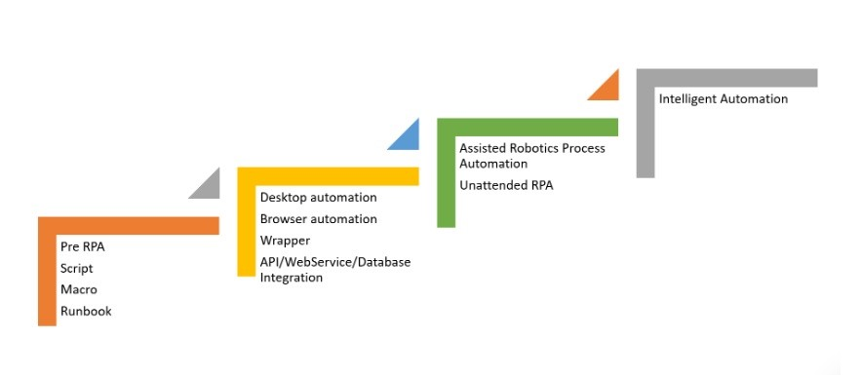
Techniques of automation

Slide 9
Finding a process suitable for automation
There are many jobs that we do on a day-to-day basis that are repetitive. We may not realize it, but many knowledge workers today are performing tasks that are tedious, routine, and monotonous.

Slide 10
Finding a process suitable for automation
Perhaps some of the following tasks may sound familiar to you:
Visiting a variety of websites to download reports. Followed by extracting information from each report and compiling the data into a spreadsheet for further analysis, reporting, and then emailing the consolidated report to your manager.
Checking your email for alerts and notifications. Reading the email and if it says act on this, you go to another system to key in an order or perform a transaction. Rinse and repeat for the remaining 100 emails in the inbox.

Slide 11
Finding a process suitable for automation
Downloading a report from a central dashboard and comparing the thousands of rows in the Excel with that of a master copy for discrepancies.
Basic data entry—entering rows and rows of data into a system.

Slide 12
Finding a process suitable for automation
The ideal process for RPA is one that has the following characteristics:
No abstract decision making: The robot is going to do exactly what you tell it to do. Therefore, whatever process that you decide to automate, it's got to work the same way over and over again. If you program it to purchase a chocolate cake with cherries on the top, it's going to do that each time it runs. It's not going to suddenly decide that the weather has been hot lately and that the client may want a chocolate sundae instead (unless you tell it to).

Slide 13
Finding a process suitable for automation
Requires no human intervention: The moment that you need a human to perform steps within the process, chances are, you won't be able to automate it fully. Some examples of this include steps that require a wet-ink signature or read off a physical token. You still can automate processes that have human elements in them, just not completely (also known as assisted automation)

Slide 14
Finding a process suitable for automation
Repeatable: The robot is going to take the same series of steps each time it runs. Given the same inputs, the process will deliver the same outputs. While you can put a certain amount of rules into the flow, the results have to be predictable and repeatable for the robot to function correctly.
Takes up a considerable amount of time to run manually: Getting the robot to run a process that takes five minutes to complete daily equates to more time savings than that of a process that takes five minutes to run annually. Go for the processes that yield higher time savings.

Slide 15
Finding a process suitable for automation
Interacts with systems that do not get updated unexpectedly: One of the greatest strengths of robots is their ability to work with most applications, even legacy types. They can read screens, write to text boxes, and click most types of buttons. However, the training the robot receives to perform these actions is only good if the screen that it was trained to understand does not change. Should, for example, the application owner decide to introduce a new mandatory field to the form, the robot will have to be re-trained to understand the new field.

Slide 16
Finding a process suitable for automation
Therefore, choose processes that work with applications that are not prone to changes. Ideally, one that you can anticipate the changes when it gets updated (which is easy to do if you or your organization is the owner) so that you have ample time to re-train the robot. Applications that are owned by others, like those on the internet, may change at will, and cause your process to go awry unexpectedly.

Slide 17
Finding a process suitable for automation
Requires accuracy, especially when performing data-entry: Humans tend to make typos when keying data. If you have worked with any forms that deal with money, you would know that simply moving a decimal place in a number can be fatal. Even misspelling an address or postal code can result in a missing shipment and a bad customer experience. Robots will not make these types of mistakes, and therefore can be trusted with processes that require a high level of accuracy in data-entry.

Slide 18
Finding a process suitable for automation
Timeliness is important: Robots can be tasked to look for emails or read a database 24x7. That means the moment an order comes in, even in the wee hours of the night, the robot can process it rather than waiting for a human to report to work the next day to do the job.

Slide 19
The process definition document
Once you have decided which process to automate, we will create a process definition document (PDD). Don't be daunted by the thought of doing documentation. The PDD is simply a place to write down exactly what the robot should be doing, step-by-step. Think of the robot as a new trainee and you will need to pass it the manual on how to perform this task. If you already have a manual, you can re-use it. Otherwise, even doing a simple one at this point will help organize your thought processes later when you build the process.

Slide 20
The process definition document
The PDD typically contains the following sections:
Manual process description and target systems
Process diagram
Process details
Exceptions

Slide 21
Manual process description and target systems
To start off, we will capture the high level description of the process. In our example, we could write the following:
A shopping list is drawn up based on what we need for the upcoming week
We log on to the shopping site, http://www.amazon.com, every Monday at 10:00 am in the morning
One-by-one, we work through the shopping list and search for the items to purchase
The item is added to the shopping cart

Slide 22
Manual process description and target systems
An email alert is sent to me for verification and to check out the item
Here, we will also note the systems that we are going to work with. In this case, that will be the shopping site, http://www.amazon.com as well as Excel, for storing the shopping list, and Outlook for sending out emails.

Slide 23
Process diagram
Next, we will draw out the process diagram, which is really a pictorial way to show what the process does in the form of a flow chart.
The flow chart always has a start and end point that is typically depicted by two ovals. In between, add the steps of the process inside rectangles. You do not have to put in the details of each step; that will be done in the next section.
The process starts by getting the list of items to purchase. We then work through the list one-by-one by launching the shopping website, search for the item and add it to the cart. After the operation is done, we close the website.

Slide 24
Process diagram
We also have a decision diamond to decide whether or not there are more items to purchase. If there are, we loop back to get the next item to purchase. Once everything has been added to the cart, we send an email notification to inform someone to check out the items and complete the purchase.

Slide 25
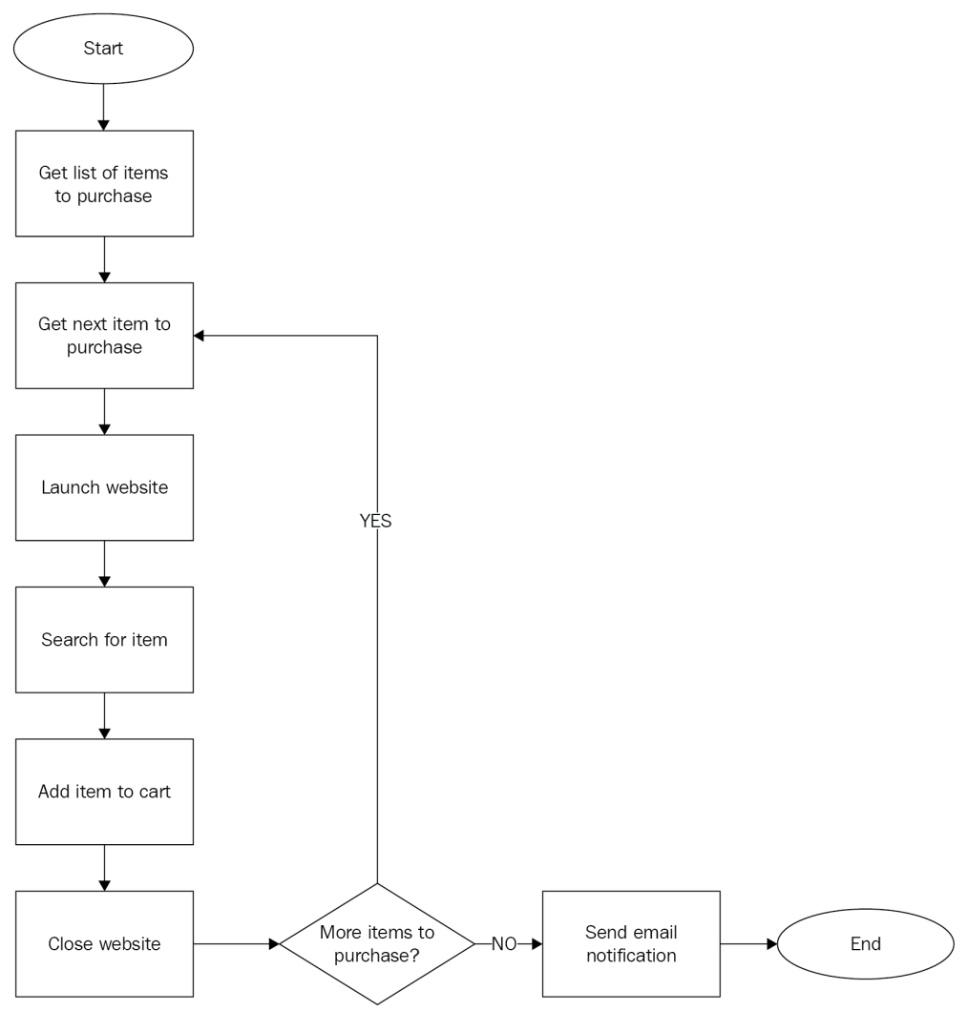
Process diagram

Slide 26
Sales Ordering Processing
Let's start with our second Automation Anywhere project. We will automate the sales order processing.
Organizations generate a sales order (SO) on receiving a purchase order (PO), which is an intent to buy one or more items. The PO specifies the product or service that a customer would like to purchase. The SO is used for inventory and order management.
For this automation project, we will take order data from an Excel spreadsheet and input it into the Orders app in Apptivo – cloud-based business management software.

Slide 27
Technical Requirements
Automation Anywhere A2019 Community Edition. Sign up at https://www.automationanywhere.com/products/community-edition.
A PC with the Automation Anywhere Community Edition A2019 bot agent installed.
Google Chrome with the Automation Anywhere extension installed .
Internet Explorer 11.
Microsoft Excel 2007 or later.
API

Slide 28
Project Overview
As we said, we will create SOs using data from an Excel spreadsheet. Usually, this data comes from POs. For this project, we are assuming that we have an Excel sheet generated from POs. This can be done by the Automation Anywhere IQ bot, which can read POs in PDF format to generate a spreadsheet with data.

Slide 29
Project overview
In this project, we will have an A2019 bot read the SO details from an Excel sheet, which we will place in the Input folder. It will process each row of SO data and input it into the Apptivo Order application. For each order entered into the application, the bot will take the generated SO number and input it into the Excel spreadsheet. Once all the SOs from the Excel sheet have been processed, the bot will move the spreadsheet to a Processed folder.

Slide 30
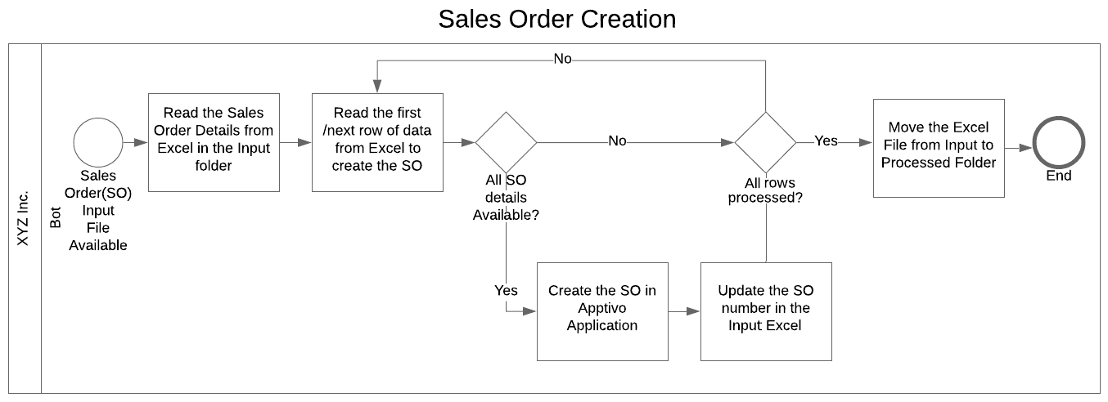
Process Diagram

Slide 31
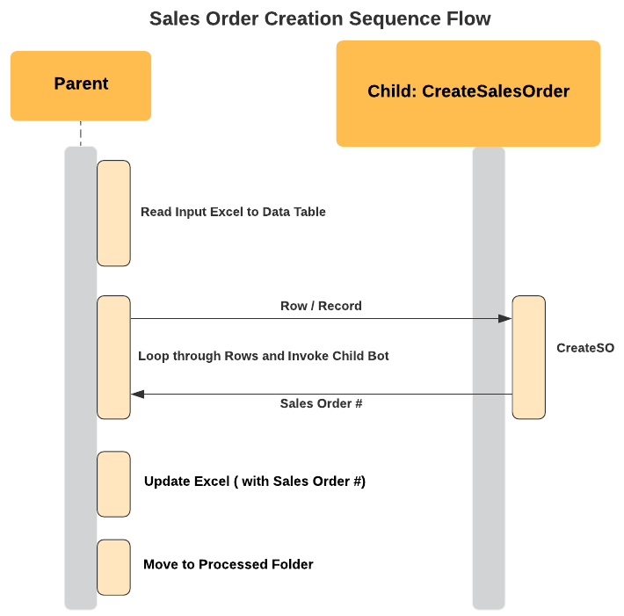
Flow Diagram

Slide 32
Employee Emergency Notifications
You may have come across many situations where your organization needs to reach out to employees urgently.
At the time of writing, the world is going through the Covid-19 pandemic. A virus is one such scenario where an emergency notification needs to be sent to employees. Other such scenarios include hurricanes, floods, wildfires, active shooters, and more.

Slide 33
Employee Emergency Notifications
With Robotic Process Automation (RPA), you can look up your HR system, identify the employees by specific criteria (for example, office, region, and so on), and send mass messages. Since RPA looks up the HR system as it sends messages, it will have up-to-date information regarding the employees that need to be notified.

Slide 34
Employee Emergency Notifications
We will be sending employee notifications by looking up a list of employees in a spreadsheet. The bot will loop through the employee list, read their names and phone numbers, and send Short Message Service (SMS) notifications using the Twilio API. This API will log whether the message was sent successfully or not before moving on to the next employee. The bot continues with this process until all the employees on the list have been processed.

Slide 35
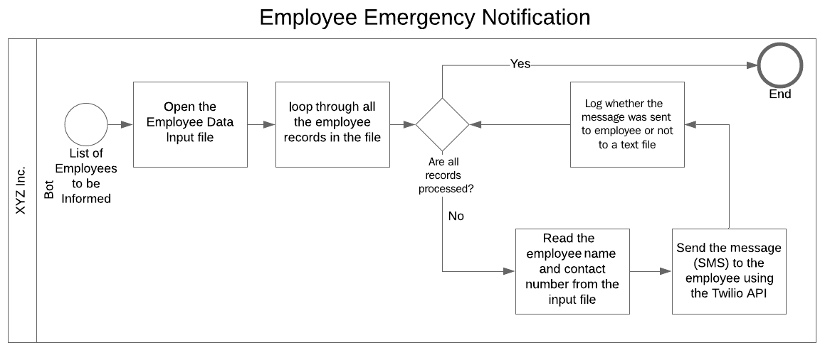
Process Diagram

Slide 36
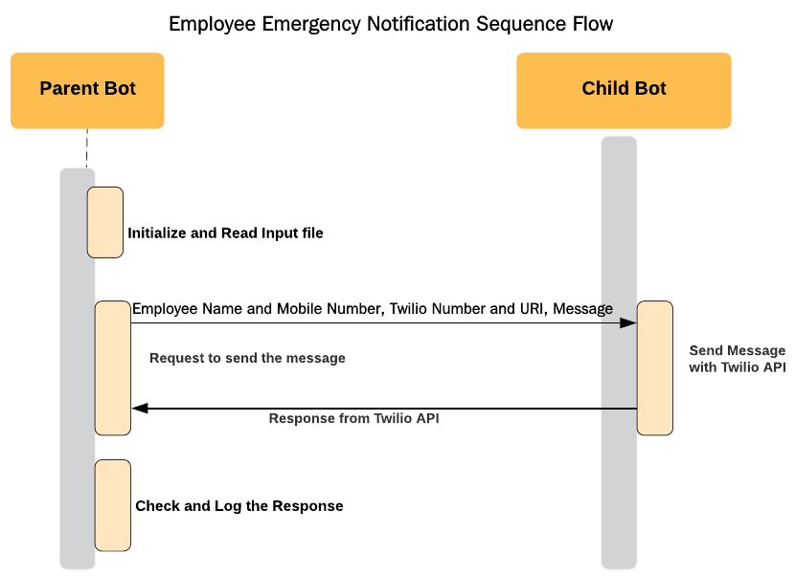
Flow Diagram

