Slide 1
ROI
Welcome to the module on Performing ROI Analysis and Creating an Automation Design. Let us begin by looking at the example of technology firm, Logix. It's finance department has to send financial data such as salary details to other departments on time, whether or not to automate this time consuming process is an important decision for Logix. Business decisions such as this are made after considering a lot of factors.
When it comes to automation it cannot be implemented straight away either. Logix will have to weigh in all the possible scenarios that might arise due to its implementation and then decide accordingly. More specifically the company needs to compare the benefits of automating the process versus the costs involved in doing so. In such instances, return on investment or ROI analysis is performed. It is done right after the complexity assessment is completed.

Slide 2
Let us see why. ROI analysis is a measure of the returns derived from automation compared to the time and costs in implementing automation. It gives you an accurate estimate of overall profits you will earn due to automation and this helps you decide whether to pursue automation of any processes or not.
ROI analysis is typically carried out when you are constructing a business case for implementing automation. For carrying out ROI analysis you need information pertaining to the possible impact of automation on your organization.
You will also need to know the estimated cost of implementing the automation strategy.

Slide 3
ROI
After collecting information related to these points you can utilize the ROI calculator to find out the expected ROI. Based on the results of the ROI and other analyses, you can decide upon automating or not automating any process or task. Once this analysis is over you will have completed all the required key checks and inquiries such as the ones listed here. With these insights, you are ready to start creating automation design before the actual automation development. At Logix after determining all the required parameters, the finance department of the company can create the automation design for the process to be automated. Automation built on an intelligent process design increases efficiency and helps develop sustainable and scalable automation. But is that why it is so very important to create an automation design before moving on to the RPA development phase of the project life-cycle?

Slide 4
ROI
Let's find out. For a robust automated process it's necessary to have in place prerequisites, plans, workflows, and Infrastructure. To determine all these in a simplified and an orderly manner, Logix has created a 10-step process framework. Additionally to be able to manage the entire subsequent RPA project life-cycle more efficiently, they have in place these recommended RPA project documents and checklists.
All in all utilizing such a wholesome framework while creating the automation design gives you an informed method and an effective plan for automating any suitable process, not only this it will also help reduce the time normally spent in documentation, reduce clerical errors, and hold RPA team members accountable for their work, increasing the productivity and efficiency of the overall RPA project.

Slide 5
ROI
That's why organizations like Logix invest in performing return on investment analysis and creating an automation design to determine if creating an automation design can help define everything needed for automation.
This gives a positive kickoff to the subsequent RPA development and testing phase of the RPA project life-cycle. Let's now go ahead and delve deeper into how the ROI analysis is performed and also the procedure of each automation design activity that Logix's financial team is going to execute.
By the end of this module you will be able to, describe the steps to determine the savings and factor in the costs involved in implementing an automation.

Slide 6
ROI
Perform an ROI analysis for automation using the ROI calculator. Perform the 10-step process to determine preliminary information such as prerequisites, plans, workflows, and infrastructure. Enter the information collated from the 10-step process into the process design document. Define requirements for automation development in the requirement gathering document.
Outline the deployment related inputs needed by the production team during deployment in the bot handover document. Maintain details related to RPA projects status throughout the project cycle in the solution design document.
Provide the related tests scenarios to be used by the developers in the test case document. Implement best practice of utilizing checklist documents related to code review and deployment.
Coming back to our example of the technology firm Logix, the finance department will first analyze the returns to be gained after investing in automating the handling of salary slips and create a suitable automation design to proceed.

Slide 7
ROI
When calculating return on investment or ROI, or automation, you need to consider all the inputs pertaining to savings and costs. For example, at Logix, before the finance department decides to automate the salary slip handling process.
It will consider all inputs that will affect the savings and cost of automation. Different categories of possible savings you need to consider in ROI analysis include manual hours saved, quality improvement through error reduction. Productivity gain, improved business agility, increased customer satisfaction and brand awareness, and improved regulatory compliance, and data governance. All of this data combined will determine the total savings in one year.

Slide 8
ROI
Let us look at these categories in detail. Effectively implementing automation helps your organization save manual hours and costs. To find out the manual hours saved, you need information about the number of processes being automated.
Average number of hours saved daily by each process, and number of times the process runs in a week.
Effective automation enables quality improvement through error reduction. The overall number of errors committed reduce and the results for common processes across the organization are consistent. To calculate these cost savings, you need numerical data related to cost per error, number of hours in which an error occurs.

Slide 9
ROI
Productivity gain is another major outcome of automation. Employees can devote more time to tasks involving greater creativity and value. Overall, the organization can achieve much greater efficiency in completing tasks. Thus automation gives you incremental benefits in addition to manual hour savings. To calculate productivity gain, you need to know the percentage improvement in productivity due to hours saved. Automation also improves business agility. Data moves more accurately and quickly. Business margins and soft savings increase.
To calculate these savings, you need information about specific cost savings due to increased reliability of data, improvement in morale, improved margins and other soft savings. A successful automation implementation helps you serve customers more effectively and increase brand awareness.

Slide 10
ROI
To calculate these savings you need information about specific cost savings due to limited customer attrition, decrease in Lost sales and improved customer satisfaction, and service. Finally, on applying automation the overall process is improved and you waste fewer resources on the process. To calculate these savings, you need information about specific cost savings due to improved internal reputation.
Six Sigma waste reduction goals and process improvement, and documentation of processes. After calculating the savings, you need to factor in the costs involved in implementing the automation. These include costs pertaining to setting up and maintaining of Automation Anywhere or AAE software, as well as training employees on automation technology.
On adding up the costs in all these categories, you get the total software and training cost. Let us explore these categories in detail. The first category is the cost of AAE software. This includes the cost of installing, deploying and maintaining AAE software including Automation Anywhere Enterprise platform, additional AAE control rooms.

Slide 11
ROI
Additional AAE development clients or bot creators, and additional AAE runtime clients or bot runners. Finally there is the cost of training employees so that they can utilize AAE software effectively for automating tasks.
ROI is a measure of total profits after accounting for all the costs. By deducting total costs from total savings in a given period, you can determine the ROI for automation in that period. Soft savings are associated with business agility.
So that's how ROI analysis helps organizations like Logix, to compare the benefits of automating a process versus the costs involved in doing so.

Slide 12
Welcome to the AAE return on investment or ROI calculator. ROI analysis is performed using the ROI calculator spreadsheet. Let's see how logix uses this calculator to estimate the overall profits it will earn due to automation. Let us explore the ROI calculator. The ROI calculator is an Excel file containing two sheets: ROI details and ROI summary.
For calculating the net savings due to automation and performing an ROI analysis, you will need to use the ROI details sheet. In this sheet, you will be entering numerical data regarding costs and savings related to automation. The sheet includes the different costs and savings categories that we discussed earlier.
Enter the relevant information for each category like manual hours saved, improved quality through error reduction, productivity gain, business agility, customer satisfaction and brand improvement, regulatory compliance and data governance, and cost of solution.

Slide 13
ROI
Thus, you will get the data on the saving for each of the categories. After you have calculated the savings and cost, the total savings summary section will display the gross value of all savings, and the net savings is derived by subtracting automation costs from total savings.
The share of each category in the total savings is visible in the pie chart named savings by category. Similarly, the ROI summary sheet presents a comprehensive textual and graphical report of different business value parameters such as the ROI and profit percentages involved in automation.

Slide 14
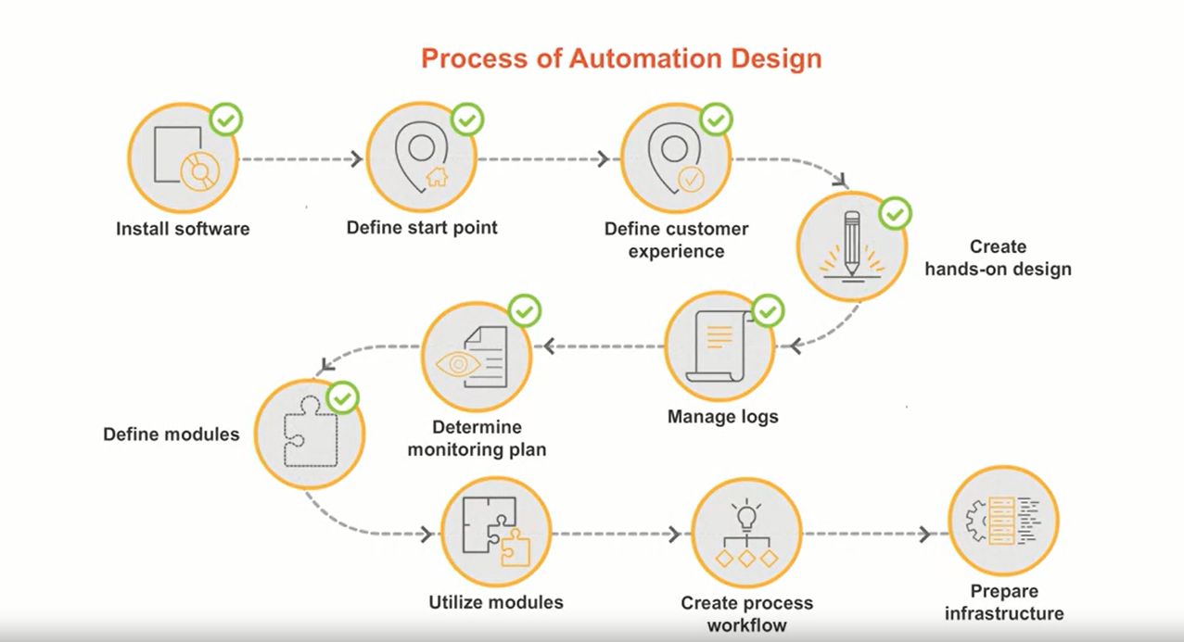
Creating a Automation Design

Slide 15
Performing Process Steps
Logix's finance department is implementing the 10-step automation design process to collate preliminary information for automating their task related to salary handling. Let's see how they are going about this.
The 10-step process has been created to help you in a simplified and orderly manner initiate the designing of the process to be automated. Let's find out about each of these steps, one by one.
Step 1 is installing the required software for automation. You must install all the necessary components of Automation Anywhere Enterprise, or AAE on all systems where the process will execute. Also, ensure that you provide necessary system permissions to the application, so that the automation execution can be completed unhampered.
Step 2 is defining the start point for automation. You need to establish starting factors like interfaces, unique identifiers, and other information related to the fields that you're extracting from and/or inputting to.
Step 3 is about defining customer experience. You can usually determine this by outlining the end goal output details, such as who, what, and how's about the output customers training requirements, and the related modifications or improvements that may be required.

Slide 16
Performing Process Steps
Step 4 is creating hands-on design. You need to predict potential problems and scenarios that might come up in automation, and also identify their solutions.
Step 5 is managing logs. Here, you need to figure out ways to smartly handled the huge amount of corresponding data generated during the automation process. For this, note down information related to events, error logs, and their reviewers.
Step 6 is determining monitoring plan. Here, you need to define and distribute monitoring duties. Note down ways of handling situations related to continuation of the automation, interruption, restart, error notification, and output handling.
Step 7 is defining modules. Here, you need to classify each automation unit in a process as sub-task modules, executable modules, and/or template modules, depending on how these modules are supposed to be executed. A sub-task module is a freestanding automation that can be executed via a run task within the main task, to complete a portion of the end-to-end process. An example of this module can be an automation related to logging onto customer relationship management or CRM or salesforce. On the other hand, an executable module is a freestanding automation that is meant to be executed once to perform a specific action, such as creating all folders necessary for task development. The third type of module, a template module, is a section of AAE commands and variables that can be copied and pasted into a task to speed up the development process, and to keep all tasks consistent. For example, defining task folders and associated variables for task development

Slide 17
Performing Process Steps
Step 8 is utilizing modules defined in the previous step. In this step, you need to execute and observe the modules to see how they work. While executing a sub-task module, note down list of non vital sections, identify their value, check re-usability of the standalone sub-task modules, if any, and also check for intermediate outputs. While executing an executable module, check if it is performing the specified action. While executing a template module, check if it is able to reduce efforts of the development process, while keeping all tasks consistent.
Step 9 is creating process workflow. This step is all about determining and noting down the workflow, based on effectiveness, personnel, and stakeholders.
Finally, the last step 10 is preparing Infrastructure for deployment of automation. For this, you need to assess and note down all the required infrastructural elements. You may contact the respective parties handling the infrastructure to obtain the required information. There you go. These 10 steps will pave your way for a robust automation design, and set you up for a promising and productive automation development. Next, you need to fill all the notes and observations you correlated while performing all these steps in the respective sections of the process design template.

