Slide 1

SPARK – INTRODUCTION
Hadoop Framework:
Purpose: Used extensively by industries to analyze large datasets.
Programming Model: Based on MapReduce, which is simple and efficient.
Advantages:
Scalable
Flexible
Fault-tolerant
Cost-effective
Challenge: Maintaining speed in processing large datasets, including:
Query waiting time
Program execution time

Slide 2
Introduction of Apache Spark:
Reason for Development: Spark was introduced to speed up the computational process of Hadoop.
Independent Framework:
Spark is not a modified version of Hadoop.
It has its own cluster management and doesn’t depend on Hadoop.
Relationship with Hadoop:
Hadoop is one of the ways to implement Spark.
Spark uses Hadoop only for:
Storage purposes.
Processing, when needed.

Slide 3
Apache Spark
Apache Spark is a lightning-fast cluster computing technology, designed for fast computation. It is based on Hadoop MapReduce and it extends the MapReduce model to efficiently use it for more types of computations, which includes interactive queries and stream processing. The main feature of Spark is its in-memory cluster computing that increases the processing speed of an application. Spark is designed to cover a wide range of workloads such as batch applications, iterative algorithms, interactive queries and streaming. Apart from supporting all these workload in a respective system, it reduces the management burden of maintaining separate tools.
Evolution of Apache Spark
Spark is one of Hadoop’s sub project developed in 2009 in UC Berkeley’s AMPLab by Matei Zaharia. It was Open Sourced in 2010 under a BSD license. It was donated to Apache software foundation in 2013, and now Apache Spark has become a top level Apache project from Feb-2014.

Slide 4
What is Unified-
Sparks is designed to support wide range of task over the same computing engine.
For e.g. – Data scientist , Data analyst and Data engineer all can use the same platform for their analysis , transformation or modeling.
What is Computing Engine-
Sparks is limited to a computing engine. It doesn’t store the data.
Spark can connect with different data source like S3 , HDFS, JDBC/ODBC , Azure storage etc.
Sparks works with almost all data storage system.
What is Parallel Data Processing -
Parallel data processing is like dividing a big task into smaller parts and working on them at the same time to finish it faster.

Slide 5
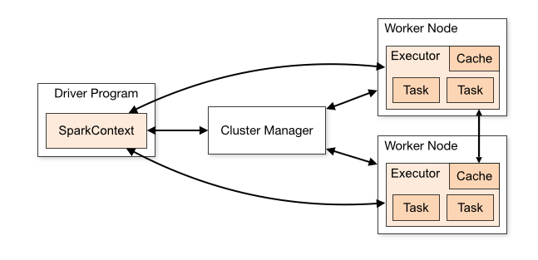
What is Cluster Computing -
Cluster computing is like teamwork among computers to solve big problems. It involves multiple computers (or servers) working together as a single system to perform tasks, process data, or run applications.
Driver Program
The Driver Program is where the main code of your application runs.
Inside it, there is a SparkContext, which acts as the entry point for all the Spark functionalities.
Think of SparkContext as the "brain" that coordinates everything.
Cluster Manager
The Cluster Manager manages the resources (like CPU and memory) in the cluster.
It is responsible for assigning tasks to worker nodes based on available resources.
The Driver Program communicates with the Cluster Manager to schedule tasks.
Worker Nodes
These are the machines that do the actual work (processing the data).
Each Worker Node has:
Executor: A small program that runs on the worker node. It is responsible for:
Running Tasks (small units of work).
Storing intermediate data in its Cache to speed up processing.
The Driver Program plans what to do.
The Cluster Manager organizes the workers.
The Worker Nodes execute the tasks and store data temporarily if needed.

Slide 6
Features of Apache
Spark Apache Spark has following features.
Speed: Spark helps to run an application in Hadoop cluster, up to 100 times faster in memory, and 10 times faster when running on disk. This is possible by reducing number of read/write operations to disk. It stores the intermediate processing data in memory. 1. SPARK – INTRODUCTION Apache Spark 2
Supports multiple languages: Spark provides built-in APIs in Java, Scala, or Python. Therefore, you can write applications in different languages. Spark comes up with 80 high-level operators for interactive querying.
Advanced Analytics: Spark not only supports ‘Map’ and ‘reduce’. It also supports SQL queries, Streaming data, Machine learning (ML), and Graph algorithms.

Slide 7
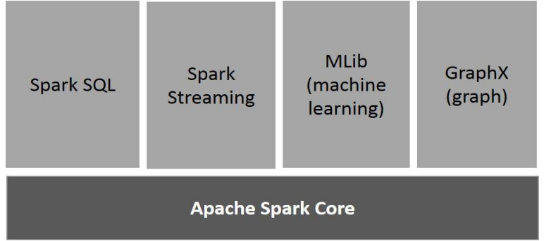
Components of Spark
Apache Spark Core : Spark Core is the underlying general execution engine for spark platform that all other functionality is built upon. It provides In-Memory computing and referencing datasets in external storage systems.
Spark SQL Spark : SQL is a component on top of Spark Core that introduces a new data abstraction called SchemaRDD, which provides support for structured and semi-structured data.
Spark Streaming : Spark Streaming leverages Spark Core's fast scheduling capability to perform streaming analytics. It ingests data in mini-batches and performs RDD (Resilient Distributed Datasets) transformations on those mini-batches of data.

Slide 8
MLlib (Machine Learning Library) : MLlib is a distributed machine learning framework above Spark because of the distributed memory-based Spark architecture. It is, according to benchmarks, done by the MLlib developers against the Alternating Least Squares (ALS) implementations. Spark MLlib is nine times as fast as the Hadoop disk-based version of Apache Mahout (before Mahout gained a Spark interface).
GraphX : GraphX is a distributed graph-processing framework on top of Spark. It provides an API for expressing graph computation that can model the user-defined graphs by using Pregel abstraction API. It also provides an optimized runtime for this abstraction.

Slide 9

Apache Spark
In the modern data landscape, businesses deal with massive volumes of data in diverse forms. Traditional databases like Oracle, Teradata, and MySQL were designed to handle structured data efficiently but face limitations with:
Semi-structured data (e.g., JSON, XML)
Unstructured data (e.g., images, videos, logs)
Modern data processing requires a system that can handle:
Velocity: The speed at which data is generated (e.g., real-time sensor data, streaming logs).
Variety: The diversity in data formats (structured, semi-structured, and unstructured).
Volume: The massive scale of data (terabytes to petabytes).
ETL vs. ELT
Earlier Approach: ETL (Extract, Transform, Load)
Data was transformed first before loading it into storage systems like data warehouses.
Transformation limited scalability as the process was centralized.
Modern Approach: ELT (Extract, Load, Transform)
Data is loaded first into distributed storage systems (like Hadoop HDFS, cloud storage).
Transformations happen post-load using distributed computing frameworks like Apache Spark.
ELT provides greater flexibility and scalability, especially for processing diverse datasets.

Slide 10
The Two Key Challenges
Storage: Traditional systems struggle to store vast, varied data efficiently.
Processing: Legacy systems are often incapable of processing large datasets quickly, especially when dealing with real-time or batch processing needs.
Solutions to These Challenges
There are two architectural approaches to solve the issues of storage and processing:
Monolithic Architecture:
Centralized systems where storage and computation occur in a single machine or tightly coupled environment.
Issues:
Lack of scalability as data grows.
Single point of failure.
High latency for large-scale data processing.
Distributed Architecture:
Storage and processing are distributed across multiple nodes in a cluster.
Systems like Hadoop and Spark excel in this approach.

Slide 11
Spark Architecture
The Spark follows the master-slave architecture. Its cluster consists of a single master and multiple slaves.
The Spark architecture depends upon two abstractions:
Resilient Distributed Dataset (RDD)
Directed Acyclic Graph (DAG)

Slide 12

Introduction to Scala Programming Language
Scala is a modern programming language that combines the features of object-oriented programming (OOP) and functional programming (FP). It is designed to be concise, scalable, and efficient, making it a popular choice for big data, machine learning, and web applications.
Basic Fundamentals of Scala Programming
Object-Oriented and Functional:
Scala supports object-oriented programming, where you work with classes and objects.
It also supports functional programming, which allows you to write code using functions and immutability.
Statically Typed:
Scala is a statically typed language, meaning you declare the type of a variable or let Scala infer it for you.
Runs on the JVM:
Scala is built to run on the Java Virtual Machine (JVM), so it can use Java libraries and frameworks.

Slide 13
Uses of Scala Programming
Big Data:
Widely used in big data tools like Apache Spark.
Web Development:
Used for creating scalable web applications.
Machine Learning:
Provides support for libraries like Breeze for numerical computing.
Backend Development:
Great for building reliable and concurrent server-side applications
Advantages of Scala Programming
Conciseness:
Less code is required compared to Java for similar functionality.
Interoperability:
Fully compatible with Java, so you can use Java libraries in Scala.
Scalability:
As the name suggests, Scala is designed for scalability, making it ideal for large applications.
Concurrency Support:
Provides better support for concurrent and parallel programming.

Slide 14
Sr.No | Data Type & Description
1 | Byte - 8 bit signed value. Range from -128 to 127
2 | Short - 16 bit signed value. Range -32768 to 32767
3 | Int - 32 bit signed value. Range -2147483648 to 2147483647
4 | Long - 64 bit signed value. -9223372036854775808 to 9223372036854775807
5 | Float - 32 bit IEEE 754 single-precision float
6 | Double - 64 bit IEEE 754 double-precision float
7 | Char - 16 bit unsigned Unicode character. Range from U+0000 to U+FFFF
8 | String - A sequence of Chars
9 | Boolean - Either the literal true or the literal false
10 | Unit - Corresponds to no value
11 | Null - null or empty reference
12 | Nothing - The subtype of every other type; includes no values
13 | Any - The supertype of any type; any object is of type Any
14 | AnyRef - The supertype of any reference type

Slide 15
Types of Variables in Scala
var:
Mutable variable (its value can be changed).
Example: var x = 10
val:
Immutable variable (its value cannot be changed).
Example: val y = 20
lazy val:
A variable whose value is computed only when it is accessed.
Example: lazy val z = 30
def:
Defines a function or value that is calculated when called.
Example: def multiply(a: Int, b: Int) = a * b

Slide 16
String Function :
Here are some commonly used format specifiers:
%s - String
%d - Decimal integer
%f - Floating-point number
%c - Character
%b - Boolean
%x - Hexadecimal integer
%o - Octal integer
%e - Scientific notation (lowercase)
%E - Scientific notation (uppercase)
%g - General format (uses %f or %e based on the value)
%a - Hexadecimal floating-point number

