Slide 1

TERRAFORM

Slide 2

TERRAFORM
Contents
Introduction to Infrastructure as a Code (IaC)
Features of Infrastructure as a Code (IaC)
Introduction to Terraform
Terraform highlights
Terraform Components
Providers
Configuration Syntaxes
Modules

Slide 3


INFRASTRUCTURE as a CODE (IaC)
Infrastructure as a Code (IaC)
Infrastructure management – Traditional way
Traditionally infrastructure was configured manually
Scripts (Platform Specific)
Graphical User Interface
Manual configuration would pose below challenges
Scalability
Consistency depends on accuracy of manual configuration
Configuration Drift
Difficult to document
Difficult to keep multiple environments in lockstep

Slide 4
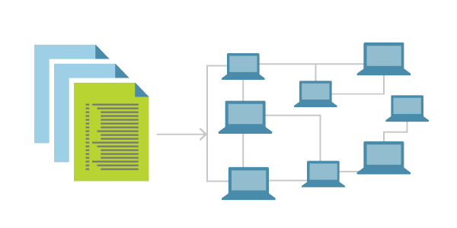
INFRASTRUCTURE as a CODE (IaC)
Infrastructure as a Code (IaC)
Infrastructure management – through code (IaC)
Above challenges can be addressed through IaC
IaC allows us to configure infrastructure programmatically, through code
Definition
IaC is a process of provisioning, managing various resources in computer data centers through machine readable code rather than manual configuration
Allows for automation of the creation and modification of infrastructure
Can be Imperative or Declarative
Advantages of IaC
Speed
Consistency
Accountability
Lower cost

Slide 5
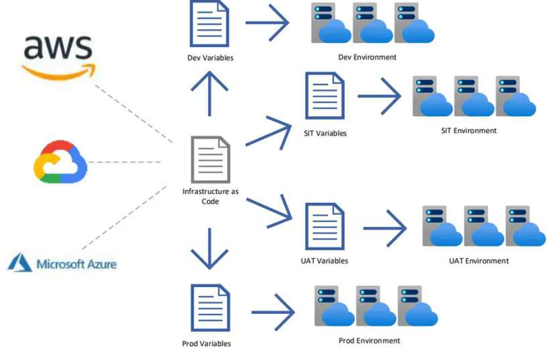
INFRASTRUCTURE as a CODE (IaC)
Features of Infrastructure as a Code (IaC)
Codify infrastructure provisioning
Version control infrastructure
Consistency
Speed
Facilitate cost savings
Single source of truth
Accountability
Team Collaboration (CI)
CI/CD Pipelines
Simplify, Standardize, and scale at ease
Static Application Security Testing (SAST)

Slide 6
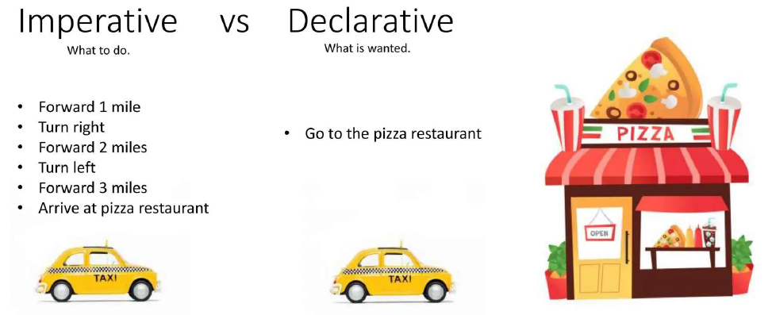
INFRASTRUCTURE as a CODE (IaC)
Infrastructure as a Code (IaC) – Imperative vs Declarative

Slide 7
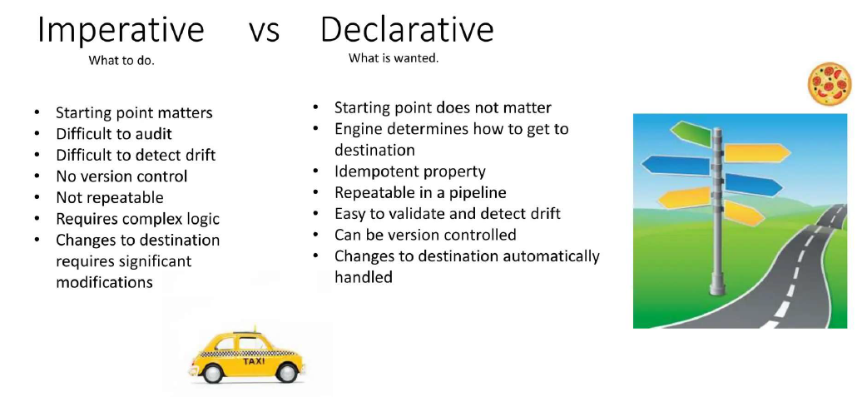
INFRASTRUCTURE as a CODE (IaC)
Infrastructure as a Code (IaC) – Imperative vs Declarative

Slide 8
TERRAFORM
TERRAFORM - Introduction
Terraform is an Infrastructure-as-Code (IaC) tool that enables you to build, change, and version cloud and on-premises resources safely and efficiently.
It is an IaC tool offered by HashiCorp
Terraform is used to:
Build infrastructure
Maintain infrastructure
Version infrastructure
Terraform improves the efficiency of infrastructure management
HashiCorp Configuration Language (HCL)

Slide 9
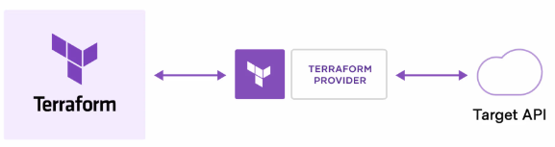
TERRAFORM
How Does Terraform Work?
Terraform creates and manages resources on cloud platforms and other services through their application programming interfaces (APIs).
Providers enable Terraform to work with virtually any platform or service with an accessible API.
Provider is a plugin that:
Enables Terraform to interact with the target platform
Understands API interactions of that platform
Exposes resources available in it
Terraform Language
Declarative Language
It serves the purpose of declaring a resource
Resources represent infrastructure objects

Slide 10
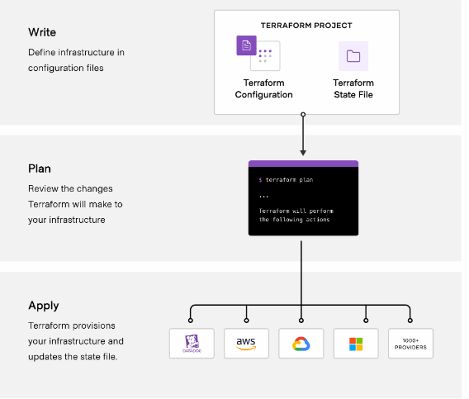
TERRAFORM
How Does Terraform Work?
The core Terraform workflow consists of three stages
Write: The user defines resources, which may be across multiple cloud providers and services.
Plan: Terraform creates an execution plan describing the infrastructure it will create, update, or destroy based on the existing infrastructure and your configuration.
Apply: On approval, Terraform performs the proposed operations in the correct order, respecting any resource dependencies.

Slide 11
TERRAFORM
Terraform Language Syntax
Configuration Syntax
Describes the native grammar of the Terraform language
Based on Hashi Corp's proprietary HCL (Hashi Corp Configuration Language)
Easy for humans to read and write
JSON Configuration Syntax
Describes how to represent Terraform language constructs in JSON format
Harder for humans to read and edit
Easier to generate and parse programmatically

Slide 12

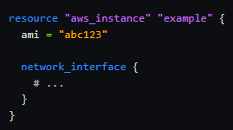
TERRAFORM
Terraform Language Syntax (Contd.)
Terraform Language Key Constructs
Built around two key syntax constructs: arguments and blocks
Arguments
An argument assigns a value to a particular name
The identifier before the equals sign is the argument name
The expression after the equals sign is the argument's value
Blocks
A block is a container for other content
A block starts with a keyword that represents its type
Block type defines how many labels must follow the type keyword
Some block types do not need any labels
Block body
Starts with a { after the labels (if any label exists)
Ends with }
Contains further arguments
Can contain other blocks (nested blocks)
Argument Name
Argument Value
Labels
Block type key word
Nested block

Slide 13
TERRAFORM
Terraform Language Syntax (Contd.)
Terraform Language Data Types
Data types of argument values
Primitive
Lists
Maps
The Primitive data types are:
String → enclose in double quotes
Number → By default, numbers are base 10
Boolean → true, false (NOTE: enclose in double quotes for TF < 0.12 – “true”, “false”)
Lists are made with square brackets [].
Example: [“London”, “New Delhi", “New York”]
Maps are made with braces {} and colons :
Example: {“Firstname”: “David”, “Lastname”: “Phillips”}

Slide 14
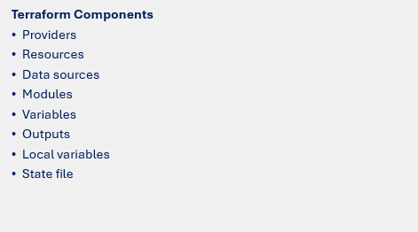
TERRAFORM
Terraform - Components

Slide 15
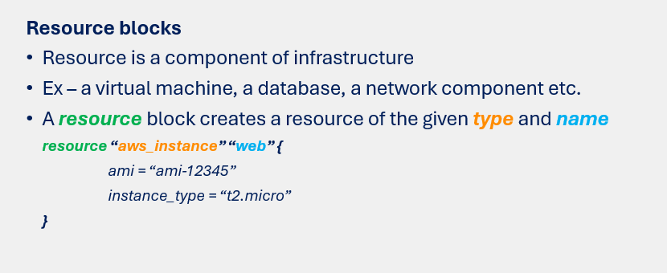
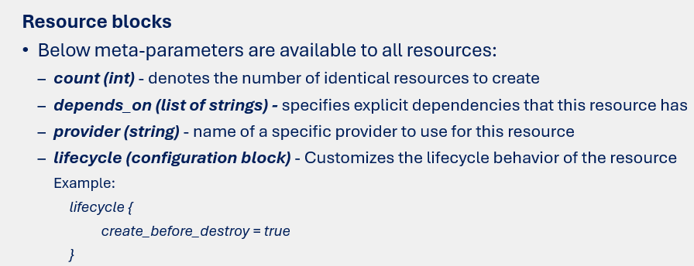
TERRAFORM
Terraform - Components

Slide 16
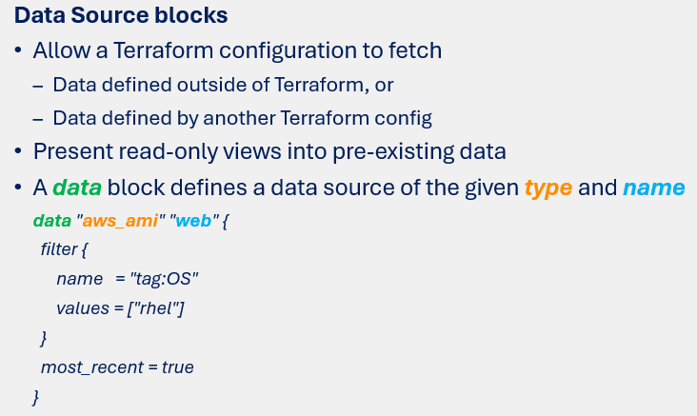
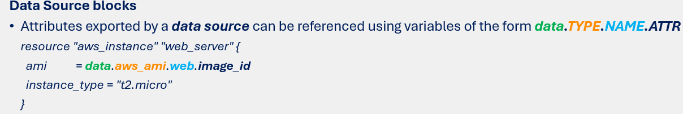
TERRAFORM
Terraform - Components

Slide 17
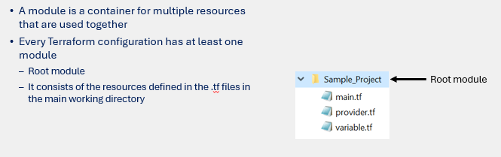
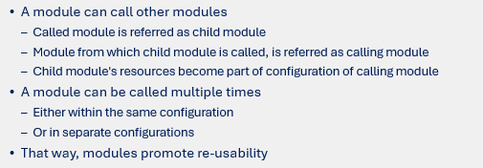
TERRAFORM
Terraform – Components: Modules

Slide 18
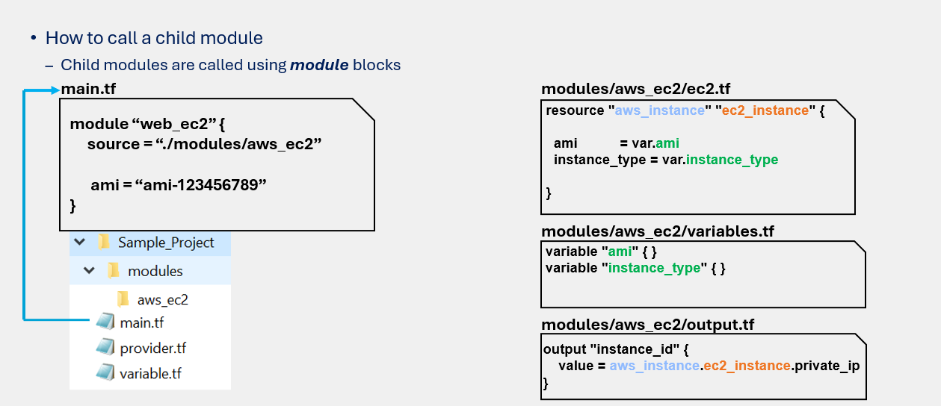
TERRAFORM
Terraform – Components: Modules (Contd.,)

Slide 19
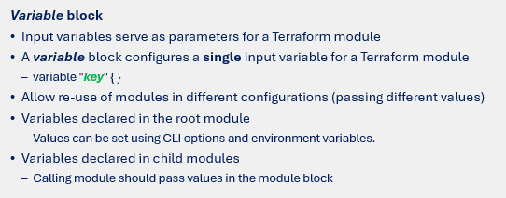
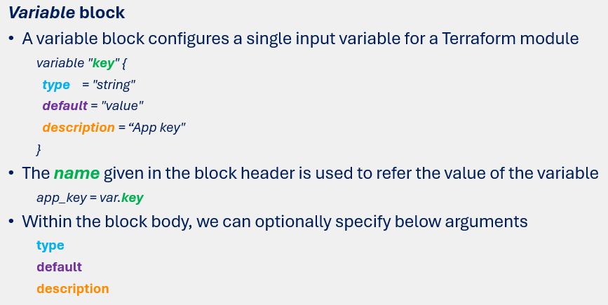
TERRAFORM
Terraform – Components: Input Variables

Slide 20
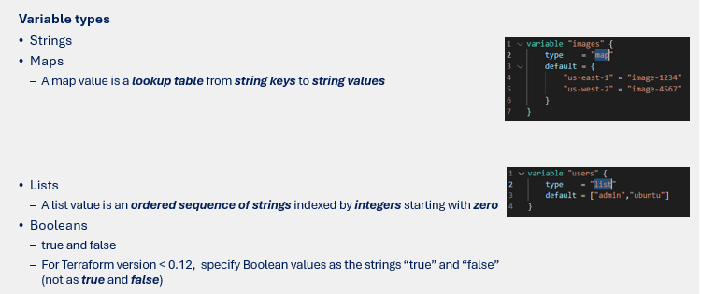
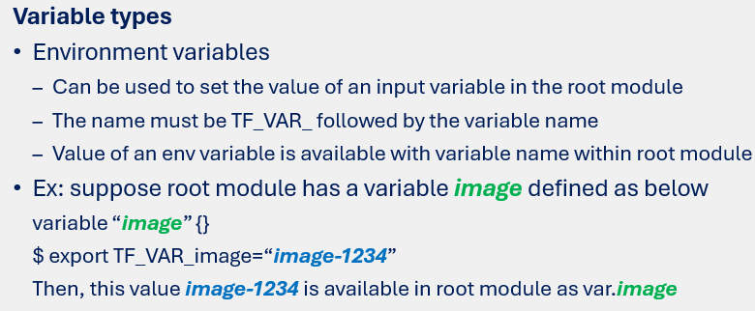
TERRAFORM
Terraform – Components: Input Variables (Contd.,)

Slide 21
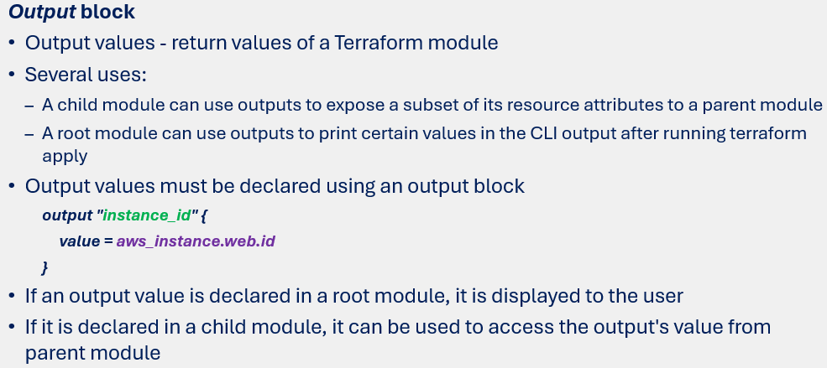
TERRAFORM
Terraform – Components: Output Block

Slide 22
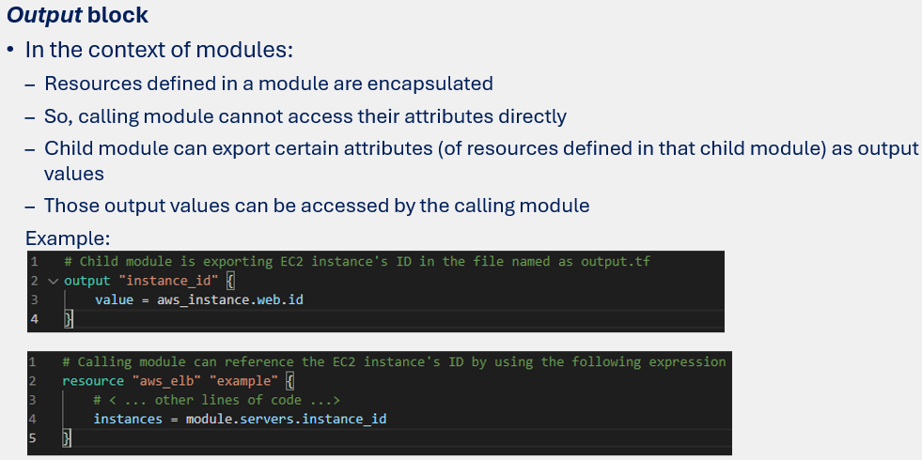
TERRAFORM
Terraform – Components: Output Block

Slide 23
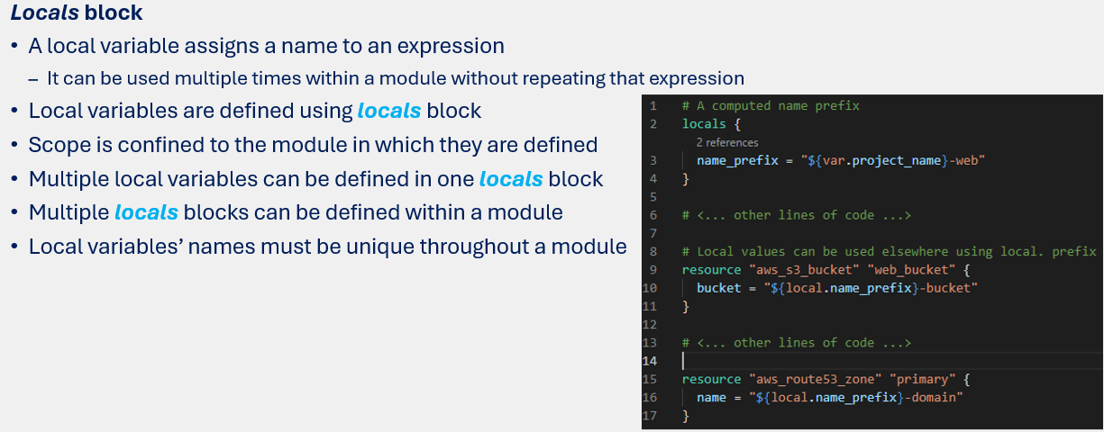
TERRAFORM
Terraform – Components: Local Block

Slide 24
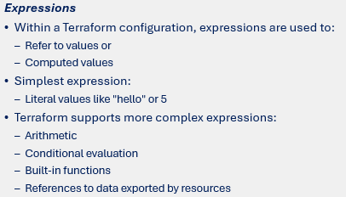
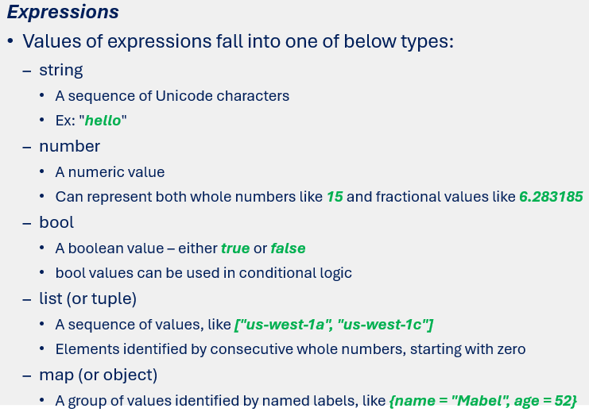
TERRAFORM
Terraform – Components: Expressions

