Slide 1
Development of an E-commerce Chatbot
Presented by: Kolupoti Sai Prakash

Slide 2
Objective
To design and implement a smart, user-friendly sales chatbot for an e-commerce platform that enables:
Product search using natural language queries
Filtering by price and rating
Real-time, interactive product exploration

Slide 3
Technology Stack
Frontend: React.js, HTML5, CSS3
Backend: Python Flask
Database: SQLite
Deployment: Vercel (Frontend), Render (Backend)
Version Control: Git & GitHub

Slide 4
App Features
User authentication (login interface)
Chatbot interface for queries
Product cards with image, rating, and availability
Reset conversation feature

Slide 5
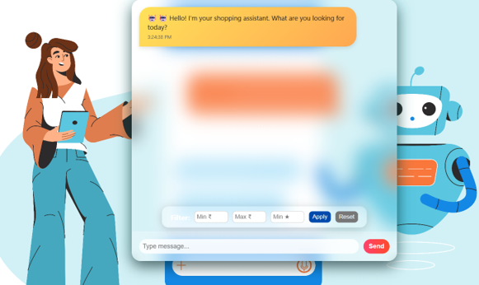
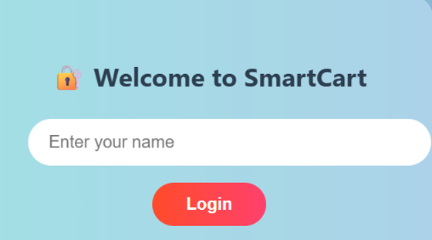
Screenshots

Slide 6
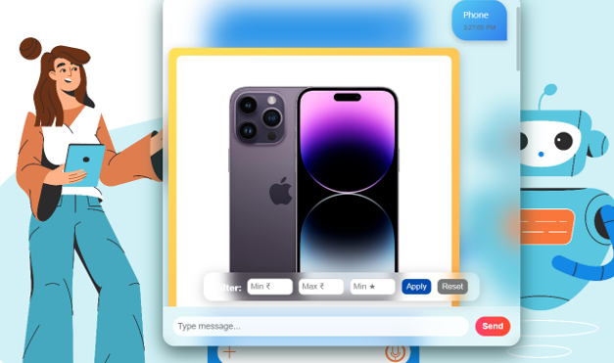

Screenshots

Slide 7
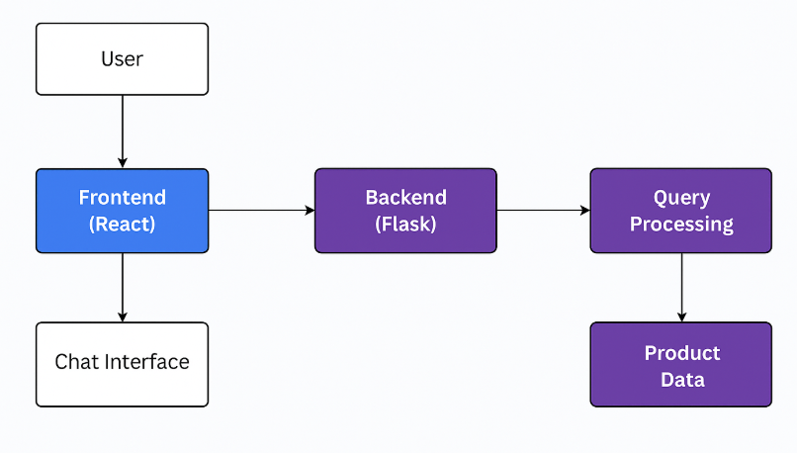
Architecture

Slide 8
Challenges & Learnings
Challenge | Solution
Handling NLP queries | Used keyword parsing with fallback
CORS errors | Integrated Flask-CORS
Responsive UI | CSS Grid + Flexbox
Backend connection | Correctly routed API with Render
GitHub conflicts | Used proper pull and merge commands

Slide 9
Live Links
Frontend (Vercel): https://ecommerce-chatbot-gilt.vercel.app/login
Backend (Render): https://ecommerce-chatbot-backend-jn1d.onrender.com
GitHub Repository: https://github.com/saikolupoti/ecommerce-chatbot-backend

