Slide 1
The Relevance of Intellectual Property
in the International Context
Israel, December 5, 2005
Guriqbal Singh Jaiya
Director, SMEs Division
World Intellectual Property Organization (WIPO)
Geneva, Switzerland

Slide 2
Avoiding Common Pitfalls:
Intellectual Property and Exports

Slide 3

Taking the Decision
to Export
Exporting involves considerable investments in financial, managerial and production resources.
Importance of an Export Plan:
  to develop a a clear export strategy
  to determine a product’s readiness
  for export
  to determine if there is a market for the product/service abroad
  help to obtain funds for exporting
Notes:
Survey 2000 PWC. USA: Fortune 1000 companies suffer US$ 45billion per year lost business information. Problem accelerating last years.

Slide 4

Taking the Decision to Export
Key issues when exporting:
  identifying export markets
  estimating demand
  finding local partners and channels of distribution
  adapting the product / design / brand / packaging
  contractual agreements with export sales reps, distributors, licensees, local manufacturers, etc
  determining price
  making transport arrangements
  advertising and marketing the product

Slide 5
Taking the Decision to Export
WHAT ABOUT INTELLECTUAL PROPERTY?

Slide 6
IP and Exports
Firstly, IP is an important consideration in some of the above points:
  Pricing of the product will partly depend on the extent to which the trademark is recognized and valued by consumers, and the extent to which product will face competition from rival products
  Adaptation of product / brand / design / packaging, will involve creative or inventive work that may be protected through the IP system

Slide 7


IP and Exports
  In raising funds, patents, but also trademarks may be important for convincing investors, venture capitalists, etc.
  In agreements with local partners it will be important to clarify issues of ownership of IP rights, particularly if the product will be manufactured, packaged or modified abroad

Slide 8
IP and Exports
  Marketing and advertising campaigns will rely strongly on the brand/trademark which if unprotected would be much more difficult to enforce
  The timing of participation in fairs may be affected by the timing of your applications for IP protection

Slide 9
IP and Exports
Secondly, protecting IP in export markets may help a company to prevent others from imitating or copying the product (or parts of it) without authorization.
Thirdly, IP protection may enable a company to access new markets through licensing, franchising, joint ventures or other contractual agreements with other companies.

Slide 10

IP and Exports
Fourthly, failure to consider IP issues may result in fatal losses if your products are considered to be infringing the rights of others
Exporters often realize the importance of protecting their IP once it is too late: e.g. once they have missed the deadlines for application or once their product or brand has been copied.

Slide 11

10 Points to Remember for
Avoiding Common Pitfalls
1. IP protection is territorial
Example: if you have applied for and obtained patent protection for your innovative product in your own country, you will NOT benefit from similar protection in other countries unless you have also obtained protection in those countries.
Exceptions:
  Copyright and related rights:
  automatic protection in over 150 countries
  Trade secrets: no formal registration.

Slide 12
10 Points to Remember
2. IP laws and procedures are not identical world-wide
Example 1: trademark protection use vs. registration
Example 2: first-to-file system for patents vs. first-to-invent system
Example 3: software protection (copyright vs. patents)
Example 4: designs or works of applied art (copyright vs. industrial design protection)

Slide 13
10 Points to Remember
3. Ensure that your product does not infringe IP rights of others: analyze your “freedom to operate”
Example 1: the same trademark may already exist in the export market
Example 2: it is possible that a given technology is not patented in your country but is patented elsewhere
Example 3: you may have a license to use a given technology in your own country, but you do not have the right to use it in an export market

Slide 14
10 Points to Remember
4. There are regional and international protection systems that may be useful for saving time and money and simplifying procedures for applying for protection in various countries.
International Systems:
- Industrial Designs: The Hague System
- Trademarks: The Madrid System
- Patents: The Patent Cooperation Treaty or PCT

Slide 15
10 Points to Remember
Regional Systems (may also be used by applicants from outside the regions)
- African Regional Industrial Property Office
- Benelux Designs and Benelux Trademarks Offices
- Eurasian Patent Office
- European Patent Office
- Office for the Harmonization of the Internal Market (TMs and IDs in EU)
- Organisation Africaine de la Propriété Intellectuelle
- Patent Office of the Cooperation Council for the Arab States of the Gulf

Slide 16

10 Points to Remember
5. There are deadlines for applying for IP protection abroad
Once you have applied for patent or design protection in your home country you have a limited period of time (called the “priority period”) to apply for the protection abroad. Once the priority period has lapsed, if you have not filed an application, it will be too late.
Patents: 12 months
Designs: 6 months
Trademarks: 6 months*

Slide 17



10 Points to Remember
6. Early disclosure of your product without protection is risky
Example: if you disclose your product to trade partners (e.g., export sales representatives) without a non-disclosure agreement or you publish your new product in a catalogue, brochure, etc. prior to applying for protection you may lose your invention or design to others or find you may no longer protect it.

Slide 18

10 Points to Remember
7. Clearly define issues pertaining to IP ownership with partners
Example: If you are developing a new product with another enterprise, establishing a joint venture, or modifying the design, package or trademark of a product, ensure that it is clear (preferably in the written contract) who will be the owner of any IP generated.

Slide 19
10 Points to Remember
8. To license IP in a foreign market, the IP needs to be first protected in that market
Companies seeking to license the manufacturing of their product in a number of markets, should ensure that their IP is protected and is not in the public domain in those markets (e.g. protection has been obtained and has not expired)

Slide 20
10 Points to Remember
9. A country’s policy on parallel importing may affect a company’s export and pricing strategy
Parallel importing relates to whether a product bought by another company may be introduced into a different country (where its IP is protected) without the authorization of the right holder. This may, for example, affect a company’s pricing strategy in foreign markets.

Slide 21
10 Points to Remember
10. Prior to launching a product under a given trademark, it is important to check whether the trademark has undesirable connotations and/or whether an application for its registration as a trademark may be rejected in that country.
Examples: Ford NOVA, in Spanish means “does not go or work”; PAJERO literally means “straw dealer” but is also slang for masturbation

Slide 22
THE HAGUE SYSTEM
FOR THE INTERNATIONAL REGISTRATION OF INDUSTRIAL DESIGNS

Slide 23
Registered v. Unregistered Rights
copyright
UCD in EU
Cr
D
GP
R?
To register or not to register :
- pros and cons of registration
- options for an international strategy

Slide 24
To Register or Not to Register
Advantages of Registration
  Broader, Stronger, Easier to enforce protection
Disadvantages
  Costs
  Formalities
  Effect of the “Territoriality of Rights”

Slide 25
Usual Applicable Formalities for National Filings of Industrial Designs
Specific application form
could be « single » filing
drawings or photographs
address for service
priority document
statement of utility
identity of creator
assignment deed
translation
legalization of documents
payment in local currency
Office A
A

Slide 26
International Protection Strategy (I)
Concepts of Filing + Territoriality =
Multiplication of formalities
------
------
------
------
------
------
B
C
------
------
------
------
------
------
D
E

Slide 27
International Protection Strategy (II)
Using the Hague Agreement
-------
-------
-------
-------
B
D
WIPO
A
C
E
Single application having effect in several countries

Slide 28
Options for an international strategy
The Hague System in a Nutshell
Allows for the Registration of Industrial Designs
  in up to 36 Contracting Parties
  through a single procedure
  in a single language (E or F)
  by paying a single set of fees
… still, as an applicant
  you select the countries that you want
  you get independent assignable national rights
  but have only one central title that you need to manage

Slide 29
Overview
Procedural Agreement under Art. 19 PC
  does not define conditions for protection
  protection is afforded under national law
Three Acts of the Hague Agreement :
  the London Act (1934 Act);
  the Hague Act (1960 Act) [99% of new filings]
  the Geneva Act (1999 Act)
    will enter into force on December 23, 2003
    operations will start on April 1st, 2004

Slide 30
The 1999 Geneva Act : 2 Aims
Enlargement of the Hague Union
  Respond to the needs of examining offices
  International organizations
Modernizing the System
  in particular for the textile and clothing sectors by
    allowing deferment of publication up to 30 months (with the possibility of decreasing the publication fee)
    allowing 2-D samples instead of reproductions

Slide 31
Basic Principles
Who may file under the Hague Agreement ?
- “Closed” system, opened only to “nationals” of Member States
- “Nationals” : natural persons or legal entities having the nationality of, or a domicile or a real and effective commercial or industrial establishment on the territory of a Member State (see Art. 3 PC). Under the 1999 Act, an habitual residence will suffice.

Slide 32
Hague Membership

Slide 33
Member States
Belgium Greece Netherlands Belize Holy see Republic of Moldova Benin Hungary Romania
Bulgaria Iceland Senegal
Côte d’Ivoire Indonesia Serbia and Montenegro
Democratic People’s Italy Slovenia
Republic of Korea Kyrgyzstan Spain
Egypt Liechtenstein Suriname
Estonia Luxembourg Switzerland France Monaco The F.Y.R. of Macedonia
Gabon Mongolia Tunisia
Georgia Morocco Ukraine
Germany (Total: 36)
• = 1934 Act only • = 1960 Act only • = party to 1999 • = party to All 3 Acts

Slide 34
Basic Principles (II)
How to file ?
- Directly with the International Bureau (Quid e-filing?)
- First national filing not required
- Official application form in English or French
- No need to appoint a representative with the Int’l Bureau
Contents of an application
- up to 100 designs for articles from the same class of Locarno
- selection of States
- may claim priority from a first filing or cite exhibition
- deferment can be requested for up to 30 months
- samples of 2-D designs may be filed instead of reproductions

Slide 35
Basic Principles (III)
What does the International Bureau do?
- Formal examination
- Recording in the International Register
- Publication in the International Designs Bulletin
- Notification to the Member States through the Bulletin
What are the effects of an international deposit?
- Same effect as a regularly filed national application
- in all Member States expressly chosen by the applicant

Slide 36
Basic Principles (IV)
No specific task for the office of a designated State
- National offices spared from formality examination
- National offices spared from publication/registration
- Member States receive their share of the fees
Office of designated State may refuse protection
- only on same substantive grounds as for national filings
- effect of that refusal is limited to the territory of that State
- refusal must be communicated within time limit
If not refused, same effect as a registration in that State

Slide 37
Basic Principles (V)
Duration is 5 years renewable
  at least once (1960 Act) or twice (1999 Act)
  may be renewed for longer if law of designated State allows
Do the advantages stop at the stage of filing ?
  “Advanced procedural treaty”, i.e. an International Register is created and maintained
  renewals and modifications : centralized procedure
    single central request
    single set of requirements
    one language to communicate in
    single payment in a single currency
    single renewal date and cycle to monitor

Slide 38
How much ?
Theoretical minimum : 285 €
Average cost : 5 designs in 12 countries, each country receiving 32 € under the 1960 or the 1999 Act : 580 €
Example : Moroccan textile company, filing a deferred application for 10 designs designating MA, IT, EG, ES, TN :
- if all 10 designs are retained for publication : 510 € - or, if only only 1 design is retained : 440 €

Slide 39


Hague users from the Textile Sector
WESTFÄLISCHE TEXTIL
MIROGLIO FRANCE S.A
ELEGANTE BED-LINEN FASHION
POTUS ANSTALT
VIASTAEL SA
FANTECHI S.P.A
RUBELLI S.P.A
LANIFICIO BATACCHI & GORI
POINTEX S.P.A
CASATEX S.R.L
PAOLA LENTI S.R.L
TISSAGES DE GRAVIGNY
MANIFATTURA TESSILE BALDINI
DM/061581 - DM/062958

Slide 40
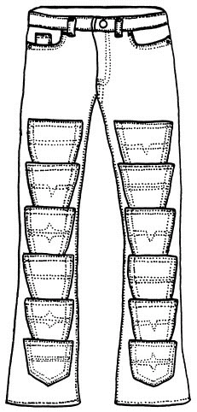

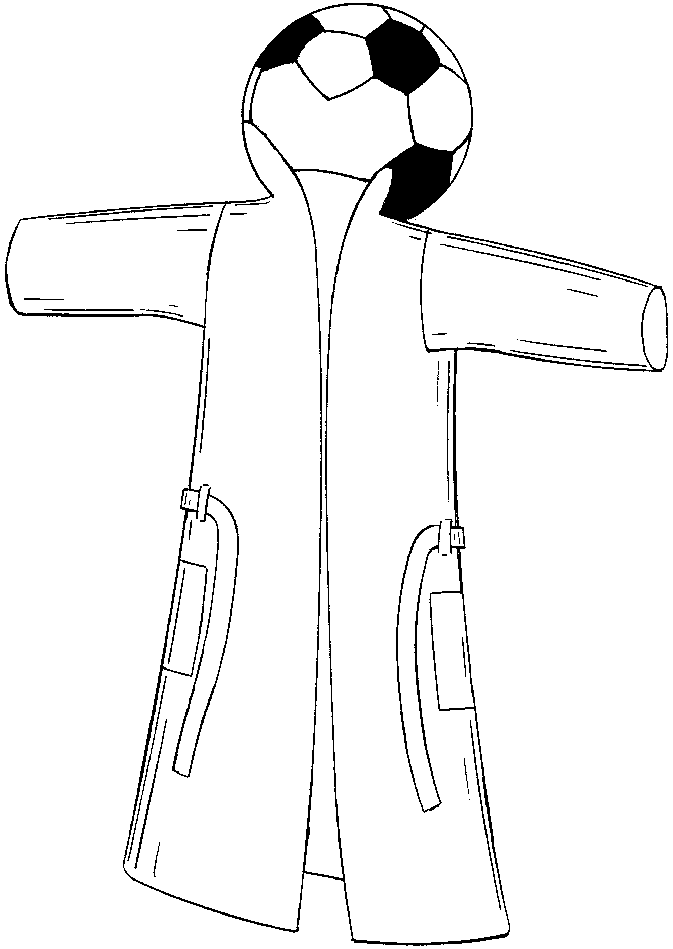
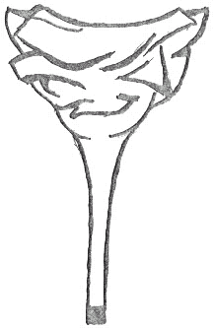
Hague users from the Clothing Sector
STREET ONE GMBH
HERMES SELLIER
ESCADA AG
NATURANA DÖLKER
GIORGIO ARMANI S.P.A
TOD'S S.P.A
SALOMON
FRAGOS GARMENTS
PEDRO ORTUÑO SANTA
and quite many individuals
DM/062270 - DM/062456 DM/048045 - DM/063893

Slide 41
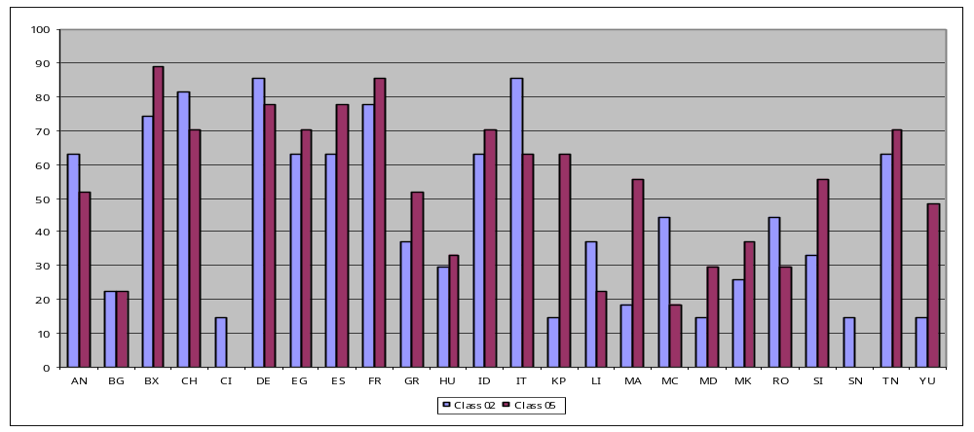
Countries Chosen by Users from the Textile and Clothing Sectors

Slide 42
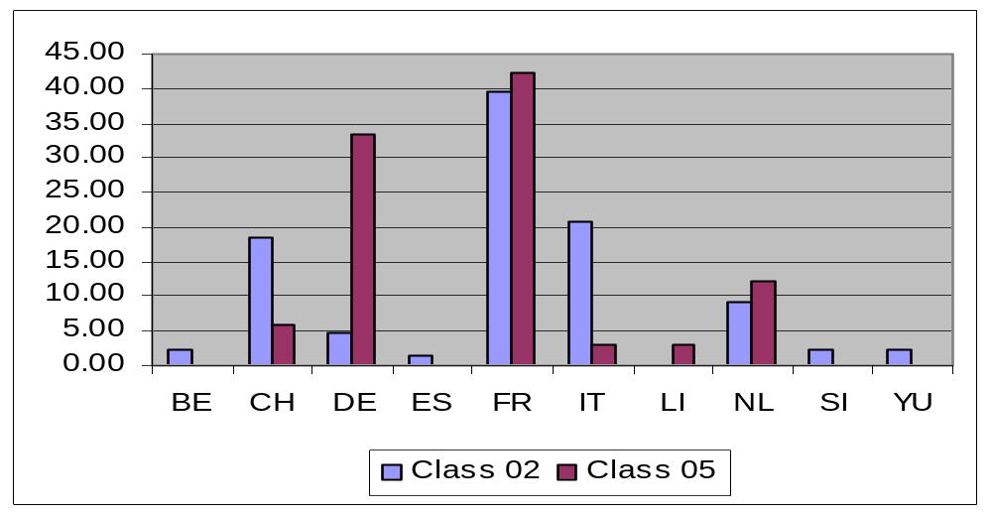
Origin of Hague Users from the Textile and Clothing Sectors
N.B. : Classes 02 and 05 still represent only 5% of new filings

Slide 43
The Hague Agreement in a nutshell
Advantages for the users : economy and simplicity at the time of filing but also throughout the life of the registration :
  one application or request
  one set of requirements
  one language
  one set of fees in a single currency
Advantages for the national Office :
  relieved from formalities, publication and registration
  receives share of the fees

Slide 44
Key Meassage
A new framework favorable to textile and clothing industries
  UCD
  RCD
  1999 Act of the Hague system
Need to join the Hague system (1999)

Slide 45
Madrid Agreement (1891)
  1900 - 1967: revised 6 times
Madrid Protocol (1989)
  1 Jan 1995: entry into force
  1 Apr 1996: operational
  accommodates more systems
Madrid System
Concerning the International Registration of Marks
Common Regulations (1996)
  1 Apr 2002: latest revision
  common definitions
  differentiates requirements
Admin. Instructions (2002)
  1 Jan 2005: latest revision
National Laws & Regulations
Notes:
Common Regulations are adopted by the Madrid Assembly by consensus vote of all the States that are party to either the Madrid Agreement of the Madrid Protocol.
Although the States that are party to the treaties look to the IB to take the lead in drafting the Common Regulations, the IB does not have the same control over of the adoption of final regulations that appear in the Common Regulations as does the USPTO in drafting the regulations that appear in the CFR, as does the IB, draft the regulations, ask for comment and then

Slide 46
Madrid Union
(78 Members)
Agreement only 11
Protocol only 22
Agreement and Protocol 45
(including EC)
Notes:
From the viewpoint of geographical distribution, the Madrid Union has today 43 Members in Europe, 20 in Asia, 12 in Africa, and 3 in the Americas.
45 members of the Union, all those indicated here in dark blue, are bound by both the Agreement and the Protocol, 22 other Members, here indicated in green-blue are bound only by the Protocol and finally, the remaining 11 members, those indicated here in light blue, are bound only by the Agreement.
Because the system is still scarcely represented in some areas in the world, WIPO has been making every effort to keep non-member countries, and those which are still bound only by the Agreement, informed about the advantages of joining the Protocol.
In the last 12 months, we have been able to identify a growing interest of governments, trademark owners and practitioners in many non-member countries in learning more about how the Protocol works. We have been responding to numerous requests for information, sending speakers, organizing seminars and providing training to nationals from many countries. WIPO is available to respond to similar requests from other interested countries.
[Altogether the Madrid member countries account for more than half of the world population ( 3.1 billion people) (out of 6.1 billion). And their combined Gross Domestic Product represents about 2/3 of the world gross product. That is a very attractive market for those companies entitled to use this system.]

Slide 47
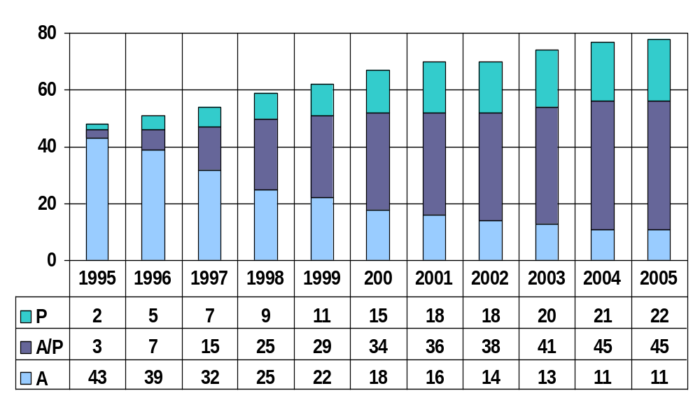
Madrid Union Members

Slide 48
Contracting Parties
www.wipo.int/treaties/en/documents/pdf/g-mdrd-m.pdf
66 PROTOCOL
Albania, Antigua and Barbuda, Armenia, Australia, Austria, Belarus, Belgium, Bhutan, Bulgaria, China, Croatia, Cuba, Cyprus, Czech Republic, Democratic People’s Republic of Korea, Denmark, Estonia, European Community, Finland, France, Georgia, Germany, Greece, Hungary, Iceland, Iran, Ireland, Italy, Japan, Kenya, Kyrgystan, Latvia, Lesotho, Liechtenstein, Lithuania, Luxembourg, Monaco, Mongolia, Morocco, Mozambique, Namibia, Netherlands, Norway, Poland, Portugal, Republic of Korea, Republic of Moldova, Romania, Russian Federation, Serbia and Montenegro, Sierra Leone, Singapore, Slovakia, Slovenia, Spain, Swaziland, Sweden, Switzerland, Syria, The Former Yugoslav Republic of Macedonia, Turkey, Turkmenistan, Ukraine, United Kingdom,
United States of America, Zambia
11 AGREEMENT ONLY
Algeria, Azerbaijan, Bosnia and Herzegovina, Egypt, Kazakhstan, Liberia, San Marino, Sudan, Tajikistan, Uzbekistan, Vietnam

Slide 49
What the Madrid System is . . .
One to Many Relationship: Provides for the centralized acquisition, maintenance and management of trademark rights around the world by filing a single international application for a single international registration (IR) in which one or more Contracting Parties (CP) are designated.
“Bundle of Rights:” The IR has the effect of a registration in each designated Contracting Party (DCP), although it is not itself, nor does it result in, an independent registration.

Slide 50
. . . and what it is not.
Since the Madrid System is a procedural arrangement, it does not determine:
  the conditions for protection;
  the refusal procedure to be applied when deciding whether a mark may be protected; or
  the rights which result from protection.
Such issues are governed by the law of each CP designated in the IR.

Slide 51
Basic Principles
Basic application or basic registration (“basic mark”) in a CP of the Madrid System
Connection between owner named that basic mark and that CP: establishment, domicile, or nationality
IA must designate one or more other CPs with common treaty
Set time limits for refusal of extension request
Possibility of subsequent designation (SD)
IR dependent on basic mark for 5 years
10-year term and renewal
Centralized management of IR

Slide 52
Basic Advantages
National or Regional International Route
Route (Madrid System)
• many Offices for filing • one Office for filing
• many languages • one language
many currencies • one currency
• many registrations • one int. registration
• many renewals • one renewal
• many modifications • one modification
• foreign attorney or agent • foreign attorney or agent
first needed at filing first needed if refused

Slide 53
Basic Procedure
OFFICE OF
ORIGIN (OO)
Certifies that particulars in international app. = those in basic mark
International
Application
Checks formalities
Records in the International Register
Publishes in the International Gazette
Notifies designated Contracting Parties
INTERNATIONAL
BUREAU (IB)
OFFICE OF
DESIGNATED
CONTRACTING
PARTY (DCP)
Substantive examination: refusals
must be made within set time limits
refusal
no refusal = effect of
a national registration

Slide 54
Agreement vs Protocol
Agreement
Protocol
Accession
States
States and IGOs
Entitlement (EDN)
Cascade
No Cascade
Basic Mark
Basic registration
Basic registration
or basic application
Fees
Basic
Complementary
Supplementary
Basic
Complementary
Supplementary
Individual fee option
or
Refusal time limit
12 months
12 months or 18 months or 18+ months
Dependency
5 years
5 years with possibility of
transformation
Languages
[CR R6]
French
French or English or Spanish

Slide 55
As of September 2005
145,000 different holders of international registrations
440,000 international registrations in force
  11.5 designations per international registration
5 million active designations
  equivalent to national or regional registrations

Slide 56
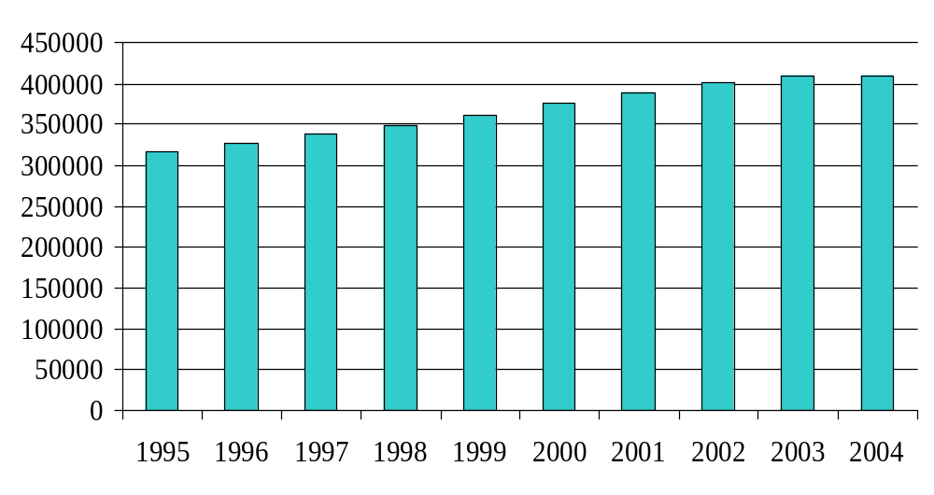
Registrations in Force

Slide 57
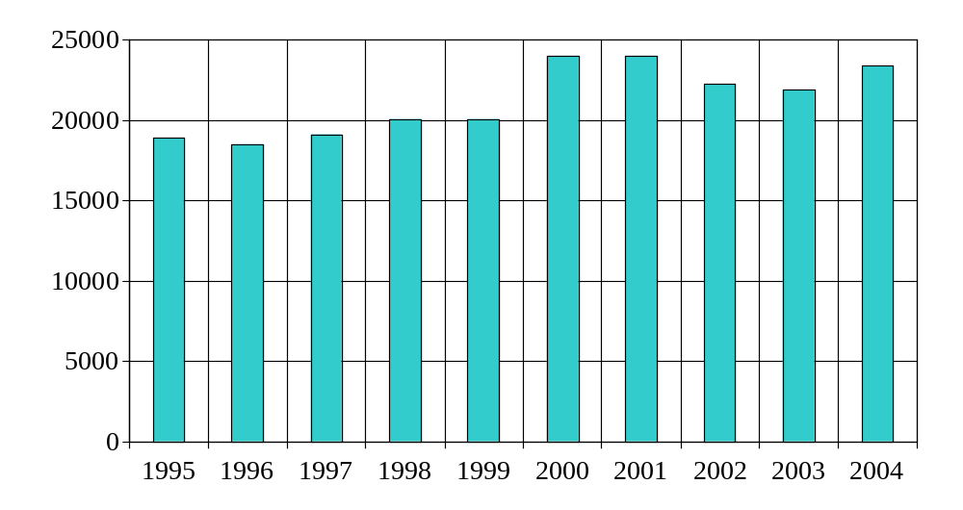
Registrations Per Year

Slide 58
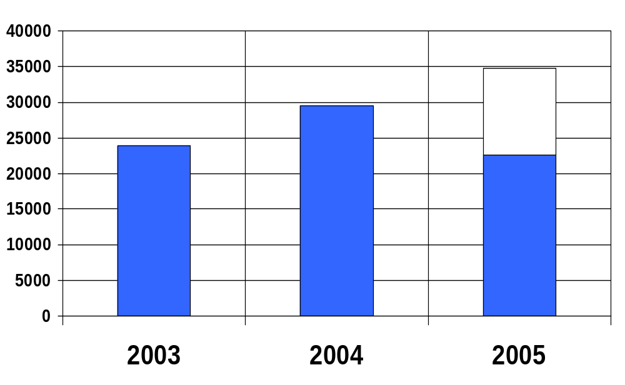
International Applications
As of August 2005
Notes:
In the filing area, demand for the registration of marks has continued to grow very significantly for the third consecutive year.
The growth in filings was particularly strong between 2003 and 2004, where the number of applications received by WIPO increased by more than 23%.
But throughout this year 2005, the filing activity has continued to grow
In the first eight months of this year WIPO received some 22,000 applications (22,691), which represented a 19% (18.6%) increase over a similar period in 2004 (19,137) and more than a 40% increase over 2003 (15, 995).
By the end of this year, we expect we will reach a figure of some 34,800 (34,841) applications for the year.

Slide 59
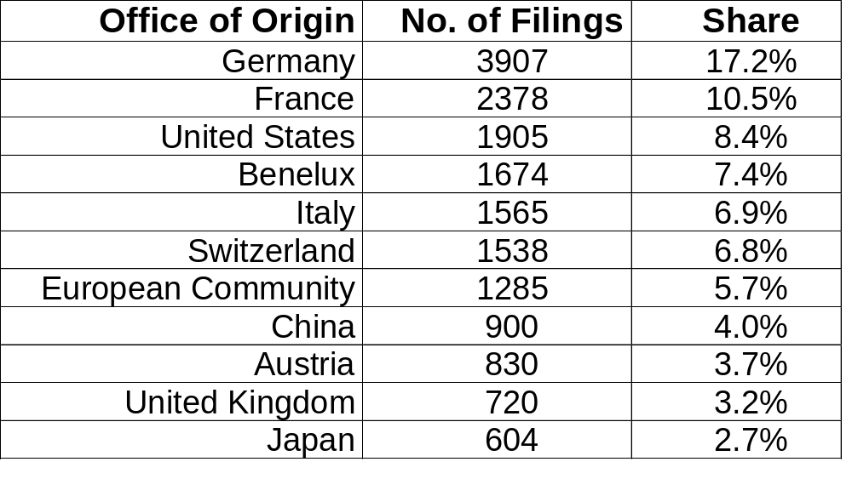
International Applications Filed
January to August 2005
Notes:
The ranking of major user Contracting Parties within the Madrid Union for the first eight months of 2005, therefore looks like this.
With Germany as number one, accounting for more than 39 hundred applications, and representing some 17% of the total number of applications filed during the period.
Followed by France (with a 10% share), the United States of America (with 8.4%); the Benelux countries, Italy and Switzerland (with some 7% each), the European Community (which already represents almost 6% of total filings), China, Austria, United Kingdom and Japan.

Slide 60
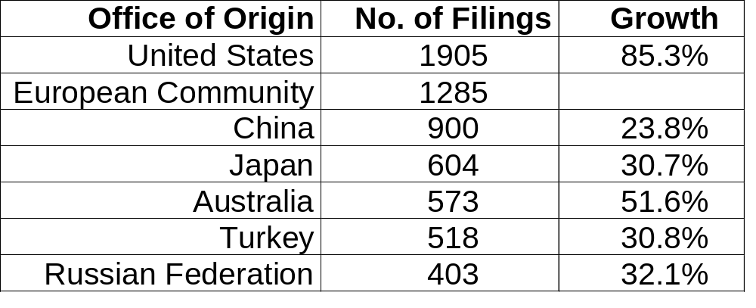
International Application Growth
January to August 2005
Notes:
The Members of the Madrid Union which have contributed most to the growth in filings this year have been the European Community and the United States of America.
In the first eight months of the year, applicants from the United States filed some 19 hundred applications, which represented an increase of 85% over 2004.
And applicants basing their international applications on European Community Trade Marks accounted for almost 13 hundred applications (1,285).
Over this period as well, also important growth rates could be noted concerning other countries, such as China (a 23.8% growth), Australia (more than 50%), Japan, Turkey and the Russian Federation (around 30% each), as indicated in this table.

Slide 61
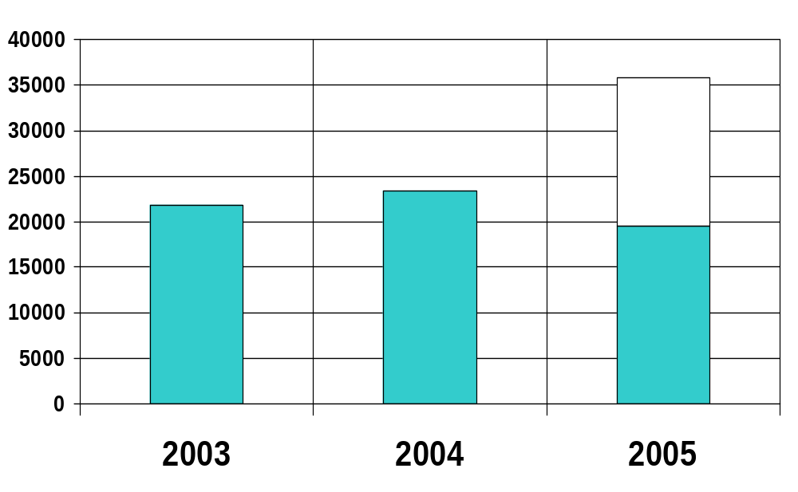
International Registrations
As of August 2005
Notes:
This very steep growth in filing activity has obviously posed challenges to the International Bureau in terms of coping with the processing of a higher volume of applications.
Measures were taken in 2004 and in the first half of 2005 to address this challenge. They included training new examiners, redeploying translators, further streamlining procedures, and providing additional information technology support.
As a result, as from last month, the International Bureau has been regularly recording, each week, more registrations than the number of applications received, on that same week. Which means that the processing time within WIPO is getting shorter.
Already today, the average time for an application with no irregularities to get processed, from the date of receipt by the IB to the date of registration has been brought down to 9 weeks. Our intention is to bring this average processing time figure further down to 5 weeks by the end of December of this year and still further down to three weeks sometime early next year.
[By August 2005, we had recorded almost 20,000 registrations, which means 25% more than last year. By the end of the year, we expect to have recorded some 35,800.]

Slide 62
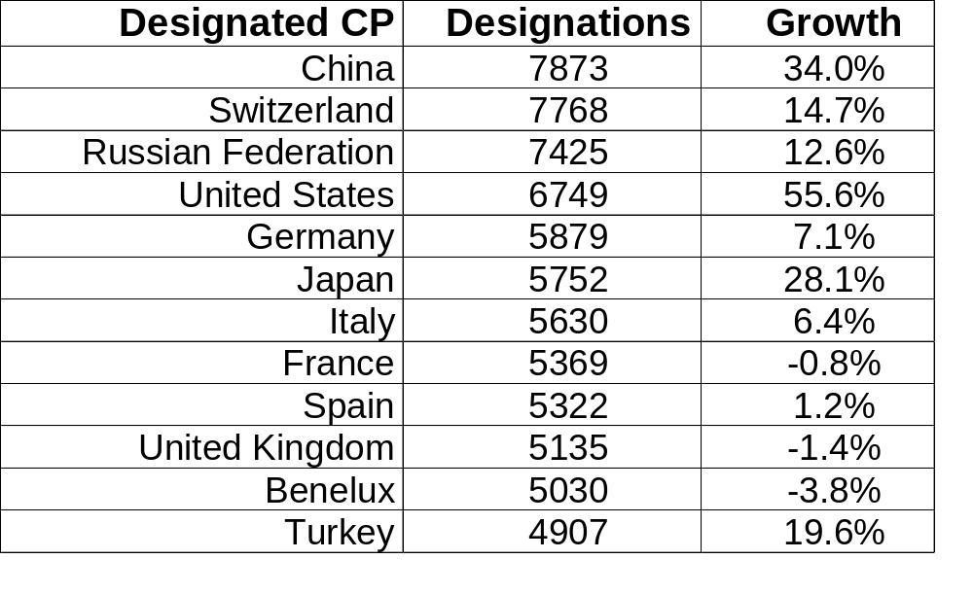
Designations (IR and SD)
January to August 2005
Notes:
Now, let us have look at the list of most designated Contracting Parties. These are figures which comprise both: (i) designations in new registrations and (ii) subsequent designations, inscribed in the International Register in the period from January to August 2005 .
The most significant development in this area is the presence of China as number one in this list. For the first time, this year China has become the most designated country, a position until now occupied for years by Switzerland. Switzerland has now become number two in this list, closely followed by the Russian Federation.
Interesting to note as well that the US has also moved up in this ranking, becoming number 4 as a result of a very high increase (a 55%) increase in the number of designations received this year.
Other countries that have moved up in the ranking of designations during this period are Japan and Turkey.
The EC is ranking number 30?

Slide 63
Profiles 2004 (1/2)
23,395 International Registrations filed:
  Average fee was was 2,850 CHF
  85% of all fees were less than 5,000 CHF
  Largest fee was 100,330 CHF

Slide 64
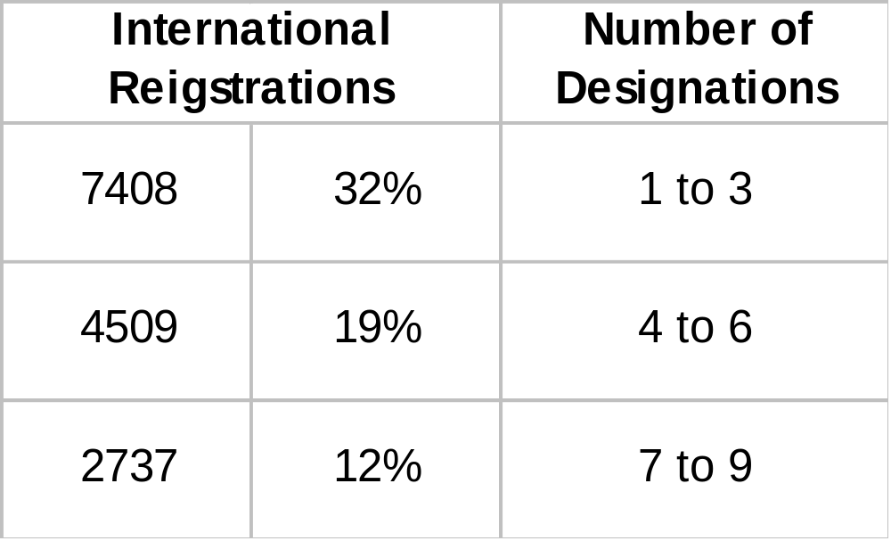
Profiles 2004 (2/2)
23,395 International Registrations filed

Slide 65
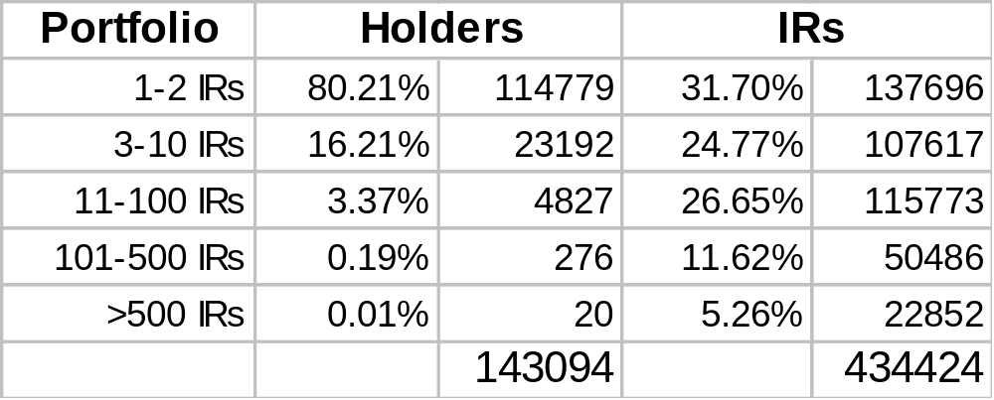
IR Portfolios as of June, 2005

Slide 66
The main legal instruments of the patent system
Paris Convention for the Protection of Industrial Property
PCT Treaty and all the subsidiary PCT legal instruments
National legislation of/for each PCT State
Priority period
(month)
0
12
International phase
30
Also and for one or more of the periods or phases shown:
Patent Law Treaty (PLT)
Budapest Treaty (deposit of biological material)
Strasbourg Arrangement (on international patent classification)
Regional patent treaties
WTO Membership
National phases

Slide 67
The main PCT legal texts
Treaty*
Agreements between ISA/IPEAs
and the International Bureau
(search and examination)
Regulations
PCT Search and Preliminary
Examination Guidelines
Administrative Instructions
(incl. forms, standards, etc)
PCT Receiving
Office Guidelines
* Containing several chapters, two of which in particular will often be referred to:
- Chapter I - All steps except preliminary examination by the IPEA
- Chapter II - Only preliminary examination by the IPEA and national phase on that basis

Slide 68
The international system for the filing of patent applications
-- a patent “filing” system for :
- inventions only (via patents, utility models or similar titles)
- not a patent “granting” system :
- decision to grant patents solely within the jurisdiction of national offices
- a “PCT patent” does not exist
-- a patent application filed under the PCT is referred to as :
an “international patent application”
or an “international application”
or simply a “PCT application”

Slide 69
Outline of the PCT procedure
Filing of
a first
application
at a national
office
Filing of a single
“international application”
at a single “receiving Office”
designating
all PCT States
National grants by “designated Offices” in/for PCT States
Priority period
(month)
0
12
International phase
30
International processing
including centralized search, examination and publication
=
…national phases
added value,
improving and
facilitating ...
…subsequent processing in...

Slide 70
2
The momentum for improving the patent system
Momentum engineered and encouraged by:
consistency between all elements
rationalization of procedures and approaches
cooperation between all interested parties
predictability of the system
All these are visible in particular through:
international standards
agreed interpretation of Treaty provisions (and subsidiary texts)
guidelines for processing applications and for search and examination
timeline of the international procedure
guaranteed availability of detailed information
on various legal, procedural and technical aspects

Slide 71
2
d
A model of international cooperation between countries and intergovernmental organizations around the world
Relatively smooth operation of the system, amidst the challenges posed
by the great diversity in:
culture of the various countries, in particular, their IP and patent cultures
their legal and patent systems
the respective official languages in use at the various Offices
While extensive consultation processes are aimed at finding a balance throughout the entire system: via sessions of the various bodies and other meetings, electronic forums, informal discussions, etc.
It remains essential that the PCT cater for the peculiarities of national laws and practices, hence its inherent intricacies, e.g.:
US law: inventorship and the qualifying applicant
JP law: self-designation effect when priority is claimed
EPC: “WTO priorities” not recognized until entry into force of EPC 2000

Slide 72
The main offices and organizations involved
Priority period
(month)
0
12
International phase
30
National and regional
IP offices
National phases
National IP Offices as PCT “receiving Offices”
and/or “International Searching and
Preliminary Examining Authorities”
and the International Bureau of WIPO
National and regional IP offices as PCT “designated Offices”

Slide 73
Sharing PCT responsibilities
-- the receiving Office
-- is one of the following:
- the national Office of any Contracting State willing to assume this responsibility
- the regional Office acting for one or more Contracting States, with their consent
- the International Bureau, by decision of the PCT Union Assembly
-- specifies:
- the international authority(ies) competent to carry out search and examination
in relation to PCT applications filed with it
- the language(s) in which PCT applications may be filed with it
-- checks:
- whether it is competent
- the documents constituting and those accompanying the application
- whether fees are paid
- whether certain time limits are complied with
-- receives and directs correspondence from the applicant to offices and authorities
-- collects fees and transfers some of them to the ISA and the International Bureau

Slide 74
Sharing PCT responsibilities
-- International Searching and Preliminary Examining Authority
-- the ISA/IPEA is one of the following:
- the national Office of any Contracting State willing to assume this responsibility
- the regional Office acting for one or more Contracting States, with their consent
- or an intergovernmental organization
and is appointed by the PCT Union Assembly
[as ISA] - discovers the relevant prior art
- establishes the international search report
- produces a first written opinion on the patentability of the invention
- in certain cases, carries out “international-type searches”
with respect to national applications filed with certain Contracting States
[as IPEA] - produces a (second) opinion on the patentability of the invention
- examines amendments made to the application
or arguments presented by the applicant
- establishes the international preliminary report on patentability

Slide 75
Sharing PCT responsibilities
-- the International Bureau of WIPO
-- acts as “Secretariat” of the PCT Union Assembly and other PCT bodies
-- constitutes the framework for the general coordination of the PCT system
amongst all PCT offices and authorities
-- offers assistance to (current and potential) Contracting States and their Offices,
- e.g., advice as to implementation of the PCT in the national law
-- offers assistance to users of the system
- e.g., guides, training courses, infoline
-- maintains and publishes all PCT legal texts (Treaty and subsidiary texts)
-- is the only receiving Office competent for all applicants,
regardless of their nationality or residence
-- translates into English various parts of the application of a technical nature
-- publishes all PCT applications and the PCT Gazette
-- retains, for 30 years, the only legally binding copy of the PCT application

Slide 76
An open door into a wealth of scientific and
technical information
-- from the date of international publication,
- a wealth of information becomes available
- bibliographical data about the international application
- technical content of:
- the application itself
- any earlier application whose priority is claimed
- through access to:
- the published version of the application (“PCT pamphlet”)
- the PCT Gazette
- copies of documents contained in the file
- access being facilitated by a number of on-line services and search tools
from the WIPO Internet site, through a portal called “Patentscope”
at: http://www.wipo.int/patentscope/en/

Slide 77
3
Outline of the PCT procedure
Filing of
a first
application
at a national
office
Filing of a single
“international application”
at a single “receiving Office”
designating
all PCT States
National grants by “designated Offices” in/for PCT States
Priority period
(month)
0
12
International phase
30
International processing
including centralized search, examination and publication
=
…national phases
added value,
improving and
facilitating ...
…subsequent processing in...

Slide 78
The international phase
-- It comprises 4 steps, one of which is optional* :
- filing by the applicant, at a single office
- search and (unilateral) examination on patentability carried out by an international authority
- centralized publication carried out by the International Bureau of WIPO
* finally, but only upon the applicant’s express request,
examination on patentability carried out by an international authority
(with possibility for the applicant to intervene)
-- It adds value to the application,
with the aim of improving and facilitating the national granting procedures, through
- centralized processing and publication
- international search and preliminary examination
according to international standards applied by all offices

Slide 79
The national phase
-- must be entered by the applicant
- only where the intention is to proceed with the application through to (possible) grant
- at the designated Office
-- may be initiated at different points
- not necessarily at the end of the international phase
- not necessarily exactly at the same time for all designated Offices
-- the outcome being :
- either grant of the patent
- or rejection of the application
- or abandonment of the application

Slide 80
The international phase -- PCT filing
Filing of a single
“international application”
at a single “receiving Office”
designating
all PCT States
Filing of
a first
application
at a national
office
Priority period
(month)
0
12
International phase
30
1st step
---
PCT
filing
…national phases

Slide 81
Filing of the PCT application
-- filing a patent application under the PCT guarantees the applicant
- an international filing date
- which is immediately effective in all PCT Contracting States
- including recognition of priority rights claimed according to the Paris Convention
- provided:
- the applicant has a link with at least one PCT Contracting State
(through nationality or residence)
- the application fulfills a few minimum requirements
(as to form and contents)
-- depending on the selected office*, such filing may even be made:
- at any time of day, any day of the year
- in any language
- without any signature, appointed agent, or payment
- in paper or fully or partly electronic form
[* for example, the International Bureau of WIPO]

Slide 82
The international filing date
A few minimum requirements must be met:
-- with respect to nationality or residence:
- at least one of the applicants (natural person or legal entity) must be
- either a national
- or a resident of a PCT Contracting State
-- with respect to the minimum contents of the international application:
- a description - at least one claim
- the name of the applicant whose indication of nationality or residence
determines the link with a Contracting State
- an indication that the application is filed under the PCT (“Petition”)
[the filing will constitute the designation of all PCT Contracting States]

Slide 83
Effects of the international application
-- from the international filing date, the international application has :
- the effect of a “regular national filing”
within the meaning of the Paris Convention
- in each designated State
-- in other words :
- the international filing date is considered to be the “actual” filing date
in each designated State
-- in addition, and to the extent the international application itself contains new matter,
the priority of the international application may be claimed
in a subsequent (national, regional or international) application
in respect of such new matter

Slide 84
The international phase -- PCT search and examination
2nd step
---
international search and (unilateral)
examination
4th step
- optional step -
---
international preliminary examination
(i.e., continuation of examination
with possibility for applicant
to intervene)
Priority period
(month)
0
12
16
22
28
International phase
30
International processing
including centralized search
and examination
=
…national phases
added value,
improving and
facilitating ...
…subsequent processing in...

Slide 85
The international search procedure
- search of the “prior art”,
as defined by the PCT,
in order to reveal relevant documents
prior to the international filing date
- the outcome being an International Search Report (ISR)
(or a Declaration of Non-establishment of International Search Report )
- will also contain observations
where “unity of invention” is lacking (does the international application relate to multiple inventions?)

Slide 86
The international examination procedure
-- consists of two parts, the second one being optional for the applicant
-- first part is automatically carried out by the ISA,
in connection with international search,
- is unilateral (the applicant has no possibility to intervene)
- will be concluded by a “written opinion” which will
- either become the examination report (“IPRP (Chapter I)”)
- or serve as a basis for the second part of the examination procedure
-- the second part is carried out by the IPEA
but only if the applicant so requests expressly within a specific time limit
- will normally start on the basis of the written opinion by the ISA
- allows for the applicant to intervene (amendments, arguments)
- will be concluded by a report (“IPRP (Chapter II)”)
-- for each application, there will always be one and only examination report

Slide 87
Effects of the international preliminary report on patentability
-- whether it is an IPRP (Chapter I) or an IPRP (Chapter II):
- its establishment constitutes the end of the examination procedure
within the international phase
- it cannot be the subject of appeal during the international phase,
neither before the ISA or IPEA, nor before the International Bureau
- it will normally serve as a basis for the start of national examination
before designated Offices
- in the case of certain designated Offices, it will even serve as a unique basis
for granting a national patent
or rejecting the application

Slide 88
The international phase -- PCT publication
3rd step
---
international
publication
Priority period
(month)
0
12
18
International phase
30
International processing
including
centralized publication
…national phases
=
added value,
improving and
facilitating ...
…subsequent processing in...

Slide 89
International publication -- main features and effects
-- it is effected
- by the International Bureau
- “promptly” after the expiration of 18 months from the priority date
- in two main formats: full text of applications (“pamphlets”) and gazette
- each in two media: electronic and paper
- in one of the (current) seven PCT publication languages
(Chinese, English, French, German, Japanese, Russian, Spanish)
-- its date constitutes the date on which the PCT application becomes part of the prior art
-- it has the effect of a national publication in each of the designated States
(with a few exceptions)
-- it can be stopped or delayed by the applicant
-- it may take place earlier, upon the express request of the applicant

Slide 90
The national phase
National grants by “designated Offices” in/for PCT States
Priority period
(month)
0
12
International phase
30
International processing
including centralized search, examination and publication
…national phases
=
added value,
improving and
facilitating ...
…subsequent processing in...

Slide 91
National phase before designated Offices
-- only relevant in (or for) PCT States
where the applicant still wants to obtain national (or regional) patents
-- for each designated Office
at the express request of the applicant,
together with:
- translation of the international application
- and payment of the national fee
-- within the time limit of 30 months from the priority date (with a few exceptions
in particular time limit of 31 months,
and, in very rare cases time limit of 20 months)

Slide 92
What designated Offices may or may not require: general principles (1)
-- time limit for compliance with national phase requirements
- the Office cannot impose any obligation to comply with its requirements
before the expiration of 30 months from the priority date
-- form and contents of the international application
- the Office can apply any requirements which are more favorable to applicants
than those fixed in the Treaty and Regulations
- the Office cannot apply requirements which are different from or add to the latter
-- allegations or declarations contained in the application
- the Office can require evidence
but only after national processing has commenced
-- qualifying as applicant according to the national law
- the Office of the designated State concerned can reject the application
if the applicant is not the inventor (with respect to the US)

Slide 93
What designated Offices may or may not require : general principles (2)
-- representation of the applicant for the purposes of national processing
- the requirement of mandatory representation is permitted,
but only once national processing has started
-- substantive conditions of patentability
- any criteria or other conditions of the national law are permitted
in particular with respect to definition of prior art
- the requirement to submit evidence is permitted
-- preservation of the national security of the country
- all measures that the country concerned considers necessary are permitted
-- protection of the general economic interests of the country
- all measures that the country concerned wishes to take are permitted,
including those aimed at limiting the rights of its nationals or residents
to file international applications

Slide 94
4
Resources materials on PCT and patent matters
-- PCT legal texts:
- Treaty, Regulations, Administrative Instructions, Guidelines, Agreements,
legal notices in the PCT Gazette, WIPO Standards, etc.
- versions in English and French being both equally authentic
several official translations (e.g., Chinese, German, Italian,
Japanese, Portuguese, Russian, Spanish, etc.)
-- PCT information material
- PCT Applicant’s Guide (English and French)
- PCT Newsletter (English, monthly)
- PCT seminar material (English, French, German, Spanish, Japanese, etc.)
-- Patent and PCT statistics
-- General patent-related matters
Available from the International Bureau, via the PCT portal on WIPO Internet site at: http://www.wipo.int/patentscope/en/
(and also in paper versions)

