Slide 1

Advanced Python for Data sciences
Prof. Mehdi Mekni
Group 1
Joshitha Gunreddy
Seshaiah Erugu
Sai Rajesh Korlam

Slide 2
Student alcohol consumption
Quick introduction about the dataset:
This is public data of secondary school education in Portugal available on the internet.
We merged two individual datasets, one for grades in mathematics and the other in Portugal language.
This dataset has information about
student grades
alcohol consumption
Student’s health
Parent’s Profession
Relationship status and so on.
The mathematics dataset has 395 rows and 33 columns.
The other has 650 rows and 33 columns.
?FACT
Mother tongue and mathematics specify the growth of any child in the world.

Slide 3
what is the secret behind excellent academic records?
How alcohol consumption effects student’s grades?
Also how love life effects the grades?
Finally, lets find out what influences their grades the most
POINTS THAT EXCITE US

Slide 4
How many hours per a week student studies Does number of hours per week affects student final grades Determine the gender and age of the students Does age of the student affects final grades How many students are in love and Does romantic life of student affects their final grades Count of students living in city and village Does living in village/ far from college affects student grades Determine student health stats and find out whether student health affects final grades or not Number of students consuming alcohol on weekdays and weekends Does consuming alcohol on weekend affects grades Does consuming alcohol on weekday affects student final grades Determine number of students want to go for higher studies Does the desire to get higher education influence the final grades How many students have internet access Having internet access affects student grades Determine number students living with their parents Does living with parent affects grades Determine the quality of family relationships and influence on student grades Does parents education and profession helps in improving student grades | We observed more students are teenagers age between 15-18, assuming that younger the student the less likely that they consume alcohol. We also determined number of students in love are less than the single students and romantic life affects the final grades as they spend less amount of time in studying and attending classes. We determined that more number of students spends 2-5 and 5-10 hours a week got good grades in final and students who spends less than 2 hours a week got poor grades. We found students consume alcohol on weekdays likely to get less grades in final and consuming alcohol on weekends is not affecting students grades. Almost all students are desired to do higher studies, stats showed students with this desire likely get good grades in final. Students with internet access are spending less number of hours which is impacting their grades negatively. This Scientific analysis shows lving with family, having good family relationships and parents education and profession helps improving student grades.

Slide 5






Libraries

Slide 6
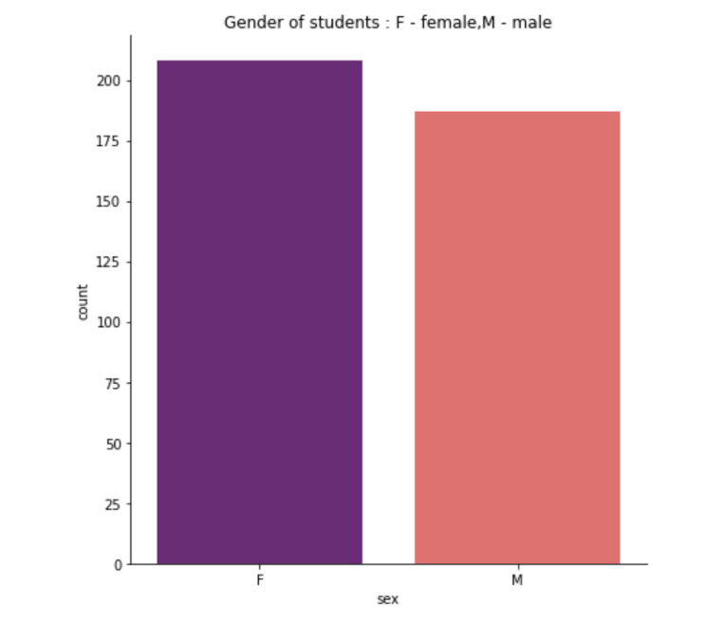
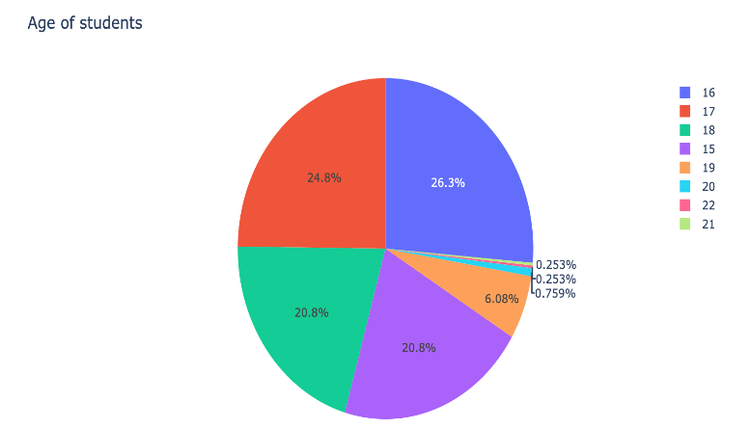
Lets first look at the gender of the students
(count of boys and girls)
Now, lets see the age of the students
RESULT: The number of girls is a little more
RESULT: so, basically we are dealing with students 15-18 years.

Slide 7
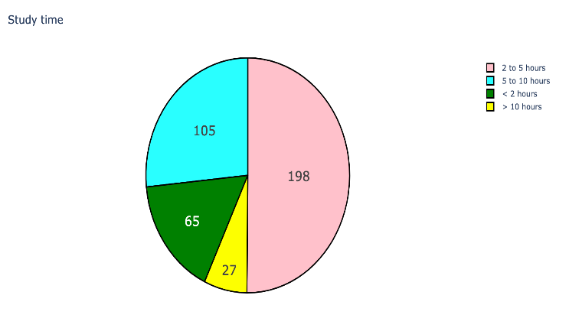
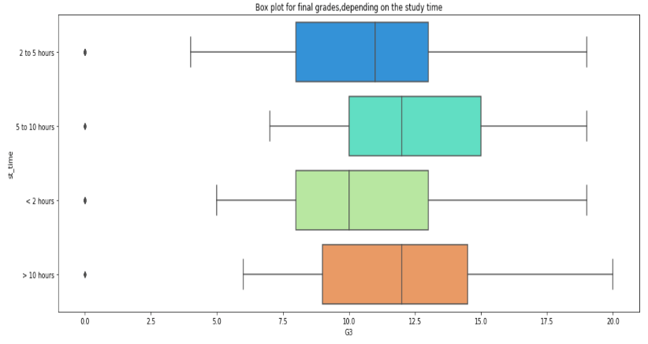
Let’s find, how many hours a week students spend on their studies.
Impact of the number of hours spent on study on the final grade of the student.
RESULT: The lowest average result is shown by students
who spend less than two hours a week studying.
Few students spend more than 10 hours a week studying
show the highest results.
RESULT: Most students spend 2 to 5 and 5 to 10 hours a week studying.

Slide 8
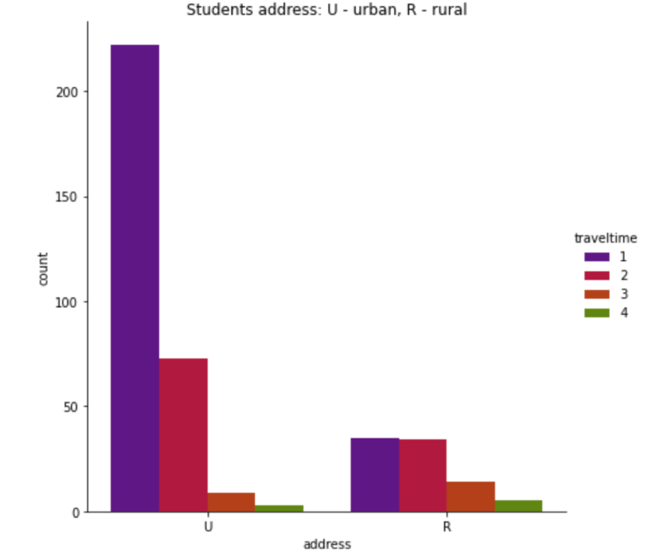
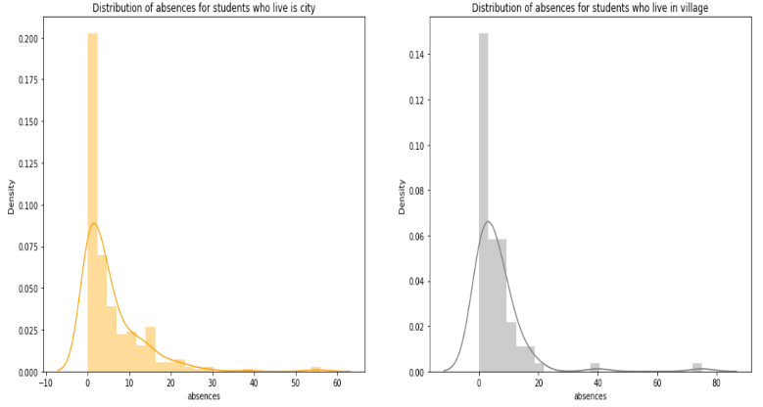
Now, lets display the time that students spend on the way to school and they live in city/village.
(1 - very close, 4 - very far)
let's see if this affects the number of absences.
RESULT: Most of the students live in the city. Few students take long to get to school.
RESULT: Among the students living in the village there are people with a lot of absences.

Slide 9
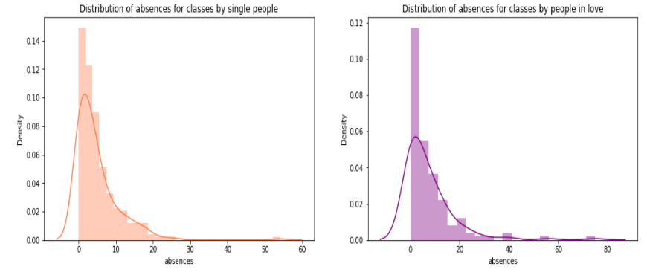
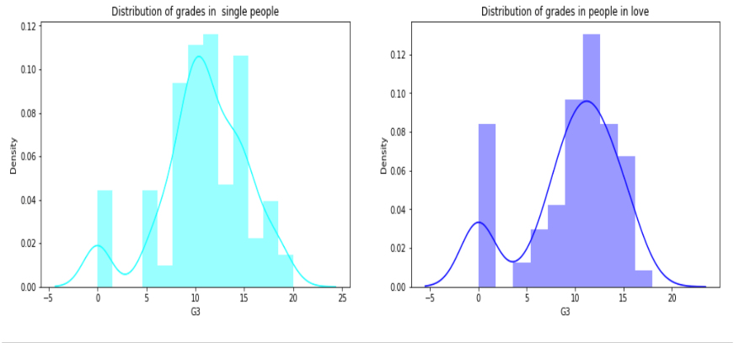
Let's see if the presence of love and relationships affects the number of absences.
Let's see if love affects the final grade of teenagers who are in love.
RESULT: Single people miss fewer classes than students in love.
RESULT: The final grades of single students are slightly higher than those who are in a romantic relationship.

Slide 10
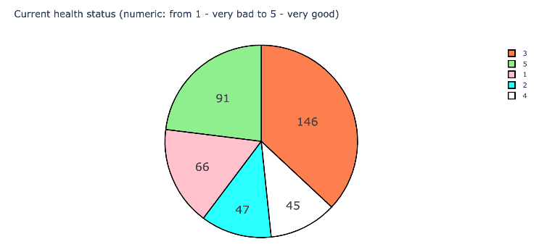
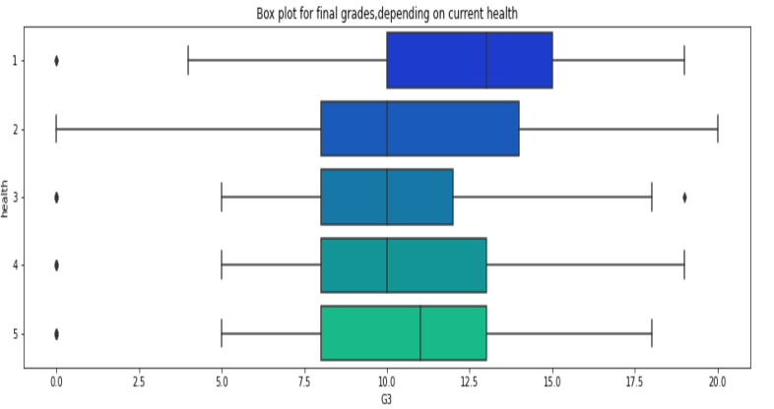
Now lets look at the health of the students.
(1 - very bad, 4 - very good)
Let's see if the health of the student affects final grades and the number of passes.
RESULT: Most of the students have good health. (3)
RESULT: In our enrollment, 66 students have very poor health. But their final estimates are quite high.

Slide 11
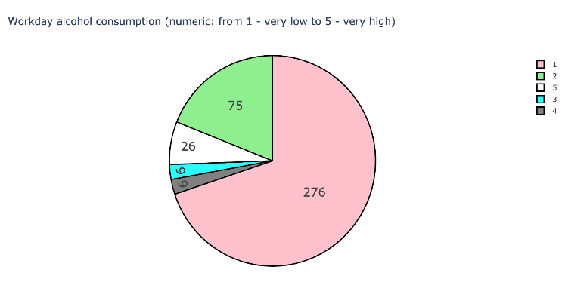
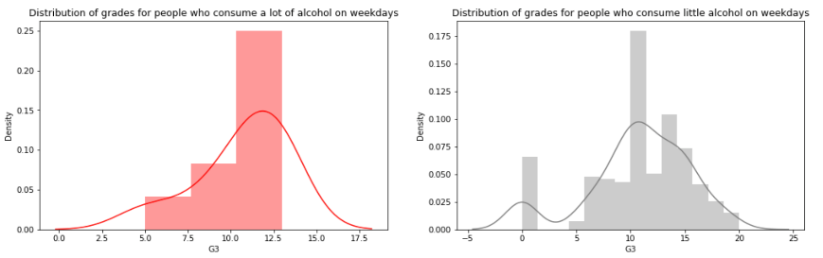
Our main interest is student alcohol consumption. Let's start with alcohol consumption on weekdays.
Let's see if consuming alcohol in weekdays affects student grades and absences.
RESULT: Most students prefer to spend a week sober or almost without alcohol.
RESULT: we can see that the final grades of these students are significantly lower.

Slide 12
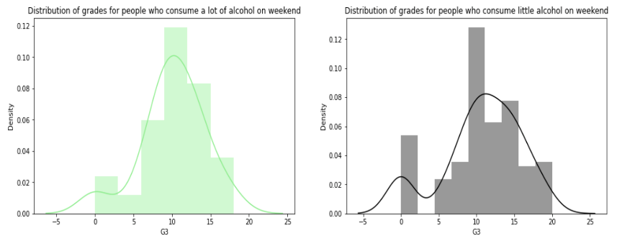
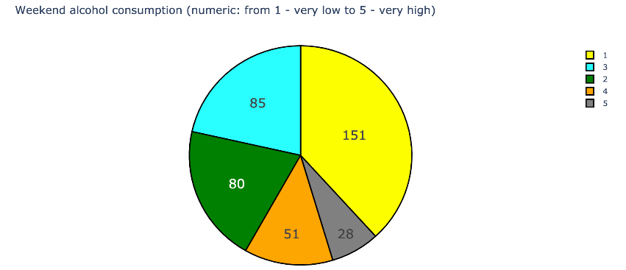
Let's look at the situation with the consumption of alcohol on the weekend.
Let’s see what the situation will be with the final grades.
RESULT: More than half of the students consume alcohol on weekends.
RESULT: Seems consuming alcohol on weekend will not affect the grades at school

Slide 13
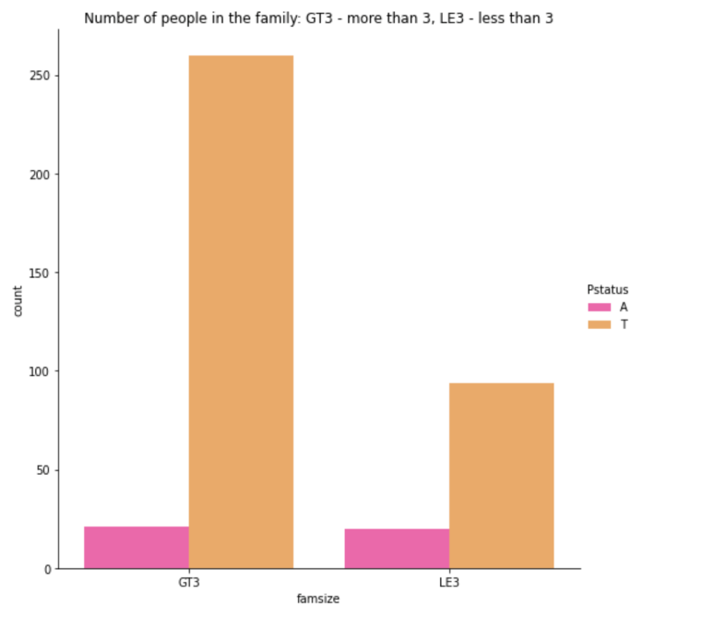
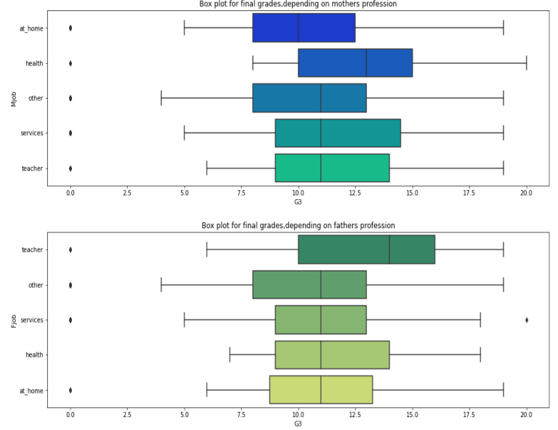
Father and mother of the student live together or not.
Let’s see how parent’s profession affects the final grades of the students.
RESULT: Most students live with their mother and father.

Slide 14
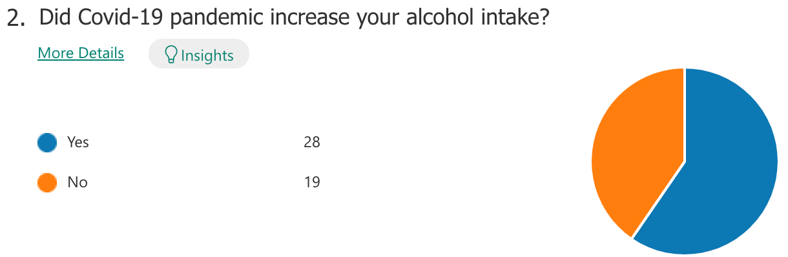
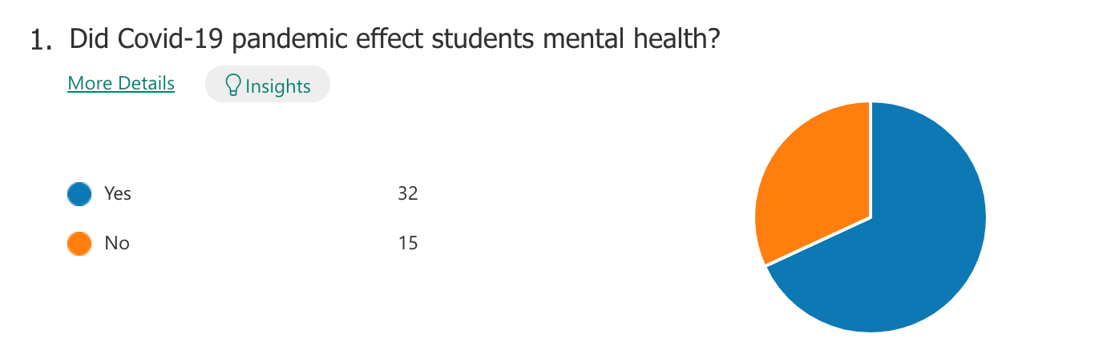
SURVEY RESULTS

Slide 15
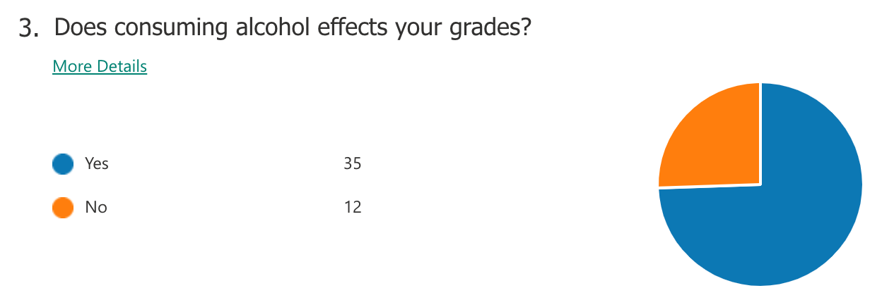
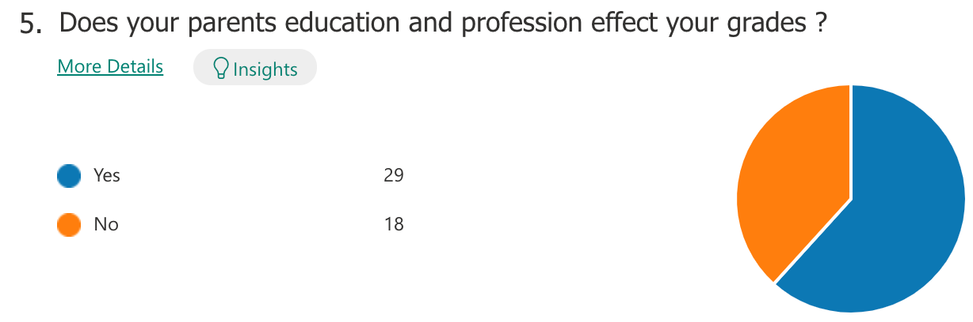
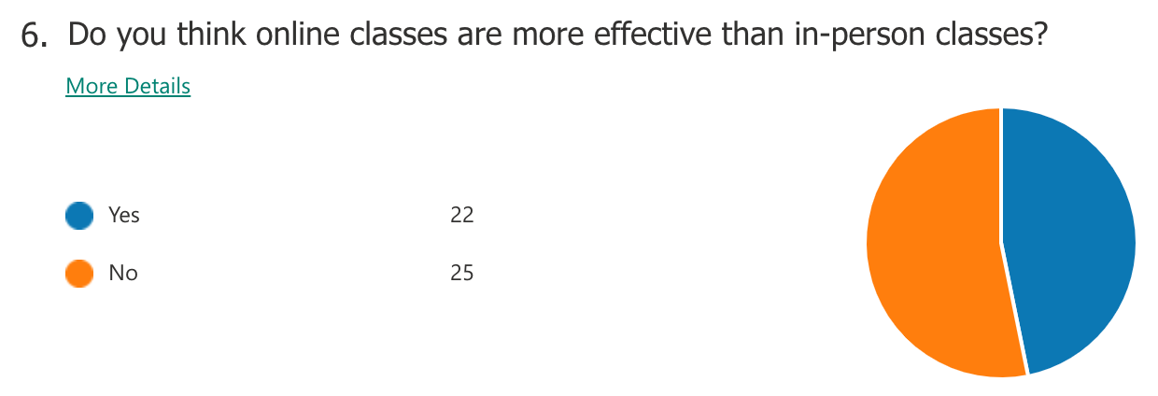
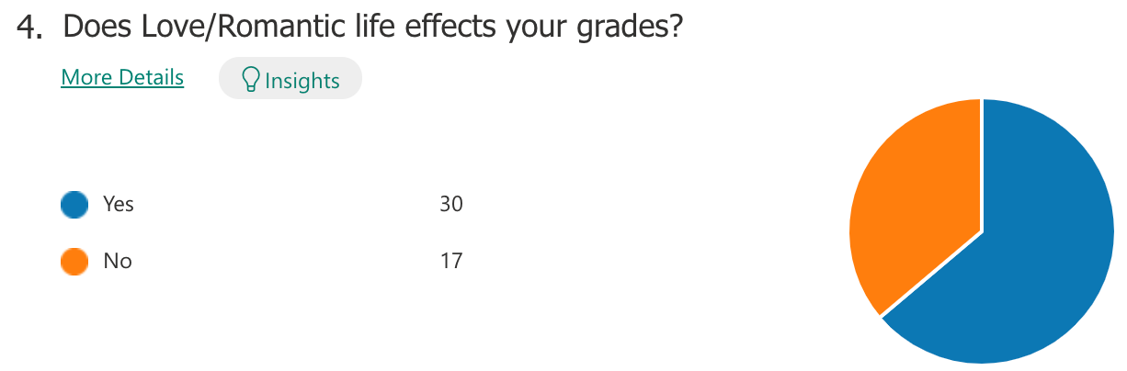

Slide 16
CONCLUSION
Is there a secret of excellent grades?
Certainly and as we have seen it is to give enough time to study, not to miss classes, remember that you can not give 100% of the time to the beloved and so on and of course not to abuse alcohol on weekdays.
What about the weekend?
Science gives us the right to relax on weekends!
Having good family relations and maintaining good health and spending less time on internet helps increasing grades in final.
This Project is very important to all the students and the institutions to find a path for their academic success and good future. Also, it helps in creating a new environment for the students to prepare for their future.

Slide 17
THANK YOU

