Slide 1
Visualizations- Daimler truck Data

Slide 2
Tasks:
1) Network Graph: We’ll identify the truck with respect to short types. We have 5 short type code, as
B=In Building, Not On Truck
T=W/Truck
O=Offline
I= Installed
E=Not Received
We‘ll get a list of trucks for the particular short type
2) Bubble Line graph for Cries Summary: Count of cries with respect to date & resp_insp_oprunt
3) Bubble graph: Identify the paint defects on cab with respect to day & vehicle_no

Slide 3
Technologies Used
Visualizations are implemented using
D3
Dimple.js
Java
MySQL

Slide 4
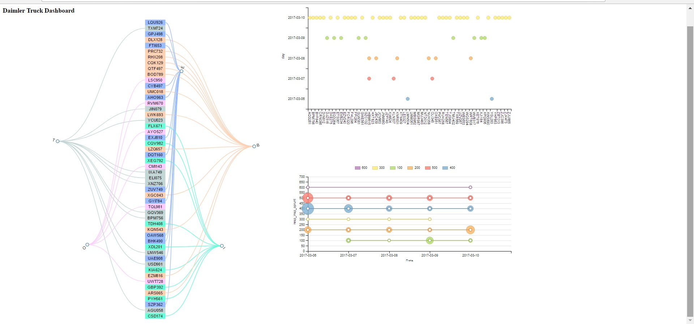
Dashboard

Slide 5
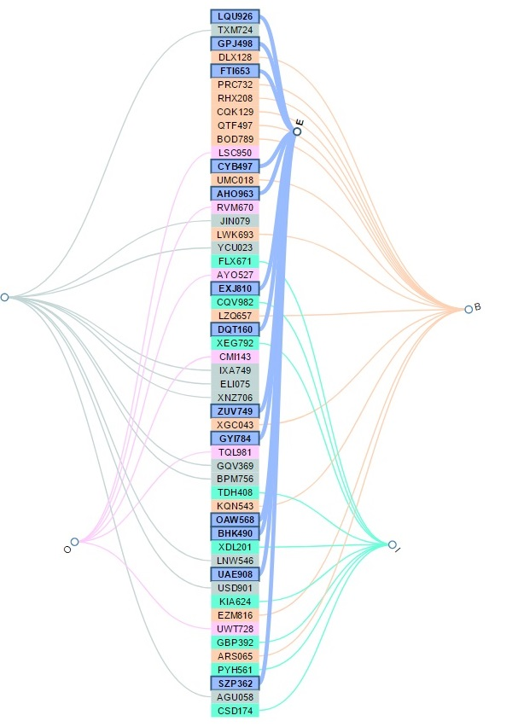
Trucks with respect to short Type Code

Slide 6
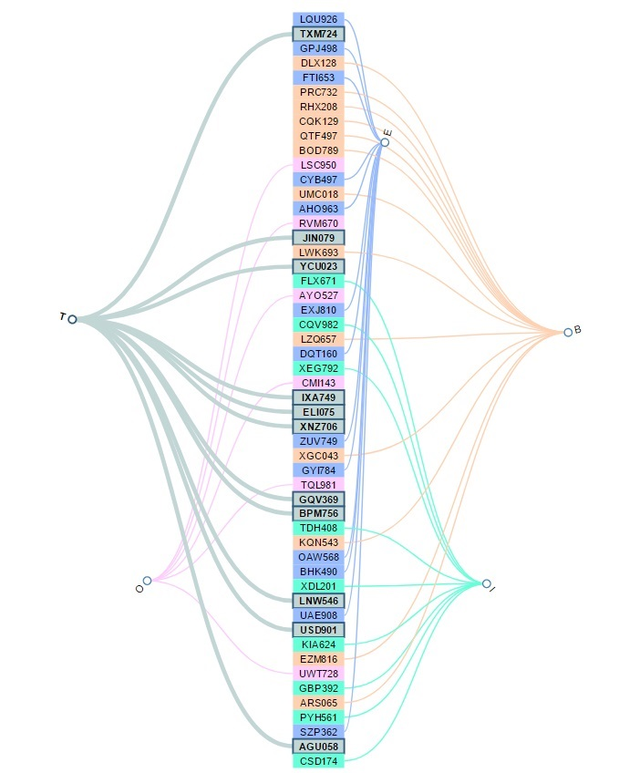
Trucks with respect to short Type Code

Slide 7
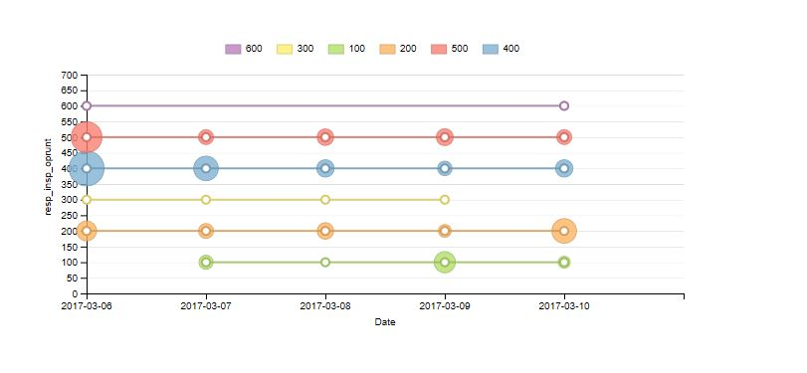
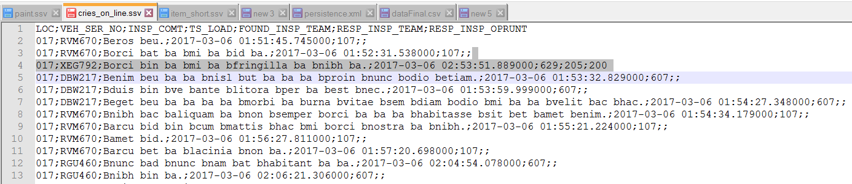
Bubble Line Chart wrt date & resp_insp_oprunt

Slide 8
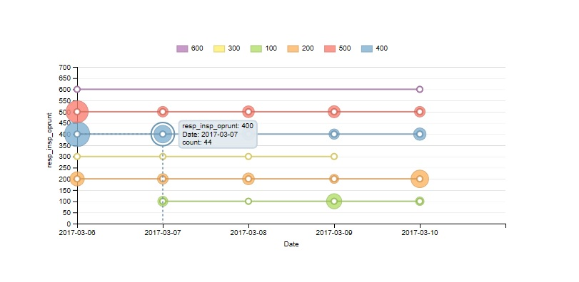
Bubble Line Chart wrt date & resp_insp_oprunt

Slide 9
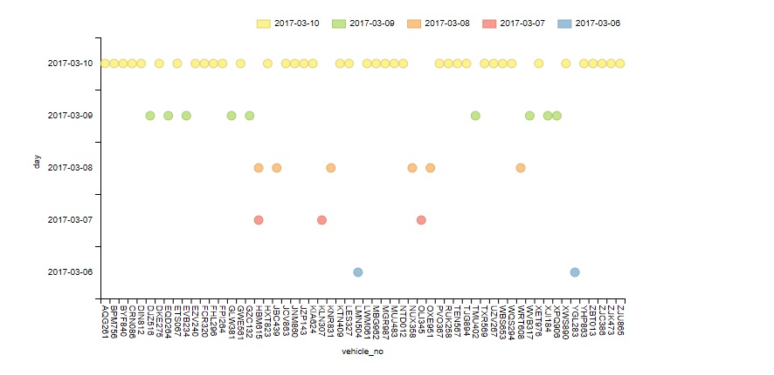
Bubble plot with respect to day & vehicle_no

Slide 10
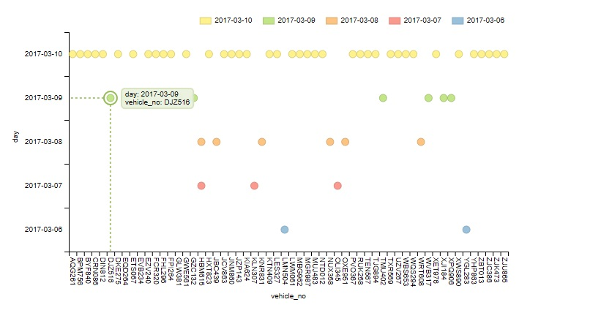
Bubble plot with respect to day & vehicle_no

Slide 11
Thank you

