Slide 1
VNR VJIET · CENTRE FOR PRESENCING & DESIGN THINKING (CPDT)
Find My Professor
Dynamic QR Office Placards & Real-Time Consultation Scheduling Ecosystem
STUDENT ENGINEERING TEAM (CSE & AI)
• Sai Koushik Pallapolu
• Team Member 2
• Team Member 3
• Team Member 4
UNDER THE GUIDANCE OF
Mrs. Prasanna Pabba
Assistant Professor, Dept. of CSE
VNR VJIET · Hyderabad

Slide 2
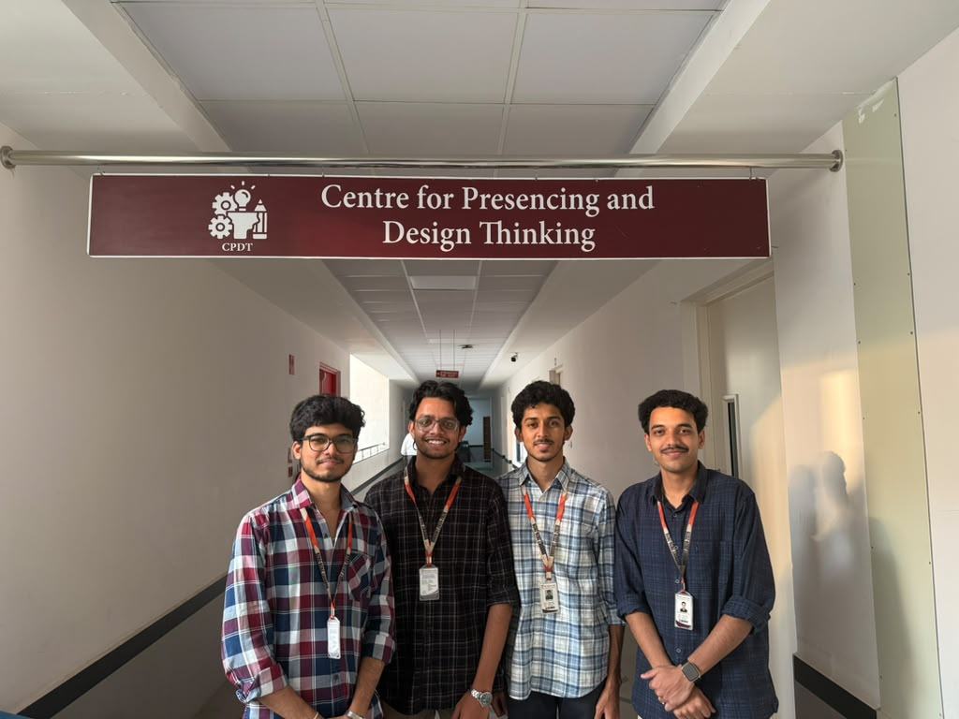
00 · TEAM INTRODUCTION
The Team
Centre for Presencing and Design Thinking (CPDT) · VNR VJIET
STUDENT INNOVATION SQUAD
• Sai Koushik Pallapolu
Lead Full-Stack Architecture · Real-time SSE Engine & Responsive UI
• Team Member 2
User Research Lead · Corridor Empathy Interviews & Student Journey Mapping
• Team Member 3
Backend & Database Architect · PostgreSQL Schema, Prisma ORM & Conflict Engine
• Team Member 4
UI/UX & Deployment Lead · Placard Generator, Mobile PWA & Cloud CI/CD

Slide 3
OVERVIEW
Agenda & Presentation Flow
Structured through the complete 5-stage Design Thinking journey
01 · Problem Statement
Campus corridor transit friction & zero cabin visibility.
02 · Research Approach
Empathy interviews, corridor observations & user mapping.
03 · Defining Insights
Categorized user needs: Primary, Secondary, Latent.
04 · POV Statement
Actionable Point of View for faculty & students.
05 · Ideation Method
Brainstorming & SCAMPER innovation methodology.
06 · The Solution
Live QR placards, 1-tap workspace & notify alerts.
07 · Our Innovation
Desirability, technical feasibility, and viability.
08 · Design for Environment
Sustainable campus infrastructure aligned with UN SDGs.
09 · Mentor Interactions
Actionable guidance from Mrs. Prasanna Pabba.
10 · Team Experiences
Course Outcomes (CO-1 to CO-4) & learnings.
11 · Conclusion & Scope
Scalable roadmap for campus-wide deployment.

Slide 4
01 · EMPATHIZE & DISCOVER
Problem Statement: The Campus Transit Dilemma
Physical availability blindness in multi-acre university institutions
THE SCALE OF THE PROBLEM
Across VNR VJIET (Academic Blocks 1, 2, 3 and B-Block), faculty balance lectures, laboratory evaluations, department meetings, and research.
Students seeking quick doubt clarification or signatures routinely climb 2 to 4 flights of stairs only to find locked cabins or empty desks.
Because physical presence at desks is completely invisible until arrival, over 40% of student cabin visits end in wasted transit.
THE DUAL BURDEN ON FACULTY & STUDENTS
• Disruptive Knocking: Faculty working on research or exam grading are constantly interrupted by students checking if they are free.
• Hallway Crowding: Students linger outside cabins in corridor bottlenecks trying to peer through glass doors.
• Inflexible Timetables: Paper timetables pasted on doors become outdated after Day 1 due to inevitable impromptu campus meetings.

Slide 5
01 · DEFINE PHASE
Problem Statement: Key Problems & How Might We
Formulating the human-centered engineering challenge
Zero Desk Visibility
Physical presence at office desk is unknown until a student climbs floors and knocks.
Wasted Time & Energy
Students waste 15-25 minutes between classes; frustration and crowded hallways.
Scheduling Friction
Ad-hoc knocking disrupts faculty grading; booking appointments via email is slow.
No Passive Feedback
When a professor steps away for 10 minutes, students have no way to get alerted upon return.
DESIGN CHALLENGE — HOW MIGHT WE...
"How might we provide students with instant, real-time awareness of faculty availability and streamline consultation bookings right at the office door, without burdening busy professors with complex administrative overhead?"

Slide 6
02 · EMPATHIZE PHASE
Research Approach & Empathy Map
Field interviews across CSE & IT corridors (Cabins 127, 201, 031)
🗣️ SAYS
• Student: 'I climbed to 2nd floor B-Block three times today, but sir was in evaluation.'
• Professor: 'I step away for 10 minutes to submit a report, and return to find students left.'
🧠 THINKS
• 'Is ma'am actually absent today or just in a quick 5-minute meeting?'
• 'If I knock now, am I disturbing an important project review?'
• 'I wish there was a live status screen right beside their nameplate.'
🚶 DOES
• Walks back and forth repeatedly between campus buildings during class breaks.
• Hovers awkwardly outside faculty room glass doors trying to peer inside.
• Sends repetitive WhatsApp messages asking 'Sir are you in cabin?'
❤️ FEELS
• Frustrated: Wasting valuable free study periods searching for teachers.
• Hesitant: Anxious about knocking on the wrong cabin door during busy hours.
• Overwhelmed: Faculty feeling interrupted when focusing on paper evaluation.

Slide 7
03 · DEFINE PHASE
Defining Insights: User Needs Matrix
Transforming user empathy into prioritized engineering requirements
NEED TYPE | IDENTIFIED CAMPUS NEED | FIND MY PROFESSOR RESPONSE
PRIMARY | Instant Live Desk Availability: Verify if professor is in cabin before walking across blocks. | Dynamic QR Door Placard & Web Portal: Camera scan reveals live color-coded status.
PRIMARY | Expected Return Estimates: Knowing when stepped-away faculty will return. | Countdown Return Target: Faculty sets +15m, +30m with optional note ('In Lab 3').
SECONDARY | Organized Consultations: Booking 15-30 min doubt slots without double-booking. | 1-Click Consultation Request: Automated calendar conflict check preventing overlap.
SECONDARY | Glanceable Office Hours: Routine availability without paper printouts that fade. | Digital Weekly Office Hours: Formatted schedule with next upcoming availability.
LATENT | Passive Real-Time Awareness: Relieving students from constantly refreshing screens. | Notify When Available: Instant push notification / toast alert sent on faculty return.

Slide 8
04 · DEFINE PHASE
Point of View (POV) Statement
Framing the core design challenge through User, Need, and Insight
USER PROFILE
The Academic Community
Undergraduate students seeking guidance and faculty members balancing lectures, research, and consultations across large campus blocks.
SPECIFIC NEED
Zero-Friction Truth
Immediate visibility into real-time physical desk availability and a direct, respectful way to schedule micro-consultations right at the cabin door.
DEEP INSIGHT
Physical-Digital Gap
Physical door signs are completely disconnected from live schedules, while existing ERP apps are too slow and cumbersome for quick 2-minute status updates.
ACTIONABLE POV STATEMENT
"College students seeking academic guidance need a glanceable, instant way to verify faculty availability and request consultations at the door because physical absence is currently invisible until arrived, causing wasted transit time and disruptive interruptions for busy professors."

Slide 9
05 · IDEATE PHASE
Ideation Method: Brainstorming & SCAMPER
Systematically exploring alternatives and landing on the optimal solution
BRAINSTORMING EVALUATION
❌ Biometric door sensors: Expensive hardware & privacy concerns. | ❌ Timetable auto-tracking: Impromptu meetings make it inaccurate.
❌ NFC tags on doors: Incompatible with many phones. | ✅ Persistent QR Door Placards + Real-Time Web: Universal, zero-cost, sub-second sync.
S
Substitute
Static door timetables replaced by dynamic QR placards.
C
Combine
Physical door scanning combined with instant push alerts.
A
Adapt
Airport departure board paradigm adapted for campus cabins.
M
Modify
Scheduling modified into quick conflict-checked 30-min slots.
P
Put to Use
Placards double as emergency notices and office hour guides.
E
Eliminate
Eliminated wasted multi-floor campus trips and disruptive knocking.
R
Rearrange
Inverted booking: students scan & request; faculty accepts in 1 tap.

Slide 10
06 · SOLUTION OVERVIEW
The Solution: Find My Professor
A unified, real-time campus availability & scheduling ecosystem
1. Permanent QR Placards
High-resolution QR placards outside cabin doors. Never need reprinting when schedules change.
CORE ARCHITECTURE
Find My Professor bridges the physical-digital divide across university academic blocks.
• Zero App Installation: Works natively in Safari/Chrome via standard smartphone camera.
• Sub-Second Real-Time Sync: Changes made by professors push to all student phones instantly via Server-Sent Events (SSE).
• Autonomy & Privacy: Faculty self-report availability in 1 tap without intrusive location surveillance.
2. 1-Tap Faculty Workspace
Professors toggle status (Available, In Class, In Meeting, Away) with return time in 3 seconds.
3. 'Notify When Available' Alerts
Students favorite teachers and receive instant live notifications the moment they return to office.
4. Conflict-Checked Micro-Consultations
Students book 30-minute consultation slots; professors accept or decline with 1 click.

Slide 11
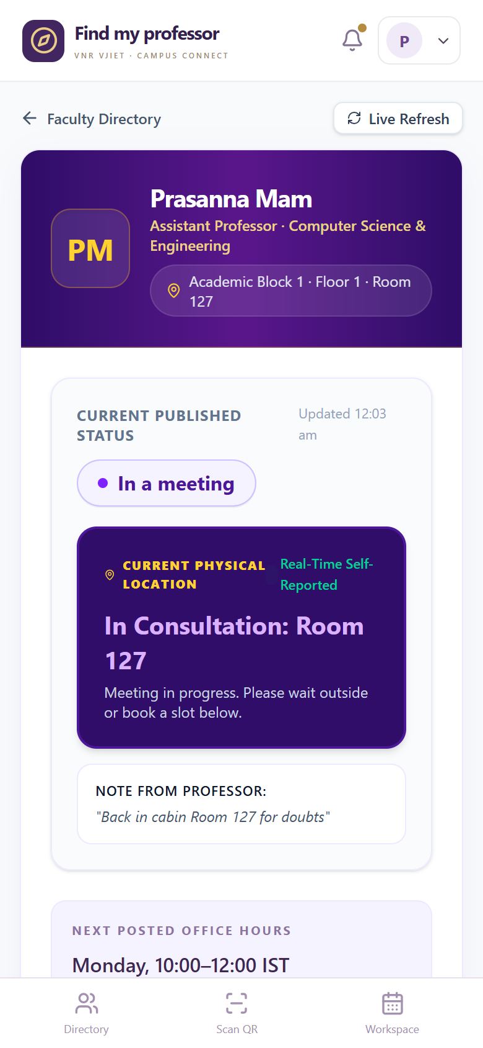
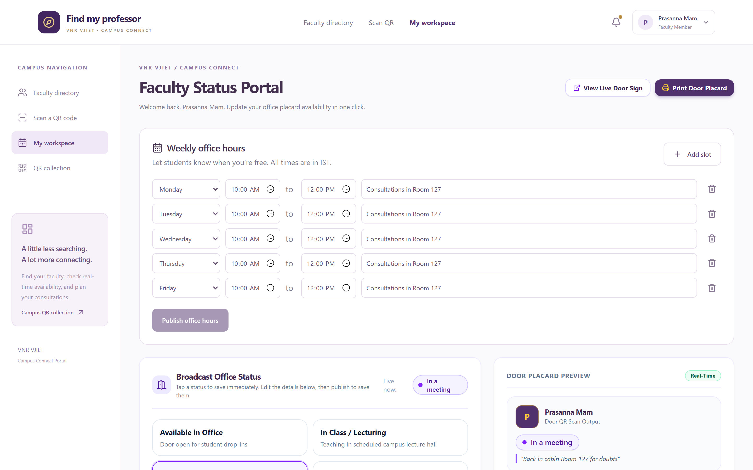
06 · PROTOTYPE PHASE
Prototype & End-to-End Workflow
Live interactive product demonstration and user touchpoints
01 · Scan Door Placard / Directory
Student scans cabin door sticker (Room 127) or browses the campus directory.
02 · View Real-Time Availability
Placard displays live color badges, return countdown, and weekly office hours.
03 · Tap 'Notify When Available'
If teacher is away, student enables the bell toggle to subscribe to live arrival alerts.
04 · Request Consultation Slot
Student selects time window and reason; system verifies no overlapping meetings exist.
05 · Instant SSE Synchronization
Professor workspace receives instant alert; changes propagate in sub-second latency.

Slide 12
07 · TECHNICAL IMPLEMENTATION
Technical Feasibility & System Architecture
Engineered for lightweight high-throughput campus execution
CORE TECHNOLOGY STACK
• Frontend SPA: React 19, TypeScript, Tailwind CSS v4, Lucide Icons
• Backend API: Node.js, Express, TypeScript, Server-Sent Events (SSE)
• Database & ORM: PostgreSQL with Prisma ORM, automated migrations
• QR Engine: HTML5-QRCode scanner, dynamic canvas placard rendering
• Cloud Hosting: Render Managed Web Service & Managed PostgreSQL with HTTPS
REACTIVE REAL-TIME ARCHITECTURE
Stateless SSE stream (/api/v1/events) maintains open connection with mobile clients. When status updates occur, an event fires, prompting active clients to refetch data with zero battery-draining polling.
MOBILE RESILIENCE & MITIGATIONS
• Screen Sleep Reconnect: visibilitychange listener immediately reconnects and refetches the moment a student wakes their phone.
• Staleness Guard: Configurable TTL flags self-reported status as 'Stale' if unconfirmed, preventing outdated information.

Slide 13
07 · INNOVATION ANALYSIS
Innovation: Desirability, Feasibility & Viability
Assessing practical sustainability and campus-wide institutional viability
DESIRABILITY
Human Adoption
Students already carry smartphones and instinctively scan QR codes daily. For faculty, a 1-tap mobile toggle respects their autonomy and takes less than 3 seconds.
FEASIBILITY
Engineering Viability
Built entirely on modern, robust web standards (React 19, TypeScript, PostgreSQL, SSE). Zero hardware dependencies: uses durable laminated QR placards.
VIABILITY
Institutional Value
Can scale across all 15+ engineering departments of VNR VJIET at near-zero incremental cost. Can be hosted on internal college servers or lightweight cloud tiers.
INNOVATION STATEMENT
"Where Is My Professor transforms passive campus doors into interactive, real-time communication portals, bridging the physical-digital divide in higher education through zero-cost QR infrastructure and instantaneous live event streams."

Slide 14
08 · SUSTAINABILITY
Design for Environment and SDGs
Contributing to institutional sustainability and UN Sustainable Development Goals
SDG 04
QUALITY EDUCATION
Maximizes high-value academic interaction. Removes transit friction and missed consultations, enabling focused final-year project guidance, lab mentorship, and academic growth.
SDG 09
INDUSTRY & INNOVATION
Modernizes legacy university infrastructure into a smart, digital campus ecosystem using lightweight web technologies and cloud databases rather than expensive proprietary hardware.
SDG 11
SUSTAINABLE CITIES
Reduces wasted inter-building foot transit and elevator electricity consumption across multi-story blocks. Completely eliminates recurring paper reprinting for notices and door schedules.

Slide 15
09 · FEEDBACK & ITERATION
Mentor Interactions & Refinements
Guidance and evolutionary feedback from Mrs. Prasanna Pabba (Assistant Professor, CSE)
STAGE | FOCUS AREA | MENTOR'S GUIDANCE | ACTION TAKEN BY TEAM
Iteration 1 | Problem Scope & Adoption | 'Avoid intrusive surveillance. Faculty will reject mandatory automated tracking.' | Pivoted strictly to an autonomous 1-tap self-reported workspace with automatic TTL expiration.
Iteration 2 | Physical Door Placard | 'Students scanning the door still need general weekly schedules when teachers are away.' | Integrated weekly recurring office-hour slots directly into placard with automated day highlighting.
Iteration 3 | Passive Real-Time Alerts | 'Students waiting outside shouldn't have to keep refreshing their phones.' | Engineered 'Notify When Available' subscriber bell and real-time floating notification toasts.

Slide 16
10 · REFLECTION & OUTCOMES
Team Experiences and Learnings
Course Outcomes (COs) and collaborative Design Thinking growth
COURSE OUTCOMES ACHIEVED
• CO-1 · Engineering Problem Definition
Applied 5-stage Design Thinking to solve campus physical availability blindness.
• CO-2 · Human-Centered Sustainability
Connected human empathy with UN SDGs (SDG 4, 9, 11), saving transit energy and paper.
• CO-3 · Rapid Interactive Prototyping
Designed, coded, and iterated a production full-stack web app with mobile camera QR scanning.
• CO-4 · Real-World Engineering Deployment
Deployed to cloud with managed PostgreSQL, automated migrations, and seed pipelines.
CORE TEAM REFLECTION
"The greatest lesson from the CPDT Design Thinking curriculum was that engineering solutions succeed not because of algorithm complexity, but because of how deeply they respect human habits.
By eliminating the barrier of installing apps and keeping faculty updates to 1 tap, we turned a perennial campus frustration into a joyful, effortless interaction."

Slide 17
11 · OUTLOOK
Conclusion & Future Scope
Scalable roadmap for institution-wide deployment across VNR VJIET
PROJECT CONCLUSION
Find My Professor demonstrates how lightweight, modern web software can transform everyday physical architecture into dynamic, connected systems.
The system is fully functional, verified with automated end-to-end tests, supports 23 faculty accounts across 5 engineering branches, and is ready for departmental corridor rollout.
'We don't replace personal faculty-student mentorship; we remove the friction that stands in its way.'
FUTURE EXPANSION ROADMAP
• Indoor Campus Navigation: Interactive maps guiding students from main gate to Room 127/201.
• Low-Power E-Ink Cabin Displays: Battery-powered electronic door placards that sync status over Bluetooth/Wi-Fi automatically.
• WhatsApp / Telegram Notification Bot: Direct push alerts to students' messaging apps when favorited faculty returns.
• Official ERP (Automation4U) Integration: Auto-populating verified class schedules and exam duties.

Slide 18
VNR VJIET · CPDT 2026
Thank You!
Open for Questions, Live Demonstration & Feedback
PROJECT MENTOR
Mrs. Prasanna Pabba
Assistant Professor, Dept. of CSE · VNR VJIET

