Slide 1


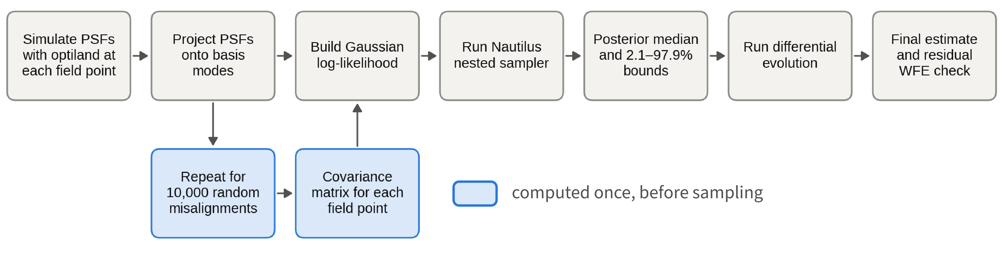
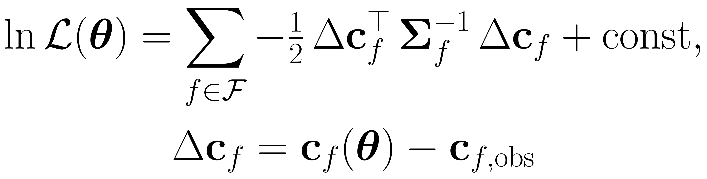
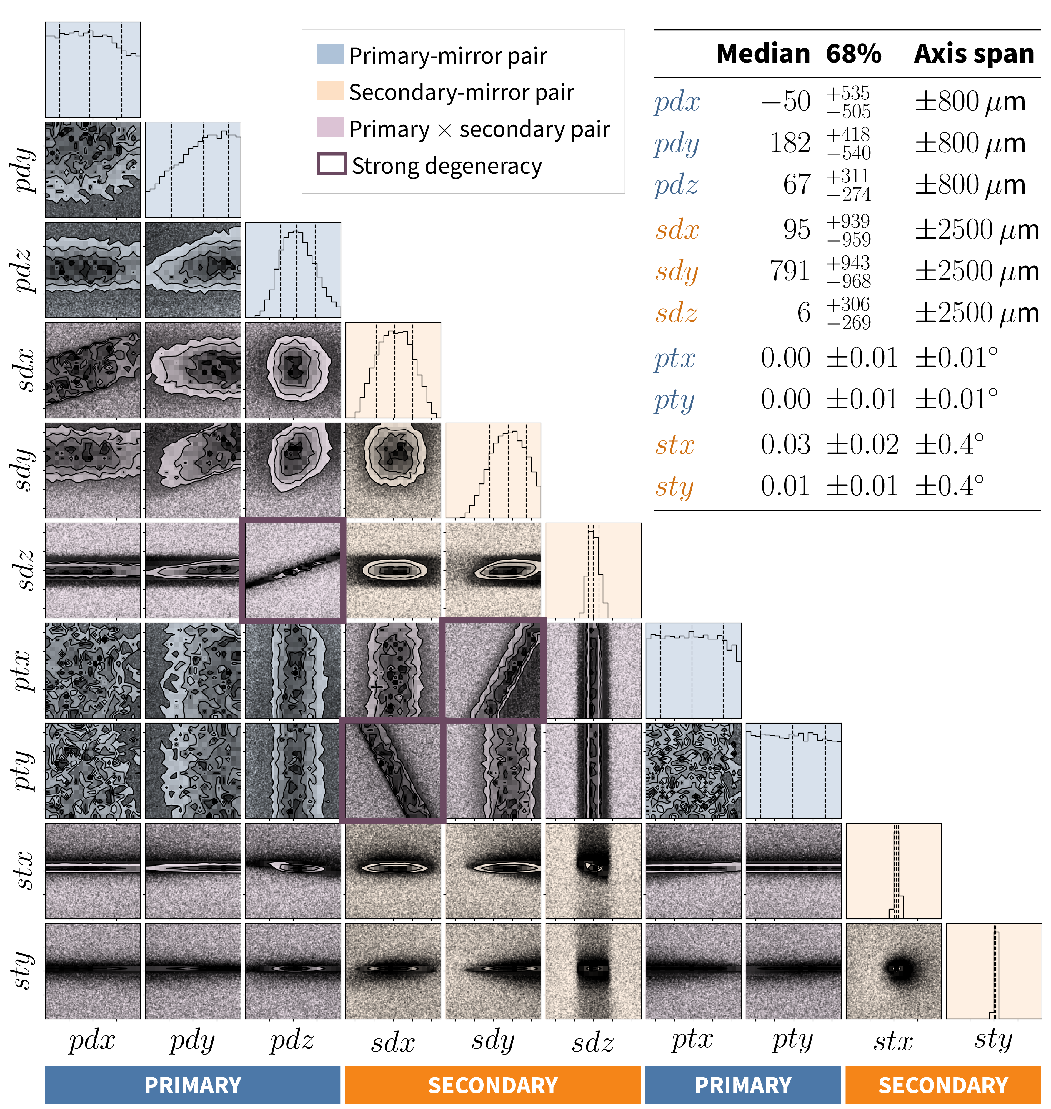
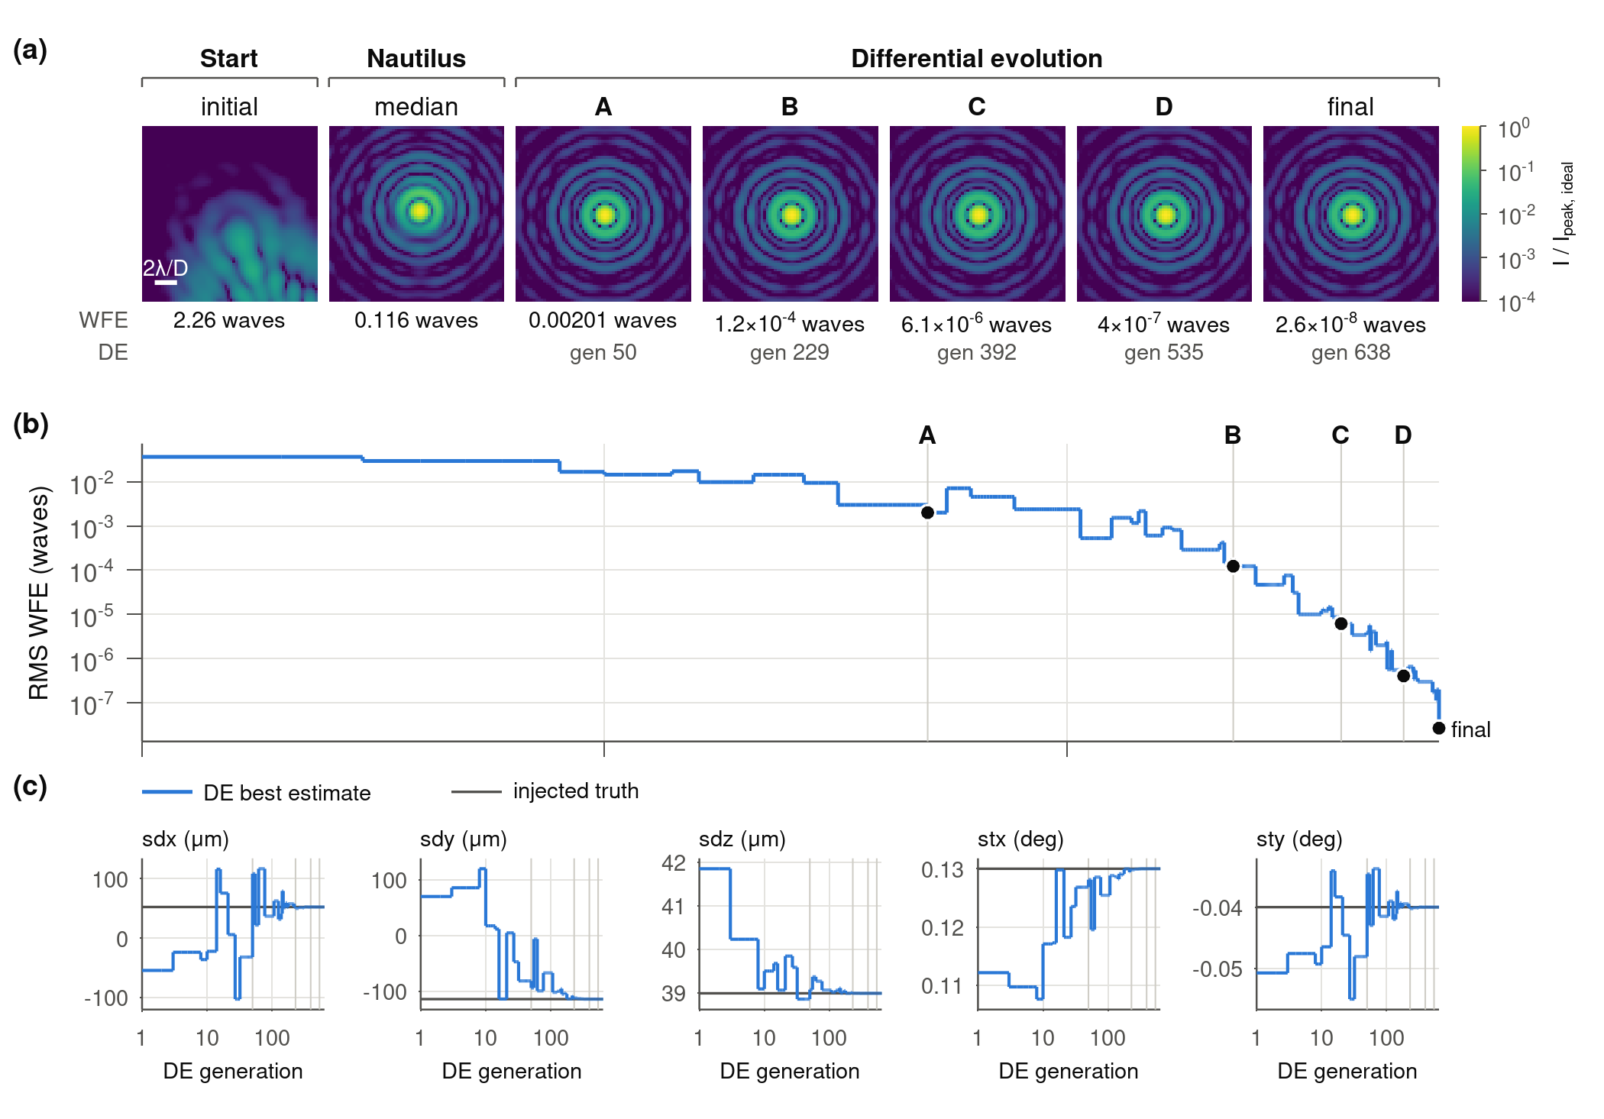
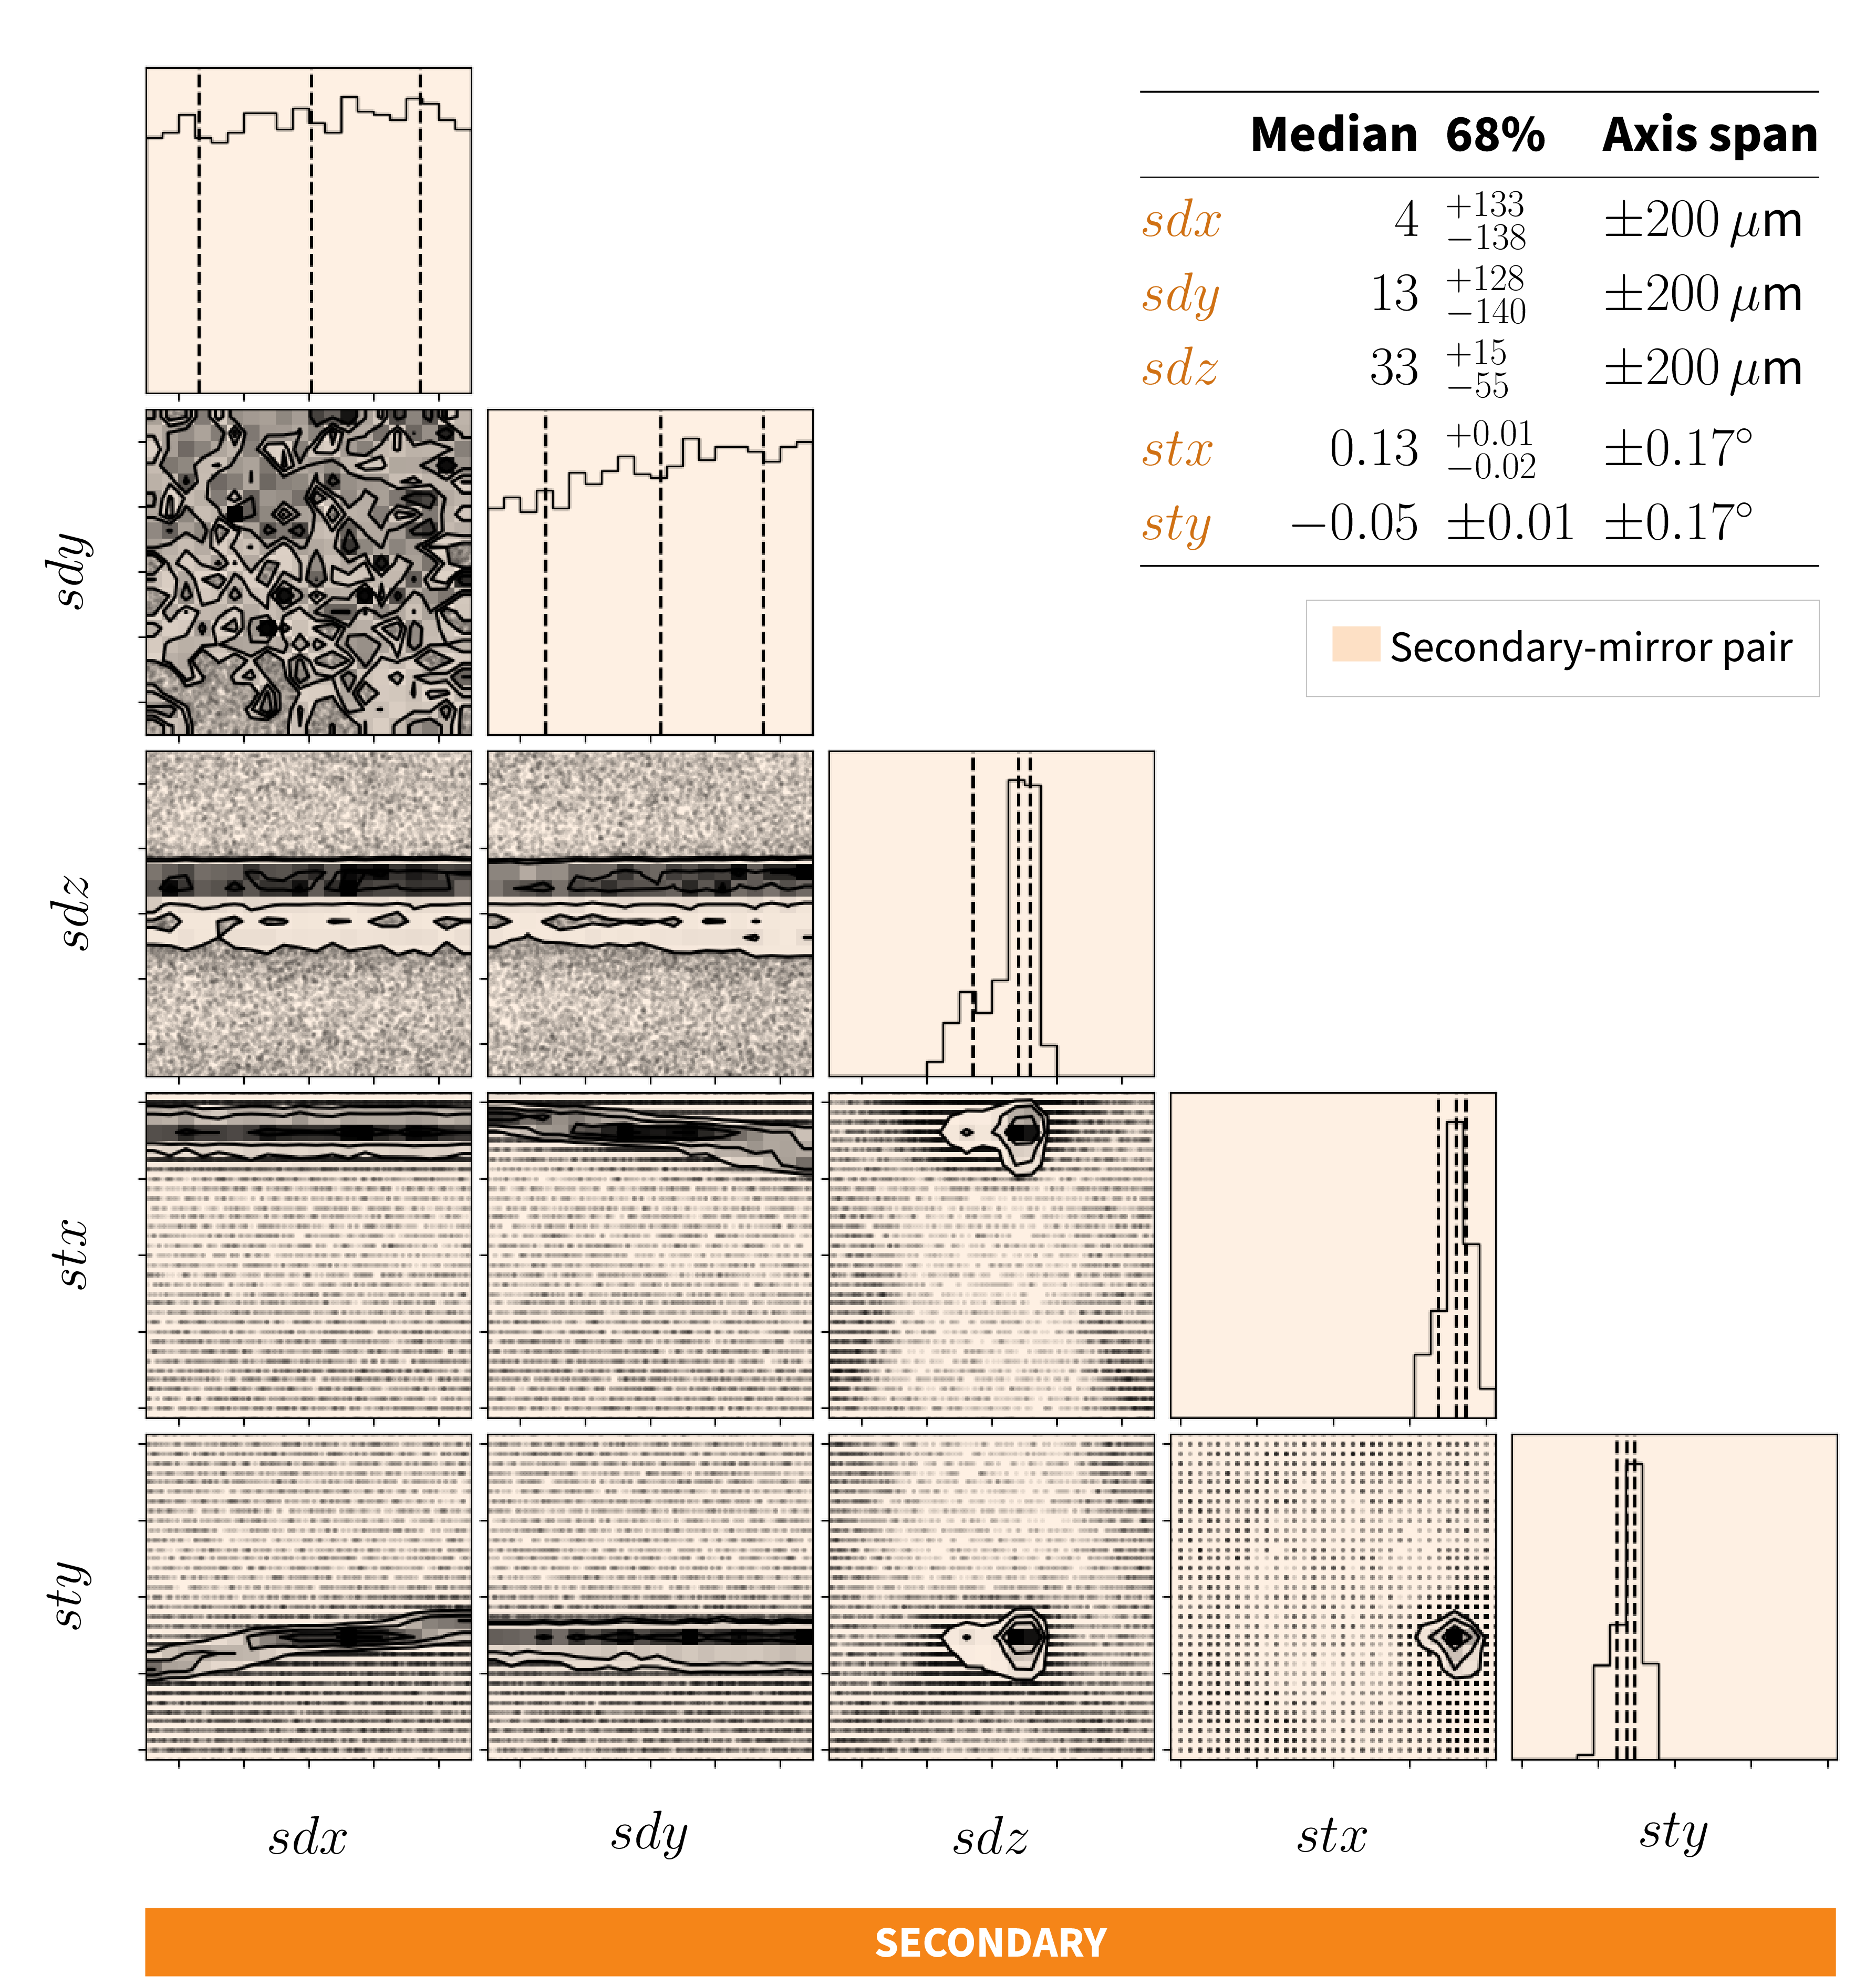
O Mirror, Where Art Thou?
Position retrieval using nested sampling and global minimization
Connect on
LinkedIn
Sai Krishanth P.M.^{1,2}, Sanchit Sabhlok¹, Jaren N. Ashcraft³, Kyle Van Gorkom¹, Ewan S. Douglas¹
¹Steward Observatory and ²Wyant College of Optical Sciences, University of Arizona ³UC Santa Barbara Contact: saikrishanth@arizona.edu
Motivation
Inference pipeline
Validating on a TMA
Can we tell where a telescope’s mirrors are from its images alone?
Compact TMA [6] (6.47 m pupil, λ = 0.65 µm) with ten degrees of freedom: decenter, despace and tilt of both the primary and the secondary. PSFs at 10 field points carry Gaussian noise (σ = 0.01 per pixel) and are projected onto 11 Zernike modes.
A misaligned mirror distorts the point spread function (PSF) differently across the field. Phase retrieval recovers the wavefront, not the mirror positions.
Nautilus: 93 200 likelihood calls, ln Z ≈ +484.7.
DE recovers all translations to ≤ 17 µm and reduces on-axis OPD RMS from 8.24 to 7 × 10⁻³ waves.
What we did: infer rigid-body mirror positions directly from multi-field PSFs.
Ray-traced Hubble (5 secondary-mirror DoF) and a compact TMA (10 primary + secondary DoF) in Optiland [1].
Compared multi-field PSF coefficients via a Gaussian likelihood.
Mapped the posterior with nested sampling, then refined it with differential evolution.
Checked each solution by the residual wavefront error.
Optiland [1] PSF coefficients enter a Gaussian likelihood:
Nested sampling (Nautilus [2,3]) maps the posterior.
Differential evolution [4,5] refines the Nautilus starting point.
Validation: on-axis OPD RMS of the residual telescope.
 | Primary |  | Secondary
 | Truth | Recovered | Truth | Recovered
dx (µm) | −152.75 | −159.43 | −42.31 | −38.01
dy (µm) | 316.91 | 309.97 | 923.33 | 939.85
dz (µm) | 26.63 | 24.77 | −32.75 | −34.56
tx (deg) | 2.98 × 10⁻⁵ | 2.22 × 10⁻⁴ | 0.0269 | 0.0272
ty (deg) | 1.61 × 10⁻⁵ | 6.80 × 10⁻⁵ | 0.0098 | 0.0098
Σ_{f} from 10⁴ random misalignments.
Validating on Hubble
Algorithm recovers Hubble’s optical alignment to numerical precision
Ritchey–Chrétien model (2.4 m pupil, λ = 0.55 µm) with five secondary-mirror degrees of freedom: decenter (sdx, sdy), despace sdz and tilts (stx, sty). Noise-free PSFs at 5 fields, 15 circular-Bessel modes, priors of ±200 µm and ±0.167°.
Nautilus (42 800 likelihood calls, ln Z ≈ +107.5) tightly constrains both tilts and, more loosely, sdz.
sdx and sdy stay nearly flat across the ±200 µm prior.
DE starts from the median of the final 100 posterior samples, (131.13, 56.64, 40.87, 0.12, −0.03), which alone cuts the on-axis OPD RMS from 2.26 to 0.12 waves.
Nautilus posterior for the ten TMA parameters, shaded by mirror. Outlined panels are the strongest primary–secondary degeneracies.
(a) On-axis PSF, uncorrected (2.26 waves) to final DE solution (2.6 × 10⁻⁸ waves). (b) RMS wavefront error per DE generation. (c) Parameters converging to the injected truth.
Translations recovered to < 0.01 µm:
pdx and both primary tilts are nearly flat across their priors; only the secondary tilts are tightly constrained.
Degeneracies: pdz–sdz trade off in focus; ptx–sdy and pty–sdx trade off in coma, because a tilt of one mirror and a decenter of the other both add nearly field-constant coma.
 | Truth | Recovered (DE)
sdx (µm) | 52.22 | 52.22
sdy (µm) | −113.86 | −113.86
sdz (µm) | 38.99 | 38.99
stx (deg) | 0.13 | 0.13
sty (deg) | −0.04 | −0.04
Conclusions and next steps
References
Mirror alignment is recovered directly from multi-field PSF coefficients.
Hubble: OPD RMS 2.26 → 3 × 10⁻⁸ waves.
TMA: OPD RMS 8.24 → 7 × 10⁻³ waves.
Degeneracies motivate multi-field sensing.
Next: chromatic and realistic noise models, and laboratory and on-sky PSF data for future large space telescopes.
Nautilus posterior for the five secondary-mirror parameters; the table gives full-posterior medians and 68% intervals.
[1] Harrison 2026, Optiland v0.6.0
[2] Lange 2023, MNRAS 525, 3181
[3] Skilling 2006, Bayesian Analysis 1, 833
[4] Storn & Price 1997, J. Global Optim. 11, 341
[5] Virtanen et al. 2020, Nature Methods 17, 261
[6] Kim, Choi & Douglas 2023, Proc. SPIE 12677, 126770E
Even so, DE using only the on-axis field recovers every translation to within 0.01 µm of the truth (centre panel).
We thank T. Eifler, N. Franz, K. Derby and S. Blomquist.

