Slide 1

Fusion of Symmetric and Asymetric Algorithms(AES-256&RSA-2048)
N Prudhvi Raju(CSE17092)
Sai Preetham(CSE17134)
P Tarun Sai(CSE17129)
Sai Krishna C R(CSE17112)

Slide 2
Implementation of encryption scheme with combination of Symmetric and Asymmetric techniques using NodeJs
User Interface
Encryption
Decryption

Slide 3
The representative encryption algorithms RSA and AES cannot meet the requirements of the efficiency and security of text/file encryption in separate use.
a hybrid encryption algorithm combining AES and RSA algorithm is proposed to solve the above problems to solve the efficiency and security problems in encryption.

Slide 4
Encryption Scheme:
Obtains Alice's public key.
Generates a fresh symmetric key for the data encapsulation scheme.
Encrypts the message under the data encapsulation scheme, using the symmetric key just generated.
Encrypts the symmetric key under the key encapsulation scheme, using Alice's public key.
Sends both of these encryptions to Alice.

Slide 5
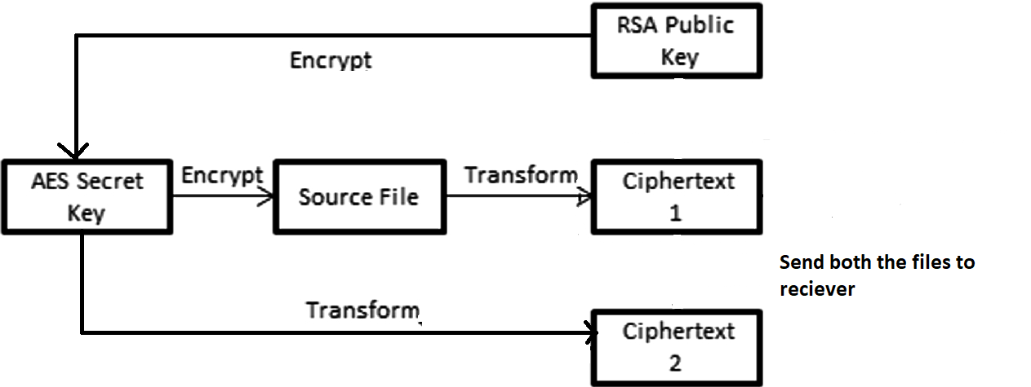
Encryption Diagram

Slide 6
Decryption Scheme:
Sends both of these encryptions to Bob.
To decrypt this hybrid ciphertext, Bob does the following:Uses his private key to decrypt the symmetric key contained in the key encapsulation segment.
Uses this symmetric key to decrypt the message contained in the data encapsulation segment.

Slide 7
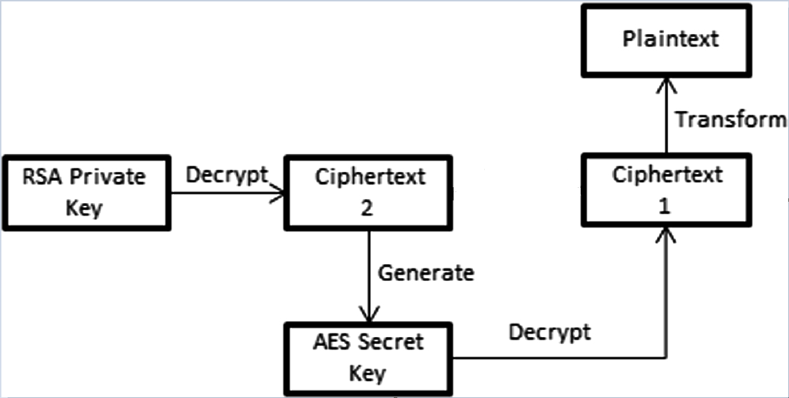
Decryption Diagram

Slide 8
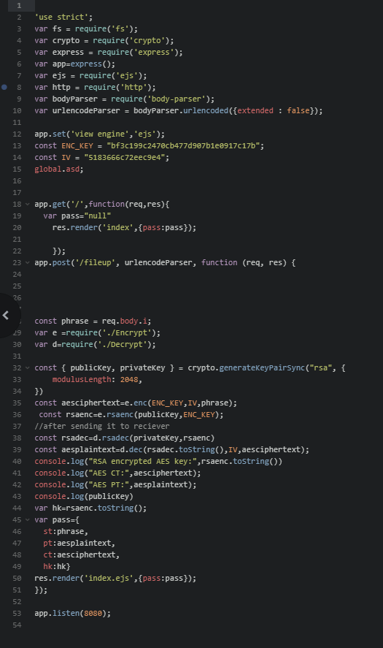

Slide 9
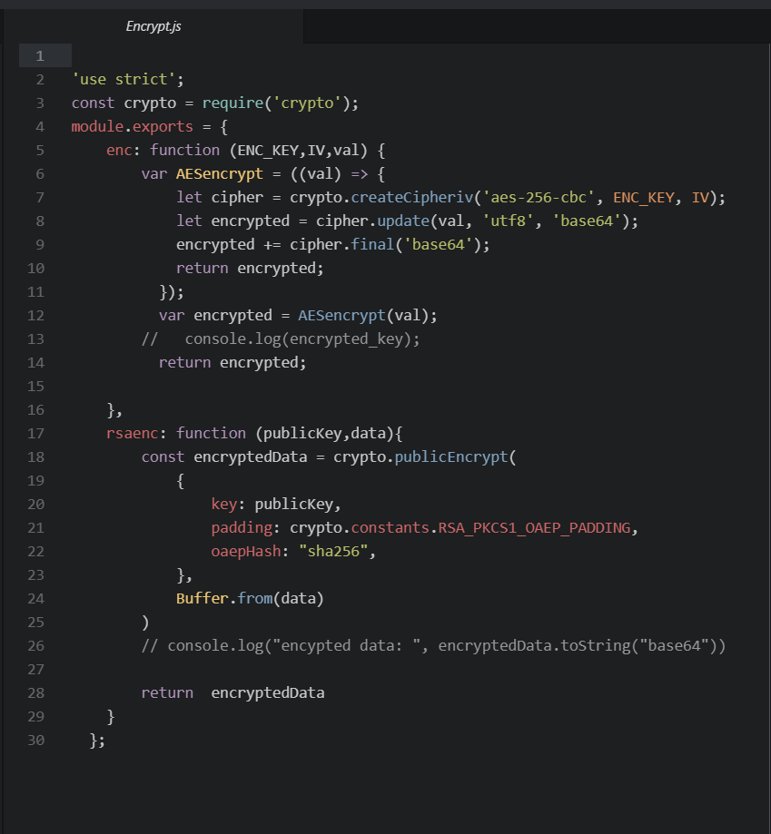

Slide 10
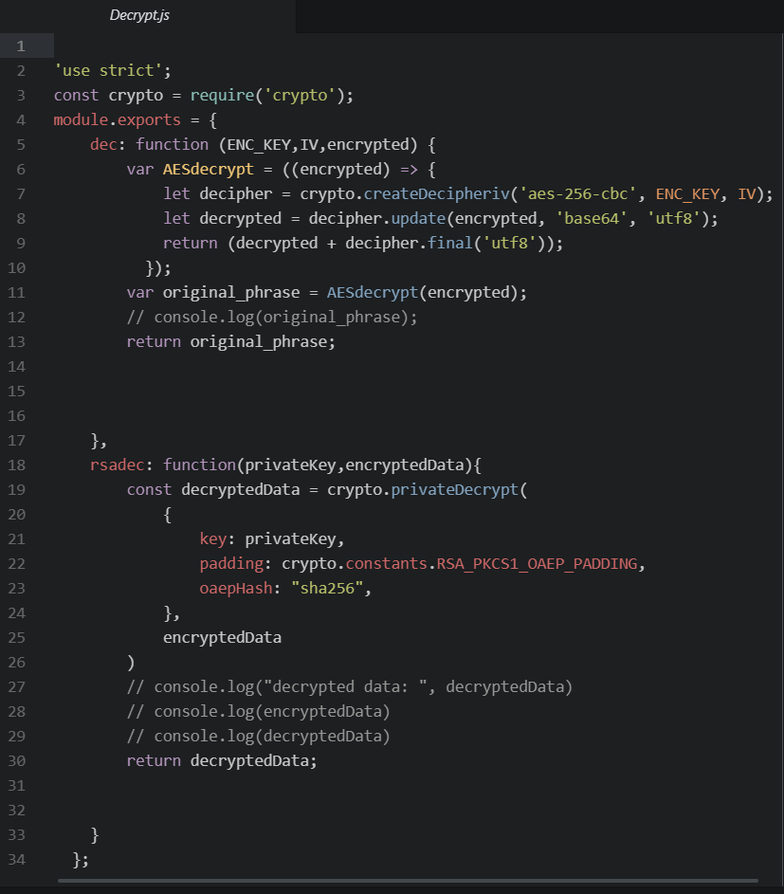

Slide 11
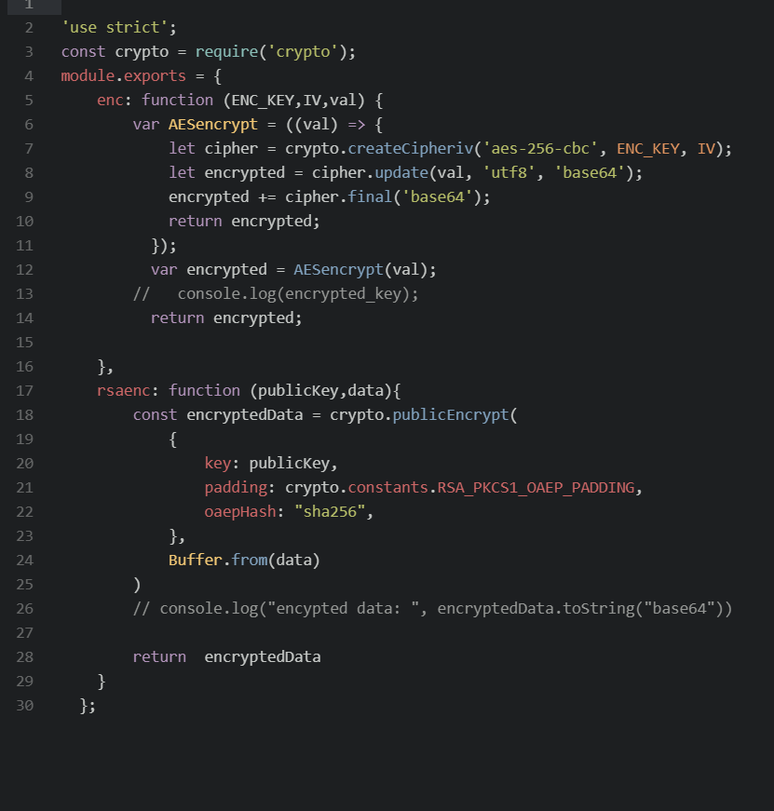

Slide 12
THANK YOU

