Slide 1
Federal Contract Oversight
FY2025 Risk Classification Framework
Combining Cumulative Risk Logic and Unsupervised Clustering
Session Update: EDA, Updated Ground Truth & Initial Modeling
Akshitha Pitla · Sai Krishna Grandhi · Vinod Kumar Kethavath
The Catholic University of America · MS Data Analytics · Spring 2026
600,862
3
8.4%
0.7574
Contracts Analyzed
Departments DoD·DHS·HHS
High Risk Rate
XGBoost ROC AUC

Slide 2
OVERVIEW
Presentation Outline
01
Introduction
Problem definition, background, motivation
02
Methodology
Dataset, data cleaning, feature engineering, ground truth
03
Model Development
Three unsupervised algorithms + three supervised classifiers
04
Results
Classifier performance, SHAP feature importance
05
Discussion
Interpretation, contributions, future work
06
Conclusion
Summary and key takeaways

Slide 3
INTRODUCTION — PROBLEM DEFINITION
The Federal Contract Oversight Challenge
$700B+
The U.S. federal government awards over $700 billion in contracts annually. With 600,000+ transactions, manual risk review is not feasible at scale.
Scale Impossible to Review
No Standardized Risk Framework
Massive Financial Exposure
600,000+ transactions per year.
No officer can assess all contracts.
High-risk awards remain invisible.
Risk is multi-dimensional — financial,
vendor, compliance, performance.
No unified system combines them.
One undetected high-risk contract
can represent millions in fraudulent
or wasteful government spend.

Slide 4
INTRODUCTION — BACKGROUND
Background & Motivation
Why This Problem Matters
Why Machine Learning
Federal procurement fraud and waste cost taxpayers billions annually (GAO, 2024).
GAO procurement literature suggests 5–10% of federal contracts carry irregularity risk.
Existing oversight relies on manual audit sampling — covers less than 5% of contracts.
DoD, DHS, and HHS collectively represent the largest civilian and defense contracting spend.
No publicly available labeled dataset for federal contract risk exists.
USASpending.gov provides comprehensive FY2025 contract transaction data publicly.
Machine learning offers a scalable, data-driven approach to systematic risk detection.
Prior work in fraud detection (credit card, insurance) shows ML is highly effective on imbalanced tabular data.

Slide 5
METHODOLOGY — DATASET
Dataset — FY2025 Federal Contracts
600,862
3
293
FY2025
Total Contracts
Departments
(DoD · DHS · HHS)
Raw Columns
Data Period
Six Risk Dimensions Identified Across 56 Engineered Features
Financial Risk
Procurement Risk
Compliance Risk
Obligation amounts, value gaps, outlay ratios, contract ceiling
Competition type, pricing type, award type, number of offers
FedBizOpps posting, subcontracting plans, cost pricing data
Vendor Risk
Performance Risk
Socioeconomic Fraud
Foreign funding, SAM status, entity type, business size
Contract duration, NAICS code, performance dates
HUBZone, veteran, women-owned, 8(a) flag combinations

Slide 6
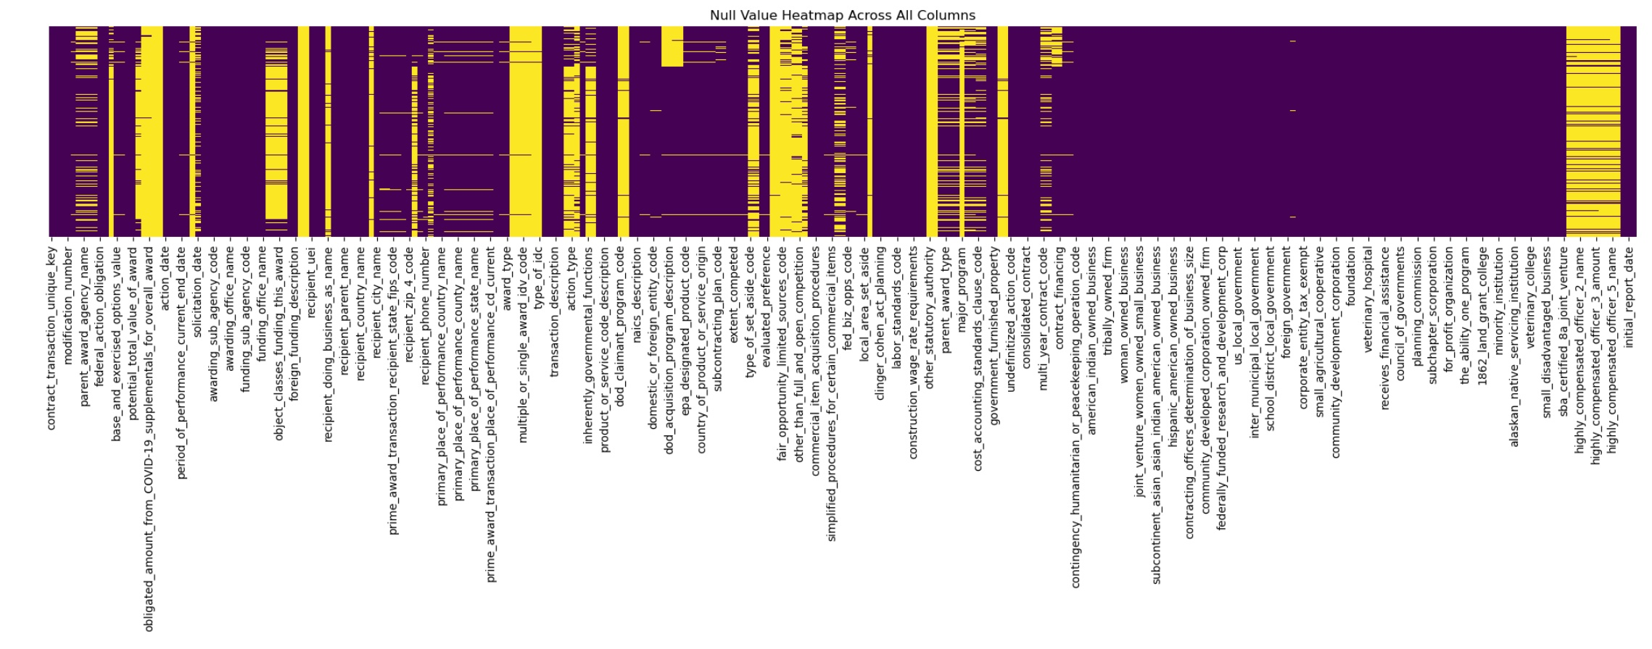
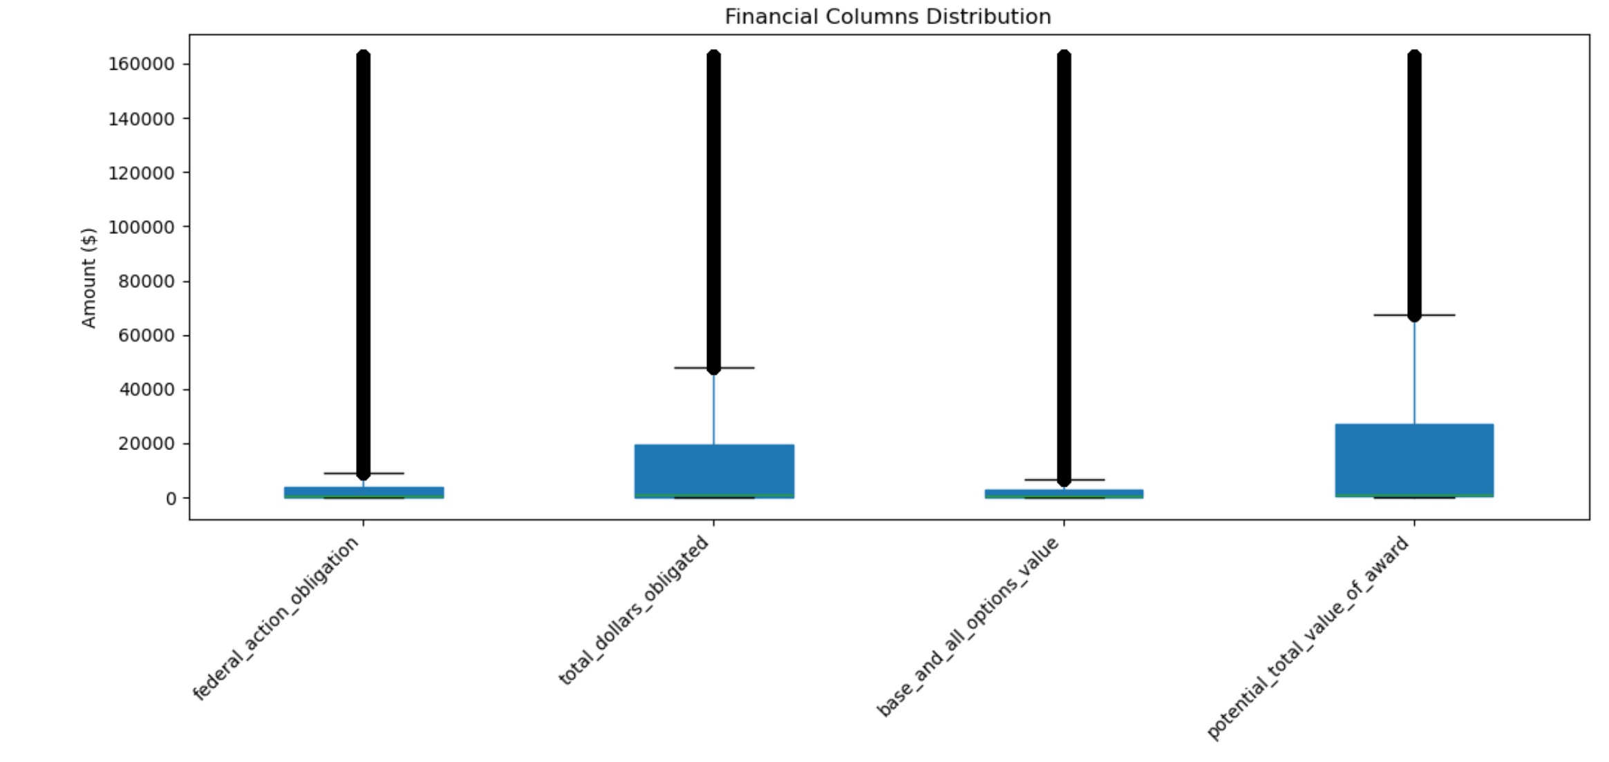
METHODOLOGY — EXPLORATORY DATA ANALYSIS
EDA — Data Quality & Financials
Null Value Heatmap — 293 Columns
Financial Columns Distribution
Finding: Many columns are heavily null (yellow). Right-side columns (executive compensation, COVID supplements) dropped — not relevant to risk detection.
Finding: All 4 financial columns are heavily right-skewed. Median near zero but outliers reach $160K+. Log transformation applied before clustering.

Slide 7
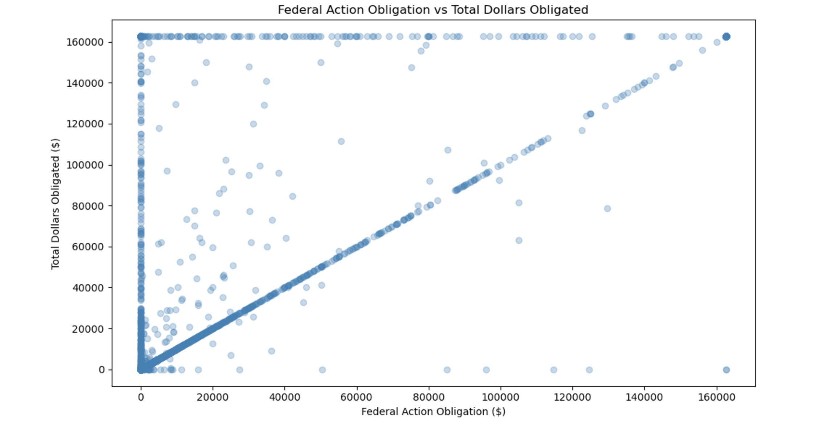
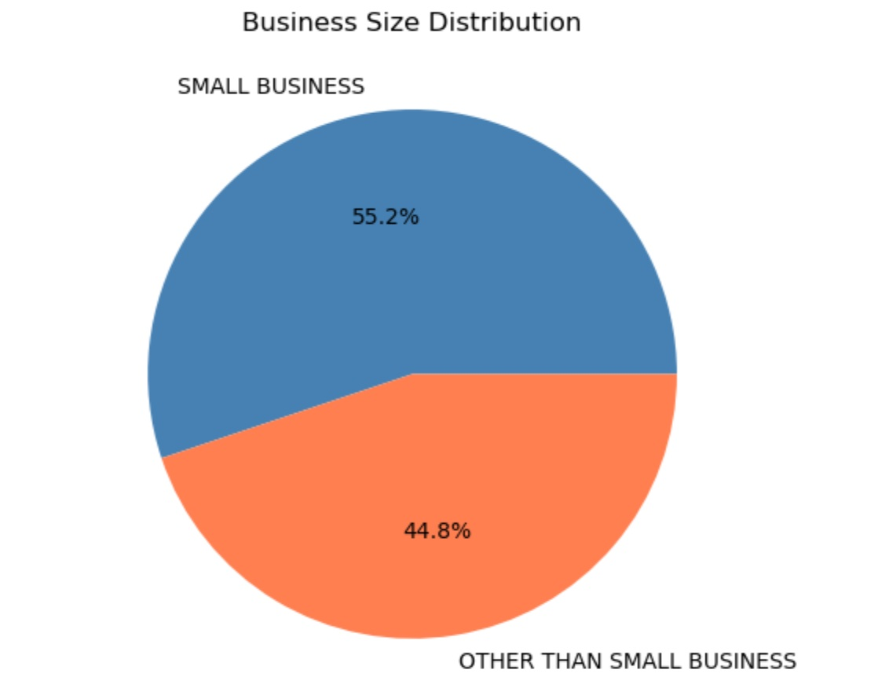
METHODOLOGY — EXPLORATORY DATA ANALYSIS
EDA — Correlation & Vendor Analysis
Obligation vs Total Dollars Obligated
Business Size Distribution
Finding: Strong diagonal = most contracts have obligation ≈ total obligated. Off-diagonal outliers (top-left) = contracts where total obligated far exceeds the action amount — a financial risk signal.
Finding: 55.2% Small Business vs 44.8% Other Than Small Business. Near-equal split raises misclassification risk — set-aside fraud is a key socioeconomic risk dimension.

Slide 8
METHODOLOGY — DATA CLEANING
Data Cleaning & Preparation
1
Load & Merge
Combined DoD + DHS + HHS CSV files → 600,862 rows, 293 columns
Dropped 4 fully null columns → 289 usable columns
2
Null Analysis
Identified columns with >50% null → dropped high-null columns
Selected 56 meaningful risk features across 6 dimensions
3
Date Engineering
Derived days_of_performance from start/end dates
Extracted modification_type prefix (STANDARD / PRICING / ADMINISTRATIVE)
4
Null Row Removal
Dropped rows with any remaining null across 56 features
464,385 clean rows retained (77.5% of original dataset)
5
Label Encoding
Label-encoded all 41 categorical columns
StandardScaler applied → X matrix (464,385 × 56)

Slide 9
METHODOLOGY — GROUND TRUTH
Ground Truth — Three-Algorithm Majority Vote
No prior labels exist. Three structurally different unsupervised algorithms vote independently. A contract is labeled High Risk only when 2 of 3 agree.
K-Means
Isolation Forest
HDBSCAN
Groups contracts by feature similarity. Cluster with higher obligations and longer durations → High Risk.
Scores each contract by how easily it can be isolated. Statistically anomalous contracts across any feature → flagged.
Hierarchical density-based clustering. Contracts with no dense neighborhood are labeled noise → High Risk.
62,293 flagged
37,151 flagged
21,172 flagged
k=2 · Silhouette 0.486
Contamination 8%
min_cluster_size=100

Slide 10
METHODOLOGY — GROUND TRUTH RESULTS
Majority Vote Distribution
Rule: 2 of 3 flag as anomalous → HIGH RISK. All 3 agree normal → LOW RISK. Disagreement → UNCERTAIN, excluded from training.
K-Means
Isolation Forest
HDBSCAN
Label
Count
High Risk
Anomaly
Noise
HIGH RISK (1)
39,161
Normal
Normal
Normal
LOW RISK (0)
397,369
Disagree
—
—
UNCERTAIN — Excluded
27,855
39,161
397,369
27,855
436,530
HIGH RISK
Flagged
LOW RISK
Confirmed
UNCERTAIN
Excluded
TOTAL LABELED
For Training

Slide 11
METHODOLOGY — CLASS IMBALANCE & VALIDATION
Handling Imbalance, Validation & Hyperparameter Tuning
Class Imbalance — Class Weights
10.15×
91% Low Risk vs 9% High Risk — naive model scores 91% accuracy by predicting everything Low Risk (useless). · Applied balanced class weights — High Risk errors penalized 10.15× more than Low Risk. · No SMOTE — class weights chosen for cleaner, noise-free training on real contracts.
High Risk
penalty weight
Validation — 80/20 Stratified Split
80/20
Stratified split preserves 91/9 class ratio in both train and test sets. · Training set: 349,224 rows · Test set: 87,306 rows. · Stratification prevents evaluation bias from imbalanced splits.
Stratified
train/test
5-Fold Cross Validation
0.003
Repeated Stratified K-Fold (5 folds × 3 repeats = 15 evaluations). · Confirms model stability — XGBoost AUC 0.7574 ± 0.003 across all folds. · Low std confirms results are not dependent on any single data split.
AUC std
across folds

Slide 12
METHODOLOGY — ML PIPELINE
End-to-End Machine Learning Pipeline
01
02
03
04
05
Ingest
Feature
Engineering
Ground
Truth
Classify
Evaluate
600,862 contracts
DoD · DHS · HHS
FY2025 raw data
56 risk features
6 dimensions
Derived variables
K-Means + IF
+ HDBSCAN
Majority vote
Logistic Regression
Random Forest
XGBoost
CV + Confusion
Matrix + SHAP
Feature Importance
Unsupervised algorithms construct ground truth labels → Supervised classifiers learn to generalize risk patterns to new contracts.

Slide 13
RESULTS — MODEL PERFORMANCE
Classifier Performance Comparison
All models: 56 features · 80/20 stratified split · Class weights applied · Test set: 87,306 contracts
Model
Accuracy
Precision
Recall
F1 Score
ROC AUC
Logistic Regression
76.0%
19.6%
54.1%
0.29
0.68
Interpretable baseline
Random Forest
90.6%
44.4%
17.6%
0.25
0.75
Ensemble — 200 trees
XGBoost
85.4%
32.8%
59.1%
0.42
0.7574
Best performer ★
5-Fold CV — XGBoost: AUC 0.7574 ± 0.003 · Recall 59.1% ± 0.26% · F1 0.42 ± 0.002 → Stable across all folds

Slide 14
RESULTS — CONFUSION MATRIX
XGBoost — Confusion Matrix Breakdown
Predicted: Low Risk
Predicted: High Risk
Actual:
Low Risk
4,739
69,799
9,675
High Risk contracts
correctly flagged (TP)
True Negative
False Positive
Actual:
High Risk
3,093
3,093
4,739
High Risk contracts
missed (FN) ← critical
False Negative
True Positive
9,675
Low Risk contracts
over-flagged (FP)
69,799
Low Risk contracts
correctly cleared (TN)
For federal oversight: FN (missed High Risk) is more costly than FP (extra review).

Slide 15
RESULTS — SHAP FEATURE IMPORTANCE
Top Risk Drivers — SHAP Analysis
Top 8 Risk Drivers — Mean |SHAP| (higher = stronger influence on High Risk prediction)
1
contract_financing
0.407
Non-standard financing (advance/progress payments) hardest to audit
2
product_or_service_code
0.231
IT and consulting categories carry higher inherent risk
3
days_of_performance
0.174
Longer contracts = more exposure, harder to monitor
4
total_dollars_obligated
0.159
Higher financial stakes correlate with High Risk
5
naics_code
0.153
Professional services and IT historically riskier
6
potential_total_value_of_award
0.118
Contract ceiling signals potential over-commitment
7
base_and_all_options_value
0.106
Options value gap between ceiling and obligated
8
base_and_exercised_options_value
0.098
How much was actually exercised vs awarded

Slide 16
RESULTS — BEST MODEL
Why XGBoost Outperforms — Class Weights Approach
XGBoost — Configuration
Why XGBoost Wins
n_estimators
200
1.
Gradient Boosting
scale_pos_weight
10.15 (auto-computed)
Iteratively corrects prior tree mistakes — more sensitive to minority High Risk class than Random Forest bagging.
Null handling
Native — no imputation
2.
scale_pos_weight
Class imbalance
Built-in weight parameter
Penalizes High Risk errors 10.15× — directly addresses class imbalance in the loss function.
Eval metric
AUC
3.
Tabular Design
Random state
42
Built for structured data — handles mixed feature types and missing values natively without preprocessing.
CV folds
5-fold stratified
4.
SHAP Explainability
Feature importance via SHAP shows which signals drove each contract's High Risk label — fully traceable.

Slide 17
DISCUSSION — INTERPRETATION
Interpreting the Results
XGBoost ROC AUC 0.7574
Recall 59.1% on High Risk
Substantially better than random (0.50) and logistic regression (0.68). Confirms non-linear risk patterns exist in federal contract data.
Model catches 6 in every 10 genuinely High Risk contracts. For oversight purposes, this means 4,739 out of 7,832 High Risk contracts in the test set were correctly flagged.
Precision 32.8%
Contract Financing as Top Driver
Of every 100 contracts flagged, 33 are genuinely High Risk. While not high precision, the priority for oversight is recall — missing a risky contract is more costly than reviewing a clean one.
SHAP analysis reveals contract financing type is the dominant risk signal (0.407 mean SHAP). Non-standard financing arrangements are the strongest predictor of High Risk.
Financial Features Dominate
Stable Across CV Folds
7 of the top 15 SHAP features are financial — obligation amounts, contract values, and outlay ratios. This is consistent with GAO procurement audit findings.
AUC std of 0.003 across 5 folds confirms the model is not overfitting to a particular data split. Results are reliable and reproducible.

Slide 18
DISCUSSION — DID WE SOLVE THE PROBLEM?
Success — What Was Achieved
Without This System
With This System
–
600,000+ contracts — no automated prioritization.
✓
39,161 High Risk contracts flagged automatically.
–
High-risk awards buried — impossible to find manually.
✓
4,739 confirmed High Risk caught in test set (60.5%).
–
Fraud and waste signals go undetected for months.
✓
Every contract traceable by Award ID and risk score.
VS
–
Resources wasted reviewing low-risk contracts.
✓
Oversight teams focus on the 8.4% that matters most.
–
No consistent risk methodology across agencies.
✓
Unified risk framework applied across DoD, DHS, HHS.

Slide 19
DISCUSSION — NOVEL CONTRIBUTIONS
Novel Contributions to the Field
1
Three-Algorithm Majority Vote Ground Truth
First application of K-Means + Isolation Forest + HDBSCAN majority vote for constructing defensible ground truth labels in the absence of human-annotated federal contract risk data. Addresses a fundamental gap in public sector ML.
2
Comprehensive FY2025 Federal Contract Risk Framework
End-to-end risk detection pipeline across DoD, DHS, and HHS covering 600,862 contracts. Six risk dimensions — financial, procurement, compliance, vendor, performance, socioeconomic — operationalized as ML features.
3
SHAP-Based Explainability for Procurement Oversight
Application of SHAP (SHapley Additive exPlanations) to federal contract risk detection provides contract-level explainability. Oversight officers can see exactly which features drove each High Risk prediction.
4
Contract Financing as Dominant Risk Signal
Novel empirical finding: contract_financing type is the single strongest predictor of High Risk (SHAP 0.407), surpassing financial obligation amounts. This has not previously been quantified in federal procurement ML literature.

Slide 20
DISCUSSION — FUTURE WORK
Future Work & Limitations
Human-Annotated Validation Set
Temporal Generalization
Collaborate with GAO or IG offices to obtain independently labeled contract risk data for genuine out-of-sample validation beyond the self-supervised ground truth.
Train on FY2024 data and test on FY2025 to evaluate whether risk patterns generalize across fiscal years and procurement cycles.
Cross-Agency Deployment
Real-Time Risk Scoring
Extend pipeline to all 15 federal departments. Current model trained on DoD, DHS, HHS — test transferability to other agencies (Treasury, DOE, DOT).
Integrate with USASpending.gov API for live contract risk scoring as new awards are posted. Enable proactive rather than retrospective oversight.
Hyperparameter Optimization
Ensemble of All Three Classifiers
Apply Bayesian optimization (Optuna) to tune XGBoost hyperparameters systematically. Current scale_pos_weight is computed from class ratio, not optimized.
Combine LR + RF + XGBoost predictions via soft voting or stacking. LR's high recall (54%) and XGBoost's high AUC (0.76) may complement each other.

Slide 21
CONCLUSION
Conclusion
We built an end-to-end ML pipeline that automatically identifies High Risk federal contracts from 600,862 FY2025 transactions across DoD, DHS, and HHS.
A novel three-algorithm majority vote (K-Means + Isolation Forest + HDBSCAN) was used to construct defensible ground truth labels without human annotation.
XGBoost with class weights achieved ROC AUC 0.7574 (±0.003) and recall of 59.1% — the best performance across Logistic Regression, Random Forest, and XGBoost.
SHAP analysis identified contract financing type as the dominant risk driver, followed by product/service code, days of performance, and total dollars obligated.
The system flagged 39,161 High Risk contracts (8.4% of 464K labeled contracts), providing a ranked, traceable list for oversight teams to act on.
This work demonstrates that unsupervised ground truth construction combined with supervised classification is a viable and scalable approach to federal contract risk detection.

Slide 22
REFERENCES
Reference List
[1]
USASpending.gov (2025). FY2025 Federal Contract Transaction Data — DoD, DHS, HHS. Retrieved from https://www.usaspending.gov
[2]
Government Accountability Office (2024). Federal Contracting: Opportunities to Improve Oversight. GAO Report GAO-24-105.
[3]
Chen, T., & Guestrin, C. (2016). XGBoost: A scalable tree boosting system. KDD '16. ACM.
[4]
Campello, R. J. G. B., Moulavi, D., & Sander, J. (2013). Density-based clustering based on hierarchical density estimates. PAKDD 2013.
[5]
Liu, F. T., Ting, K. M., & Zhou, Z.-H. (2008). Isolation Forest. IEEE ICDM 2008.
[6]
Lundberg, S. M., & Lee, S.-I. (2017). A unified approach to interpreting model predictions. NeurIPS 2017.
[7]
Chawla, N. V., et al. (2002). SMOTE: Synthetic minority over-sampling technique. JAIR, 16, 321–357.
[8]
Pedregosa, F., et al. (2011). Scikit-learn: Machine learning in Python. JMLR, 12, 2825–2830.
[9]
MacQueen, J. (1967). Some methods for classification and analysis of multivariate observations. Proc. 5th Berkeley Symposium.

Slide 23
Thank You
Questions & Discussion
600,862
8.4%
0.7574
59.1%
Federal Contracts
Analyzed
High Risk Rate
Detected
XGBoost
ROC AUC
High Risk
Recall
Risk Analytics for Federal Contract Oversight Using Machine Learning · FY2025

