Slide 1

SPRING FRAMEWORK

Slide 2
WHAT IS SPRING
Spring Framework is a Java platform that provides comprehensive infrastructure support for developing Java applications. Spring handles the infrastructure so you can focus on your application.
Spring is a lightweight framework. It can be thought of as a framework of frameworks because it provides support to various frameworks such as Struts, Hibernate, Tapestry, EJB, JSF etc

Slide 3
ADVANTAGES
Loosely coupling
Easy to test
Lightweight
Fast Development
Declarative support
Predefined templates

Slide 4
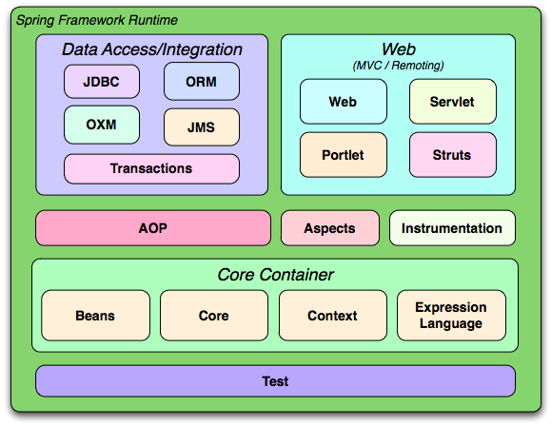

Slide 5
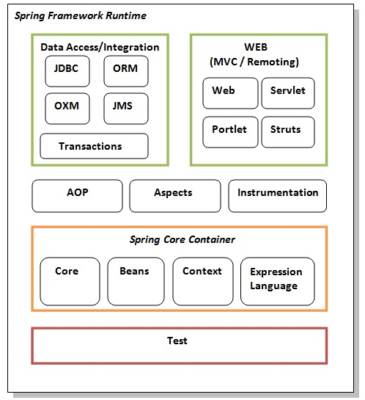

Slide 6
SPRING CORE
The Spring Core container contains core, beans, context and expression language (EL) modules.
  Core and Beans : These modules provide IOC and Dependency Injection features.
  Context: This module supports internationalization (I18N), EJB, JMS, Basic Remoting.
  Expression Language: It is an extension to the EL defined in JSP

Slide 7
AOP, ASPECTS AND INSTRUMENTATION
These modules support aspect oriented programming implementation where you can use Advices, Pointcuts etc. to decouple the code.
The aspects module provides support to integration with AspectJ.
The instrumentation module provides support to class instrumentation and classloader implementations.

Slide 8
Data Access / Integration : This group comprises of JDBC, ORM, OXM, JMS and Transaction modules. Thes e modules basically provide support to inter;act with the database.
Web: This group comprises of Web, Web-Servlet, Web-Struts and Web-Portlet. These modules provide support to create web application.

Slide 9
INJECTION OF CONTROL
The IoC container is responsible to instantiate, configure and assemble the objects.
The main tasks performed by IoC container are:
  to instantiate the application class
  to configure the object
  to assemble the dependencies between the objects

Slide 10
DEPENDENCY INJECTION
Dependency Injection (DI) is a design pattern that removes the dependency from the programming code so that it can be easy to manage and test the application.
Dependency Injection makes our programming code loosely coupled.

Slide 11
TYPES OF DI
Spring framework provides two ways to inject dependency
    By Constructor
    By Setter method

