Slide 1

Webservices- RESTful

Slide 2


what is web services
A web service is a collection of open protocols and standards used for exchanging data between applications or systems. OR
Process of exchanging information between heterogenous systems with collection of protocols.

Slide 3
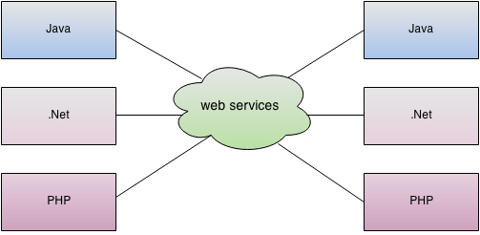

Slide 4
Web services is
is a client server application or application component for communication.
method of communication between two devices over network.
is a software system for interoperable machine to machine communication.
is a collection of standards or protocols for exchanging information between two devices or application.

Slide 5
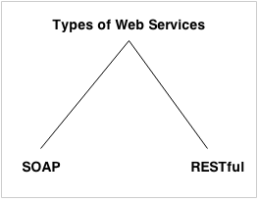
Types of web services
Soap Webservice
RestFul web services

Slide 6
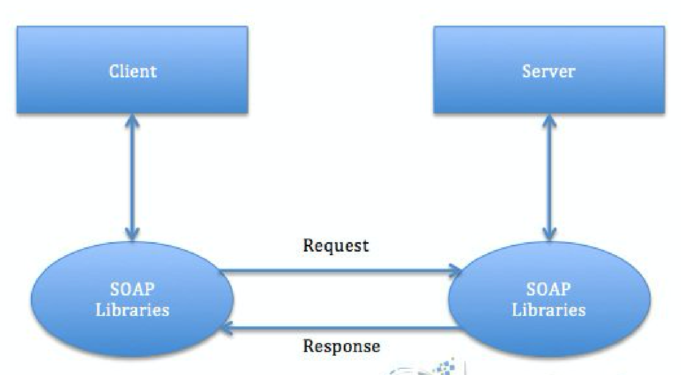
How it works

Slide 7
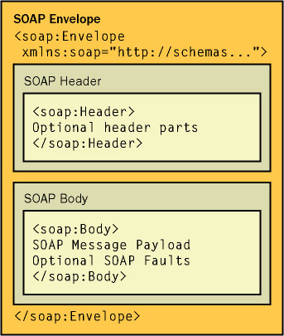
SOAP message Structure

Slide 8
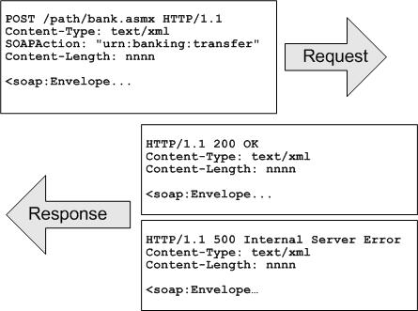
Sample request/response

Slide 9
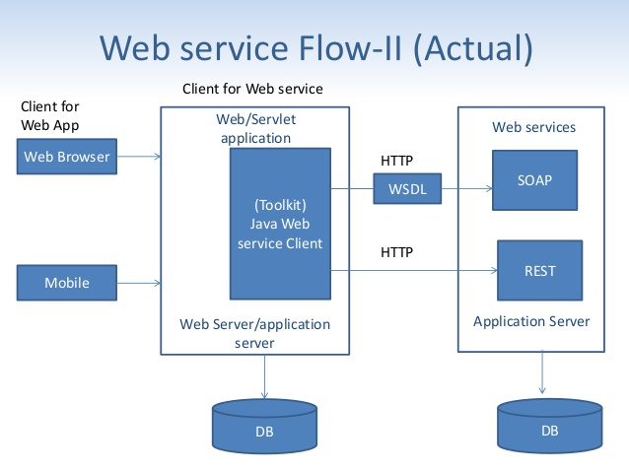

Slide 10

Http/Request methods/verbs
Method | What it means
GET | Read data/resource
POST | Send data for processing
PUT and PATCH | Replace/Update data
DELETE | Delete data

Slide 11
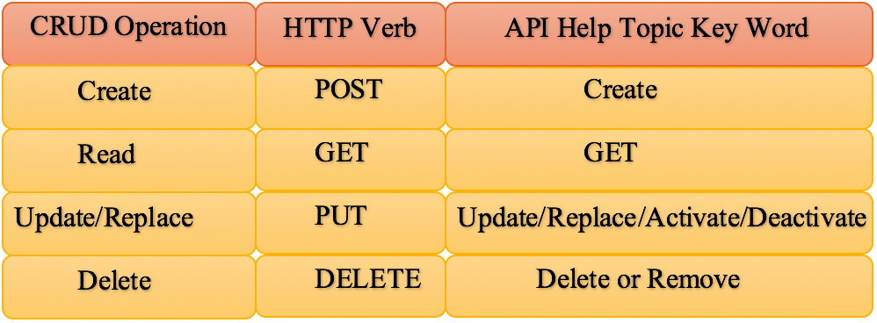

Slide 12
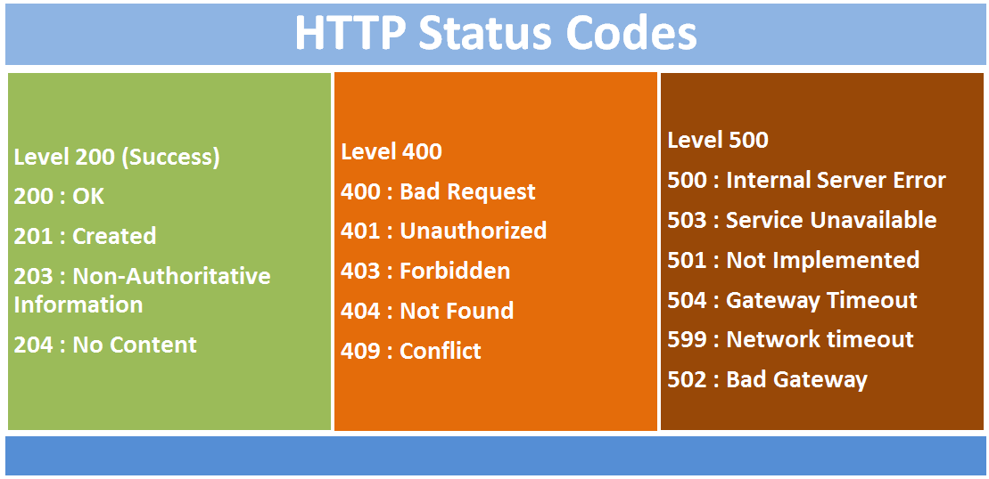
HTTPS Staus code

Slide 13
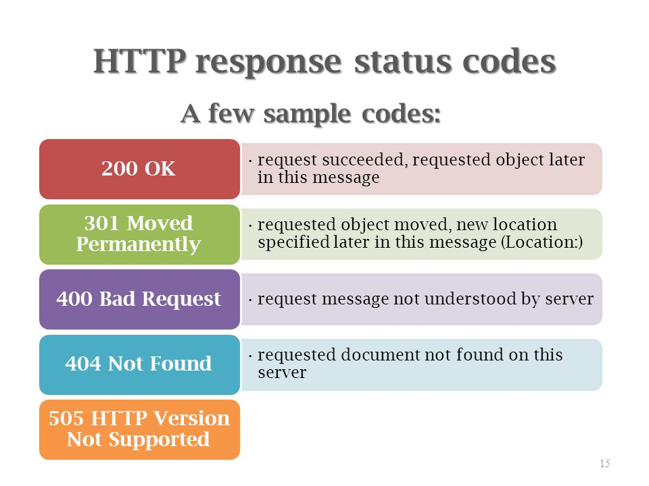

Slide 14
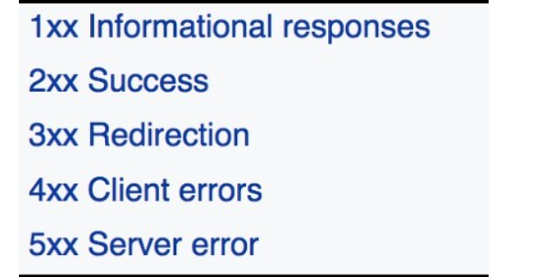
Http Status Conventions

Slide 15
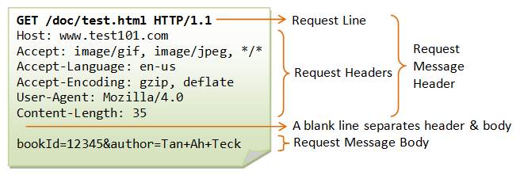
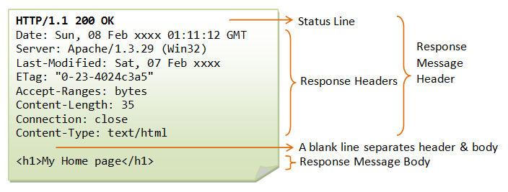

Slide 16
JSON
JSON: JavaScript Object Notation.
JSON is a syntax for storing and exchanging data.
JSON is text, written with JavaScript object notation.

Slide 17
JSON syntax rules
JSON syntax is derived from JavaScript object notation syntax:
    Data is in name/value pairs
    Data is separated by commas
    Curly braces hold objects
    Square brackets hold arrays

Slide 18
JSON files
The file type for JSON files is ".json"
The MIME type for JSON text is “application/json"

Slide 19
JSON Sample payload
{"employees":[
{ "firstName":"John", "lastName":"Doe" },
{ "firstName":"Anna", "lastName":"Smith" },
{ "firstName":"Peter", "lastName":"Jones" }
]}

Slide 20
{
"name":"John",
"age":30,
"cars": [
{ "name":"Ford", "models":[ "Fiesta", "Focus", "Mustang" ] },
{ "name":"BMW", "models":[ "320", "X3", "X5" ] },
{ "name":"Fiat", "models":[ "500", "Panda" ] }
]
}

Slide 21
Why JSON better than XML
XML is much more difficult to parse than JSON.
JSON is parsed into a ready-to-use JavaScript object.
For AJAX applications, JSON is faster and easier than XML

Slide 22
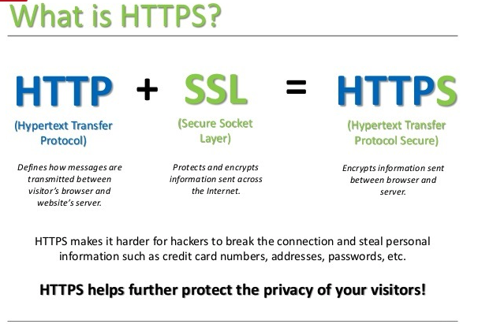
HTTP

Slide 23
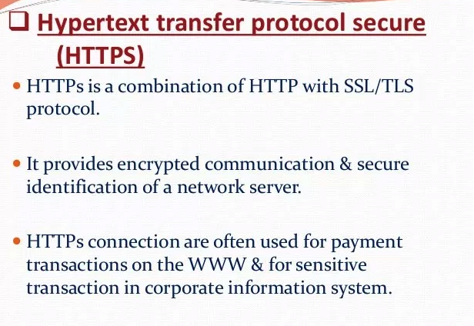
HTTPS

Slide 24
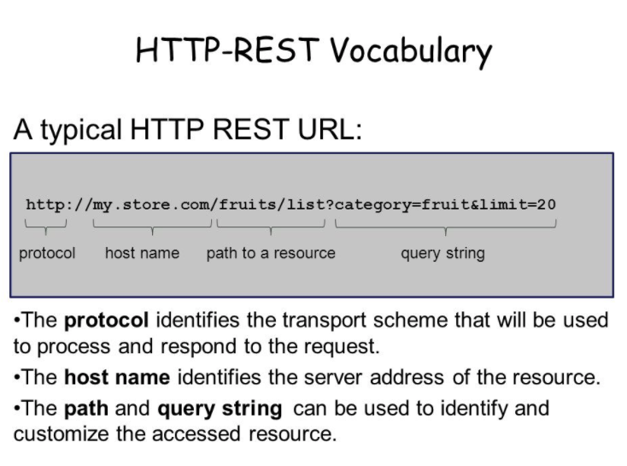

Slide 25
URI
Uniform Resource Identifiers (URIs) REST-based Web services are organized into resources

Slide 26
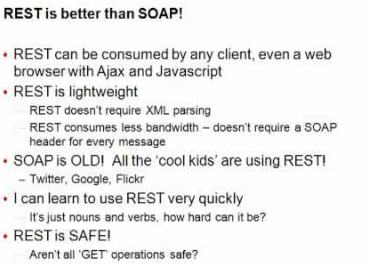
Rest Vs Soap

Slide 27
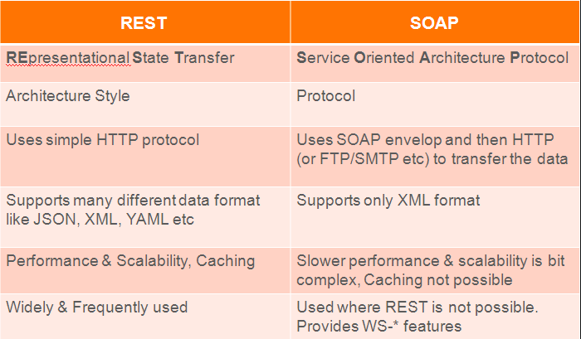

Slide 28
When to use SOAP over Rest?
Machine to machine communications (e.g Business process communications)
If need more security for WS (WS-security module)

Slide 29
To be covered
Caching
Authentication
hands excercies

