Slide 1

Estimating Vehicle Speed on Roadways
Using RNNs and Transformers:
A Video-based Approach
By
Sai Krishna Reddy Mareddy
Dhanush Kumar Antharam
Dhanush Uppalapati

Slide 2

Problem Statement:
Accurate and real-time estimation of vehicle speeds is crucial for enhancing traffic management, road safety, and enforcing speed limits.
Traditional speed measurement techniques rely heavily on physical sensors and manual enforcement, which are often expensive, potentially disruptive, and limited in geographical coverage.
Advances in computer vision and deep learning offer opportunities for non-intrusive, continuous, and automated speed detection using existing video surveillance infrastructure.

Slide 3
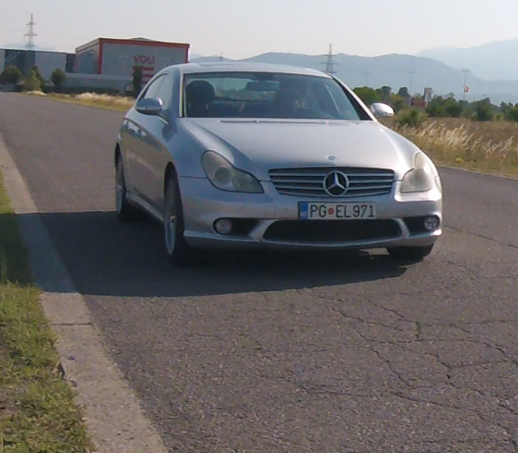
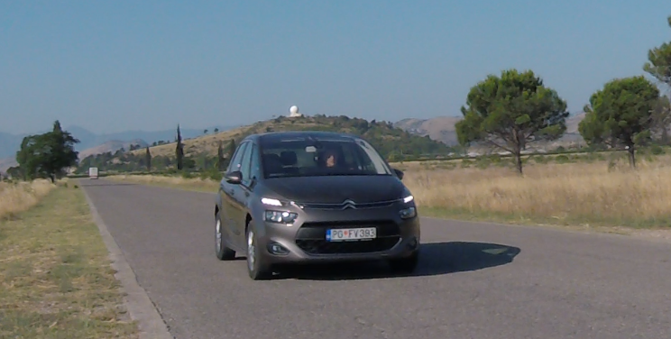
Dataset
The VS13 dataset comprises 400 high-definition video recordings, capturing 13 different vehicle models like Citroen C4 Picasso, Kia Sportage, and Mercedes AMG 550. Each vehicle is recorded at constant speeds ranging from 30 to 105 km/h, maintained through onboard cruise control for accuracy.
Dataset link: https://slobodan.ucg.ac.me/science/vs13/paper.pdf

Slide 4
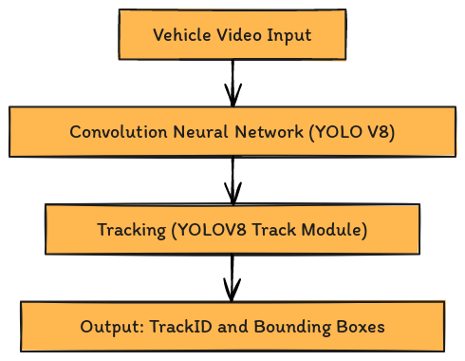
Data Preprocessing:

Slide 5
Feature Extraction:
Temporal Features : For every pair of consecutive frames, the change in bounding box coordinates is computed, highlighting the movement dynamics of each vehicle across frames.
Distance Metrics: Calculates three types of distances between consecutive frames: overall bounding box movement ( Center point) , vertical (top-left corner) movement, and horizontal (bottom-right corner) movement, capturing comprehensive motion details.

Slide 6
Normalization:
Standardizes features by subtracting the mean and dividing by the standard deviation of each feature across all data, ensuring uniform scale and aiding in the neural network's performance.
Data Augmentation:
Randomly applies noise, scales, shifts, or mirrors features to simulate variations in vehicle motion and camera perspectives, enhancing the model's ability to generalize from training data to real-world scenarios.

Slide 7
RNN Approach
Getting Embeddings from Convolutional Layer :
The initial convolutional layer transforms the input bounding box dimensions into a higher-dimensional embedding space, enabling more nuanced representation of spatial features before temporal analysis.
RNN Layer:
The use of RNN or LSTM or GRU layers allows the model to capture complex temporal dependencies and dynamics across video frames, crucial for accurate speed prediction based on the movement of vehicles.
Attention Mechanism:
Incorporates an attention module that weighs the importance of different time steps in the sequence

Slide 8
Final Layers:
After attention modulation, another convolutional layer processes the attended features to further refine and enhance the feature representation, feeding into a fully connected layer for the final speed prediction output.
Loss Function:
For classification, the model uses Cross-Entropy Loss.
For Regression , the model uses MSE Loss.

Slide 9
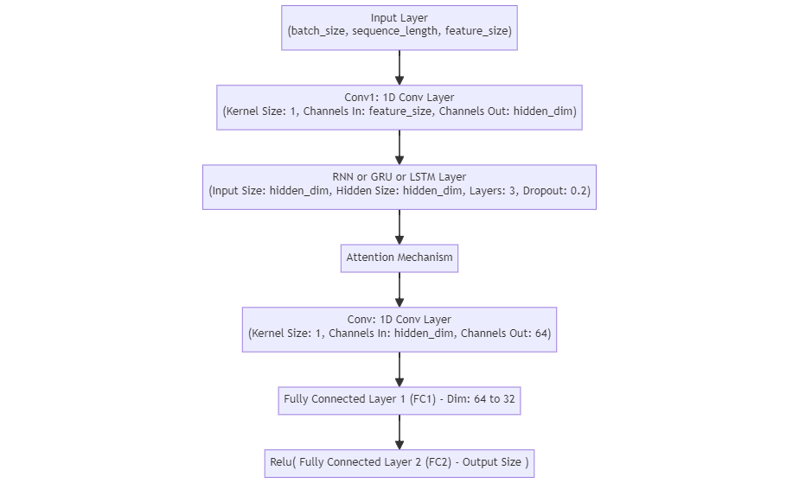
Flow Diagram

Slide 10
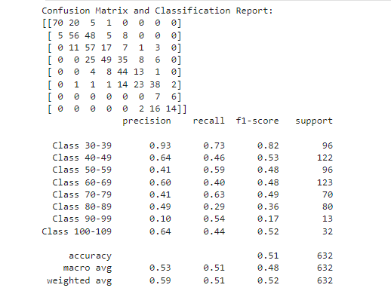
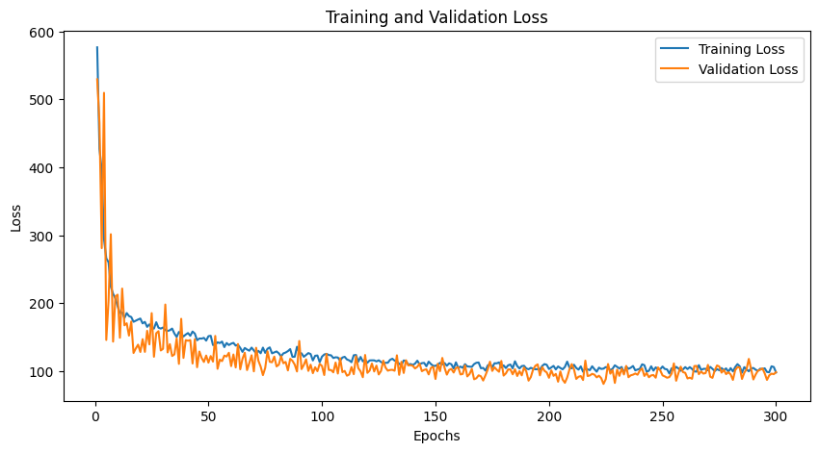
RNN Regression with Sequence Len 10
RNN Classification with Sequence Len 10
Final MSE Training loss : 122
Final Test RMSE Loss : 17.8
Sample Predictions:
Predicted: 95.9014, Actual: 100.0000
Predicted: 46.9228, Actual: 49.0000
Predicted: 67.5267, Actual: 69.0000
Predicted: 94.1912, Actual: 100.0000
Predicted: 67.8348, Actual: 67.0000
Predicted: 75.5259, Actual: 86.0000
Final Train loss : 0.90
Final Test loss : 1.18
Final Train accuracy : 61.58 %
Final Test accuracy : 50.63 %

Slide 11
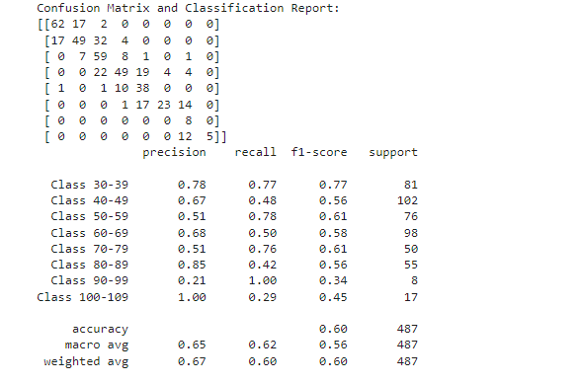
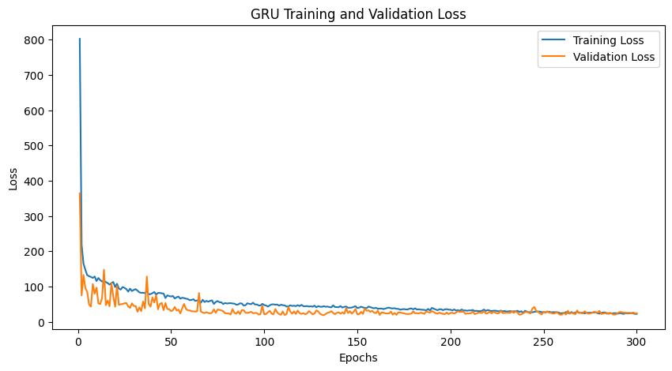
RNN Regression with Sequence Len 35
RNN Classification with Sequence Len 35
Final MSE Training loss : 72
Final Test RMSE Loss : 15.2
Sample Predictions:
Predicted: 60.7794, Actual: 61.0000
Predicted: 73.2018, Actual: 74.0000
Predicted: 47.6089, Actual: 43.0000
Predicted: 45.3637, Actual: 44.0000
Predicted: 51.7375, Actual: 49.0000
Predicted: 75.7900, Actual: 74.0000
Final Train loss : 0.24
Final Test loss : 1.05
Final Train accuracy : 98.8 %
Final Test accuracy : 60.61 %

Slide 12
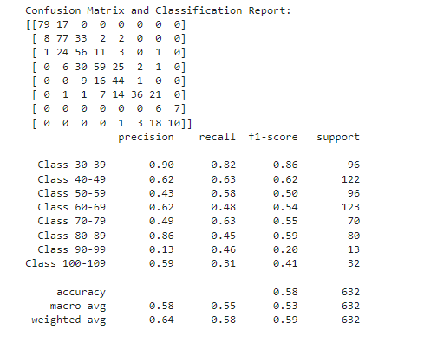
LSTM Regression with Sequence Len 10
LSTM Classification with Sequence Len 10
Final MSE Training loss : 102.2
Final Test RMSE Loss : 17.7
Sample Predictions:
Predicted: 68.6872, Actual: 57.0000
Predicted: 76.7306, Actual: 80.0000
Predicted: 65.9903, Actual: 69.0000
Predicted: 61.7196, Actual: 57.0000
Predicted: 59.9388, Actual: 61.0000
Predicted: 59.2177, Actual: 47.0000
Final Train loss : 0.96
Final Test loss : 0.94
Final Train accuracy : 58.32 %
Final Test accuracy : 58.07 %

Slide 13
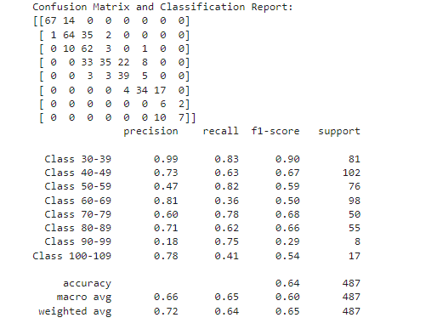
LSTM Regression with Sequence Len 35
LSTM Classification with Sequence Len 35
Final MSE Training loss : 30.58
Final Test RMSE Loss : 15.2
Sample Predictions:
Predicted: 46.2297, Actual: 47.0000
Predicted: 79.2462, Actual: 67.0000
Predicted: 52.7029, Actual: 57.0000
Predicted: 45.7315, Actual: 47.0000
Predicted: 39.6255, Actual: 38.0000
Final Train loss : 0.16
Final Test loss : 1.32
Final Train accuracy : 94.8 %
Final Test accuracy : 64.41 %

Slide 14
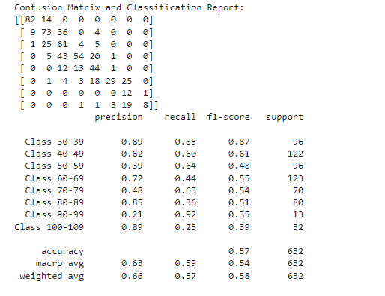
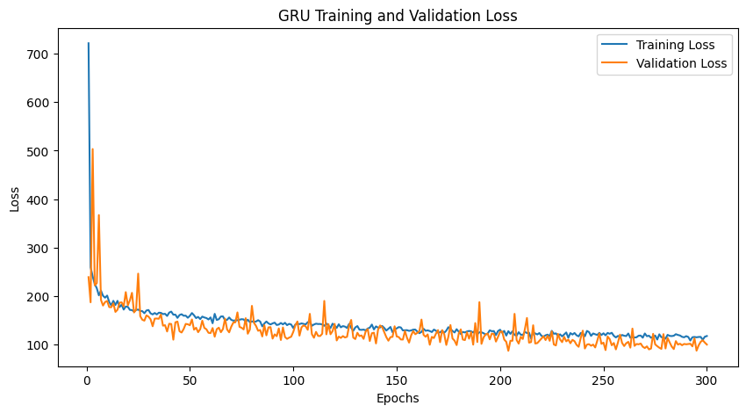
GRU Regression with Sequence Len 10
GRU Classification with Sequence Len 10
Final Training loss : 116
Final Test RMSE Loss : 17.7
Sample Predictions:
Predicted: 71.6777, Actual: 82.0000
Predicted: 48.5401, Actual: 43.0000
Predicted: 51.8533, Actual: 43.0000
Predicted: 53.4975, Actual: 50.0000
Predicted: 41.3515, Actual: 38.0000
Predicted: 60.4924, Actual: 61.0000
Final Train loss : 1.009
Final Test loss : 0.93
Final Train accuracy : 56.8 %
Final Test accuracy : 57.2 %

Slide 15
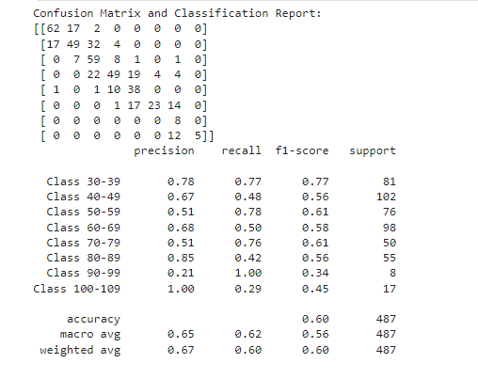
GRU Regression with Sequence Len 35
GRU Classification with Sequence Len 35
Final MSE Training loss : 24.5
Final Test RMSE Loss : 15.2
Sample Predictions:
Predicted: 52.3270, Actual: 74.0000
Predicted: 50.9507, Actual: 47.0000
Predicted: 60.7794, Actual: 61.0000
Predicted: 73.2018, Actual: 74.0000
Predicted: 51.7375, Actual: 49.0000
Predicted: 75.7900, Actual: 74.0000
Final Train loss : 0.04
Final Test loss : 1.53
Final Train accuracy : 98.86 %
Final Test accuracy : 60.1 %

Slide 16
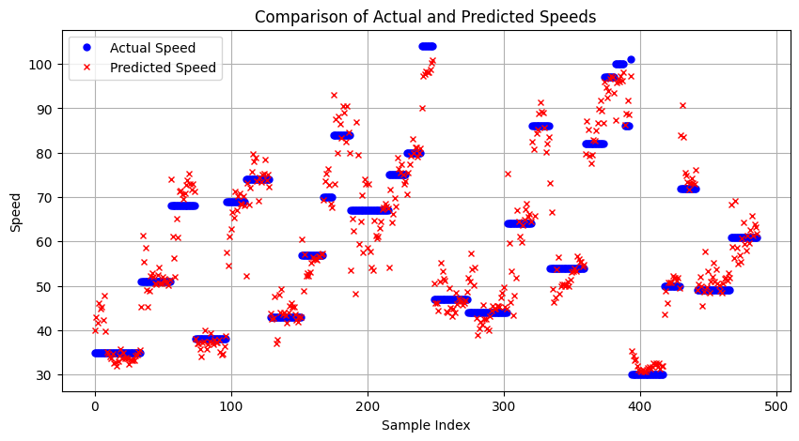
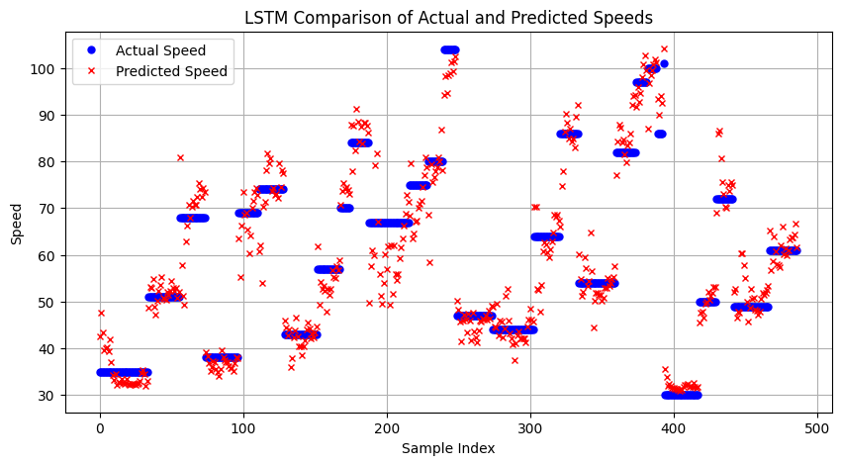
RNN Regression
LSTM Regression

Slide 17
GRU Regression

Slide 18
LSTM and GRU models consistently outperform basic RNNs, demonstrating the effectiveness of advanced gating mechanisms in managing complex temporal data for speed estimation.
Increasing the sequence length improves model accuracy and reduces errors, indicating that longer sequences capture more useful temporal context for making accurate predictions.
Moving forward, efforts should focus on refining the models to enhance generalization capabilities, exploring newer deep learning techniques like transformers could further push the boundaries of accuracy and reliability in vehicle speed estimation.

Slide 19
Transformer Based Approach
Convolutional Embedding: A 1D convolution layer initially transforms input features into a higher-dimensional space, preparing them for complex pattern recognition.
Positional Encoding: Adds unique positional signatures to the input embeddings, enabling the model to consider the order of data points within the sequence—crucial for sequence-based learning tasks.
Transformer Encoder: Utilizes a transformer architecture with self-attention mechanisms. This allows the model to process entire sequences in parallel and focus on the most informative parts of the data for making predictions.
Output Layers: The transformed data is funneled through a series of layers—ReLU for non-linearity and dropout for regularization—culminating in a final linear layer that outputs the predicted vehicle speeds.

Slide 20
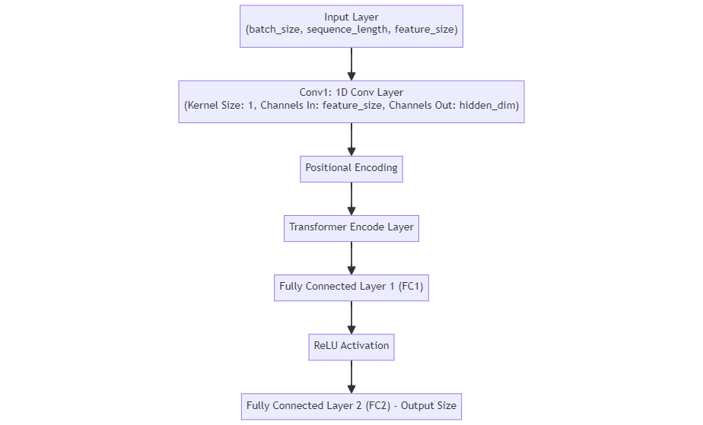
Transformer Model:

Slide 21
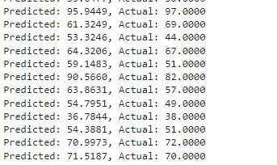
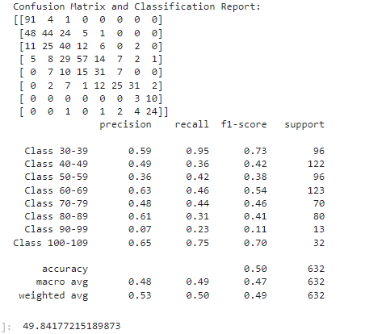
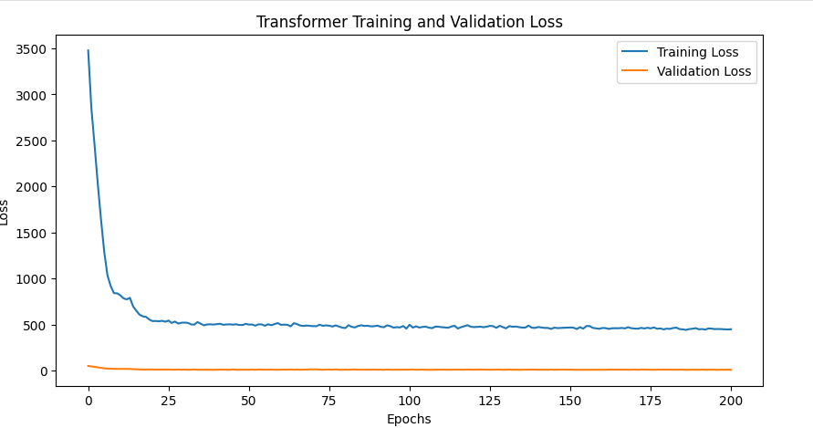
Regression with Sequence Len 10
Classification with Sequence Len 10
Final MSE Training loss : 448.43
Final Test RMSE Loss : 7.5353
Final Train loss : 1.14
Final Test loss : 0.092
Final Train accuracy : 50.38 %
Final Test accuracy : 49.68 %

Slide 22
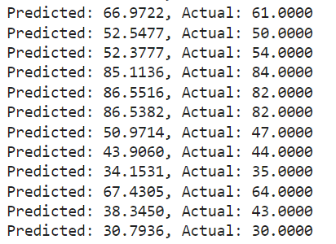
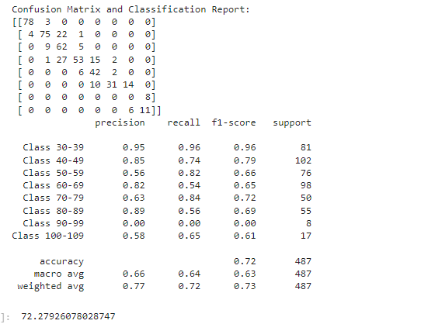
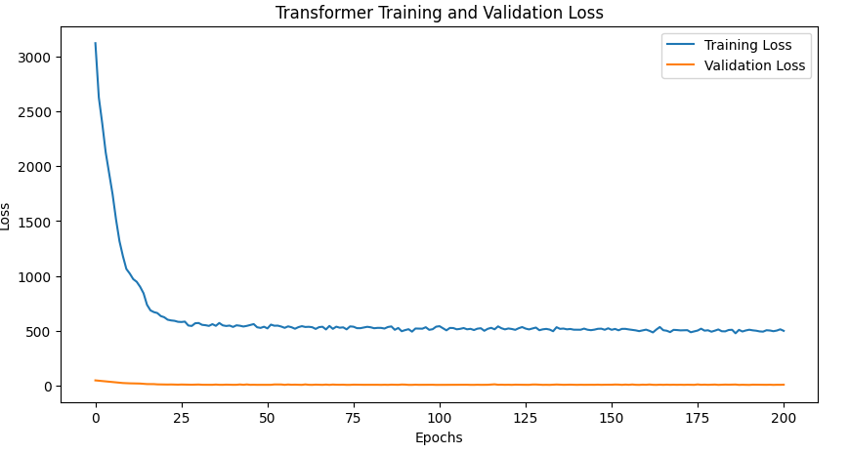
Regression with Sequence Len 35
Classification with Sequence Len 35
Final MSE Training loss : 521.814
Final Test RMSE Loss : 4.528
Final Train loss : 0.72
Final Test loss : 0.06
Final Train accuracy : 69.46 %
Final Test accuracy : 72.28 %

Slide 23
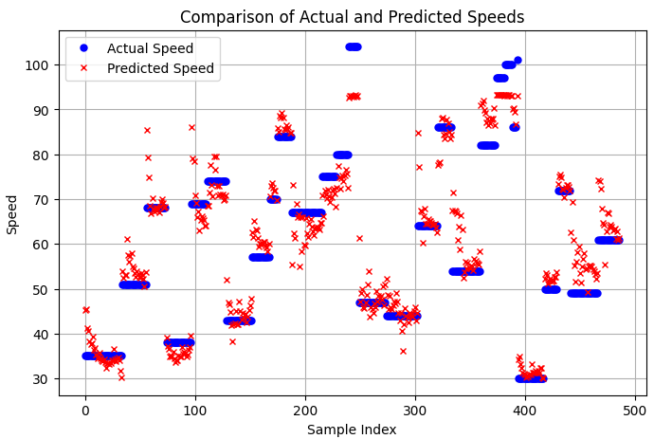
Transformer Regression

Slide 24
Comparison of Models
Regression
Classification
MODEL | RMSE
LSTM with sequence 10 | 17.7
LSTM with sequence 35 | 15.2
RNN with sequence 10 | 17.8
RNN with sequence 35 | 15.2
GRU with sequence 10 | 17.7
GRU with sequence 35 | 15.2
Transformer with sequence 10 | 7.53
Transformer with sequence 35 | 4.53
MODEL | Accuracy
LSTM with sequence 10 | 58.07%%
LSTM with sequence 35 | 64.41%
RNN with sequence 10 | 50.63%
RNN with sequence 35 | 60.61%
GRU with sequence 10 | 57.20%
GRU with sequence 35 | 60.10%
Transformer with sequence 10 | 50.68%
Transformer with sequence 35 | 72.28%

Slide 25
Conclusion
Advanced recurrent models like LSTM and GRU generally outperform basic RNNs, especially in tasks requiring understanding of long-term dependencies.
Increasing sequence length consistently improves the accuracy and decreases the loss for both RNNs and Transformers. This suggests that longer sequences provide more contextual information, which is crucial for both regression accuracy and classification precision.
Transformers, in particular, showcase exceptional performance with longer sequences, effectively leveraging their self-attention mechanisms to enhance prediction accuracy and model robustness across varying data complexities. This adaptability is crucial for deploying reliable, real-time speed estimation systems in diverse traffic conditions.

Slide 26
Thank You
Questions?

