Slide 1

Premalatha T

Slide 2
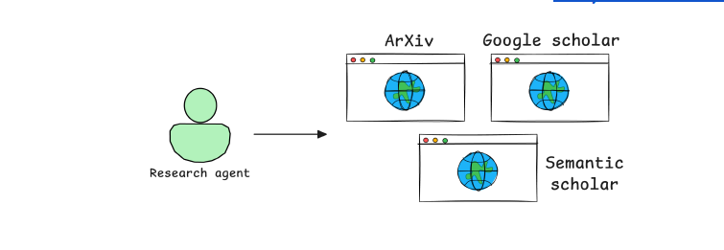


Slide 3



Slide 4
What is an AI Agent?
AI Agents are autonomous systems that can reason, plan, act, and self-correct.
They can search, filter, summarize, and format results with minimal human input.
Reason
Plan
Act
Self-
Correct

Slide 5
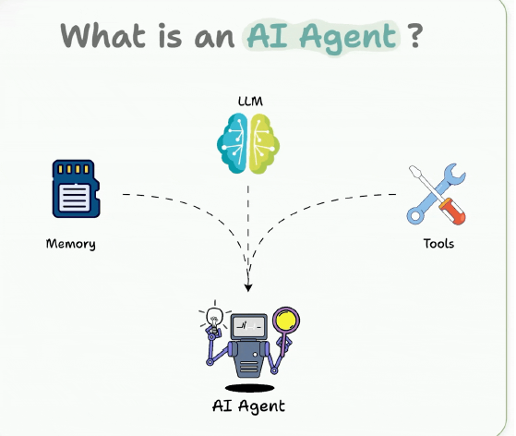

Slide 6



Agent vs LLM vs RAG
LLM = Brain (knowledge and reasoning).
RAG = Fresh knowledge source (retrieval + generation).
Agent = Decision-maker (uses LLM + tools + planning).

Slide 7
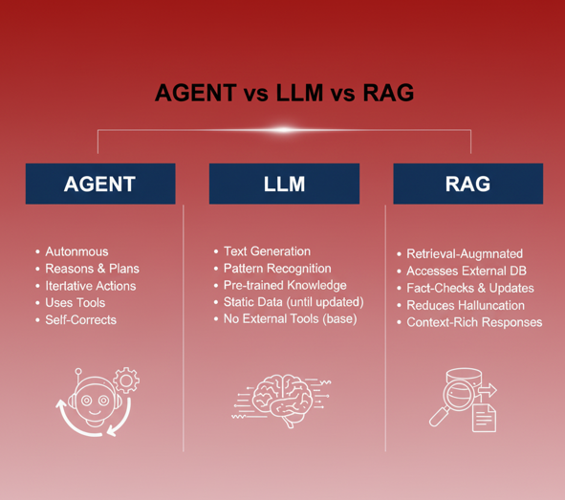

Slide 8
Feature | Large Language Model (LLM) | Retrieval-Augmented Generation (RAG) | AI Agent
Core Function | Generates human-like text based on its static training data. | Augments an LLM's response by retrieving external, current data before generation. | An autonomous system that uses an LLM/RAG as its "brain" to plan, act, and self-correct toward a goal.
Knowledge Source | Internal (what it was trained on). | Internal + External (documents, databases, etc.). | Internal + External + Real-time Tools/APIs.
Action & Autonomy | Minimal (Generate text only). | Passive (Retrieves data, still needs a prompt/user). | High (Reasons, plans, executes multi-step tasks).
Primary Goal | Answer, complete, or create text. | Provide grounded, up-to-date, and cited answers. | Achieve a complex, defined objective.
Relationship | The foundation of the other two. | An enhancement for the LLM. | An orchestrator that often uses LLM and RAG as tools.

Slide 9
Building Blocks of AI Agents
Role-playing: Define clear roles (e.g., Product Manager, Data Analyst, Auditor).
Focus/Tasks: Keep scope narrow to reduce hallucinations.
Tools: Use APIs, databases, code execution when needed.
Cooperation: Multi-agent collaboration improves accuracy.
Memory: Short-term, long-term, entity-based memory.

Slide 10
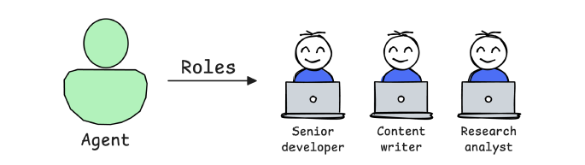
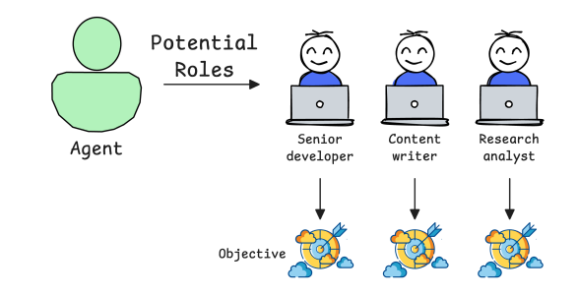

Slide 11
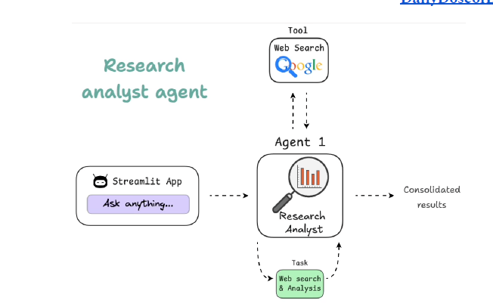

Slide 12
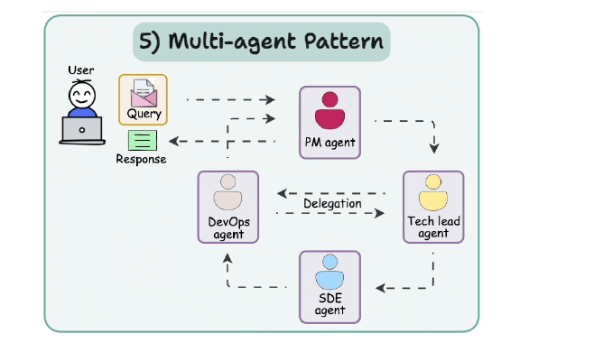

Slide 13
Agentic AI Design Patterns
Reflection: Self-evaluate outputs.
Tool Use: Gather extra info via APIs, scripts, DBs.
ReAct: Loop of Thought → Action → Observation.
Planning: Break tasks into roadmap & objectives.
Multi-Agent: Specialized agents collaborating.

Slide 14
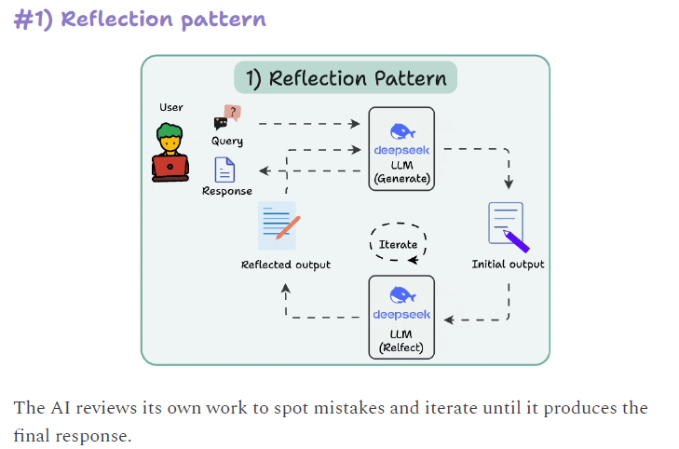

Slide 15
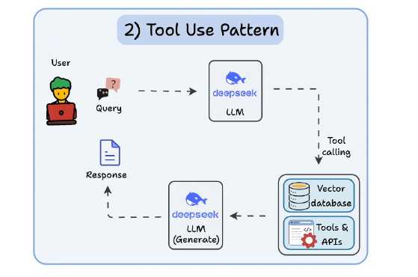

Slide 16
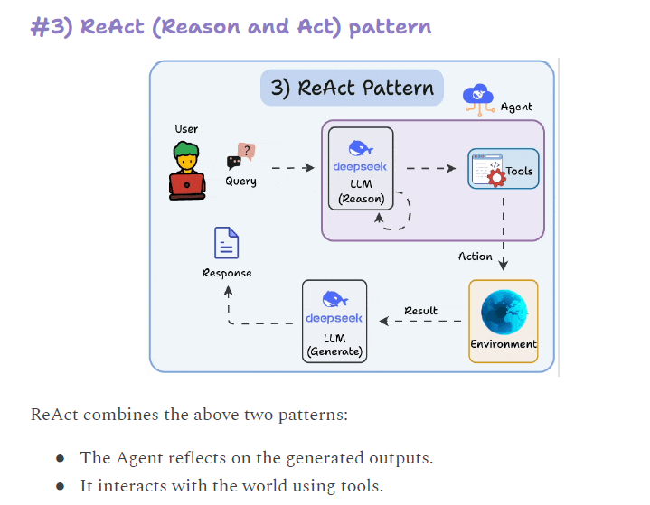

Slide 17
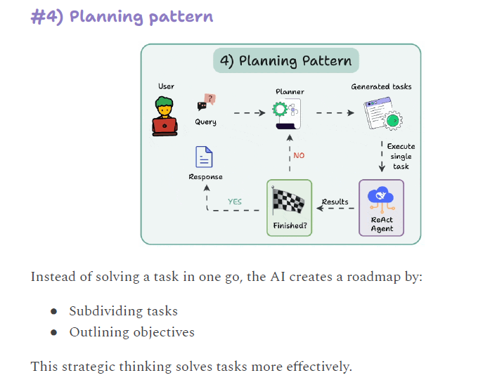

Slide 18
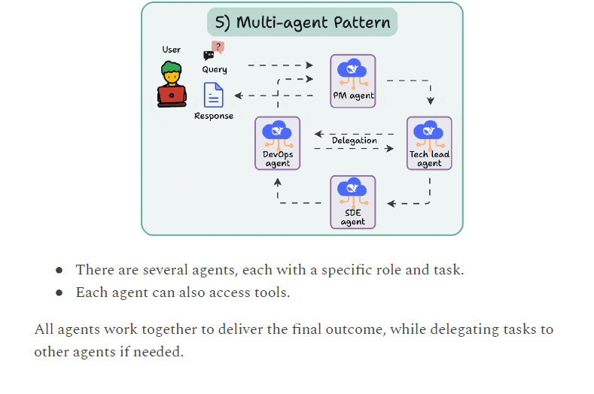

Slide 19
Levels of Agentic AI Systems
Basic responder: LLM answers directly.
Router: Directs to predefined functions.
Tool calling: Chooses and uses external tools.
Multi-agent: Manager agent orchestrates sub-agents.
Autonomous: Fully independent AI developer.

Slide 20
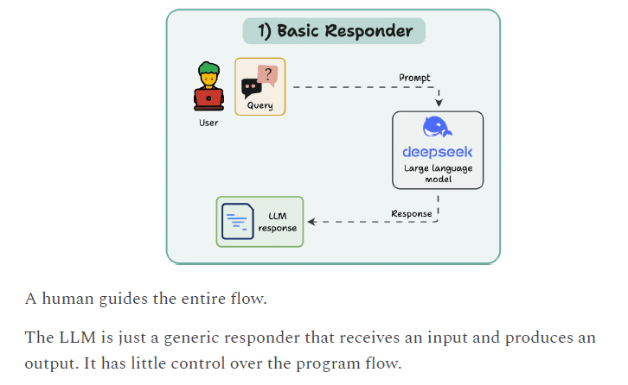

Slide 21
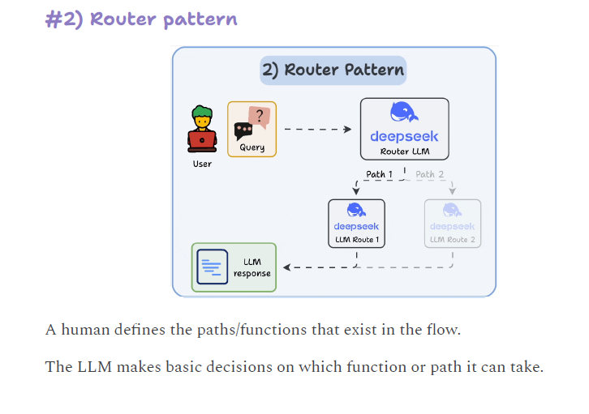

Slide 22
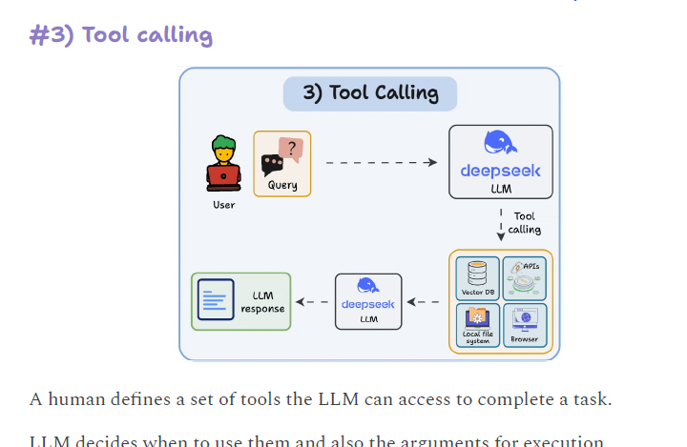

Slide 23
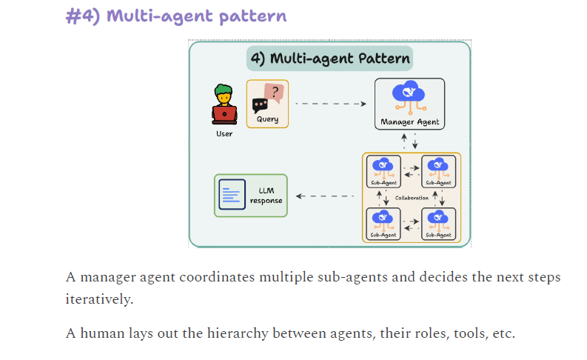

Slide 24
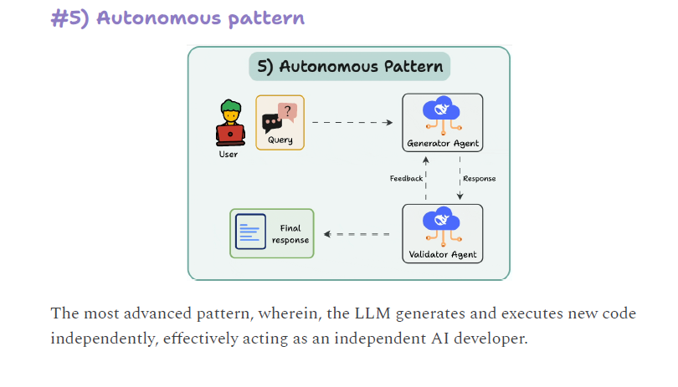

Slide 25
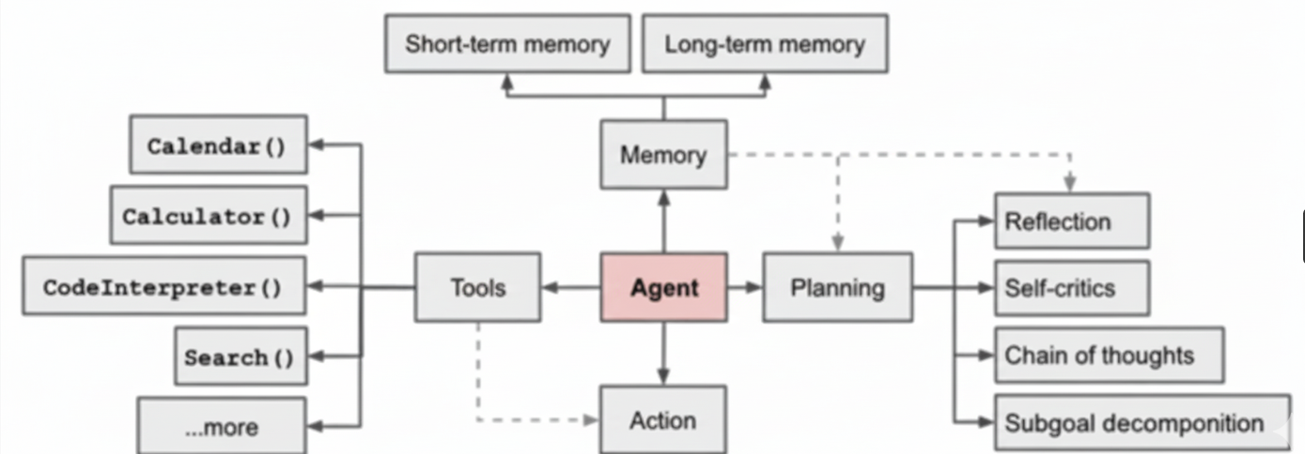

Slide 26
The Core: Agent
The Agent (highlighted in red) is the central processing unit. It receives input, interacts with all other components, and makes decisions about what to do next. Its primary function is to direct the flow of information and execution.

Slide 27
Memory
The agent relies on Memory to store and retrieve information:
Short-term memory: This holds recent information and context for the current task, similar to human working memory.
Long-term memory: This stores past experiences, knowledge, and learned information, essential for providing broader context and consistency over time.

Slide 28
Tools
Tools are external functions or resources the agent can invoke to perform specific tasks, extending its capabilities beyond its core reasoning:
Calendar( ): For scheduling, date/time lookups, or managing events.
Calculator( ): For performing mathematical operations.
CodeInterpreter( ): For writing, executing, or debugging code.
Search( ): For looking up information on the internet or in a knowledge base.
...more: Implies the system can be expanded with many other specialized tools (e.g., file I/O, database access, image generation).

Slide 29
Planning & Reflection
The Planning module is where the agent formulates its strategy and decision-making process. This module includes internal feedback loops:
Reflection: The ability to look back at past actions or thought processes and assess their success or failure.
Self-critics: A mechanism for evaluating the proposed plan or ongoing action for potential flaws or inefficiencies.
Chain of thoughts: The structured, step-by-step reasoning process the agent uses to break down a complex problem.
Subgoal decomposition: The process of breaking a large, complex task into smaller, manageable steps or sub-tasks.

Slide 30
Action
Action is the ultimate output of the agent's process. It represents the execution of the final decision, which could be:
Generating a response (text).
Calling a Tool (e.g., searching the web).
Updating Memory.
Initiating a new Planning cycle.

Slide 31
Flow of Operation
The diagram suggests a continuous cycle:
The Agent uses Planning and its internal mechanisms (Reflection, Subgoals) to decide what to do.
It can choose to interact with Memory for context or to store new information.
The plan leads to an Action.
The Action might involve calling a Tool (like Search or Calculator) to get external data or perform a computation.
The result of the Action or Tool use is often fed back to the Agent (and sometimes to Tools and Memory via dashed lines, indicating auxiliary feedback loops) for the next step of Planning.

Slide 32
Exploring and Observing AI Agent with google Colab

Slide 33
Exercise-To Recollect RAG
Premalatha T

Slide 34
Build RAG Agent using flowise

