Slide 1

Bachelor of Engineering (Computer Science & Engineering) Subject Name : Foundation OF AI Applications Lab Subject Code 20ECP-118 Prepared By: Group-4
STEGANOGRAPHY

Slide 2
Title
STEGANOGRAPHY

Slide 3
Group 4
M Vaibhav kumar (20BCS4398)
K. Sai Krishna (20BCS4448)
Durga prasad (20BCS4386)
G. Omkar Dhishan (20BCS4425)
Sujeet Sharma (20BCS4399)

Slide 4
To develop a code which can encrypt the text message into an image and decrypt such messages
AIM:

Slide 5
MODULE
We use OpenCV and Numpy libraries for the functioning of our code

Slide 6
RequIREments :
a) PC connected to Internet
b) Python IDLE( 3.7.0)
c) Libraries
d) An Image

Slide 7
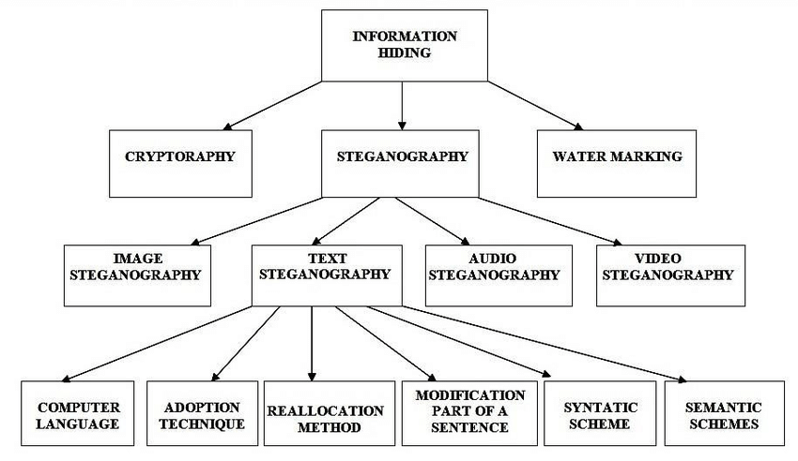

Slide 8
Explanation ABOUT STEGANOGRAPHY :
Steganography is the technique of hiding secret data within an ordinary, non-secret, file or message in order to avoid detection; the secret data is then extracted at its destination. The use of steganography can be combined with encryption as an extra step for hiding or protecting data. The word steganography is derived from the Greek words steganos (meaning hidden or covered) and the Greek root graph (meaning to write).
Steganography can be used to conceal almost any type of digital content, including text, image, video or audio content; the data to be hidden can be hidden inside almost any other type of digital content. The content to be concealed through steganography -- called hidden text -- is often encrypted before being incorporated into the innocuous-seeming cover text file or data stream. If not encrypted, the hidden text is commonly processed in some way in order to increase the difficulty of detecting the secret content.

Slide 9
CODE
from cv2 import cv2
import numpy as np
import os
def to_bin(data):
"""Convert `data` to binary format as string"""
if isinstance(data, str):
return ''.join([ format(ord(i), "08b") for i in data ])
elif isinstance(data, bytes) or isinstance(data, np.ndarray):
return [ format(i, "08b") for i in data ]
elif isinstance(data, int) or isinstance(data, np.uint8):
return format(data, "08b")
else:
raise TypeError("Type not supported.")

Slide 10
def encode(image_name, secret_data):
# read the image
image = cv2.imread(image_name)
# maximum bytes to encode
n_bytes = image.shape[0] * image.shape[1] * 3 // 8
print("[*] Maximum bytes to encode:", n_bytes)
if len(secret_data) > n_bytes:
raise ValueError("[!] Insufficient bytes, need bigger image or less data.")
print("[*] Encoding data...")
# add stopping criteria
secret_data += "====="
data_index = 0
# convert data to binary
binary_secret_data = to_bin(secret_data)
# size of data to hide
data_len = len(binary_secret_data)

Slide 11
for row in image:
for pixel in row:
# convert RGB values to binary format
r, g, b = to_bin(pixel)
# modify the least significant bit only if there is still data to store
if data_index < data_len:
# least significant red pixel bit
pixel[0] = int(r[:-1] + binary_secret_data[data_index], 2)
data_index += 1
if data_index < data_len:
# least significant green pixel bit
pixel[1] = int(g[:-1] + binary_secret_data[data_index], 2)
data_index += 1
if data_index < data_len:
# least significant blue pixel bit
pixel[2] = int(b[:-1] + binary_secret_data[data_index], 2)
data_index += 1
# if data is encoded, just break out of the loop
if data_index >= data_len:
break
return image

Slide 12
def decode(image_name):
print("[+] Decoding...")
# read the image
image = cv2.imread(image_name)
binary_data = ""
for row in image:
for pixel in row:
r, g, b = to_bin(pixel)
binary_data += r[-1]
binary_data += g[-1]
binary_data += b[-1]
# split by 8-bits
all_bytes = [ binary_data[i: i+8] for i in range(0, len(binary_data), 8) ]
# convert from bits to characters
decoded_data = ""
for byte in all_bytes:
decoded_data += chr(int(byte, 2))
if decoded_data[-5:] == "=====":
break
return decoded_data[:-5]

Slide 13
if __name__ == "__main__":
import argparse
parser = argparse.ArgumentParser(description="Steganography encoder/decoder,
this Python scripts encode data within images.")
parser.add_argument("-t", "--text", help="The text data to encode into the image,
this only should be specified for encoding")
parser.add_argument("-e", "--encode", help="Encode the following image")
parser.add_argument("-d", "--decode", help="Decode the following image")
args = parser.parse_args()
secret_data = args.text

Slide 14
if args.encode:
# if the encode argument is specified
input_image = args.encode
print("input_image:", input_image)
# split the absolute path and the file
path, file = os.path.split(input_image)
# split the filename and the image extension
filename, ext = file.split(".")
output_image = os.path.join(path, f"{filename}_encoded.{ext}")
# encode the data into the image
encoded_image = encode(image_name=input_image, secret_data=secret_data)
# save the output image (encoded image)
cv2.imwrite(output_image, encoded_image)
print("[+] Saved encoded image.")
if args.decode:
input_image = args.decode
# decode the secret data from the image
decoded_data = decode(input_image)
print("[+] Decoded data:", decoded_data)

Slide 15
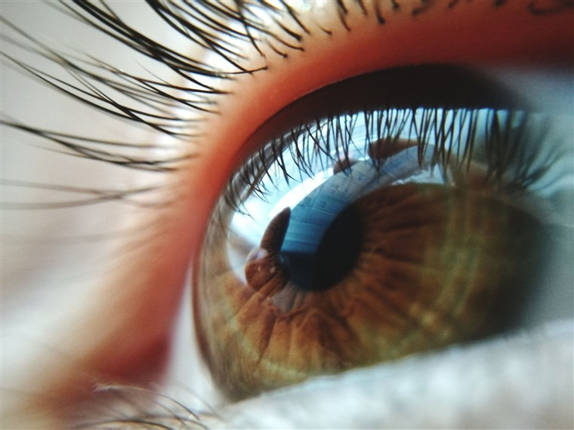
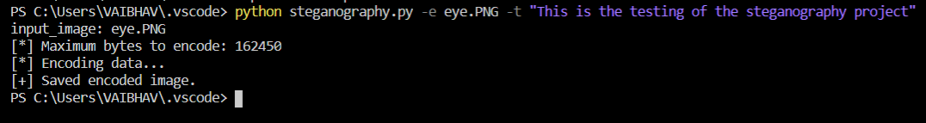
OUTPUT
Image before Encoding:
For encoding data into image:

Slide 16
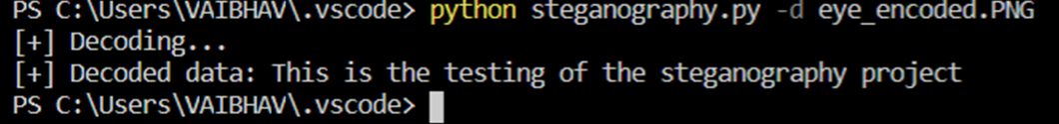
Image after encoding:
To Decode:

Slide 17
Uses:
1) Steganography means of storing data in a way that it hides the existence
of them.
2) Steganography used to carry out hidden exchanges .
3) We can send our message in other form (ex: text message is encoded
into an image and when we decode that image we get out text
message)

Slide 18
REFEReNCE LINKS
https://en.wikipedia.org/wiki/Steganography
https://www.thepythoncode.com/code/hide-secret-data-in-images-using-steganography-python
https://www.thepythoncode.com/article/hide-secret-data-in-images-using-steganography-python
https://www.python.org/

Slide 19
THANK YOU

