Slide 1
ADVANCE IOT BASED PATIENT HEALTH MONITORING SYSTEM USING CLOUD BASED BYLINK TECHNOLOGY
TEAM MEMBERS :
20MH1A04B5 - P. SAI KRISHNA GUIDE :
20MH1A04A1 - K. DIVYA Dr. R RAMAN M.Tech, Ph.D.
21MH5A0436 - K. MURALI KARTHIK
20MH1A04A0 - L. JAI SAI SANTOSH

Slide 2
contents
Abstract
Literature Survey
Problem Identification
Problem solving techniques
Key components
Software, Hardware Requirements
Block diagram
Circuit diagram
outputs
Conclusion

Slide 3
ABSTRACT
The COVID-19 pandemic has highlighted the importance of self-isolation and physical distancing in healthcare.
The Internet of Things (IoT) has been proposed as a potential application for monitoring health parameters, such as body temperature, pulse rate, body movement, and blood oxygen saturation, to provide real-time health systems.
This project uses an IoT-based wireless communication system to monitor patients remotely, allowing doctors to view their health data through an Android application.
The system uses a WIFI Module – ESP8266, Heartbeat Pulse sensor, Accelerometer, and LM35 temperature sensor, which are processed by an Arduino Uno.

Slide 4
Literature survey
Tao (2009) developed a wearable sensor system to monitor the movements of the patients. Franca (2012) has discussed that the innovations of the new generation systems are the development of continuous monitoring features for the patient and the improvement of workflows and productivity of medical personal.
An IoT deployment in healthcare needs more security because the data of any patients is more sensible and it should not be misused by any bad elements in the society.
The health related information could be interacted with doctors who are in emergency. Even in the absence of the doctor near the patient or in the hospital, the doctor can know the patients status so that the doctors advice is given in critical cases.

Slide 5
Problem Identification
Doctors play an important role in health check-ups in the conventional process. This treatment necessitates a considerable period for registration, consultation, and then observation. Reports are also created later.
Working people prefer to ignore or delay observation as a result of the lengthy procedure. This cutting-edge technique cuts down on the amount of time it takes to complete the mission. For many decades, medical scientists have been working in the fields of innovation and science to improve health care and happiness in people lives.
Their contribution to the medical field is important to us and cannot be overlooked.

Slide 6
PROBLEM SOLVING TECHNIQUE
Patient monitoring systems are considered as a part of M-health technology. These can also be named as m-health or mobile health. These systems are used for practice of medical and public health with the help of mobile devices. These monitoring systems can be used onsite or remotely.
The project is designed and developed for monitoring patients remotely using a IoT based wireless communication system. The main aim of this project is to monitor the HEART Beat, Blood Oxygen content, Body Movement and Body Temperature of the patient and display the same to the doctor through Internet based server using Blynk cloud Server.
In hospitals, patients’ body temperature must need to be monitored constantly, which is usually done by doctors or other paramedical staff. They observe the body temperature and Heart Beat of patients’ constantly and maintain a record of it.

Slide 7
KEY COMPONENTS
ARDUINO Microcontroller Board
LCD 2X16 Module
Temperature Sensor
HEART Beat Sensor
Accelerometer
Pulse Oximeter
WIFI Module – ESP8266
Transformer
Voltage Regulators
Filter Capacitors
Other Misc. Electronics Components

Slide 8
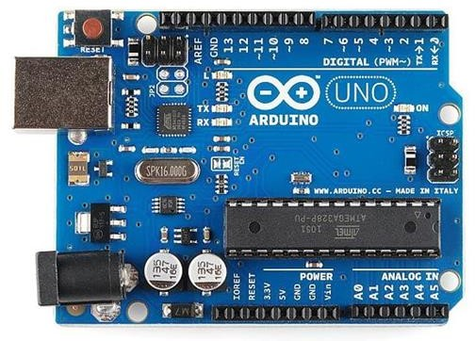
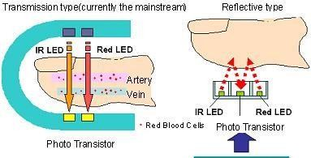
Hardware components
ARDUINO UNO
The Arduino Uno is a popular microcontroller board based on the ATmega328P microcontroller. It's easy to use and great for beginners and hobbyists. It has 14 digital input/output pins, 6 analog inputs, a USB connection, a power jack, and a reset button. The Uno can be used to develop a variety of electronic projects, from simple blinking LED lights to more complex robotics and IoT projects.
HEART BEAT SENSOR
A person’s heartbeat is the sound of the valves in his/her’s heart contracting or expanding as they force blood from one region to another. The number of times the heart beats per minute (BPM), is the heart beat rate and the beat of the heart that can be felt in any artery that lies close to the skin is the pulse. The heartbeat sensor is based on the principle of photo plethysmography.

Slide 9
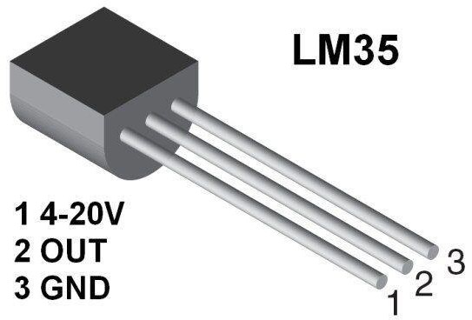
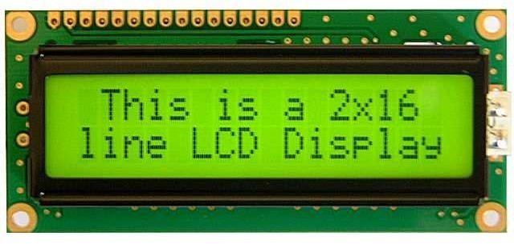
Hardware components
LM35 TEMPERATURE SENSOR
LM35 is a precision IC temperature sensor with its output proportional to the temperature . The sensor circuitry is sealed and therefore it is not subjected to oxidation and other processes. With LM35, temperature can be measured more accurately than with a Thermistor.
16*2 LCD DISPLAY
A liquid-crystal display (LCD) is a flat-panel display or other electronic visual display that uses the light-modulating properties of liquid crystals. Liquid crystals do not emit light directly. LCDs are used in a wide range of applications including computer monitors, televisions, instrument panels, aircraft cockpit displays, and signage. The LCD screen is more energy-efficient and can be disposed of more safely than a CRT.

Slide 10
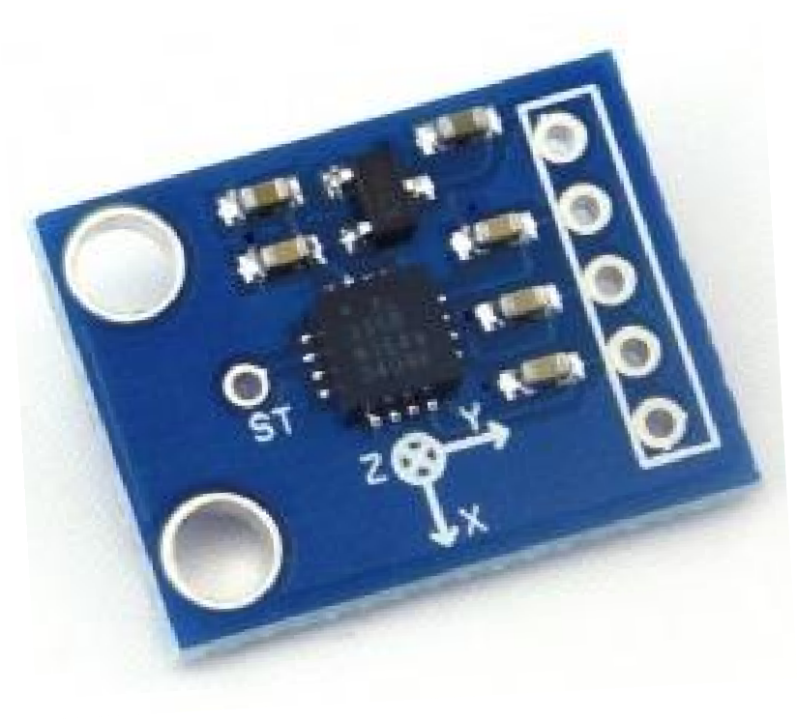
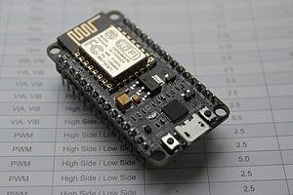
Hardware components
ACCELEROMETER
An accelerometer is a device that measures proper acceleration. Proper acceleration, being the acceleration (or rate of change of velocity) of a body in its own instantaneous rest frame, is not the same as coordinate acceleration, being the acceleration in a fixed coordinate system. Accelerometers have multiple applications in industry and science. Highly sensitive accelerometers are components of inertial navigation systems for aircraft and missiles. Accelerometers are used to detect and monitor vibration in rotating machinery.
NODE MCU – ESP8266
NodeMCU is an open-source LUA based firmware developed for ESP8266 Wi-Fi chip. By exploring functionality with ESP8266 chip, NodeMCU firmware comes with ESP8266 Development board/kit i.e. NodeMCU Development board.

Slide 11
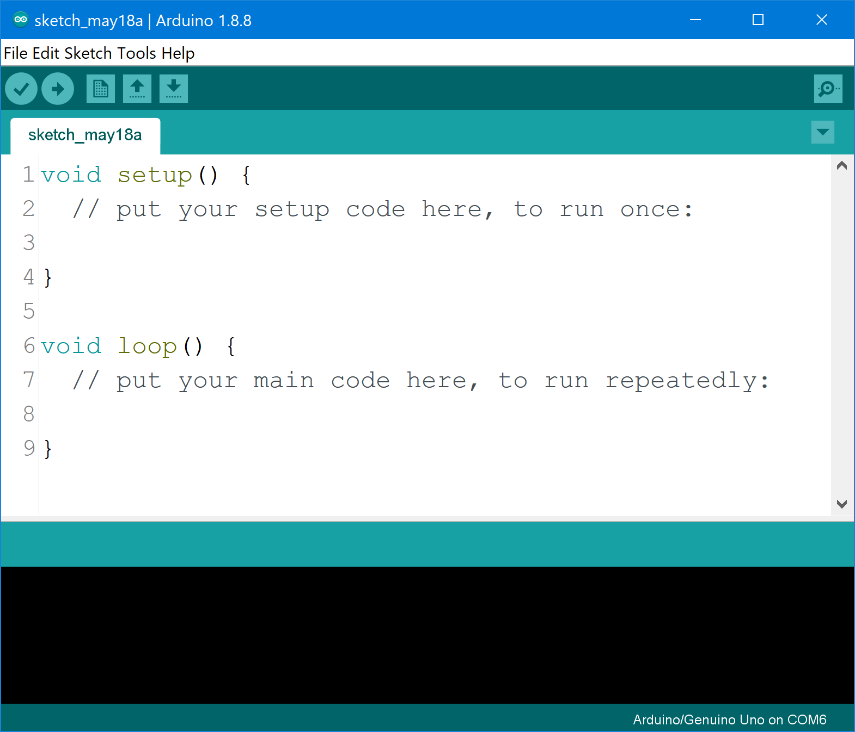
Software Requirements
ARDUINO IDE
The Arduino integrated development environment (IDE) is a cross platform application (for Windows, macOS, Linux) that is written in the programming language Java. It is used to write and upload programs to Arduino compatible boards, but also, with the help of 3rd party cores, other vendor development boards.
Blynk Server and IoT Platform
Blynk is a Platform with iOS and Android apps to control Arduino, Raspberry Pi and the likes over the Internet.
It's a digital dashboard where you can build a graphic interface for your project by simply dragging and dropping widgets.
It's really simple to set everything up and you'll start tinkering in less than 5 mins.

Slide 12
BLOCK DIAGRAM
ARDUNIO
LCD 2X16 MODULE
HEART BEAT SENSOR
WIFI MODULE
TEMPERATURE SENSOR
BUZZER
PANIC BUTTON
12V TRANFORMER
FULL WAVE RECTIFIER
VOLATGE REGULATORS AND FILTER CAPACITORS

Slide 13
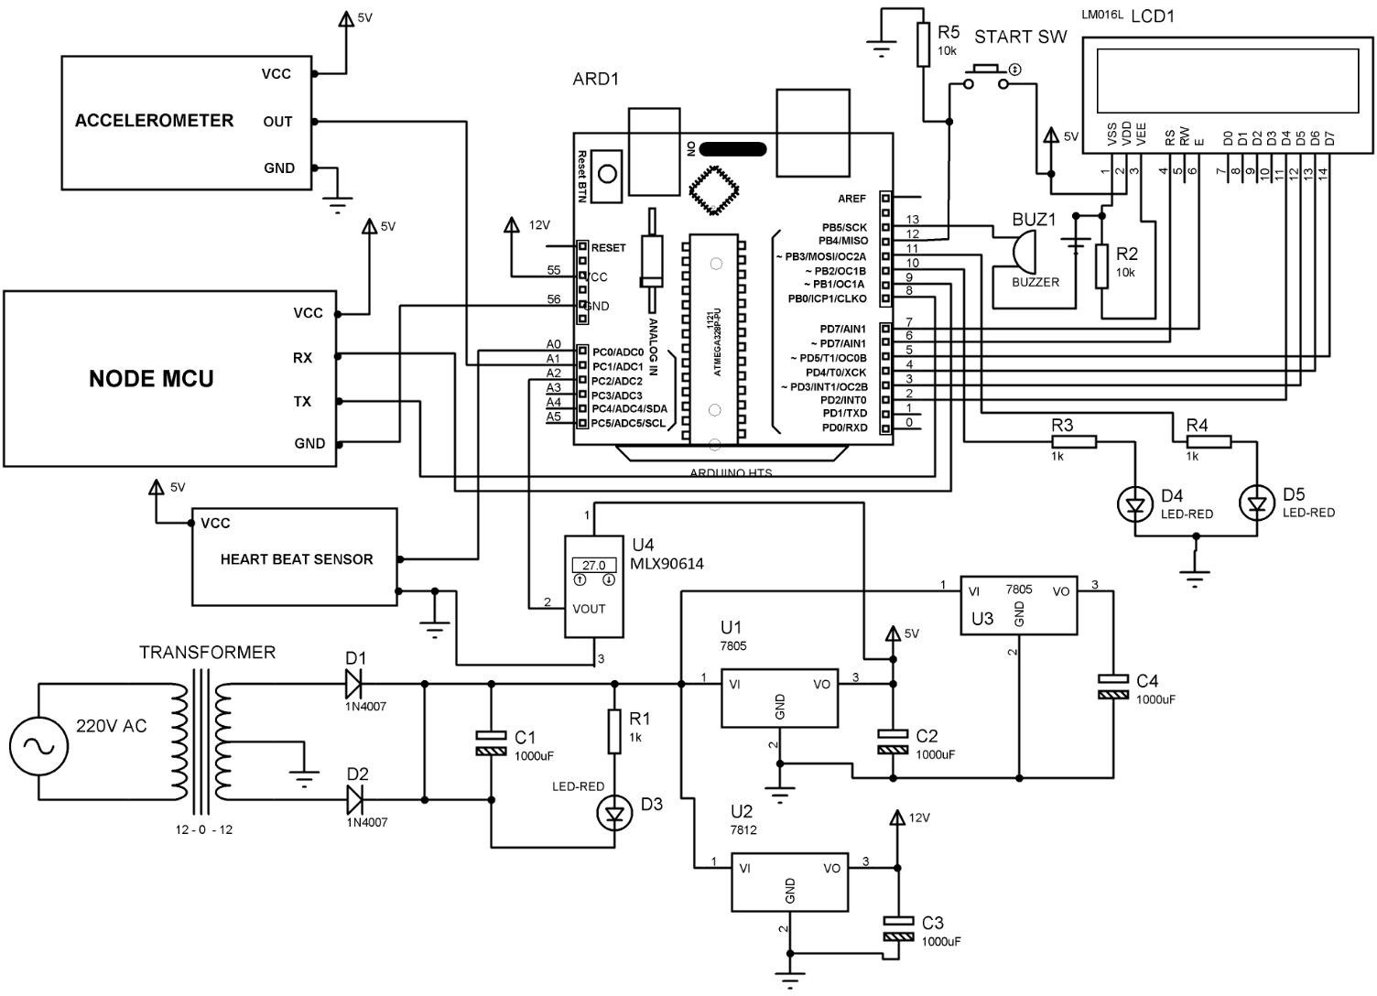
CIRCUIT DIAGRAM

Slide 14
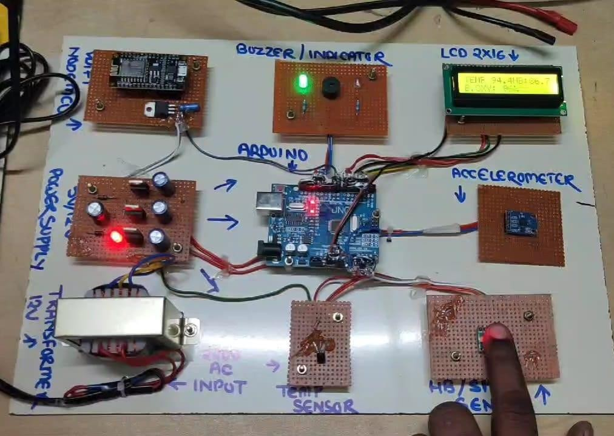
output
PROTOTYPE OF THE PROPOSED SYSTEM

Slide 15
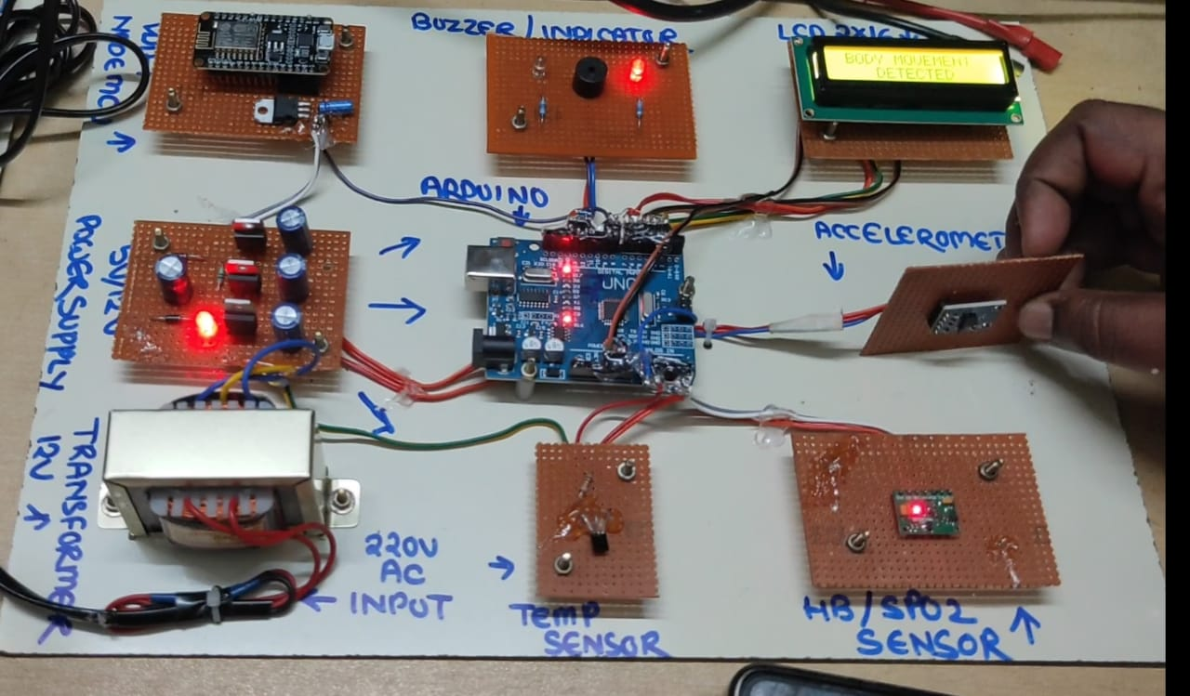
Fig. ACCELEROMETER OUTPUT

Slide 16
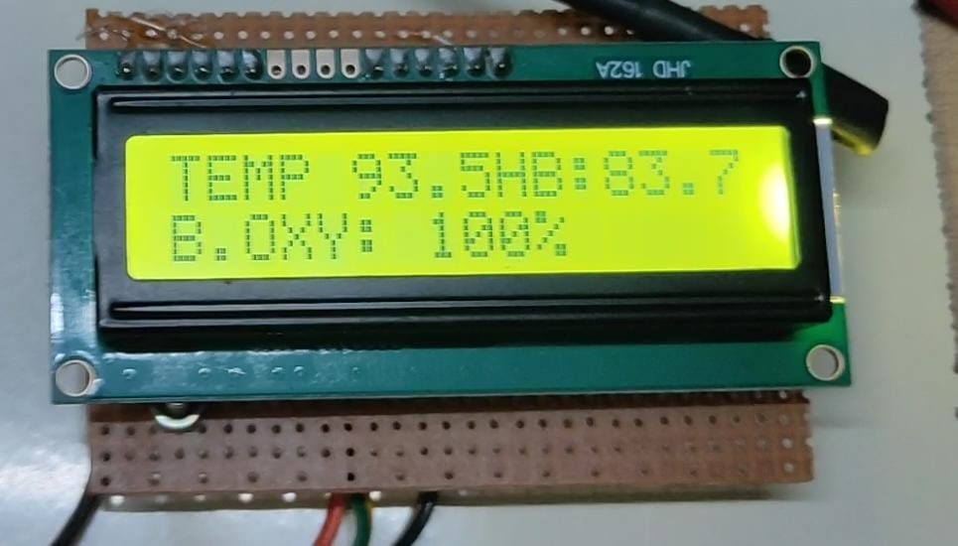
16*2 lcd display

Slide 17
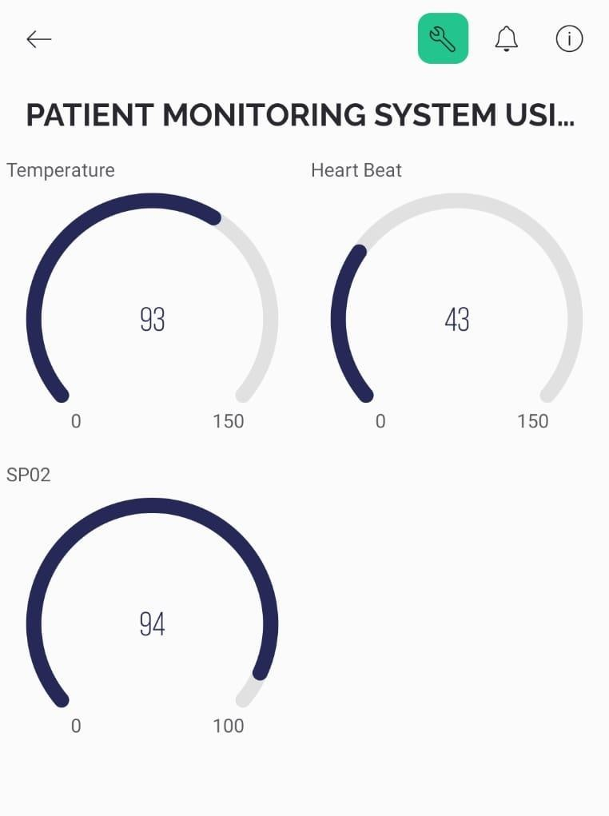
Blynk mobile application output

Slide 18
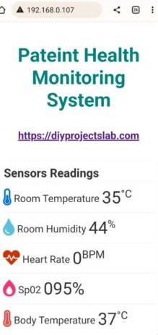
APPLICATIONS
This is an important sensor based project which has the latest technology implemented in it. And it has many applications & advantages as mentioned below.
1) This type of system can be used for COVID 19 Quarantined People for Remote monitoring of their health condition.
2) IOT Healthcare is the most demanding field in the medical area. This project is for, elderly people in our home. Also for the senior citizen living alone or living with 1 or 2 members. This project really proves helpful when family members need to go out for some emergency work.
3) Disable patients can use this project. Disable patients who find it really difficult to go to doctors on a daily basis or for those patients who need continuous monitoring from the doctor.

Slide 19
CONCLUSION
IOT Monitoring proves really helpful when we need to monitor & record and keep track of changes in the health parameters of the patient over the period of time. So with the IOT health monitoring, we can have the database of these changes in the health parameters. Doctors can take the reference of these changes or the history of the patient while suggesting the treatment or the medicines to the patient.

Slide 20
ALTERNATIVE RESOURCES
Thanks !

