Slide 1
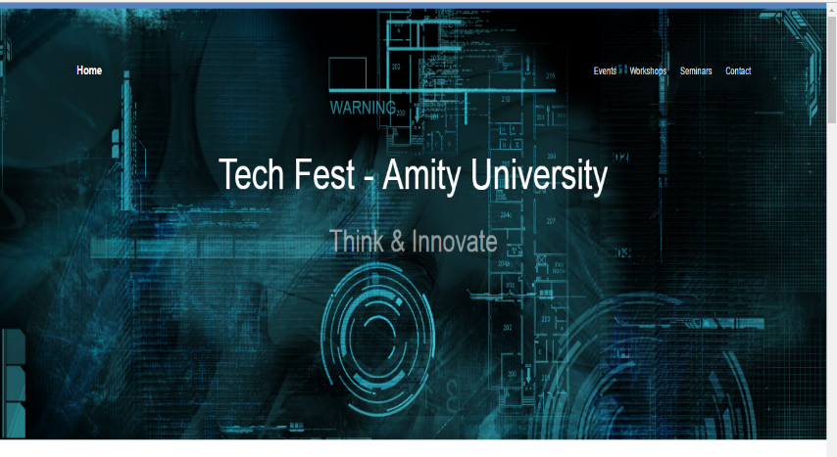
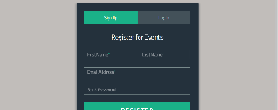
Tech Fest
Amity University
Website for the technical fest of Amity University
Web Technologies Project
Review -2
ALLPPT.com _ Free PowerPoint Templates, Diagrams and Charts

Slide 2
Group Members
Our team includes five enthusiastic undergrad students of VIT University
Bharath Kb 15BIT0018
Vinit Shahdeo 15BIT0335
Rishabh Agarwal 15BIT0252
Ratnesh Kanungo 15BIT0257
Shivam Shukla 15BIT0319

Slide 3
Introduction
Tech Fest – Amity University
Amity Youth Festival 2016 Is a 3-day annual Festival organized by the amity University, Noida. it Is an annual Gathering of Students from amity University, Other amity Universities and Other Universities & Colleges. the Objective of amity Youth Festival (ayf'16) Is to Create an Unparallel forum for the Students Comprising of all Elements of Experiential Learning, to Test their intellectual and artistic Prowess, Simultaneously Opening avenues for Sharing Mutual Experience, Skills and Talent & to Reach their Collective and individual aspirations, in the Field of Culture, Literary and Other activities on a Common Platform. ayf Helps in Developing among Our Students- Professional Skills Like Leadership, Team Work, Business acumen, Resource Generation & Management.
We’ve made a dummy website for the TechFest of Amity University

Slide 4
Our Progress
Front-End – 100% completed
Main highlights of our website
Separate and Attractive pages
Search Engine Optimization
Responsive Web Pages
Eye catchy Content
Animations and Effects

Slide 5
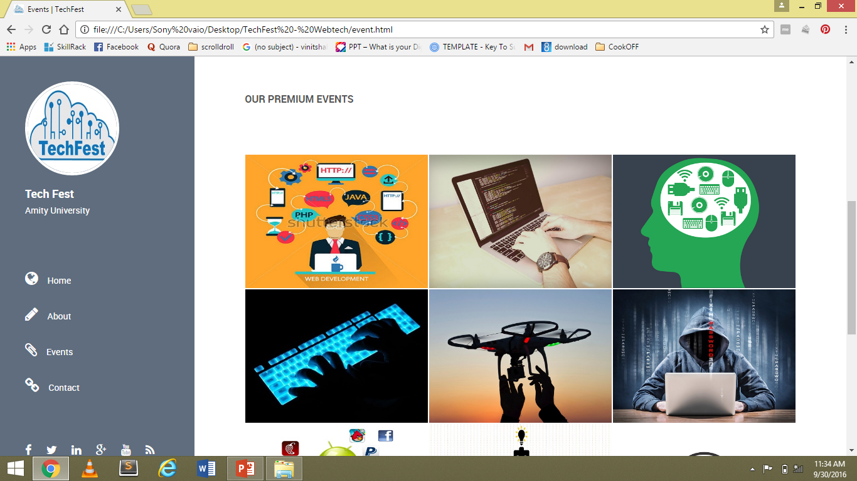
Screenshots of GUI

Slide 6
Languages Used
Front End Frameworks
HTML5
CSS3
JavaScript
Jquery
AJAX
JSON

Slide 7
Future Plans
Back End
Registration Portal
Login Portal
Payment Portal
Search Button for Events
Technologies used – NodeJS, MongoDB We’ll present fully functional website of TechFest in our next review!

Slide 8

Thank You

