Slide 1
Summer Live Project
Soil Moisture Forecasting
Using Transformer Models
Benchmarking Vanilla Transformer, PatchTST, iTransformer, and an Unsupervised Cluster-Based Transformer for 10-day minute-level forecasting
Supervisor:
Dr. Jayaram Valluru
Presented By:
Kesana Sai Krishna
Roll no: 2025dss1013

Slide 2









Presentation Outline
What we'll walk through
01
Problem Statement & Dataset
06
Model 4 — Cluster-Based Transformer (Unsupervised)
02
Forecasting Strategy
07
Evaluation Metrics Framework
03
Model 1 — Vanilla Transformer
08
Results & Model Comparison
04
Model 2 — PatchTST
09
Key Insights & Tradeoffs
05
Model 3 — iTransformer
10
10-Day Forecast Behaviour

Slide 3

Problem Statement & Dataset
The Challenge
Dataset Overview
Predict soil moisture for the next 10 days (14,400 minutes) using only historical minute-level sensor readings — with no advance knowledge of future irrigation.
Records
100,000 minutes (~69.4 days)
Columns
Minute, Irrigation, Soil Moisture
Future irrigation schedule is unknown
Irrigation range
~4 x 10⁻⁶ (flow rate)
Forecast horizon is long-range (10 days)
Soil Moisture range
0.413 – 0.435
Signal is slow-changing & low-variance
Train / Val split
80% / 20%
Must generalize from 100K training minutes
Normalization
MinMaxScaler (per feature)
Forecasting Strategy: Autoregressive rolling prediction — feed each prediction back as input for the next step.
Signal characteristic: slow-changing, smooth, low-variance continuous time series.

Slide 4
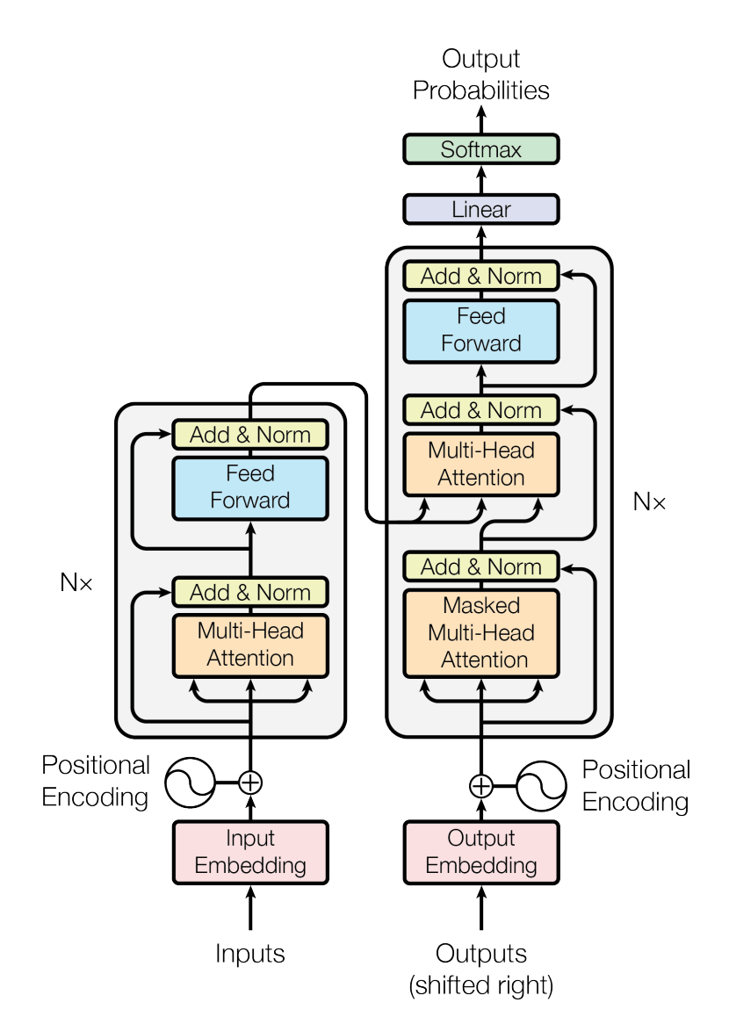

Model 1 — Vanilla Transformer
The baseline encoder-only Transformer
How it works
Each minute is treated as one token. Self-attention is computed across all 120 past time steps to predict the next value, using fixed sinusoidal positional encoding.
120 min
window
Linear
Projection
Self-Attention
(3 layers)
Predict
next step
Architecture Specs
Lookback window
120 minutes
Tokenization
1 token / minute
Positional encoding
Fixed sinusoidal
Embedding dim (d_model)
64
Attention heads
4
Encoder layers
3
Parameters
102,721
https://nixtlaverse.nixtla.io/neuralforecast/models.vanillatransformer.html

Slide 5
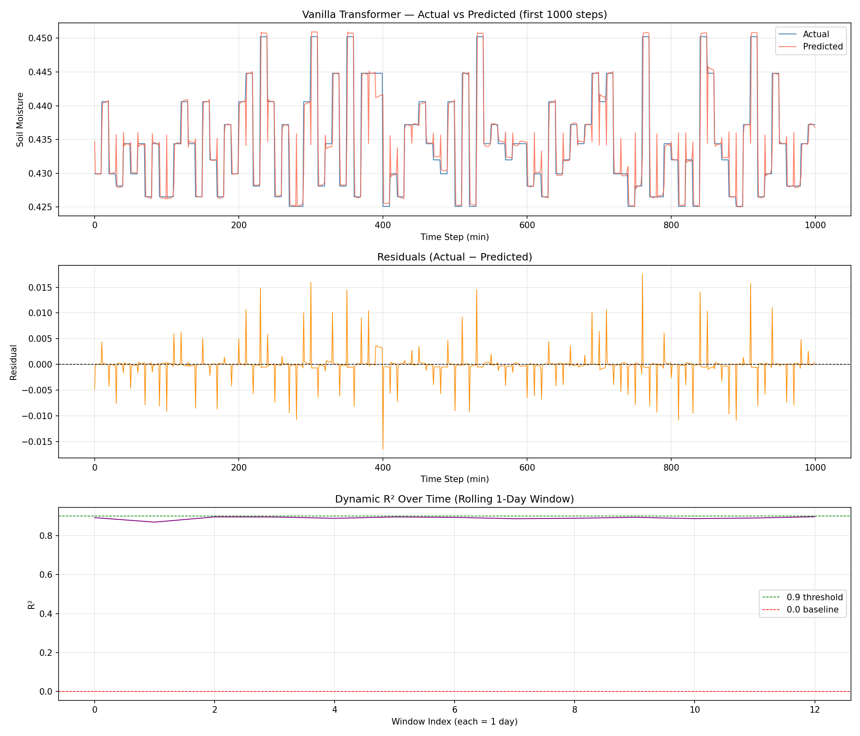
Evaluation Metrics

Slide 6
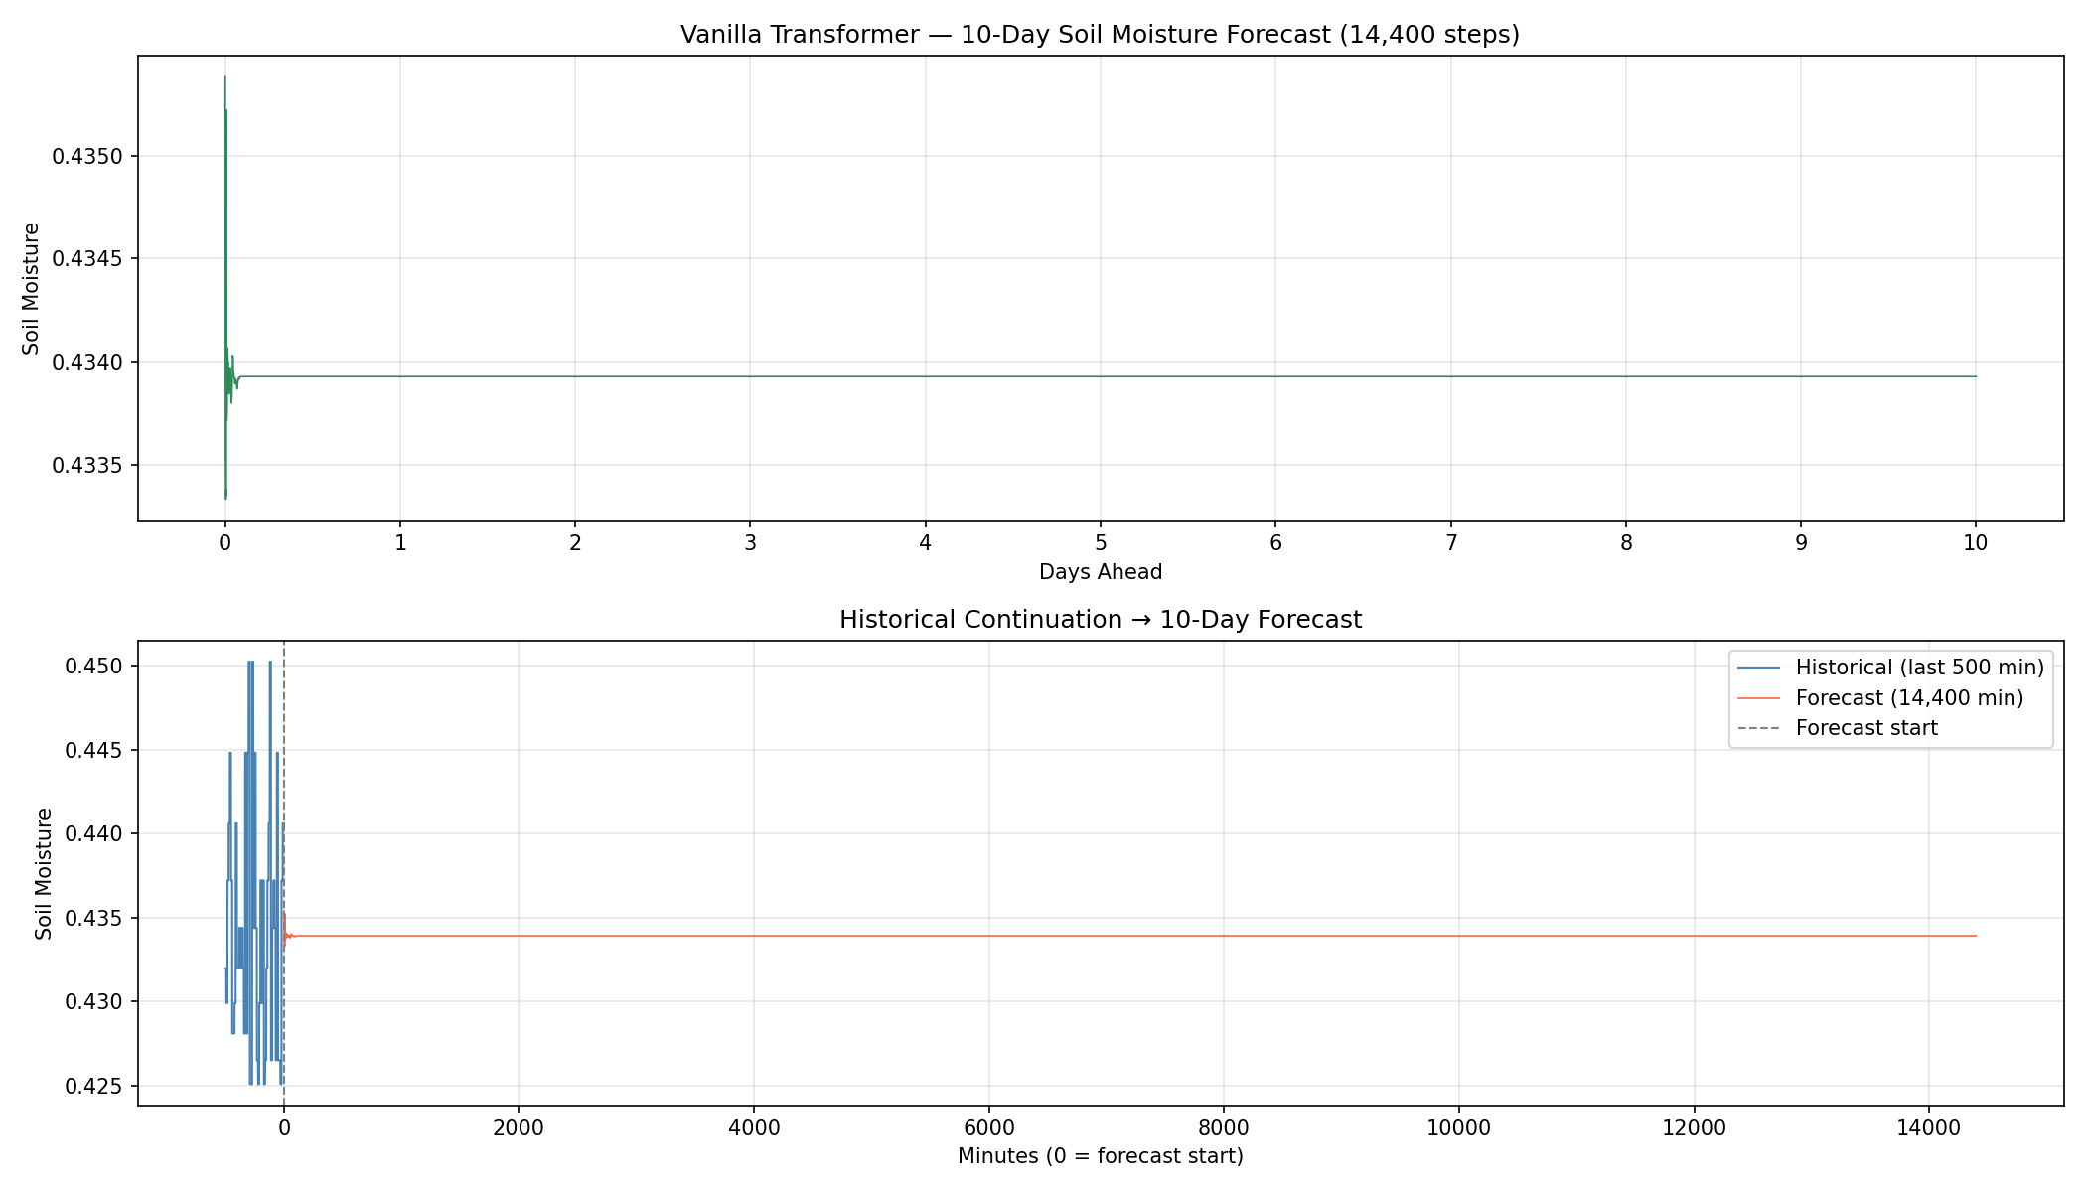
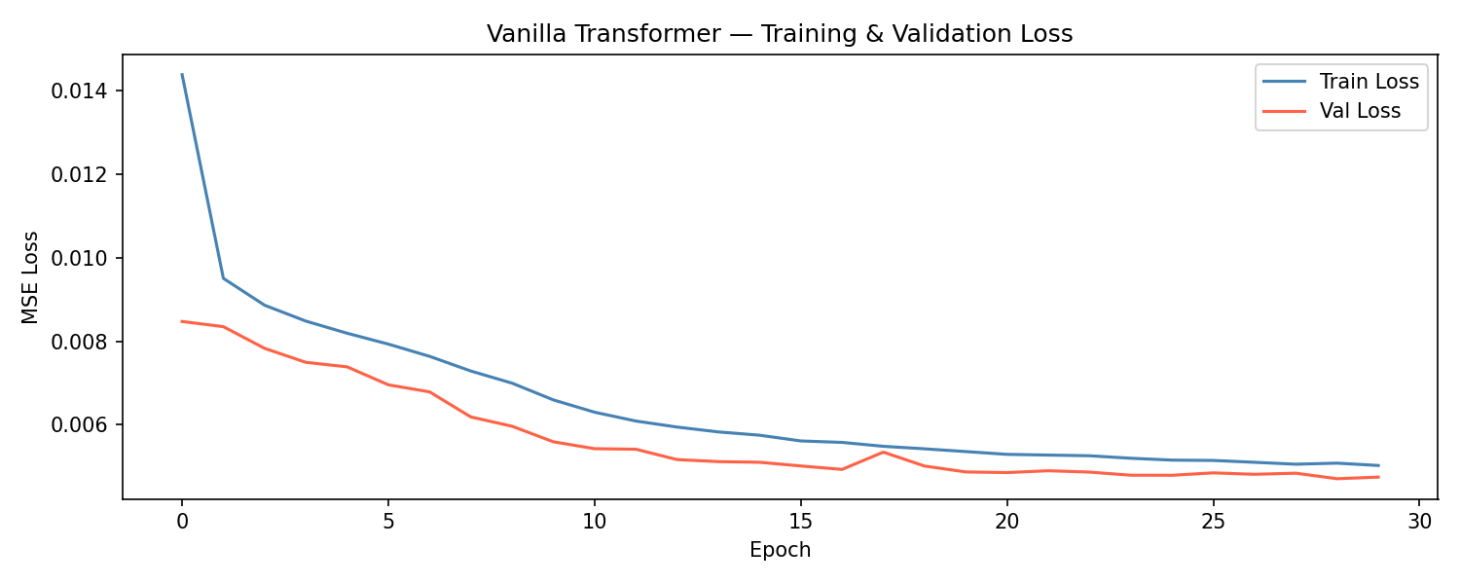
Forecast-10days
Training Curve

Slide 7
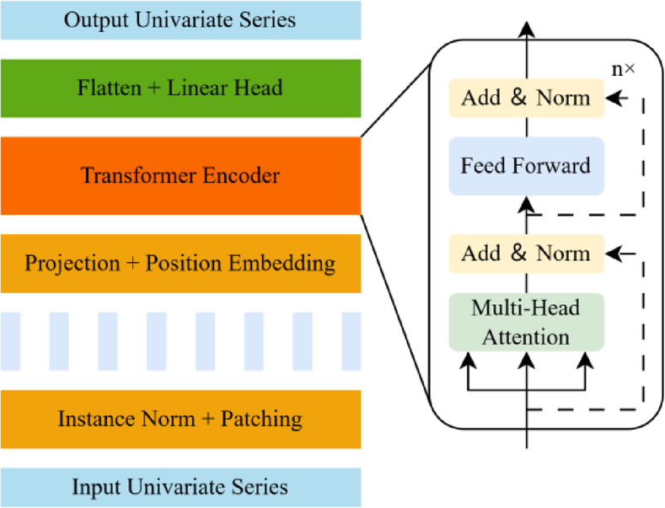
Model 2 — PatchTST
"A Time Series is Worth 64 Words" (Nie et al., 2023)
How it works
Architecture Specs
Instead of one token per minute, the 336-minute window is split into overlapping 16-minute patches (stride 8) — producing 41 patch tokens. Each variable (Irrigation, Soil Moisture) is processed independently with learnable positional encoding.
Lookback window
336 minutes
Patch length / stride
16 min / 8 min
Number of patches
41 tokens
Strategy
Channel-independent
Positional encoding
Learnable
Embedding dim
128
https://www.researchgate.net/figure/Diagram-of-the-PatchTST-MKAN-model-structure_fig3_399170280
Parameters
1,076,868
336 minutes → 41 patches of 16 min (stride 8)
Best for: high-frequency signals with sharp local patterns — not ideal for slow agricultural data.
overlapping patches → 41 tokens

Slide 8
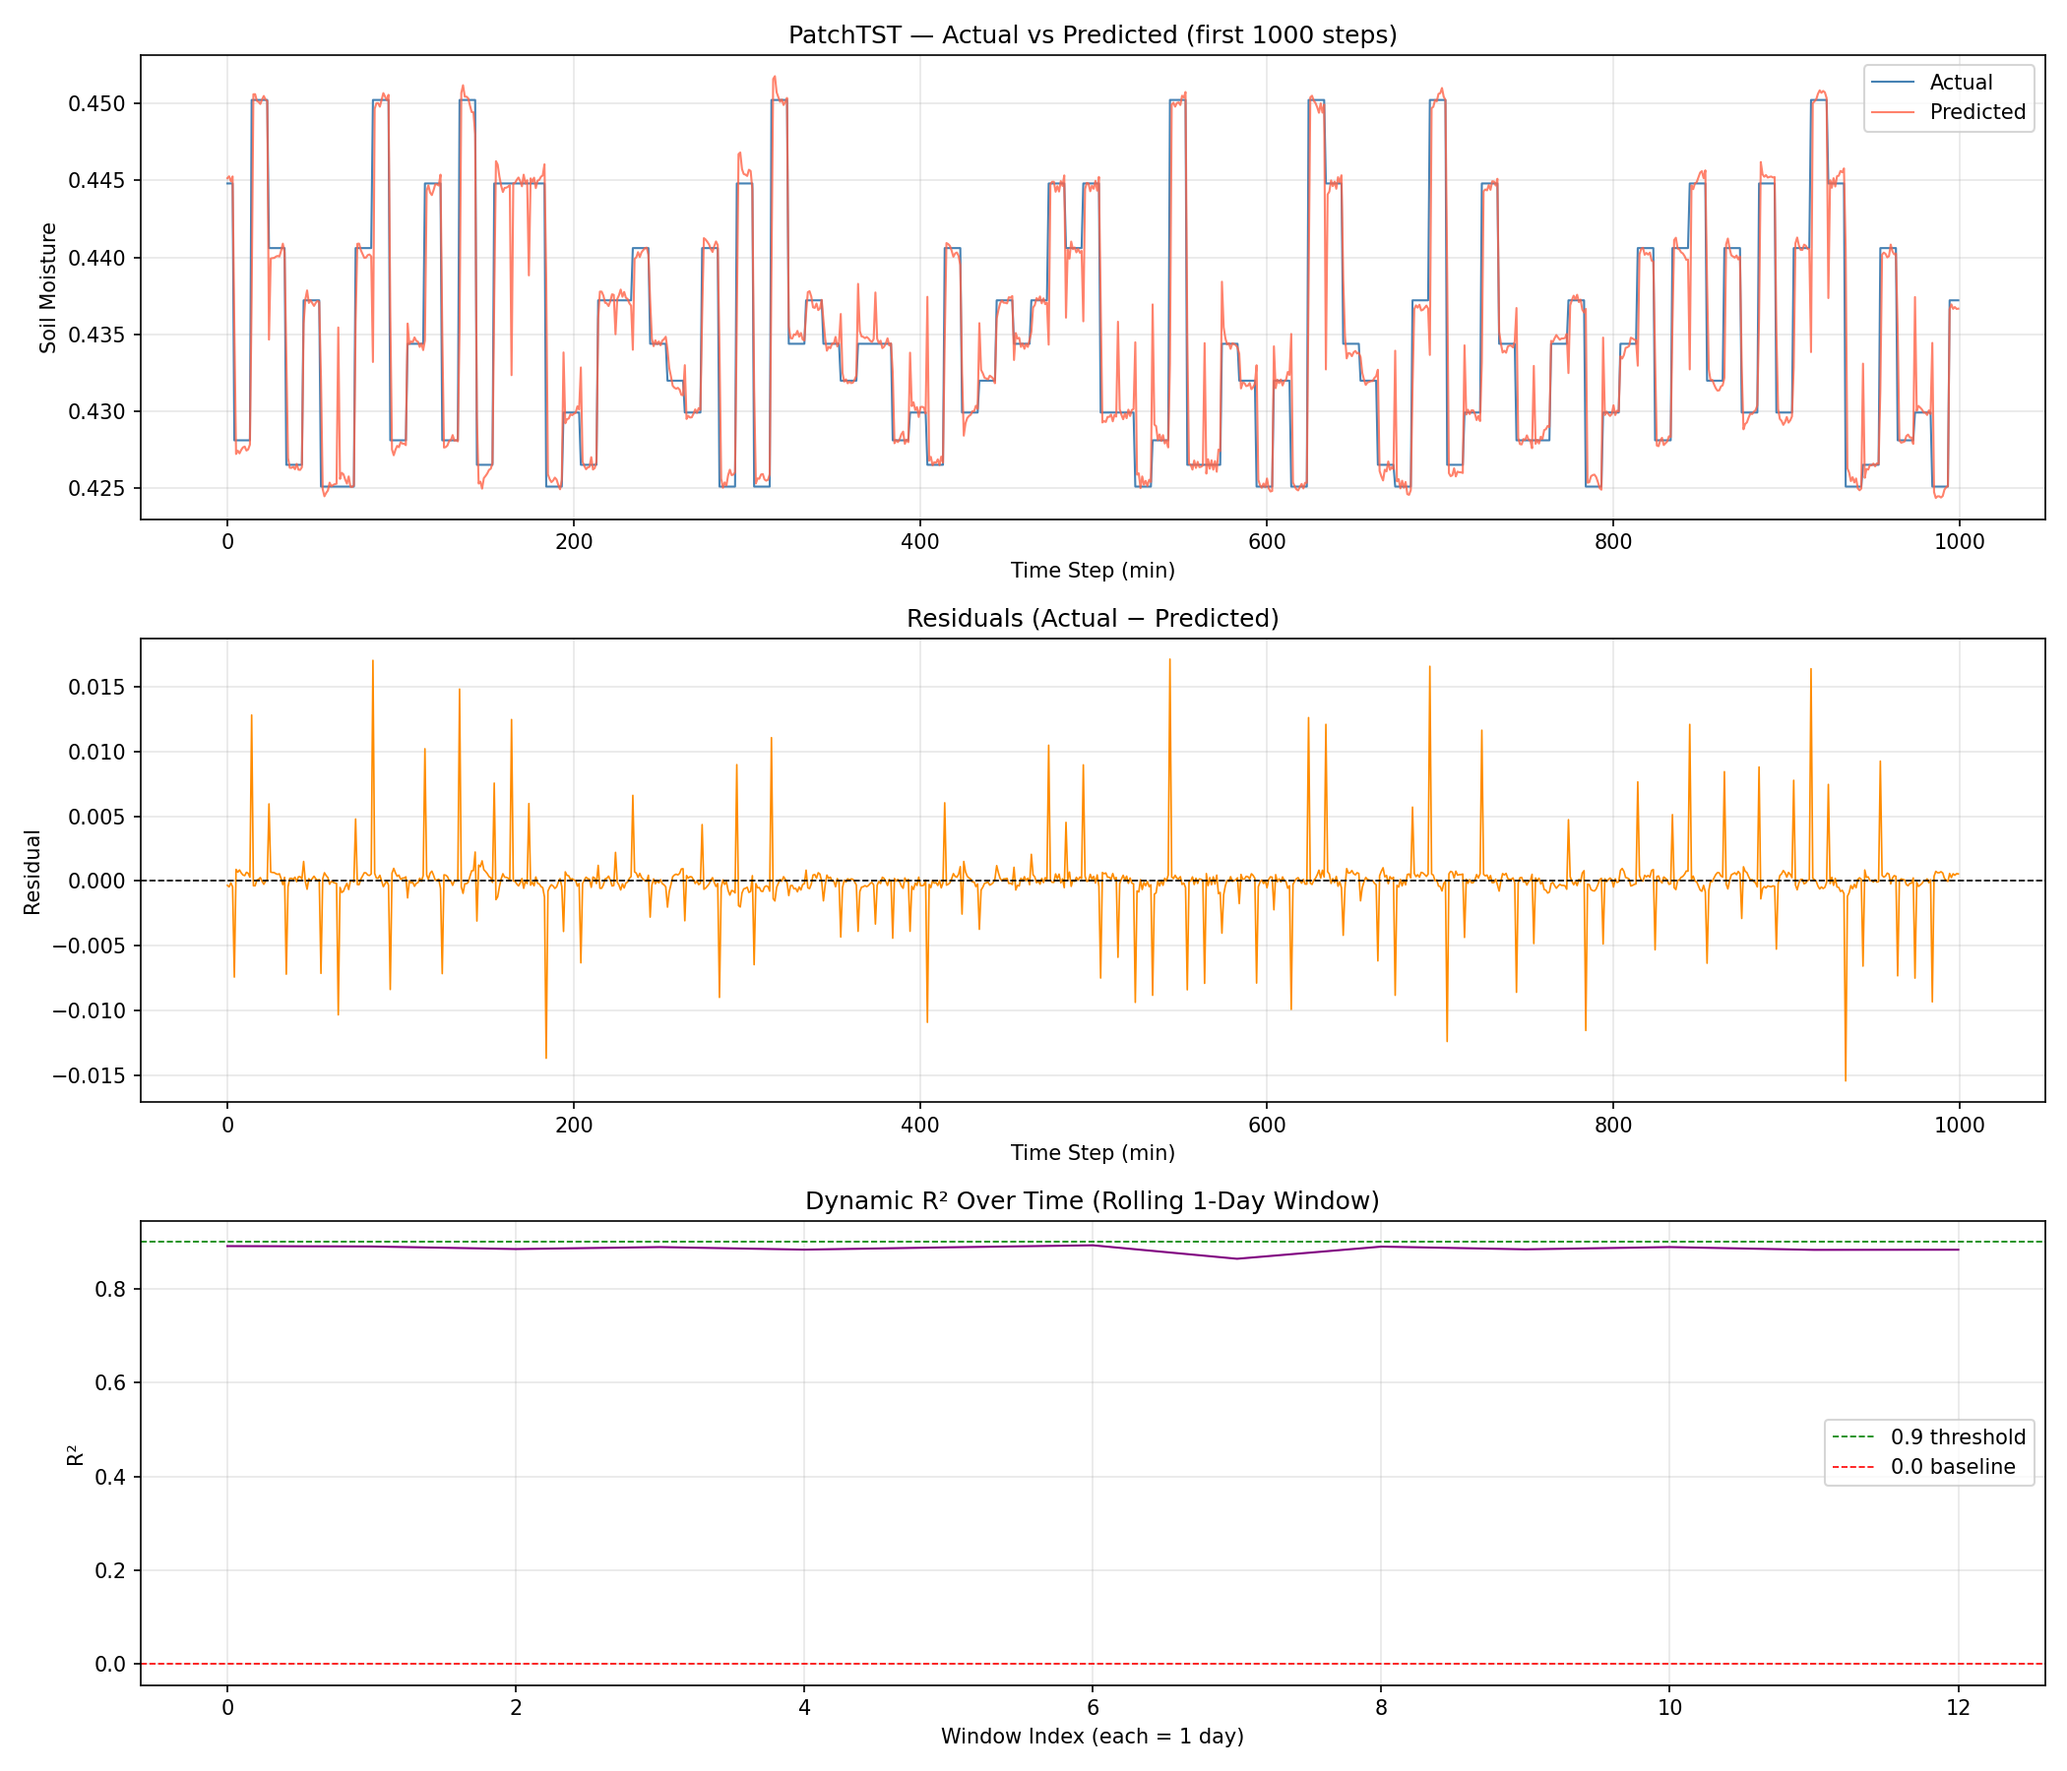
Evaluation Metrics

Slide 9
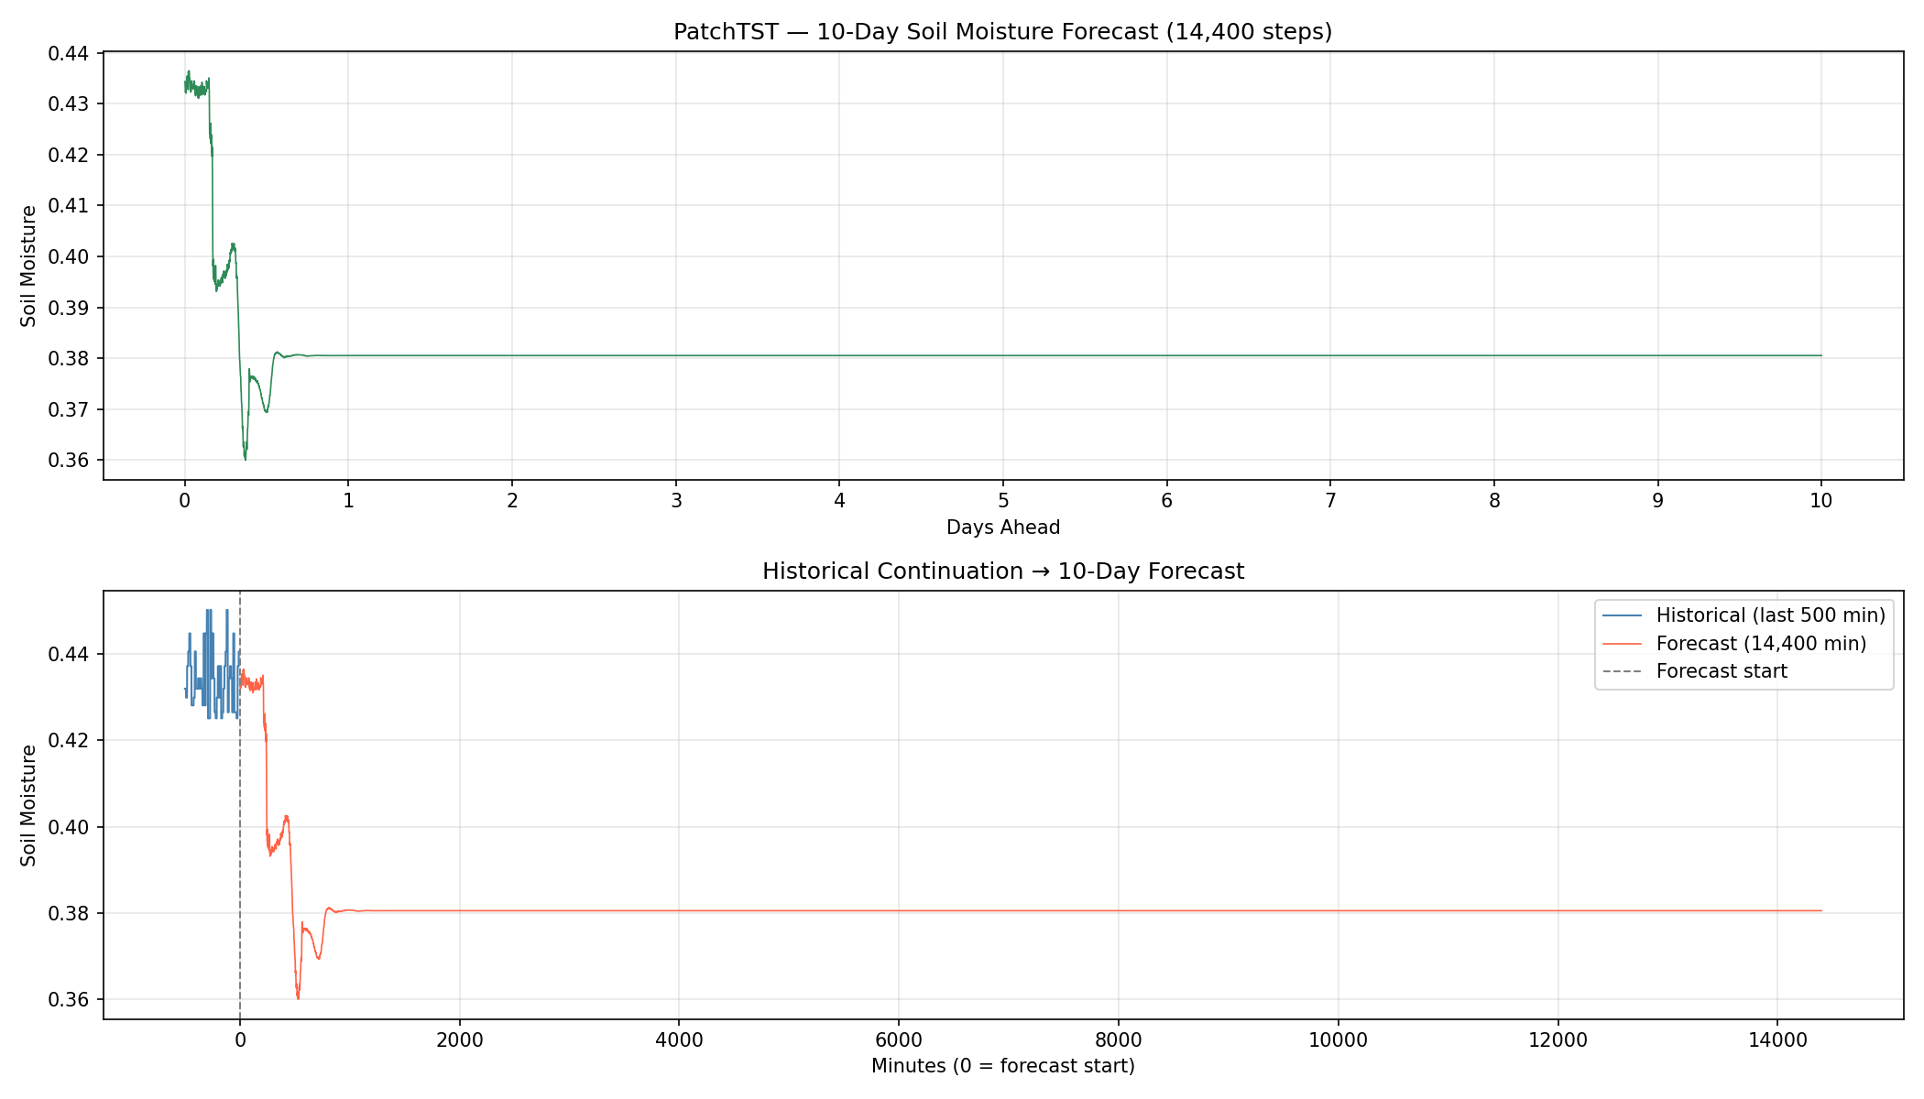
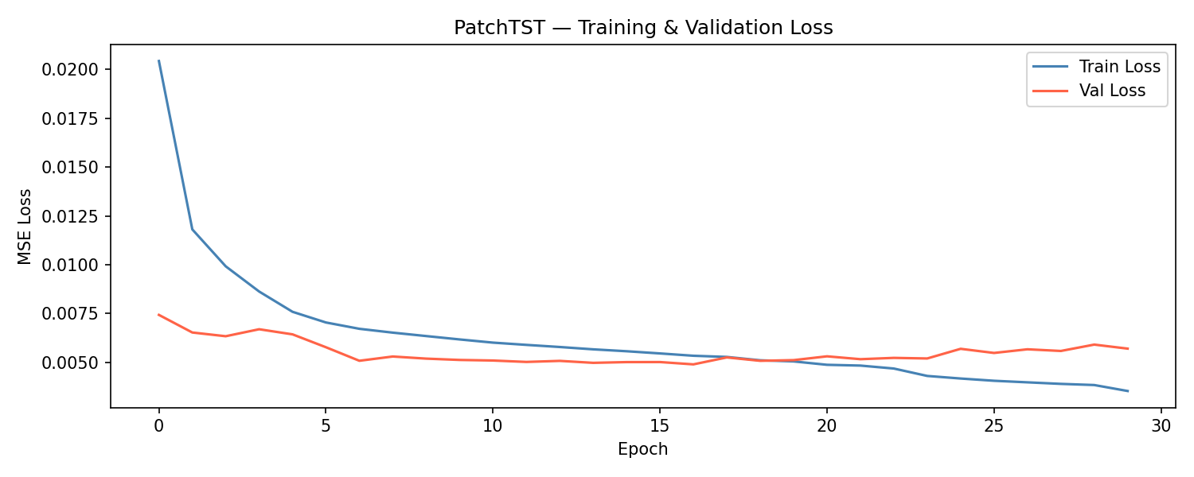
Forecast-10days
Training Curve

Slide 10
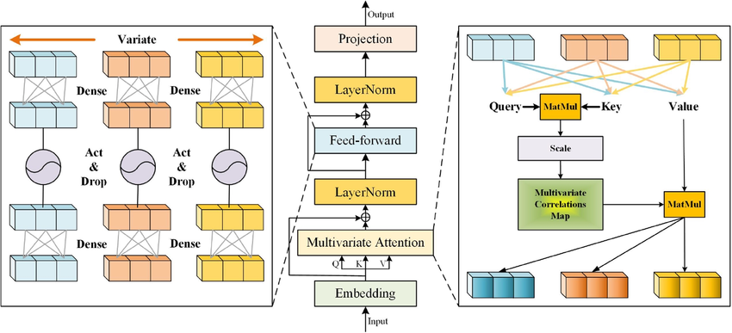
Model 3 — iTransformer
Inverted Transformers Are Effective for Time Series Forecasting (Liu et al., 2024)
How it works
The attention axis is inverted: instead of attending across time steps, the model attends across variables. Each variable's full 336-minute series becomes a single token — directly modelling how Irrigation relates to Soil Moisture.
Architecture Specs
Lookback window
336 minutes
Vanilla / PatchTST
iTransformer
Tokenization
1/variable (2 total)
Attention across
TIME STEPS
Attention across
VARIABLES
Attention over
Variables, not time
Embedding dim
128
Attention heads
4
Encoder layers
3
Parameters
441,218
Best for: datasets with many interacting variables — advantage limited here with just 2.
Limitation: with only 2 variables, the cross-variable attention has minimal relationships to exploit.
https://www.researchgate.net/figure/Model-architecture-of-iTransformer_fig1_382824268

Slide 11
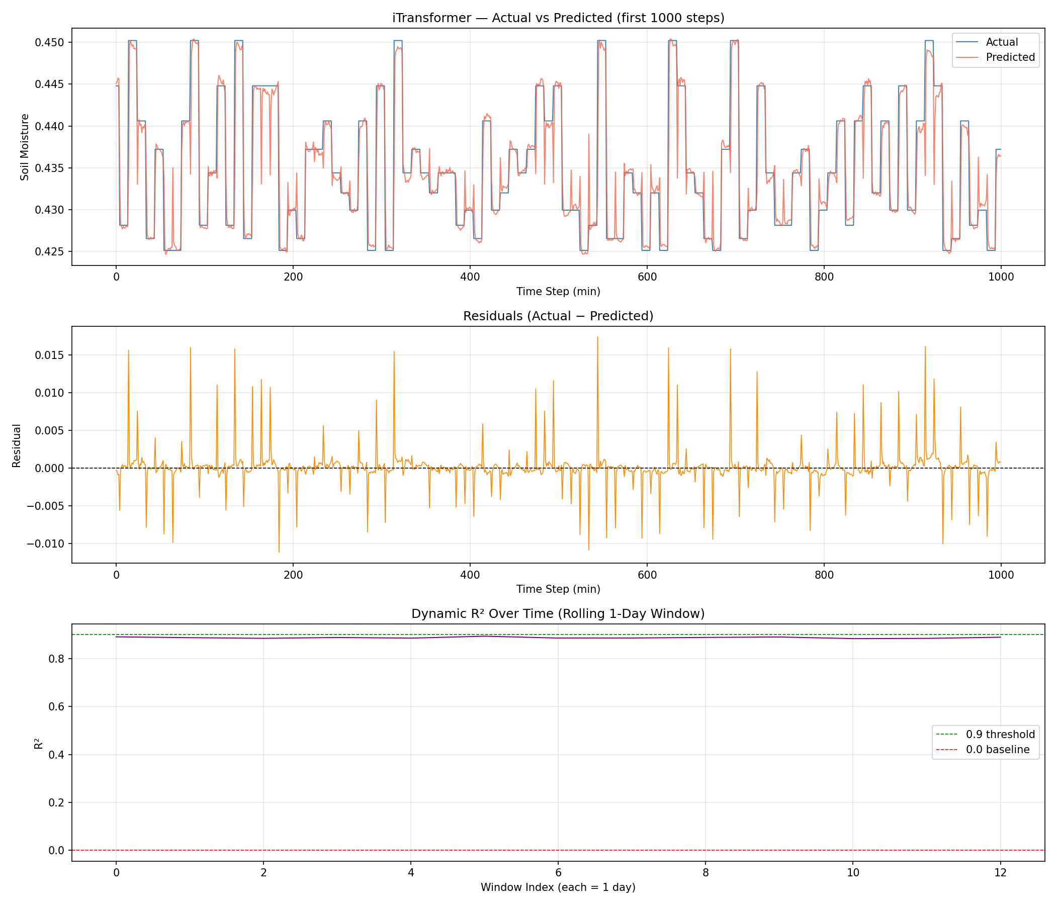
Evaluation Metrics

Slide 12
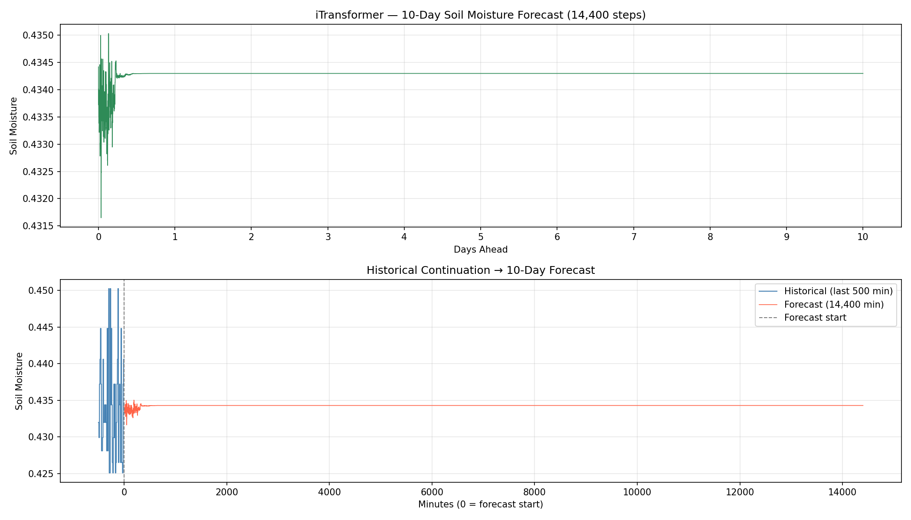
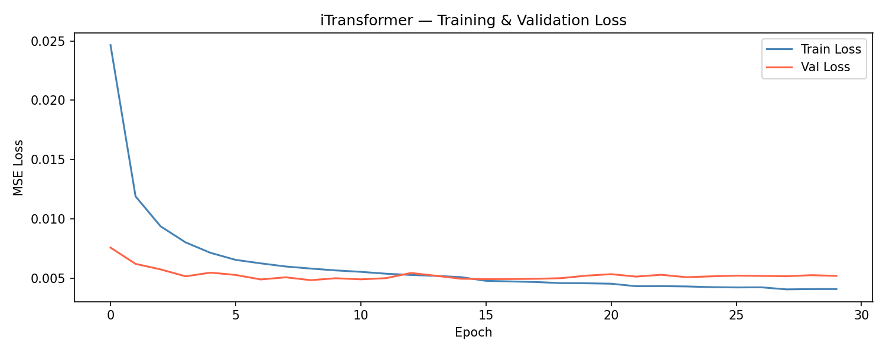
Forecast-10days
Training Curve

Slide 13
Model 4 — Cluster-Based Transformer
Unsupervised clustering + specialist transformers per behavioural group
Extract
Features
K-Means
Clustering
Behaviour
Clusters
Specialist
Transformer
Cluster-Routed
Forecast
How clustering works:
The 4 Discovered Clusters
Each 180-minute window is represented using 10 statistical features (mean, std, min, max, range, slope, mean difference, energy, last value and irrigation mean). K-Means groups similar behavioural patterns without labels. Four clusters were selected for specialist Transformer training.
C0
Cluster 0
Transitioning (moderate variation)
C1
Cluster 1
Transitioning (high variability)
At prediction time:
New window → extract features → classify into cluster → route to that cluster's specialist transformer → prediction
C2
Cluster 2
Rising trend
Specialized Transformer experts trained on clustered behavioural patterns improved overall forecasting accuracy compared with a single global Transformer.
C3
Cluster 3
Transitioning (stable transition)

Slide 14
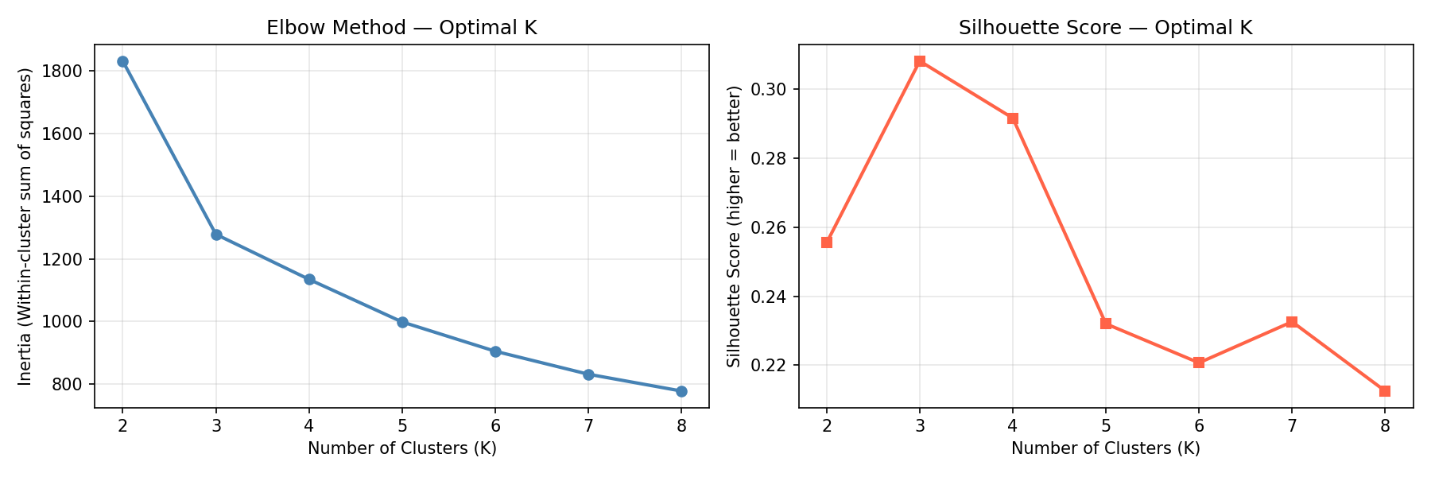
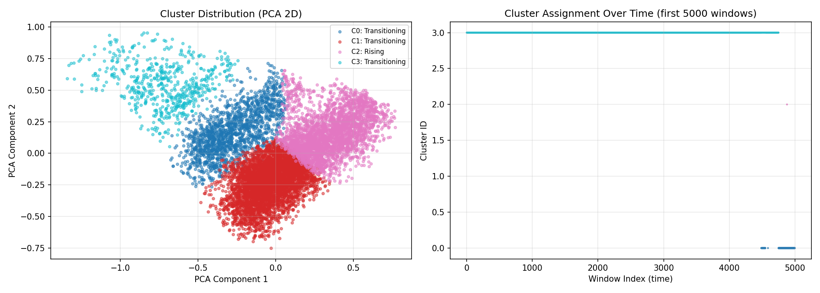
Cluster Selection

Slide 15
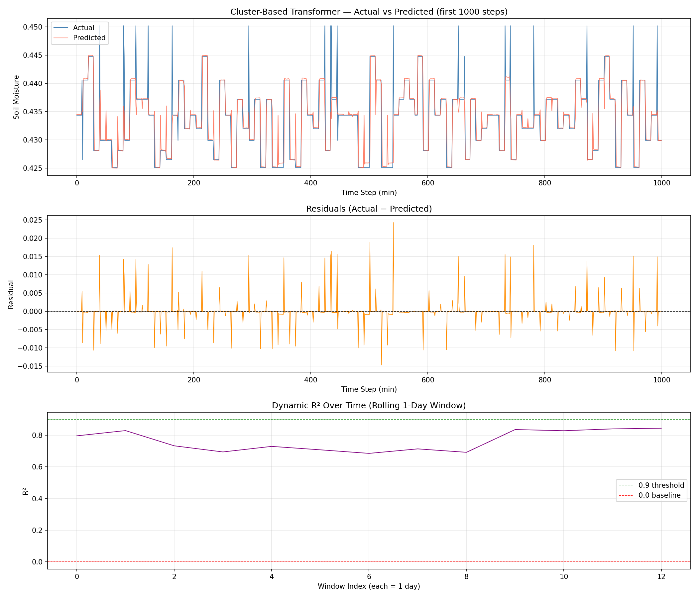
Evaluation Metrics

Slide 16
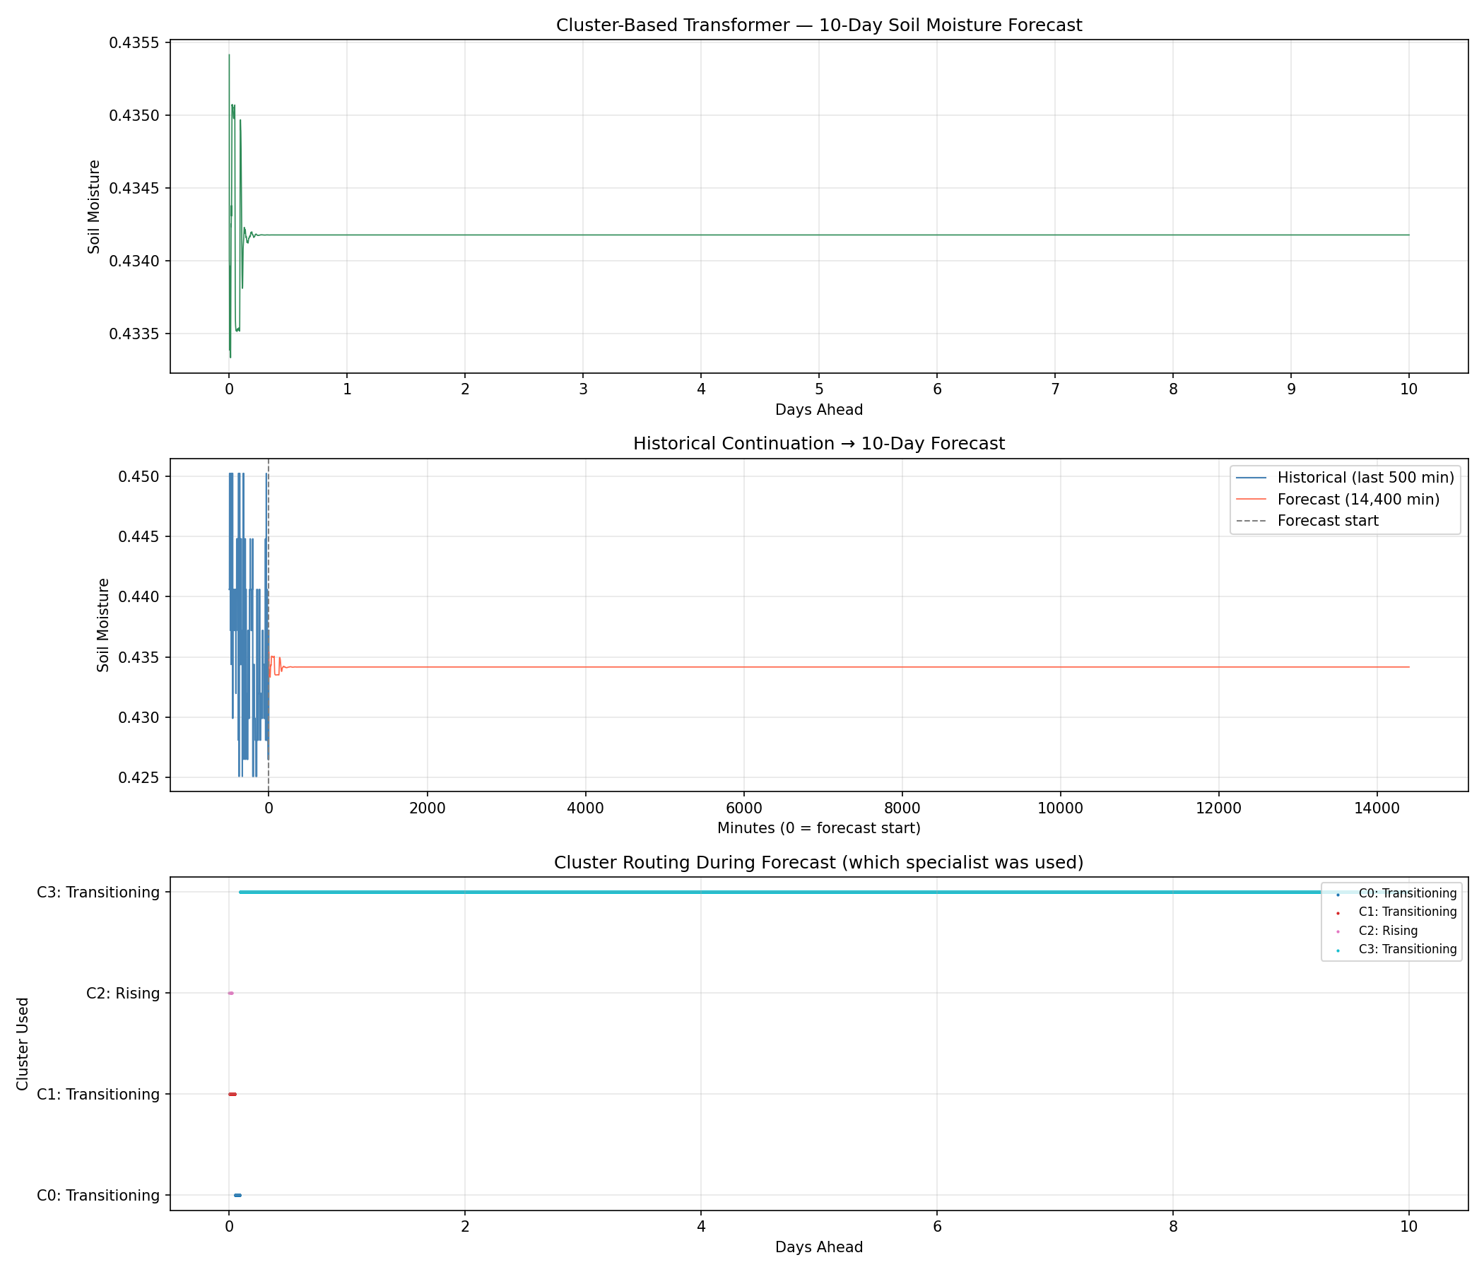
Forecast-10days

Slide 17
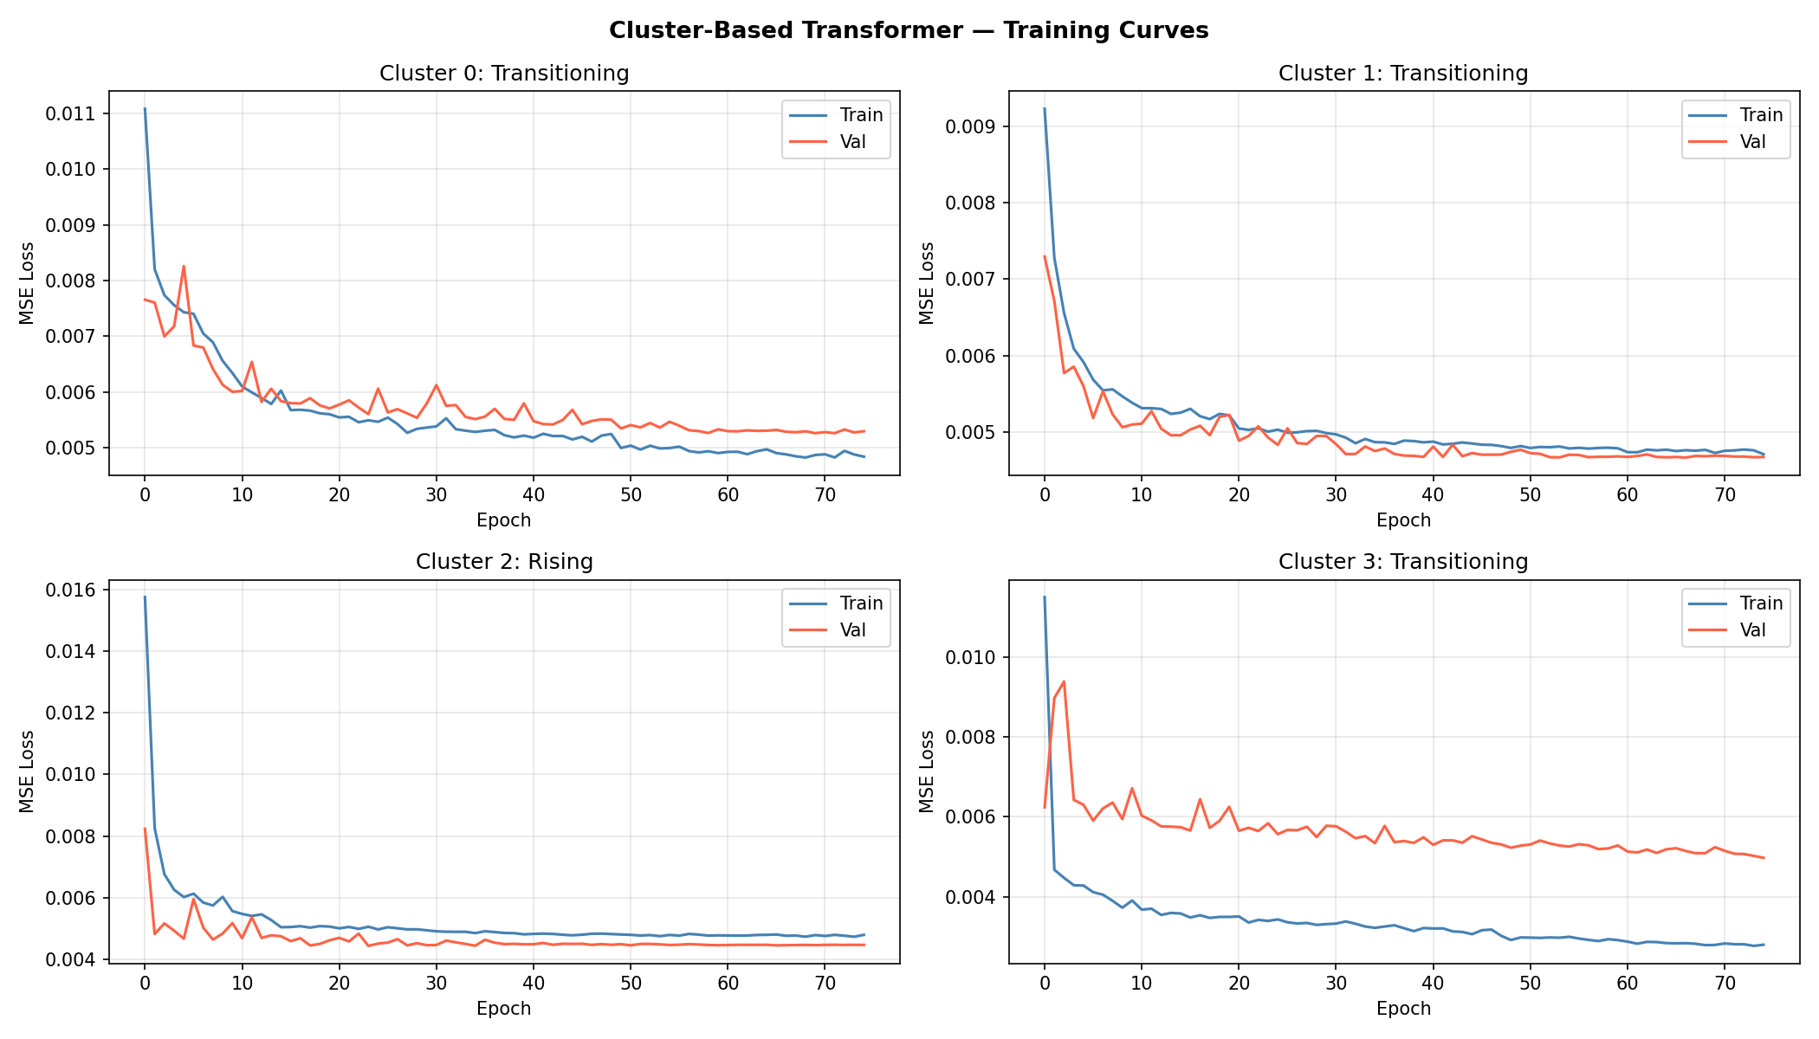
Training Curve

Slide 18

Evaluation Metrics Framework
Seven complementary metrics for comprehensive model assessment
RMSE
MAE
Point-by-point error magnitude; penalizes large errors
Average error in original soil moisture units
MAPE
Standard R²
Percentage error; scale-independent comparison
Overall variance explained by the model
MASE
Dynamic R²
Error vs naive baseline — below 1.0 means genuine learning
Rolling R² per day — reveals long-range degradation

Slide 19

Results — Full Model Comparison
Validation metrics across all four models
Metric | Vanilla | PatchTST | iTransformer | Cluster-Based
RMSE | 0.002536 | 0.002589 | 0.002572 | 0.002524
MAE | 0.000899 | 0.001009 | 0.001104 | 0.000821
MAPE (%) | 0.2058 | 0.2314 | 0.2526 | 0.1881
Standard R² | 0.8914 | 0.8873 | 0.8888 | 0.8924
MASE | 1.034 | 1.159 | 1.269 | 0.5770
Dynamic R² (mean) | 0.8907 | 0.8860 | 0.8878 | 0.7639
Beats Naive Baseline? | No | No | No | Yes
Cluster-Based Transformer achieved the best overall performance across RMSE, MAE, MAPE, Standard R² and MASE, while Vanilla Transformer maintained the highest Dynamic R², indicating more stable performance over time.

Slide 20
10-Day Forecast Behaviour
How each model's 14,400-minute forecast actually behaves
Vanilla Transformer
Forecast Range
Spread
Flat / converged — classic autoregressive mean drift
0.4333 – 0.4353
0.0020
PatchTST
Forecast Range
Spread
Drifts downward — most variation but unrealistic trend
0.3599 – 0.4364
0.0765
iTransformer
Forecast Range
Spread
Near flat — similar drift to Vanilla
0.4316 – 0.4350
0.0034
Cluster-Based
Forecast Range
Spread
Near flat, but driven by genuine pattern learning
0.4333 – 0.4354
0.0021
All forecasts use autoregressive rolling prediction; future irrigation is approximated using the historical mean (no advance data available).

Slide 21

Key Insights
What the experiments revealed about forecasting soil moisture
Overall Best Performance
Pattern Specialization Improves Accuracy
Cluster-Based Transformer achieved the best overall forecasting accuracy
It obtained the lowest RMSE (0.002524), MAE (0.000821), MAPE (0.1881%), highest Standard R² (0.8924), and the best MASE (0.577) among all four models.
Learning separate models for different soil-moisture regimes improved prediction quality
Clustering enabled specialized Transformers to model different behaviours, resulting in more accurate forecasts than a single global model.
Stability vs Accuracy
Naive Baseline Comparison
Vanilla Transformer remained the most temporally stable model
Although Cluster-Based achieved the best overall accuracy, Vanilla produced the highest Dynamic R² (0.8907), indicating more consistent performance across rolling time windows.
Only the Cluster-Based Transformer outperformed the naive forecasting baseline
Its MASE = 0.577 (<1) confirms it provides meaningful predictive value, whereas Vanilla, PatchTST, and iTransformer all had MASE >1, indicating performance comparable to or worse than a naive forecast.
Final Conclusion: The Cluster-Based Transformer is recommended for soil moisture forecasting because it achieved the highest overall predictive accuracy while being the only model to consistently outperform the naive forecasting baseline.

Slide 22
Thank You

