Slide 1
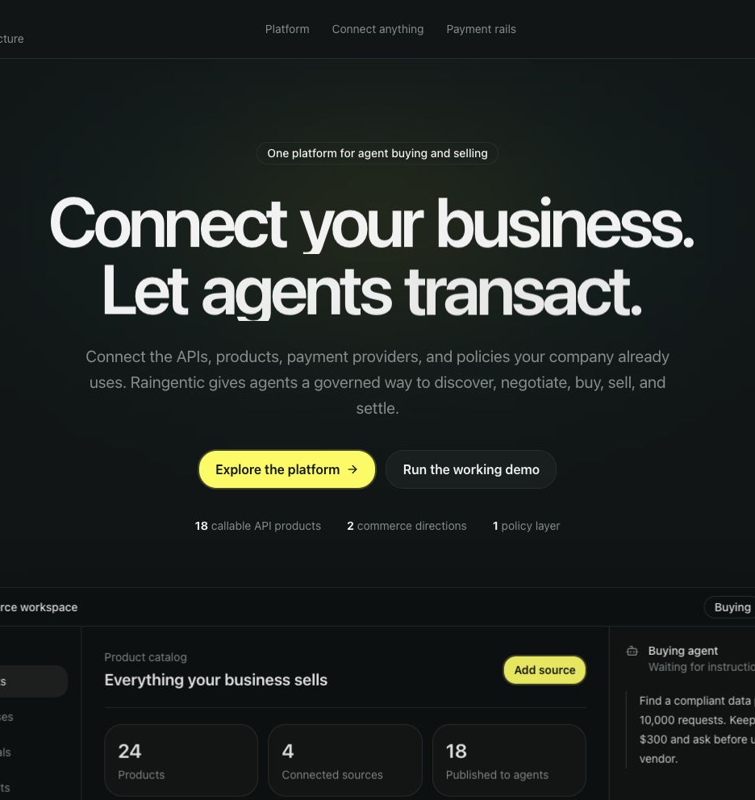
Raingentic
Make your existing business agent-commerce ready in hours
Connect an API or online store. Raingentic configures the products, policies, agent skills, and payment rails needed to buy and sell through agents.
raingentic.saibolla.com
Notes:
Open with the outcome: agents can negotiate and move money, but only inside company authority.
[Sources]
- https://raingentic.saibolla.com
- Repository README.md

Slide 2
THE PROBLEM
Agents can reason. Businesses still cannot safely let them transact.
Products
Authority
Execution
APIs, services, subscriptions, and physical goods already live across disconnected systems.
Budgets, approval thresholds, seller restrictions, and payment permissions are not native to agents.
Stablecoin rails and card rails solve different purchases, with no shared control or receipt layer.
The missing product is not another wallet. It is governed commercial authority.
02
Notes:
Frame the problem around company authority, not crypto. Businesses already have money and products; agents lack safe permission boundaries.
[Sources]
- Raingentic product thesis
- Repository docs/research/10-platform-sdk-vision.md

Slide 3
THE PRODUCT
From an existing API or store to agent commerce in hours.
01
02
03
Connect
Configure
Publish
OpenAPI document
Online store or catalog
Billing or internal API
Products and prices
Negotiation boundaries
Approvals and payment rails
Buyer and seller agents
Agent Card and commerce contract
Skills and SDK integration
Included agent skill
Point Claude, Codex, or another coding agent at the skill. It inspects the business, asks for the required Rain and Monad credentials, and prepares the integration.
Keep the API, store, inventory, checkout, and fulfillment systems you already use.
03
Notes:
This is the product claim: businesses connect what they already have and become agent-commerce ready in hours. The included skill makes implementation agent-led instead of documentation-led.
[Sources]
- Repository skills/
- Repository src/lib/setup-agent.ts
- https://raingentic.saibolla.com

Slide 4
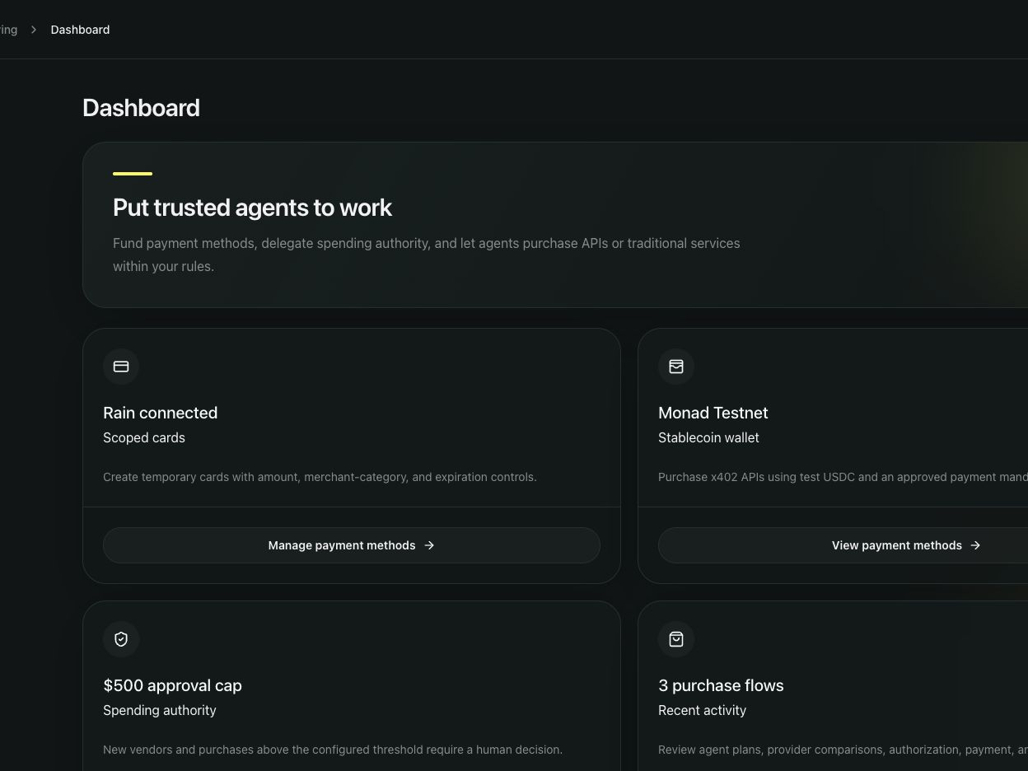
TWO-SIDED COMMERCE
One company configuration powers buying and selling.
BUY
Give the agent a mandate
Describe the outcome
Discover and compare sellers
Negotiate through A2A
Enforce company policy
Approve, pay, and verify
SELL
Publish what the business already sells
APIs, software, services, subscriptions, or physical products use the same pricing, negotiation, authorization, and receipt layer.
04
Notes:
Raingentic is not a new storefront. The same company configuration governs purchasing agents and seller agents around the systems the business already operates.
[Sources]
- https://raingentic.saibolla.com/dashboard
- Repository src/components/commerce-dashboard.tsx

Slide 5
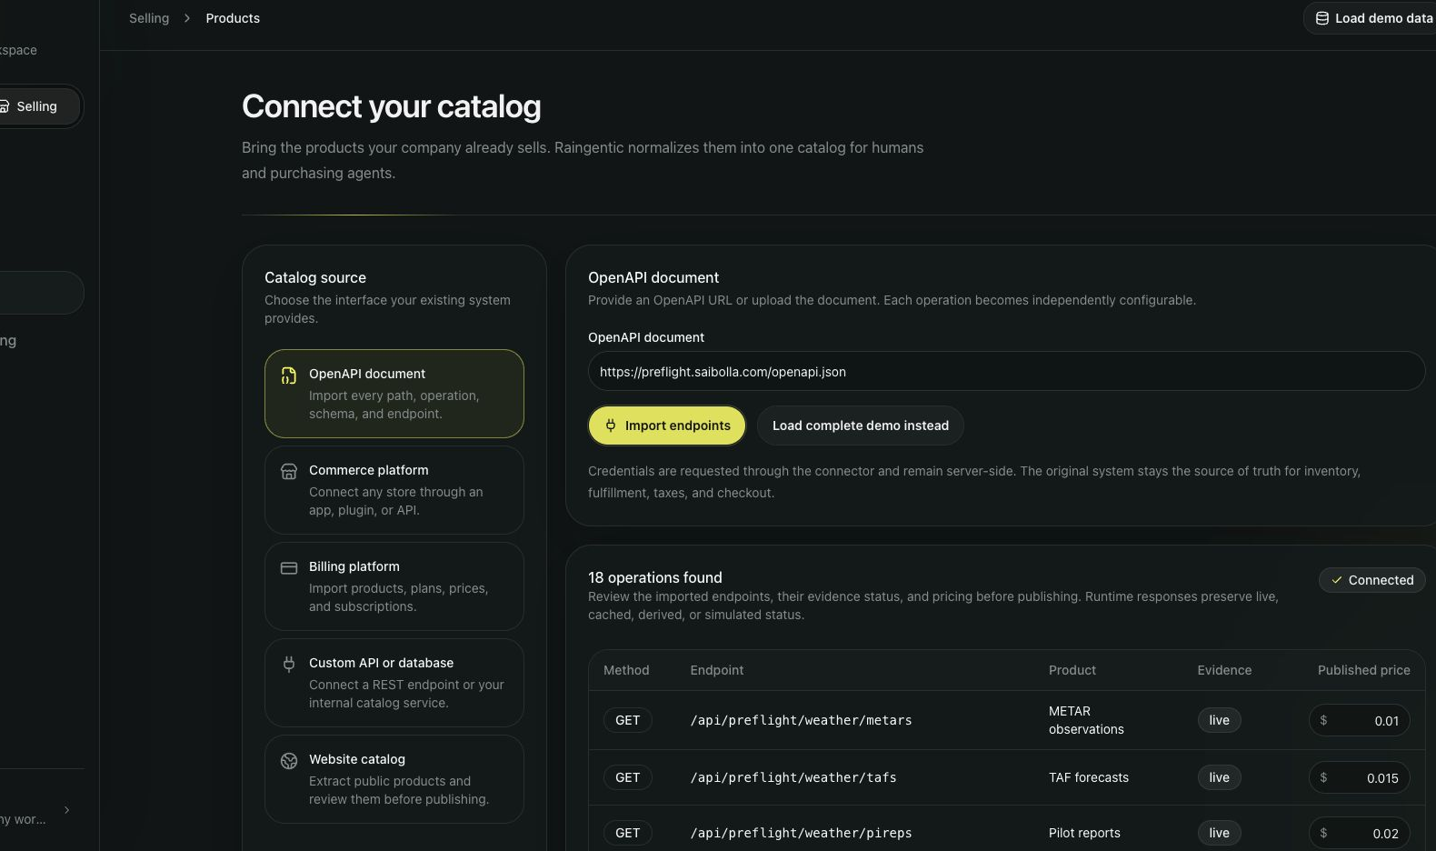
SELLING
A live OpenAPI document becomes 18 agent-buyable products.
18
independently priced operations
13 live
3 derived
2 simulated
Price floors, discounts, payment rails, and negotiation rules publish with the catalog.
05
Notes:
Show that the seller onboarding is not a mock catalog. It imports the deployed PreFlight specification and preserves evidence status and per-operation prices.
[Sources]
- https://preflight.saibolla.com/openapi.json
- https://raingentic.saibolla.com/api/catalog/import

Slide 6
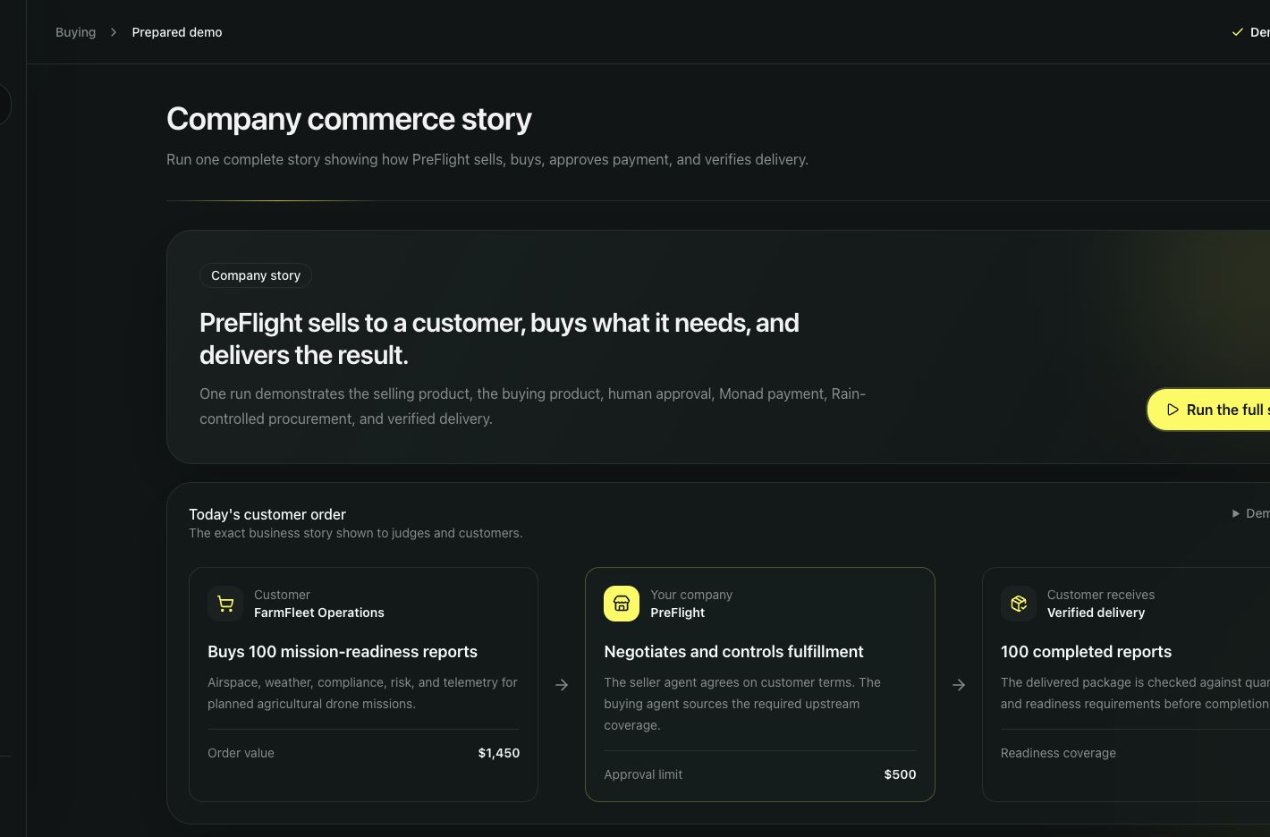
BUYER AGENT
The buyer agent turns plain English into a controlled mandate.
Request
Buy 100 mission-readiness reports. Stay below $1,500.
Structured authority
Budget
Maximum unit price
Required quantity and quality
Approved sellers
Human-approval threshold
OpenAI helps prepare the plan. Deterministic code decides whether it may execute.
06
Notes:
The buying interface is conversational, but the result is a structured mandate enforced by normal application code.
[Sources]
- Repository src/lib/agent.ts
- Repository src/app/api/purchases/run/route.ts

Slide 7
AGENT-TO-AGENT
A2A lets independent agents discover and negotiate.
Buyer agent
Seller agent
DISCOVER
REQUEST
COUNTER
AGREE
Mandate
Budget and quantity
Quality requirements
Approved payment methods
Official Agent Card
Product capabilities
Price and discount rules
Delivery terms
JSON-RPC transport · streaming events · structured tasks and artifacts
Output: a structured commercial agreement for price, quantity, quality, and delivery. No payment permission yet.
07
Notes:
A2A is the commercial conversation layer. The demo publishes an official v1.0 Agent Card and performs discovery, requests, counteroffers, and agreement through JSON-RPC and streaming events.
[Sources]
- https://raingentic.saibolla.com/.well-known/agent-card.json
- Repository src/lib/a2a.ts

Slide 8
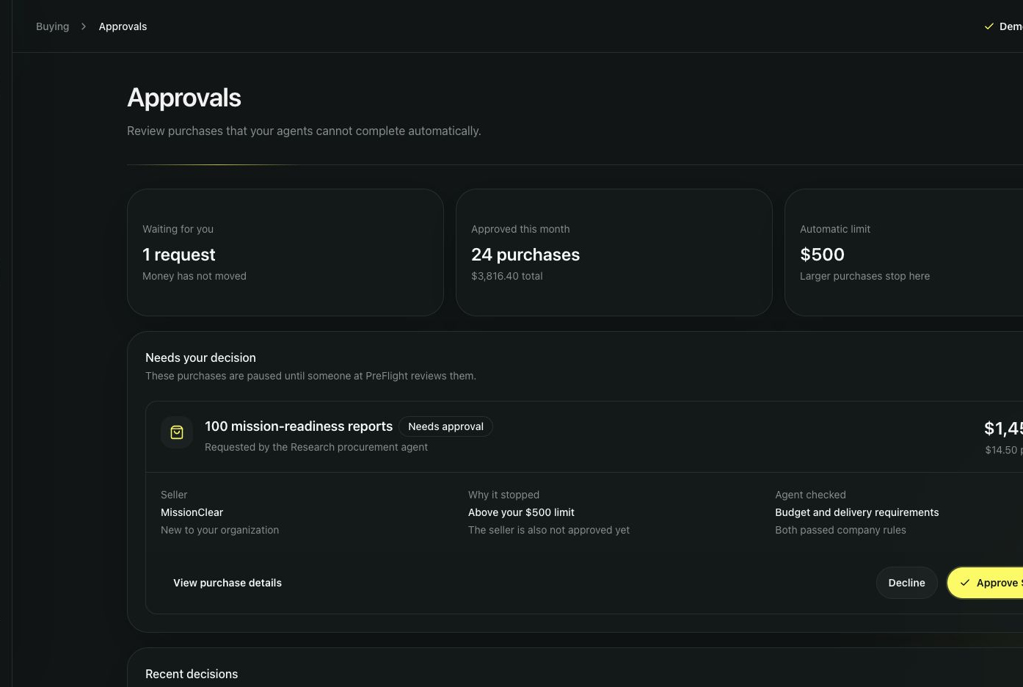
POLICY + AP2
Agreement becomes exact, signed payment authority.
Deterministic policy
Budget · unit price · seller · product · quantity · quality
Human checkpoint
$1,450 negotiated
$500 automatic limit
Nothing moves until approval
Official AP2 mandate
Buyer · seller · product · exact and maximum amount · payment method · recipient · expiration
08
Notes:
Policy and approval decide whether the agreement is acceptable. Google's official AP2 SDK then signs the exact permitted payment. Tampered amounts, wrong recipients, products, or expirations fail.
[Sources]
- https://github.com/google-agentic-commerce/AP2
- Repository src/lib/ap2.ts
- Repository src/app/api/purchases/run/route.ts

Slide 9
PAYMENT ROUTER
One policy layer chooses the payment rail.
$0.01
$464
$28,900
Monad x402
Rain scoped card
Escrow or checkout
Machine-readable APIs and data
Test USDC settlement
Protected result released after verification
Traditional upstream vendor
Exact amount, MCC, and expiry
Bad merchant declined; good purchase settles
High-value hardware or deposits
Solidity commercial terms
Fund, release, refund, or cancel
Small machine purchase. Controlled merchant procurement. High-value commercial agreement.
09
Notes:
The business does not choose one rail forever. Product type and company policy route each authorized purchase to Monad x402, Rain, escrow, or the checkout already in place.
[Sources]
- Repository src/lib/monad.ts
- Repository src/lib/rain.ts
- Repository contracts/RaingenticCommerceEscrow.sol

Slide 10
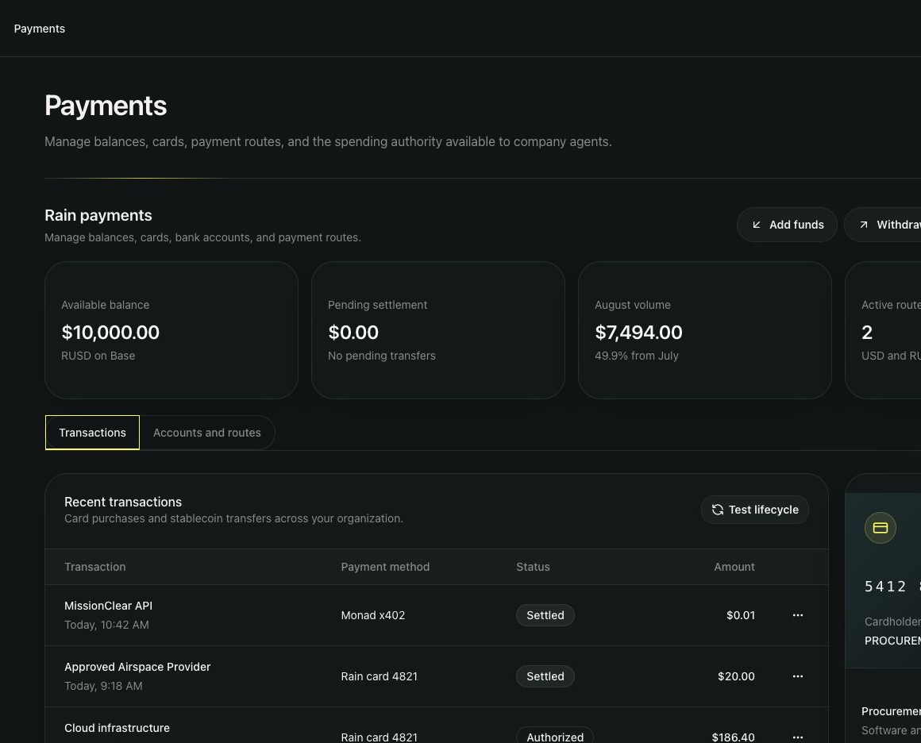
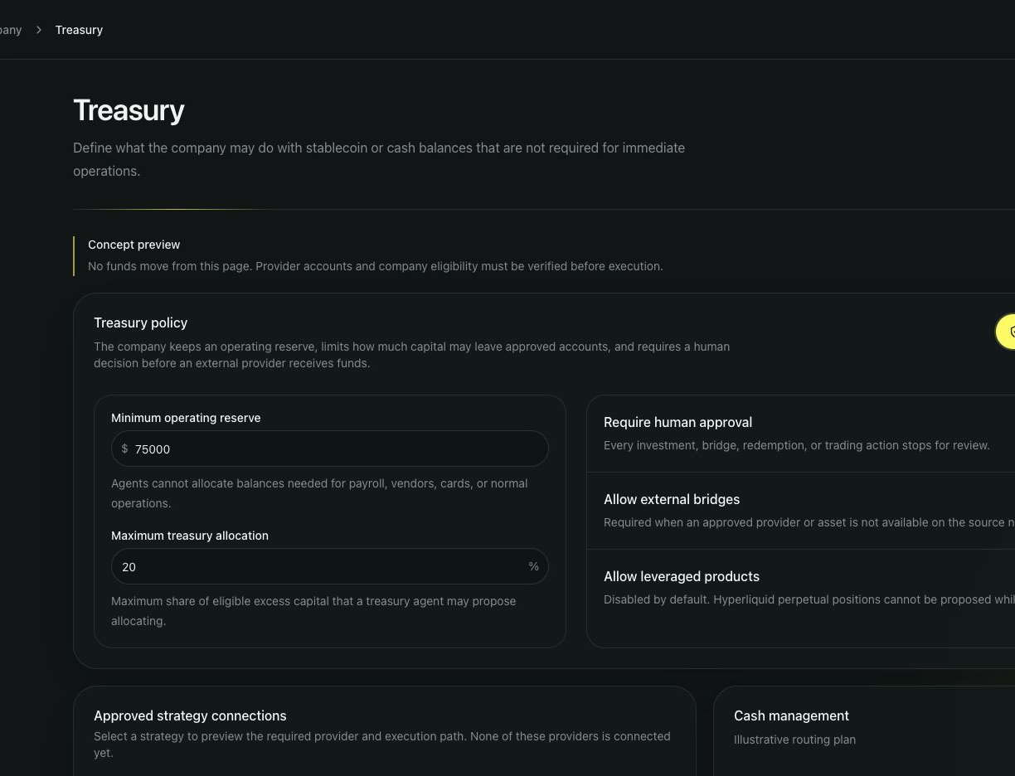
RAIN
Rain connects agent commerce to cards and treasury operations.
Controlled procurement
Payment accounts and routes
Create, restrict, decline, authorize, settle, retrieve
Simulated USD ↔ stablecoin on-ramp and off-ramp
10
Notes:
Rain provides the bridge to existing merchants and the treasury surface needed for stablecoin movement. The demo includes scoped-card lifecycle plus payment-account and route operations, on-ramp, and off-ramp simulations.
[Sources]
- Repository src/lib/rain.ts
- Rain sandbox documentation supplied for the hackathon

Slide 11
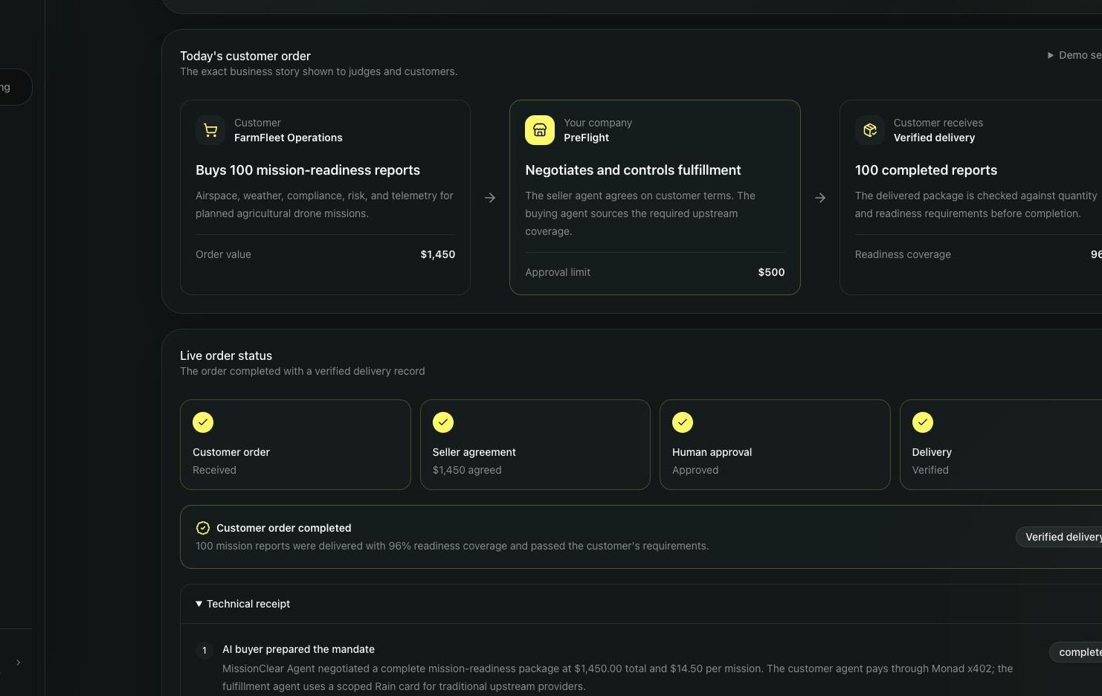
AUDITABLE OUTCOME
One receipt proves the entire transaction.
A2A
Negotiated agreement
AP2
Exact sale and procurement authority
MONAD + RAIN
x402 settlement, card decline, approved settlement, posted transaction
DELIVERY
100 reports · 96% readiness · verified
11
Notes:
The receipt ties commercial agreement, authorization, settlement, and delivery to the same mandate. This is the audit layer businesses need before agents can transact autonomously.
[Sources]
- Repository src/app/api/purchases/run/route.ts
- Repository src/components/commerce-doc-components.tsx

Slide 12
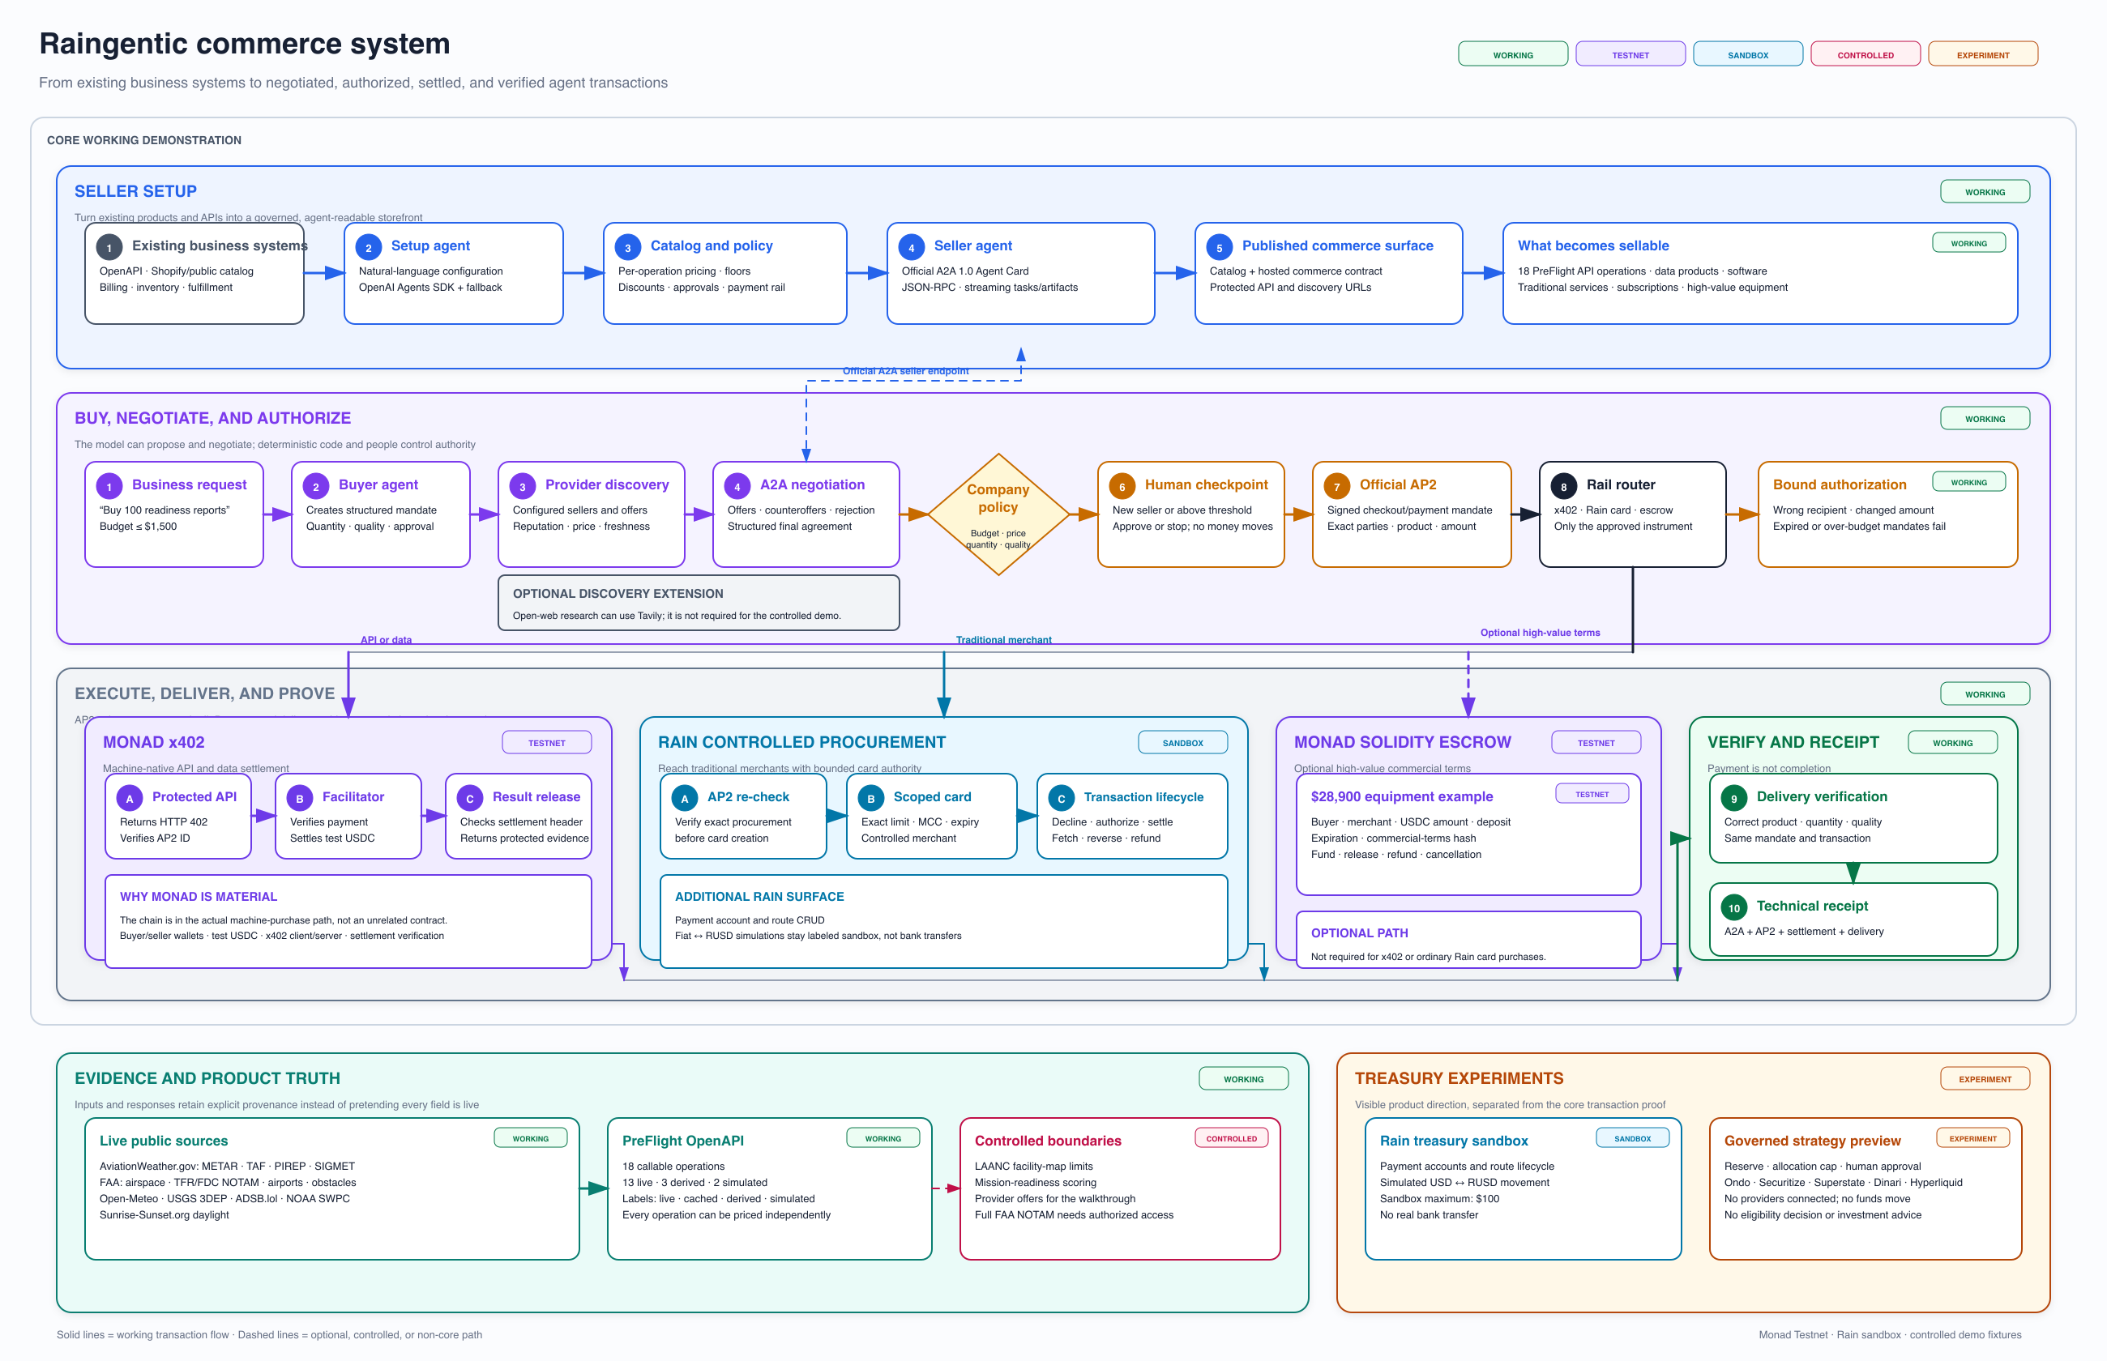
COMPLETE SYSTEM
Existing commerce in. Governed agent transactions out.
Notes:
Walk across the full system: seller setup, buyer negotiation, deterministic controls, AP2, payment routing, delivery, evidence provenance, and treasury experiments.
[Sources]
- Repository docs/architecture.svg
- Repository docs/architecture.excalidraw

Slide 13
WHY IT WINS
A practical adoption layer for Rain and Monad.
Best use of Rain
General track
Monad + Rain
Scoped cards, policy declines, approved settlement, transaction retrieval, payment accounts, routes, and treasury movement.
Agents discover, negotiate, stop for approval, move test or sandbox money, and verify delivery in one working flow.
Monad handles native machine settlement and high-value terms. Rain reaches traditional merchants and treasury routes.
Connect what the company already has. Become agent-commerce ready in hours.
Agent skill · SDK direction · raingentic.saibolla.com
13
Notes:
Close on adoption, not protocol novelty. Raingentic makes Rain and Monad usable by existing businesses without rebuilding their operations.
[Sources]
- Hackathon challenge statement
- Repository README.md
- https://raingentic.saibolla.com

