Slide 1
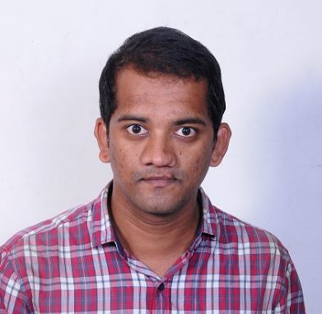


SAIKRISHNA KATHROJI
Analyst/Software Engineer
Master of computer application: 2016 - 2019
Skills
Bangalore
C# | C#Basics, OOPS, Generics, Collections, Arrays.
.NET | ADO.NET,ASP.NET with MVC5 and WEB API, Entity Framework
Python | Machine Learning
Version Control Tool | Git, GitHub, Branches, Merging
Angular | Components, Services, Modules, Routing, Forms & Validation.
UI | HTML 5 & CSS 3,JavaScript, ES6 & TypeScript ,Bootstrap
Sql | Sql database
Tools | Git, SSMS, Visual Studio, Visual Studio Code
Add On Skills | Self Learning
sai-krishna.kathroji@capgemini.com
+91 8466045263
A4
Full Stack Developer
Hands on experience on C#,ADO.NET, LINQ, Entity framework, Sql Server, ASP.NET MVC5 with WEB API
Knowledge on creating Single page Web Application in Angular .
Knowledge on creating databases in SSMS
Having Knowledge on Git And GitHub
Certifications:
AZ-900
AZ-104
Agile software development
Online Hotel Management System [ Video Profile]
Case study of Online Hotel Management System along with API Gateway, Swagger, and payment , responsive UI with HTML5, CSS, Bootstrap and Angular used as User Interface.
Degreed :
Successfully completed the degreed training in git, Sql
C#, .Net Core, Angular ,html , css.
Check out my work on GitHub

