Slide 1
GOVERNMENT DATASET ANALYSIS
Source:High Value Datasets | Open Government Data (OGD) Platform India
Dataset: Current Daily Price of Various Commodities from Various Markets
Email: krishnakatlasai@gmail.com
phone :6301373352
LinkedIn: https://www.linkedin.com/in/sai-krishna-katla-3a4a61301

Slide 2
Introduction:
What is the dataset about?
The dataset contains information on the daily prices of various commodities across different states and markets.
Key Attributes:
State, District, Market: Location details
Commodity, Variety, Grade: Type and classification
Arrival Date: Date when the commodity entered the market
Min Price, Max Price, Modal Price: Pricing details

Slide 3
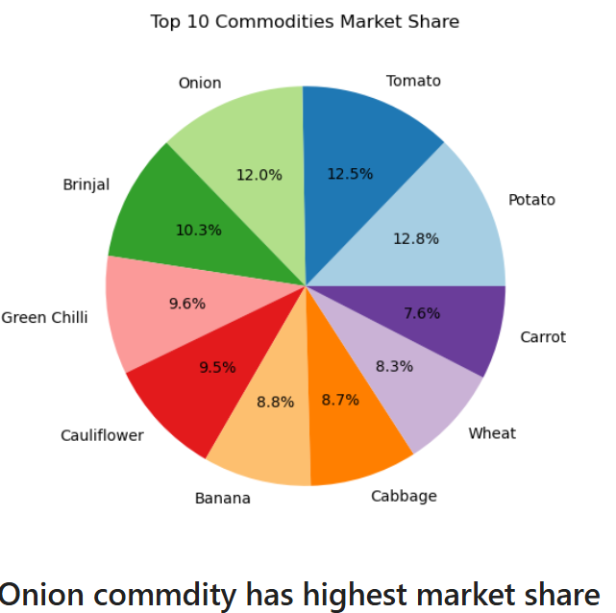
Visualization – Commodity Market Share
Pie Chart → Top 10 Most Traded Commodities
*Onion is the most frequently traded commodity

Slide 4
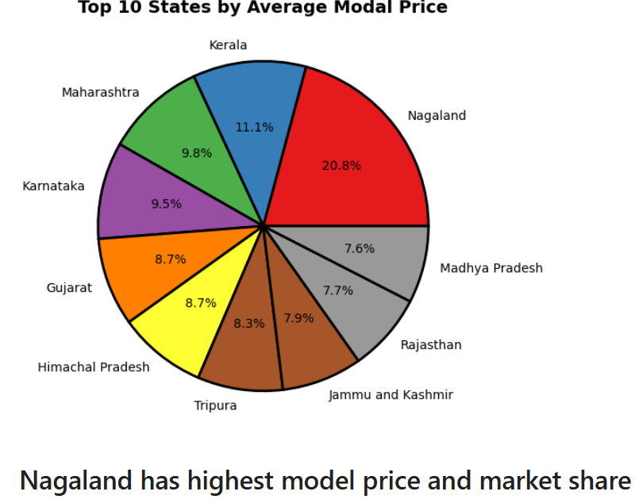
State-wise Price Comparison
Bar Chart → Top 10 States by Average Modal Price

Slide 5
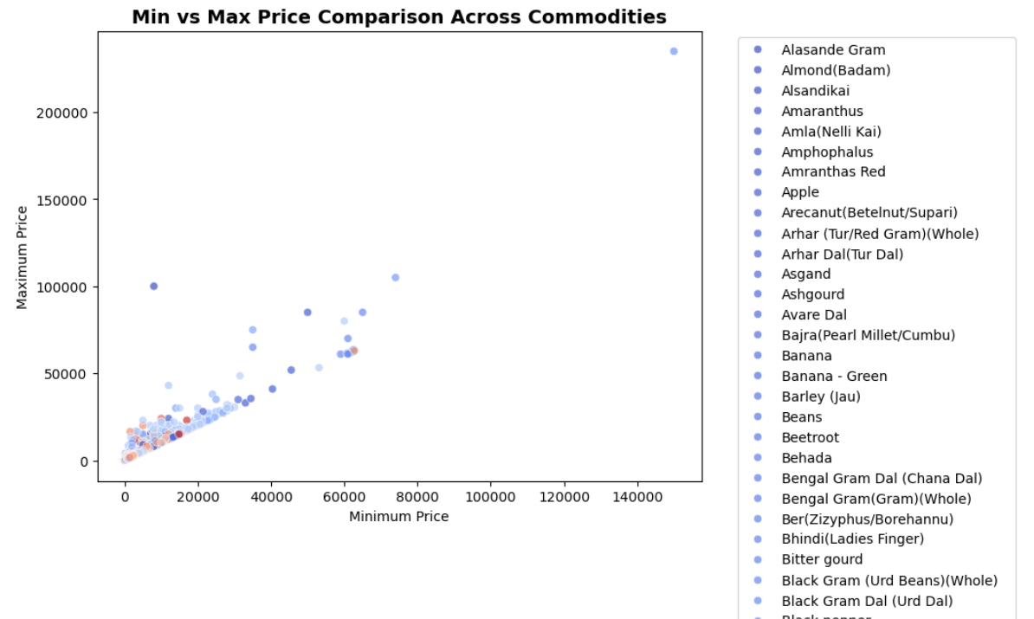
Min vs Max Price Relationship
Scatter Plot → Min vs Max Price for Commodities

Slide 6
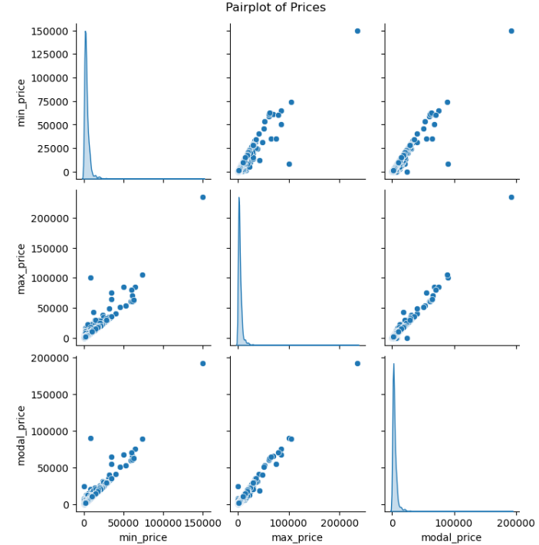
Min vs Max vs model Price Relationship
Pairplot Plot → Min vs Max vs Model Price for Commodities

Slide 7
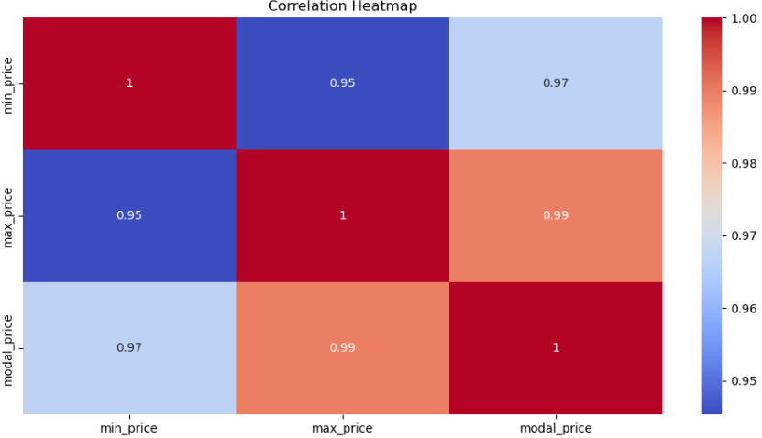
Heatmap – Correlation Between Prices

Slide 8
Conclusions & Business Insights
Price fluctuations indicate market volatility.
Demand for certain commodities keeps prices consistently high.
Regional variations in pricing exist due to logistics and supply-chain issues.
Future forecasting can help optimize pricing strategies.

Slide 9
Top 10 Most Traded Commodities (by Frequency):
Onion (most traded)
Dry Chillies, Groundnut, Gur (Jaggery), Tomato, Paddy (Dhan) (Common), Brinjal, Moath Dal, Pumpkin, etc.
State with the Highest Average Modal Price:
Andhra Pradesh → ₹6260
State with the Lowest Average Modal Price:
West Bengal → ₹3740
Commodity with the Highest Modal Price:
Dry Chillies → ₹16,500

Slide 10
Commodity with the Lowest Modal Price:
Brinjal → ₹1,400
Market with the Maximum Recorded Modal Price:
Hindupur (Commodity: Dry Chillies) → ₹16,500
Market with the Minimum Recorded Modal Price:
Kalikiri (Commodity: Tomato) → ₹1,400
Average Modal Price Across All Commodities:
₹5000
Correlation Between Prices:
Min Price & Max Price: 86.4% correlation
Min Price & Modal Price: 86.1% correlation
Max Price & Modal Price: 99.9% correlation (almost identical)

