Slide 1
BizCover CaseStudy
Perform data analysis and visualize with graphs to understand trends, outliers, and hidden patterns.
Find the customer cohorts with homogeneous characteristics to enable customer marketing effectively.
Determine customer value, journey to better understand them, and forecast business outcomes with time-series.
To answer the questions which are formulated as part of this case study,
Objectives
Visual Exploratory data analysis to discover patterns, spot anomalies, test hypothesis, and pre-process.
Use RFM model to calculate customer score/levels and identify the customers who are likely to respond for campaigns.
Segment the clusters based on their intrinsic behavior and use ML models to assign the cluster for new customers.
Measure the customer journey and find the path leading to a product purchase.
Apply time-series forecasting to predict new customers and estimate revenue for the next month.
Approach
EDA and descriptive statistics offered a holistic view of dataset which is cardinal to intuition and model development.
RFM model assigned 8 levels that resulted in customer segments: 23% risk; 18% loyal; 24% potential campaign targets.
K – Means clustering segmented the customers into 3 clusters. The model is built with reasonable inertia and the number of clusters is chosen based on a hybrid strategy. An additional random classifier is also built to predict the cluster for new customers.
SARIMAX ts model accurately modeled the seasonality and predicted the future results with acceptable error(31).
Outcomes

Slide 2



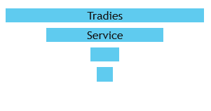
Dashboard : Exploratory Data Analysis and Insights
Jan
Feb
Mar
19675
562,750 $
Apr
#Customers
#Revenue
2019 SALES
541
5
0.02 %
44 yrs.
-29% pct.
New Customers
Products Sold
NO PURCHASE
Avg. Age
Top Customers (20%)
Jan
40% Revenue
Apr
Occupation
41%
NSW
1.5%
Miss Ratio
Retail
Ot

Slide 3
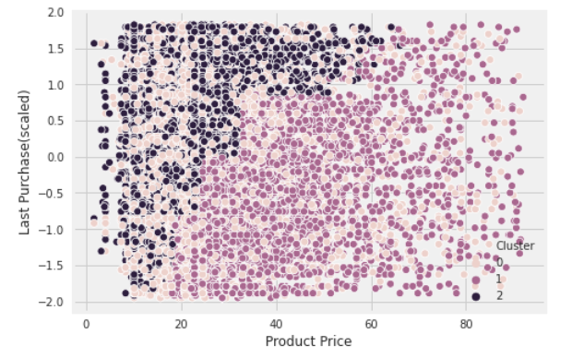
Customer Value, Segmentation and Targets
RFM captures the purchase behavior while K-means models intrinsic behavior, a combination of these could be effectively used to serve customer needs and enable target marketing.
The customers with the highest RFM scores are most likely to respond to an offer. Around 18% (Loyal, Champions) belong to this segment.
Customers with the ‘Potential’ category have purchased recently but in small amounts (~$24). 70% of them belong to NSW and ACT.
Retention® campaigns: Customers labeled “Risk” and “Needs Attention” spend a good amount(~$31) but have been dormant for a long time.
R
Cluster 0 – Like to spend moderate amount; Purchased products in Feb-Mar; Most of them are in Victoria & ACT; RFM score is 9 (Potential targets); Frequently purchased product - 2.
Cluster 1 – Like to spend high amounts; Purchased products in Mon-Feb; Most of them are in NSW; Frequently purchased product - 1.
Cluster 2 - Like to spend low amount; Average age is around 44; Purchased products recently in Mar.

Slide 4
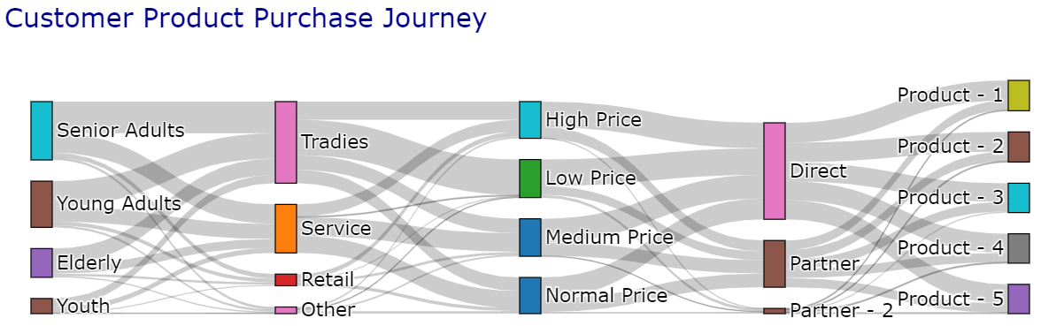
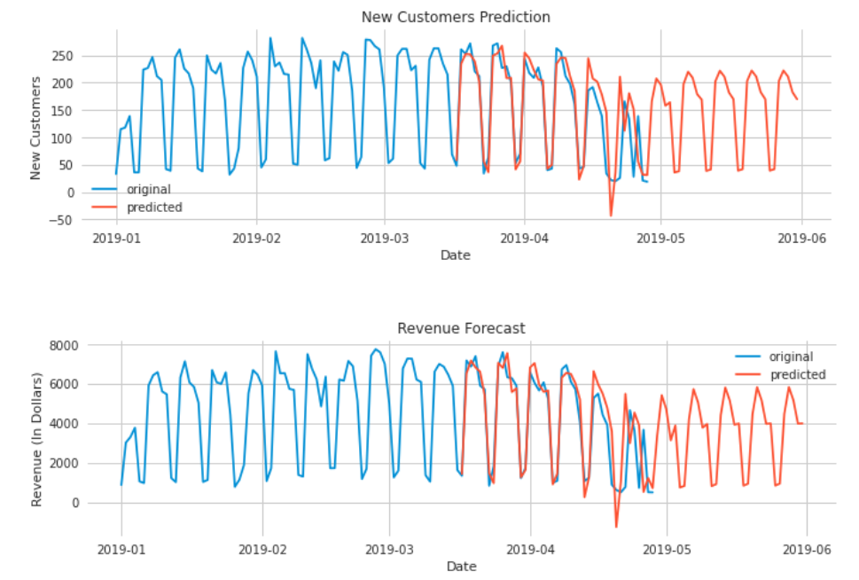
Customer Journey and Business forecast
Customer pattern analysis visualized with Sankey uncovers hidden insights in the data. Forecasting new customers and revenue sets an expectation of the future and orchestrates the marketing.
The Sankey chart showcases how attributes like occupations, price, and affiliates influence the product purchase.
Senior Adults who are working as Tradies, associated with Direct Affiliate tend to spend less and have a strong preponderance to purchase product - 2.
Elderly Retail customers with Partner Affiliate tend to spend high and purchase product – 1.
The chart clearly indicates daily seasonality with periodic highs during weekdays and lows on weekends. The SARIMA model precisely modelled the data with low error and predicted below.
New customers are expected to rise by 18%(4776) in May compared to April.
Estimated revenue from purchases is expected to be around 111,448 $ in May, a 3.3% increase from April (107,878 $).

Slide 5
Conclusion
Questions:
Total Customers purchased in 2019:19642(99.8%)
Unique Products(productid) sold: 5
Products sold(If same price indicates product): 4257
Optimal Customer Segments: 3
Segment characteristics : Defined previously.
Groups to focus: Risk group for retention,
Cluster – 0, “Potential” group for sales.
Outstanding Questions:
Is there a fixed price for each product as the price column varies with each purchase even though the productid remained same.
Is there a relation between Affiliate partners.
About Data: Data science perspective
There is no correlation or linear relationship among the attributes, therefore such data needs complex nonlinear models to fit.
Business intuition on products, Affiliate types could help in better feature treatment.
Developed models are good enough to start with; however, additional feature engineering and new variables are required to enhance them and make them robust.
4
3
What else is interesting or peculiar?
Why every customer made only one purchase as this made it impossible to model sequential behavior over time.
Performed time-series forecasting and pattern analysis as I noticed the scope and found it interesting.
A Product-specific recommendation engine could be built to tailor the customer needs & preferences.

