Slide 1
Smart Attendance System Using RFID Technology
Presented by
K.Manasa
B.Sai Teja
N.Hari Vamsi Krishna
K.S.B.S.Krishna
Batch Id:[6A]

Slide 2
Base Paper
IEEE Symposium on Industrial Electronics and Applications. RFID Based Attendance System T.S. Lim, S.C. Sim and M.M. Mansor Faculty of Engineering and Technology, Multimedia University.

Slide 3
Abstract
The conventional method of taking attendance by calling names or signing on paper is very time consuming and insecure, hence inefficient. Radio Frequency Identification (RFID) based attendance system is one of the solutions to address this problem.
With real time clock capability of the system, attendance taken will be more accurate since the time for the attendance taken will be recorded.

Slide 4
Abstract..
Radio frequency identification (RFID) refers to the use of radio frequency wave to identify and track the tag implanted into an object or a living thing.
RFID system usually consists of RFID reader and tag. It is very useful because it can uniquely identify a person or a product based on the tag incorporated.

Slide 5
Architecture

Slide 6
Existing System
The biometric system can only scan one card at a time.
Manual sending of messages to the registered phone number in case of absence of the student.
The registering of a new Id has to be done by the admin manually which Is a tedious task.

Slide 7
Proposed System
RFID scanner supports recognizing multiple cards at once when used with high frequency.
Automatic sending of messages to the registered phone numbers.
A hex keypad is used to support registering of new Ids by the respective student himself.

Slide 8
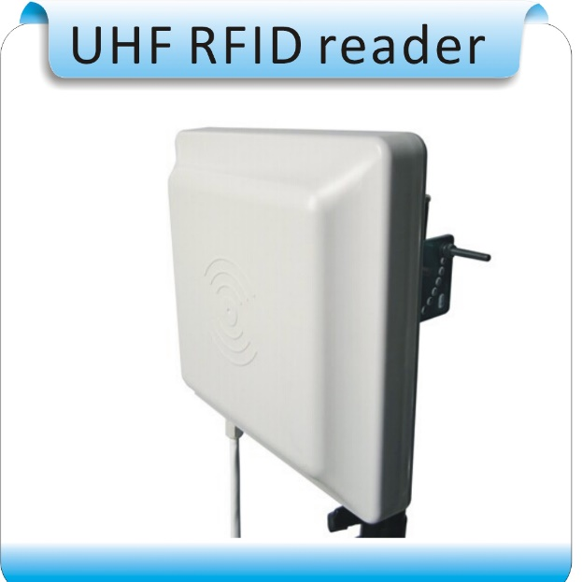
Extension of the System
We can use a ultra-high frequency RFID Reader, as a result the frequency of the reader will be high and the radius covered by it will be more so that the tag need not be shown to the sensor.
A secure lock system can be arranged to any doors and we can use RFID technology to unlock them without using any Key.

Slide 9
References
S.Shepard, “RFID Radio Frequency Identification”, s.l.: MacGraw-Hill, 2005.
Radio-frequency identification. Wikipedia (online). Wikipedia Foundation, Inc., 2009.
An Introduction to RFID Technology published in IEEE Pervasive Computing Vol.5 Issue.1 (Jan-March 2006)

Slide 10
Thank You…

