Slide 1
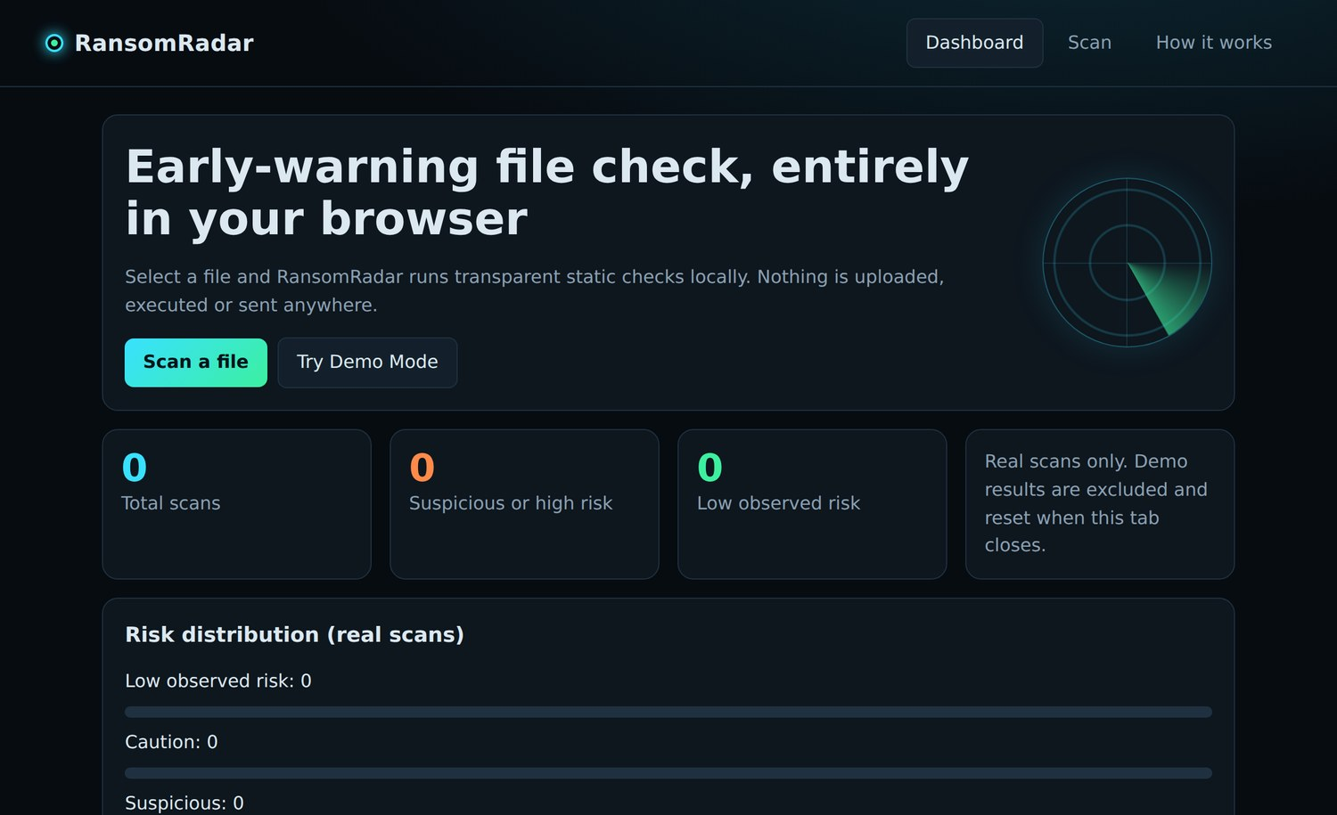
RansomRadar
Early-warning file scanner that runs entirely in your browser
What it does | How it works | Example scans
Notes:
RansomRadar is a single-page, browser-only tool that statically inspects a file for ransomware-style warning signs. Screenshot: the dashboard on first load.

Slide 2
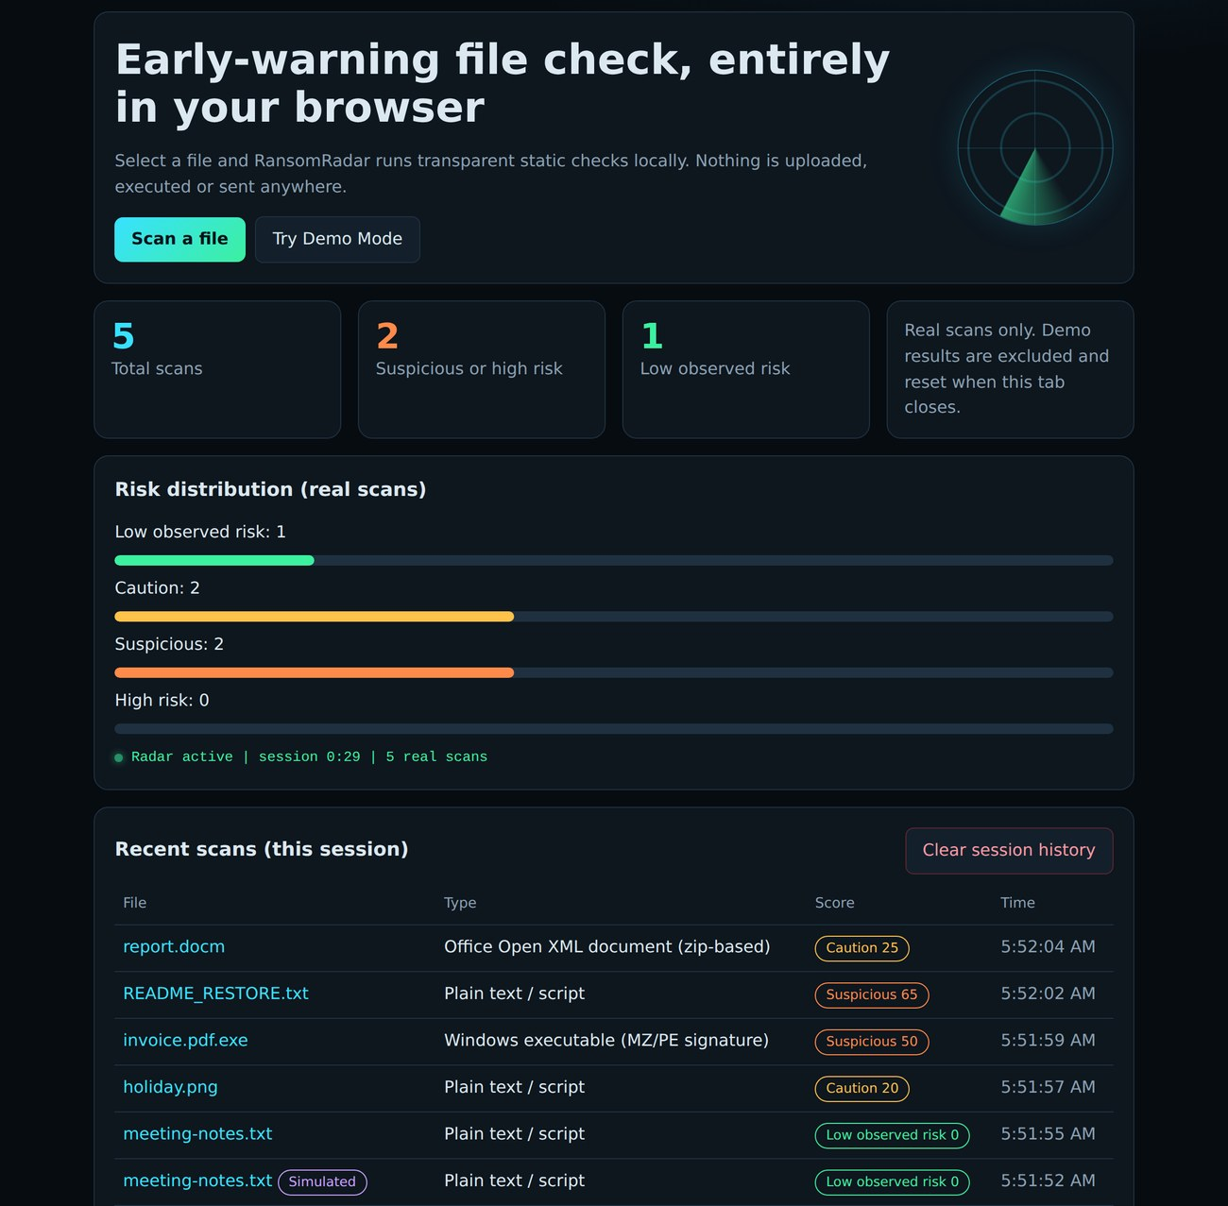
A pre-open check for suspicious files
1
Fully local
Files are read in your browser. Nothing is uploaded, executed or sent anywhere.
2
Transparent rules
Fixed point values per indicator, no black box. Every finding shows its evidence.
3
Early warning only
An educational prototype, not antivirus. The score is a heuristic.
Notes:
Dashboard: total scans, suspicious/high-risk count, low-risk count, a risk distribution, and a session-only scan history that disappears on reload. Demo scans are excluded from totals.

Slide 3
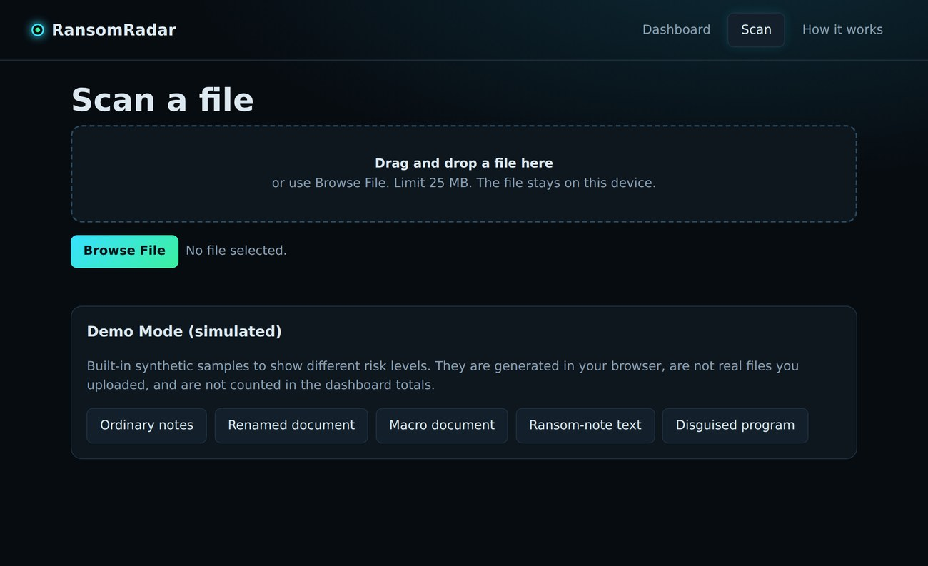
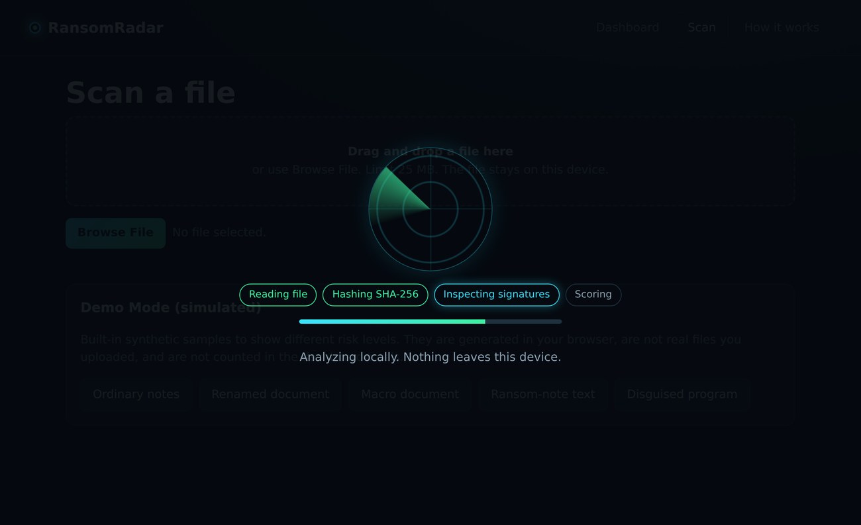
How a scan works
1. Select file
2. Analyze locally
3. Score risk
4. Show report
Drag in or browse. Max 25 MB.
Read bytes, sniff type, entropy, SHA-256.
Matches add fixed points, capped at 100.
Detected, clear or unsupported.
Reading file, hashing SHA-256, inspecting signatures, scoring.
Demo Mode loads 5 synthetic samples, flagged as simulated.
Notes:
Under the hood: File/ArrayBuffer APIs read the bytes; magic-byte signatures identify the real type (MZ = Windows exe, %PDF-, PK = zip/Office, PNG, etc.); Shannon entropy is computed over all bytes; SHA-256 comes from Web Crypto. Left screenshot: scan page. Right: the analysis overlay with its four progress steps.

Slide 4
What it looks for: 12 indicators
Name vs. bytes
Inside the file
Office and PDF
Does the name match?
Text and byte patterns
Active content
Disguised program +35
Double extension +25
Extension mismatch +20
Ransom-style extension +15
Runnable extension +10
Shadow-copy deletion +35
Ransom-note phrases +30
High entropy +15
Hidden or encoded scripts +15
Office macro +25
PDF launch action +25
PDF JavaScript +15
Each indicator is an independent check. Every match adds its fixed points.
Notes:
Disguised program = EXE/ELF header behind a document, image or archive extension. Entropy of 7.5+ is only tested on types not normally compressed and files over 2 KB. Ransom-note phrases add 10 points each, up to 30. Macro check looks for vbaProject.bin (Office zip) or _VBA_PROJECT (legacy OLE). PDF checks look for /JavaScript and /Launch tokens.

Slide 5
Scoring: points add up, then cap at 100
0-14
Low observed risk
15-39
Caution
40-69
Suspicious
70-100
High risk
A low score is not proof of safety.
Notes:
Each matching indicator contributes its fixed points (never more than its max), the raw total is capped at 100, then mapped to one of four labels. Severities: critical (red), high (orange), medium (amber), low (green).

Slide 6

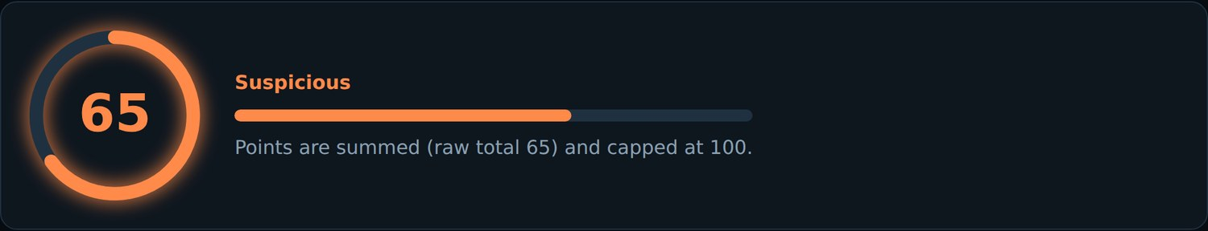
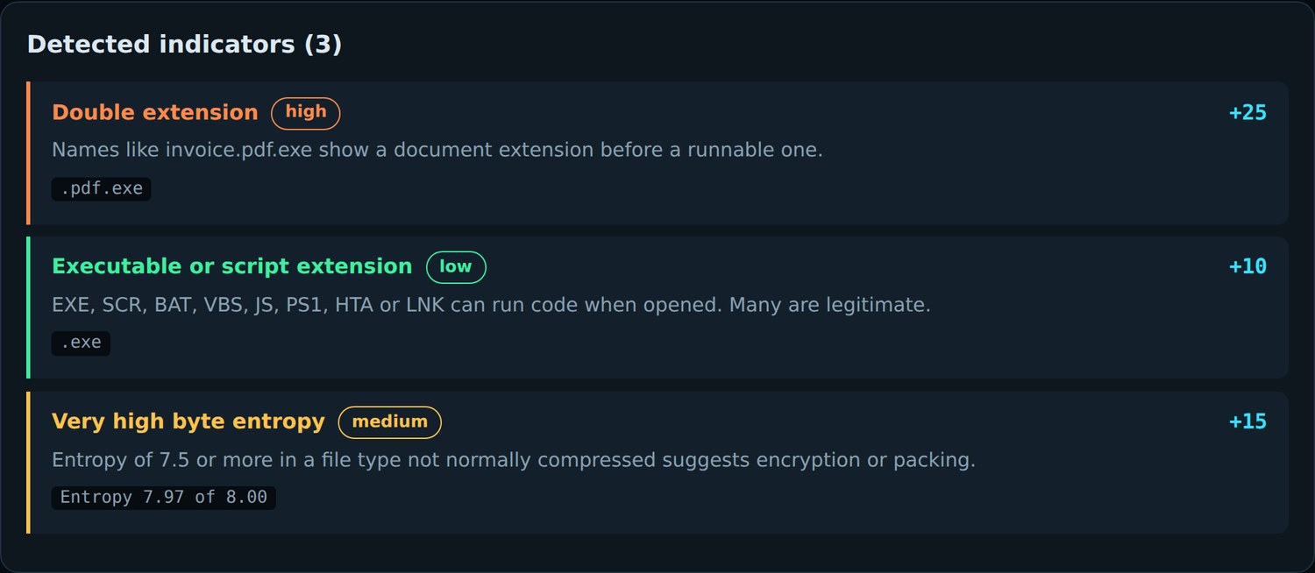
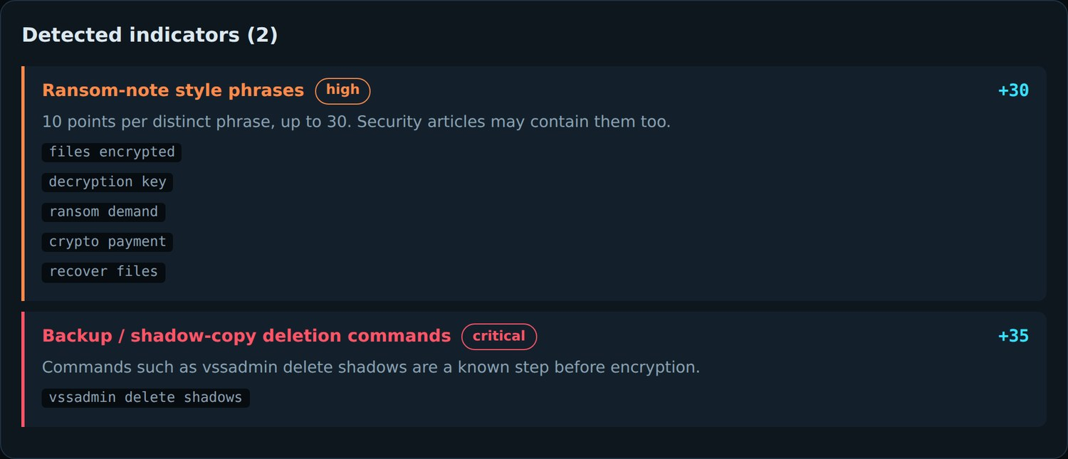
Two demo scans, scored
invoice.pdf.exe
README_RESTORE.txt
25 + 10 + 15 = 50 Suspicious
30 + 35 = 65 Suspicious
Notes:
Left: a synthetic MZ-header file named invoice.pdf.exe: double extension (+25), runnable extension (+10), entropy 7.97/8 (+15). Right: ransom-note text plus 'vssadmin delete shadows': five note phrases capped at +30, shadow-copy deletion +35. Both are Demo Mode samples, flagged as simulated in the app. A third sample, a .docx with vbaProject.bin, scores 25 (Caution).

Slide 7
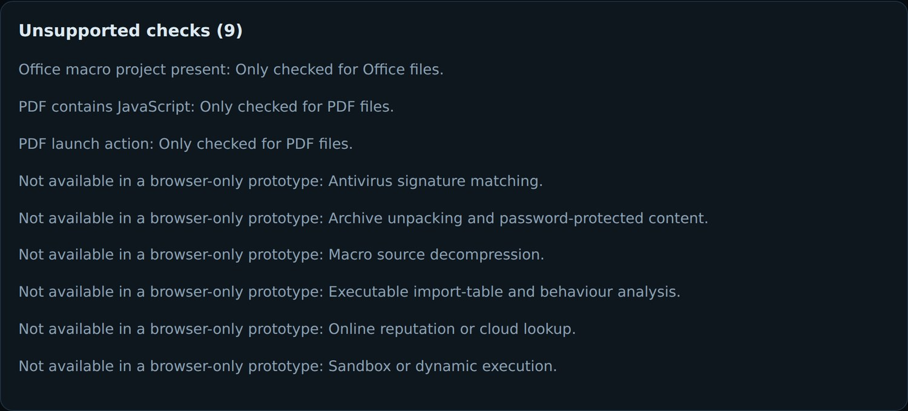
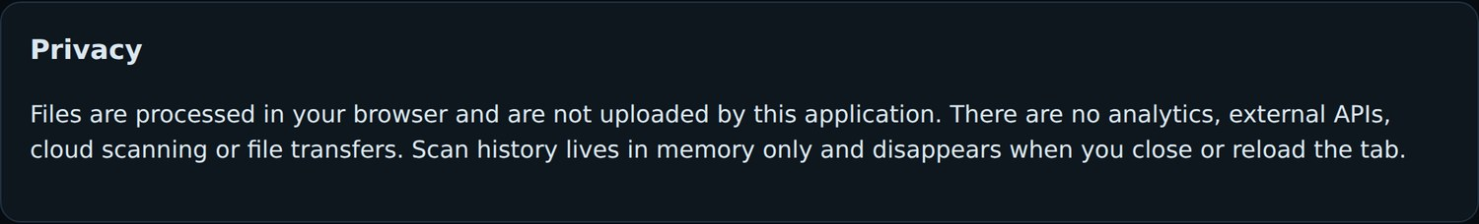
Know the limits
Private by design
No analytics, no external APIs, no cloud scanning. History lives in memory and vanishes on reload. Files are never executed.
Not an antivirus
No signature matching, archive unpacking, macro decompression, import-table analysis, reputation lookup or sandbox. High score is not proof of malware.
Notes:
Every report lists unsupported checks so the user never mistakes a clean score for a clean bill of health. Right: the unsupported-checks card and the privacy statement from the How it works page.

