Slide 1


M.Tech Program
Advanced Industry Integrated Programs
Jointly offered by University and LTIMindTree
Review II
CODESAGE: AN EXPLAINABLE AGENTIC RAG SYSTEM FOR SOFTWARE REPOSITORY COMPREHENSION
Team Member
SAIKRISHNAN P
CRESCENT 2025-27
Knowledge partner | Implementation partner

Slide 2

CODESAGE: AN EXPLAINABLE AGENTIC RAG SYSTEM FOR SOFTWARE REPOSITORY COMPREHENSION
Introduction
CodeSage is a RAG tool that answers natural-language questions about any GitHub repo by chunking its code (AST-aware for Python/JS/TS/Java/notebooks), indexing it with hybrid vector + keyword search, and generating cited answers via an LLM agent pipeline.
It runs as a FastAPI service — /ingest a repo, /query it in plain English — deployable via Docker, and is currently live and fully verified end-to-end on your own Railway deployment.

Slide 3
CODESAGE: AN EXPLAINABLE AGENTIC RAG SYSTEM FOR SOFTWARE REPOSITORY COMPREHENSION
Objective
Lets developers query a codebase in plain English instead of manually searching or reading through unfamiliar source files, getting answers grounded in the actual code with file/line citations.
Do this accurately and verifiably — using AST-aware chunking (not blind text splitting) and hybrid retrieval, with an LLM verify step that checks the answer is actually supported by the retrieved code before returning it.
Make it practically deployable and usable, not just a local script — packaged as a FastAPI service with async, non-blocking ingestion (so real-sized repos don't time out), persistent storage across restarts, and repo management endpoints, all runnable in production (as verified on your own Railway deployment).

Slide 4
CODESAGE: AN EXPLAINABLE AGENTIC RAG SYSTEM FOR SOFTWARE REPOSITORY COMPREHENSION
Scope
What it handles: ingesting GitHub repos (or local folders) across multiple languages — Python, JS/TS, Java, HTML/CSS/SCSS, and Jupyter notebooks — chunking them intelligently, indexing with hybrid (vector + keyword) search, and answering natural-language questions with cited, LLM-generated responses via a FastAPI service.
What it manages: multiple repos indexed side-by-side (filterable per-repo at query time), with endpoints to list, re-ingest, and delete indexed repos, plus persistent storage so data survives restarts/redeploys.
What it doesn't cover: live/deployed websites (only repo source code, not crawling a running site), non-code file types beyond what's explicitly chunked, and it's a single-instance design — no multi-user auth, no distributed/multi-replica job queue (the in-memory job tracking assumes one instance).

Slide 5
CODESAGE: AN EXPLAINABLE AGENTIC RAG SYSTEM FOR SOFTWARE REPOSITORY COMPREHENSION
Modules to cover
Data Ingestion Chunking
Code Chunking
1
2
Embedding Generation
Vector Database
3
4
Keyword Indexing
Hybrid Retrieval
5
6
Answer Generation & Verification
API & Deployment
7
8

Slide 6
Project Title - Calibri body 18
Methodology
AST-aware chunking — parse each file's syntax tree (Python ast, tree-sitter for JS/TS/Java/HTML/CSS, cell-by-cell for notebooks) and emit one chunk per function/class/method, instead of splitting by fixed character windows — preserves semantic boundaries so no chunk cuts a function in half.
Hybrid retrieval with Reciprocal Rank Fusion — dense vector search (Chroma + sentence-transformer embeddings) for conceptual/paraphrased queries, combined with sparse full-text search (Postgres tsvector/GIN) for exact identifiers and error strings; fused by rank position (Σ 1/(k+rank)) rather than normalizing incomparable similarity scores.
Agentic generation pipeline (LangGraph) — triage → retrieve → generate → verify, where the verify step checks for hallucinated citations or empty answers and triggers one retry with a broadened query before surfacing the result, rather than a single-shot retrieve-then-generate call.

Slide 7
Project Title - Calibri body 18
Tools Used
Backend & API — Python, FastAPI (REST API), Pydantic (request/response validation), JWT (PyJWT) for auth tokens.
RAG & AI pipeline — LangGraph (agentic triage→retrieve→generate→verify graph), Groq (LLM inference), ChromaDB (vector store), sentence-transformers (embeddings), tree-sitter + Python ast (AST-based code chunking).
Data & infrastructure — PostgreSQL (users, history, full-text search via tsvector), Redis + RQ (background job queue for ingestion), psycopg2 (DB driver).
Auth & integrations — GitHub OAuth, Google OAuth, Stripe (billing/credits), SMTP (email verification).
Frontend — React, Vite.

Slide 8
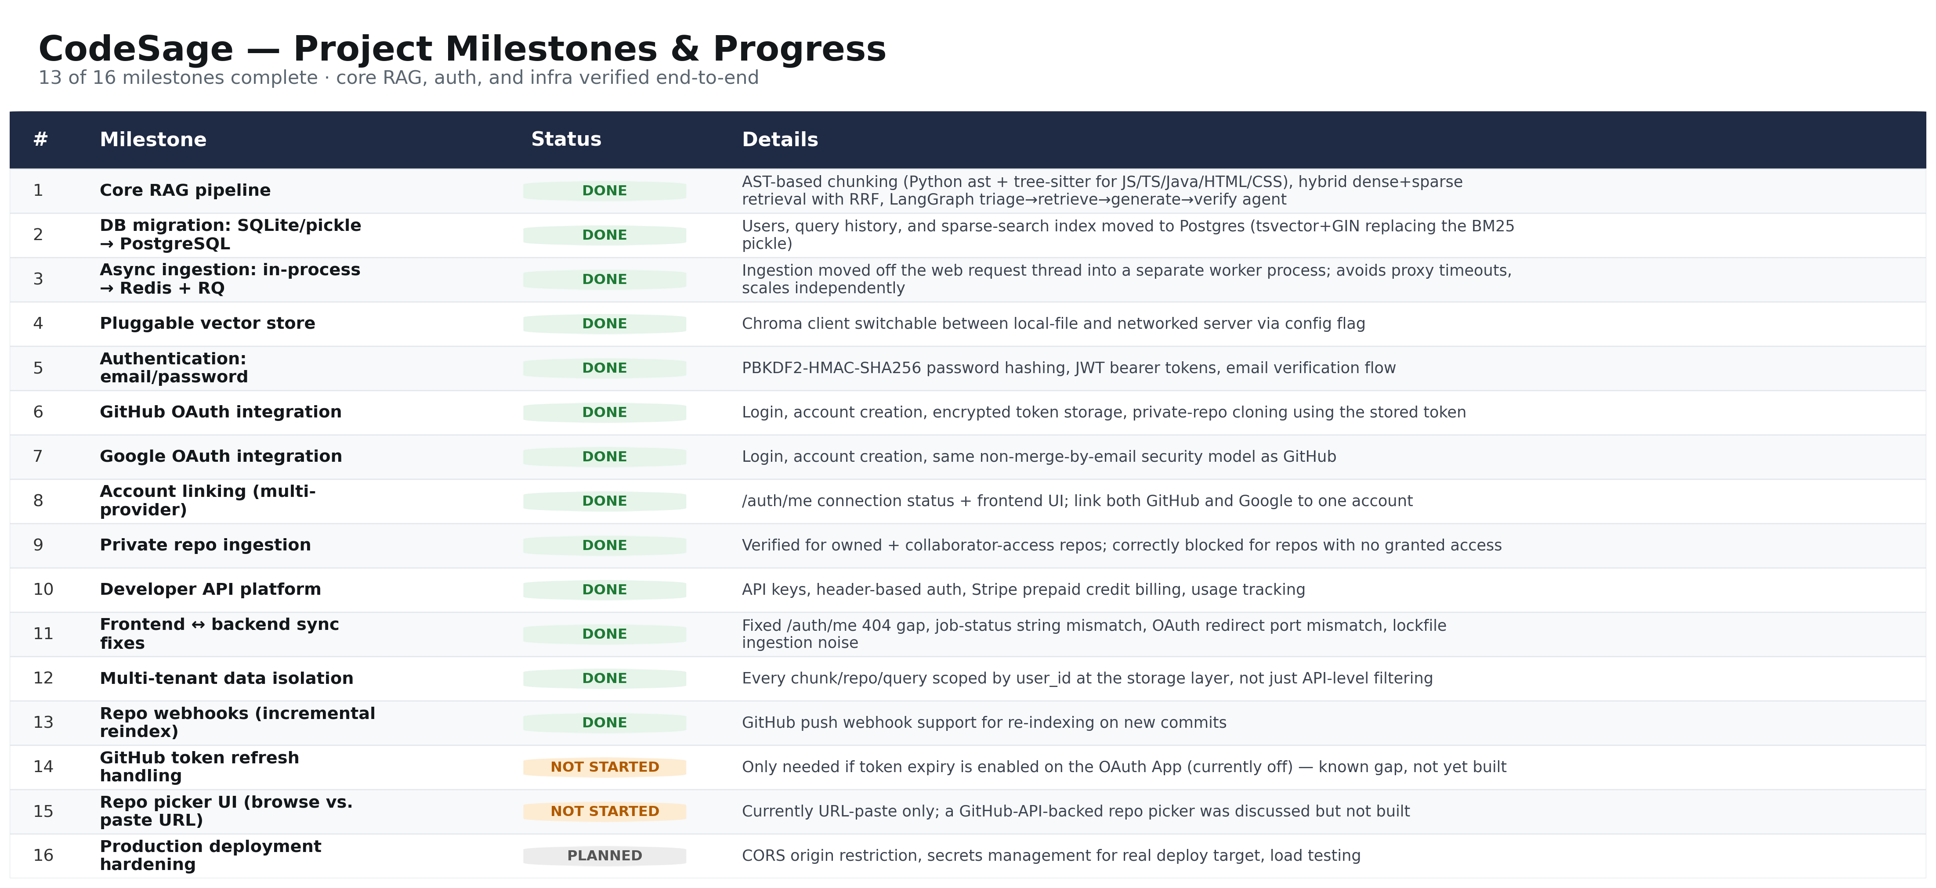
Project Title - Calibri body 18
Project plan/milestones progress

Slide 9
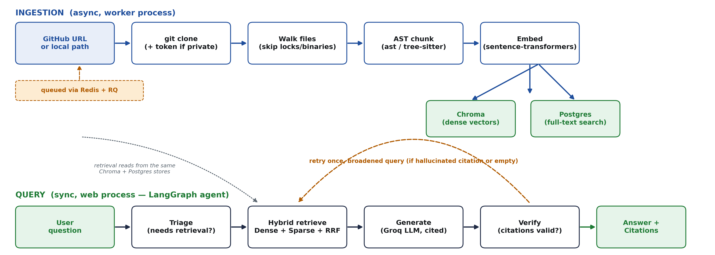
Project Title - Calibri body 18
Pipeline structure

Slide 10
M.Tech Program
Advanced Industry Integrated Programs
Jointly offered by University and LTIMindTree
Review II
WYFE: A Multimodal Personal Agent for Scheduling notes and Messaging
Team Member
SAIKRISHNAN P
CRESCENT 2025-27
Knowledge partner | Implementation partner

Slide 11
WYFE: A Multimodal Personal Agent for Scheduling notes and Messaging
Introduction
What it is: Aria is an agentic AI assistant that lives inside WhatsApp and helps you set, manage, and receive reminders through ordinary chat messages.
How you use it: You message it in natural language, like "remind me to call the bank tomorrow at 10 AM," and it works out the task, time, and intent without forms or menus.
What makes it agentic: Instead of just replying, Aria acts on its own. It understands the request, schedules the reminder, and sends a nudge at the right time.
Why it matters: WhatsApp is already where people spend their day, so reminders arrive in a familiar place with no extra app to install.

Slide 12
WYFE: A Multimodal Personal Agent for Scheduling notes and Messaging
Objective
The main objective of Aria is to build an agentic AI assistant that manages reminders through natural WhatsApp conversation, with no extra app or manual scheduling.
Understand natural language: Interpret messages like "remind me to submit the report on Friday evening" and extract the task, date, and time accurately.
Act autonomously: Create, schedule, update, and cancel reminders on its own, using tools instead of only generating replies.
Deliver on time: Send each reminder through WhatsApp at the right moment, reliably and consistently.
Stay simple and accessible: Give users a hassle-free way to stay organized on a platform they already use daily.

Slide 13
WYFE: A Multimodal Personal Agent for Scheduling notes and Messaging
Scope
Conversational reminder management: Creating, viewing, editing, and deleting reminders through natural-language WhatsApp messages.
Intent and detail extraction: Parsing the task, date, time, and basic recurrence (e.g., daily, weekly) from free-form text.
Agentic task handling: Using an LLM with tools to decide what action to take, ask follow-up questions when details are missing, and confirm back to the user.
Scheduled delivery: Sending reminders through WhatsApp at the requested time.
Basic user handling: Identifying users by their WhatsApp number and storing their reminders.

Slide 14
WYFE: A Multimodal Personal Agent for Scheduling notes and Messaging
Modules to cover
Whatsapp Interface Module
User Management Module
1
2
Language Understanding and Time Parsing Module
Agent/ Planning Module
3
4
Tool/Action Module
Memory/ Database Module
5
6
Scheduler Module
Error Handling and Testing Module
7
8

Slide 15
WYFE: A Multimodal Personal Agent for Scheduling notes and Messaging
Methodology
Understand the message: The user sends a natural-language message on WhatsApp. A webhook receives it, identifies the user by their phone number, and passes it to the LLM, which finds the intent (create, view, edit, or delete) and extracts the task, recurrence, and time. Relative phrases like "tomorrow evening" are converted into exact timestamps using the user's current date and time zone.
Decide and act: Following the reason-then-act approach, the agent chooses the next step. It asks a follow-up question if details are missing. Otherwise it calls the matching tool (create, list, update, or delete reminder), which saves the change per user in the database, and confirms the result back to the user.
Deliver and validate: The scheduler checks for due reminders, sends each one through WhatsApp, and queues the next occurrence for recurring ones. Errors are handled and logged, and the system is tested for intent accuracy, time parsing correctness, and on-time delivery, with prompts and logic refined based on the results.

Slide 16
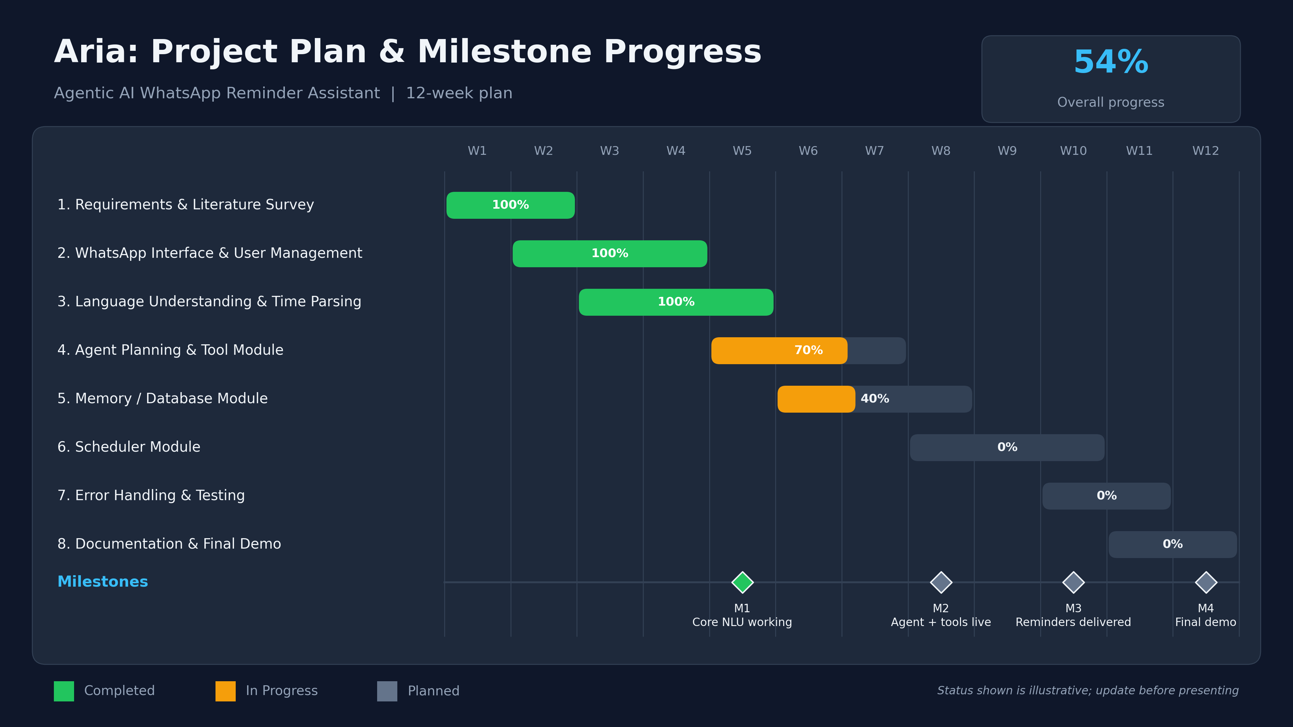
WYFE: A Multimodal Personal Agent for Scheduling notes and Messaging
Project plan/milestones progress

Slide 17
WYFE: A Multimodal Personal Agent for Scheduling notes and Messaging
Pipeline structure

