Slide 1
Project Team :-
Saikrishna
Naveen
Prashanth
Bhargav
Obul reddy
Spot Your Vaccine

Slide 2
Overview
Problem Statement
Architecture
Technologies & Tools Used
Project Flow
Web Pages
Troubleshooting
Conclusion

Slide 3
Problem Statement :-
Automated Deployment of Spot Your Vaccine Application using the possible DevOps Tools.
Design and develop tasks required to build CICD pipeline using essential technologies to deploy Spot Your Vaccine Application to cloud platform as a set of Microservices on containerized platform such as Docker and Kubernetes. Provision Infrastructure using terraform on AWS, and configure same using Ansible.

Slide 4
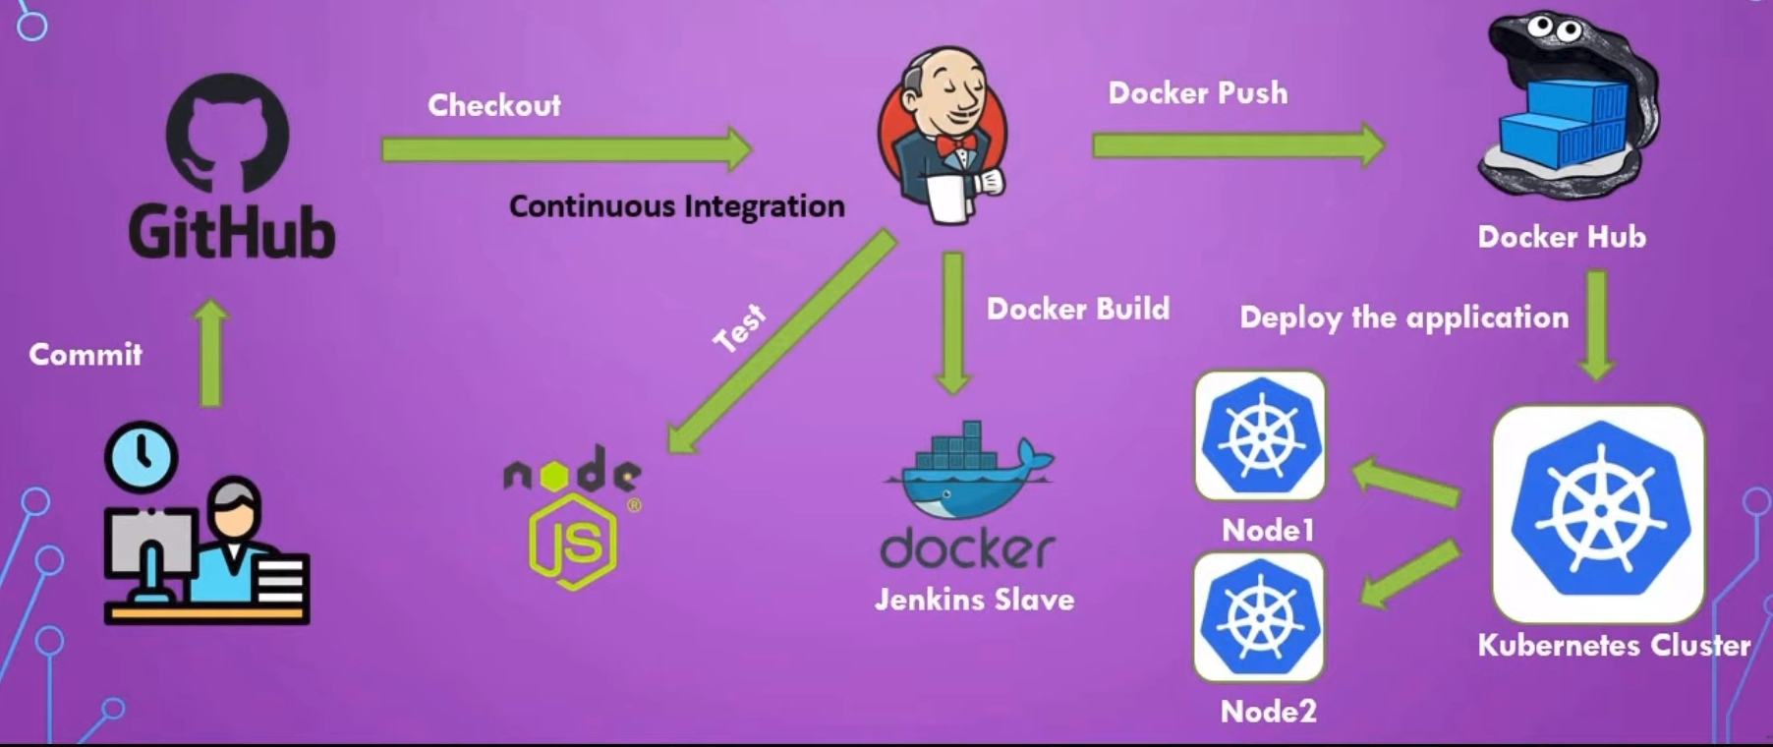

Project Architecture

Slide 5




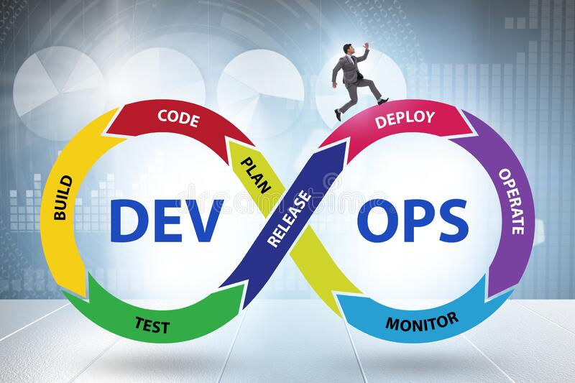






Technologies
& Tools Used

Slide 6






Project Flow

Slide 7
Troubleshooting :-
> Build Unstable
> mvn Not Found
> Whitelable Error
> Unable to Register Application

Slide 8

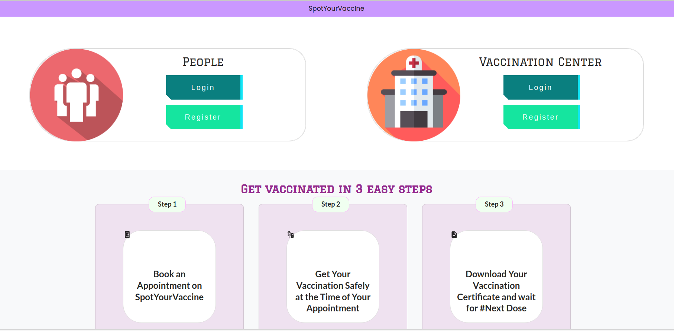
Application Demo

Slide 9
Conclusion
By using the required Devops tools Successfully Deployed the SPOT YOUR VACCINE Application on the Cloud Platform

Slide 10


