Slide 1
Social Advertisement
TEAM NAME:
PIKACHU
TEAM MEMBERS:
MD USMAN GANI SYED (LabId: 3-1)
MADHUKAR REDDY VURADI (LabId: 3-1)
CHAITANYA SAILESH TONDEPU (LabId: 3-2)
SAI KRISHNA TEJA KUNISETTY (LabId: 3-2)

Slide 2
UPDATED PROJECT IDEA
OLD IDEA
NEW IDEA

Slide 3
USER STORIES
MD USMAN GANI
Explore and find best suitable technologies(8)
Create a sample AR application with 3d object cube(8)
Teach the learnings to team members(8)
MADHUKAR
Develop a 3d objects for phone and laptop(8)
Prepare presentation for release(8)
TEJA
Integrate 3d objects phone and laptop by replacing with cube(16)
CHAITANYA
Explore IBM object detection machine learning APIS(12)
wiki Document-iteration1(4)

Slide 4
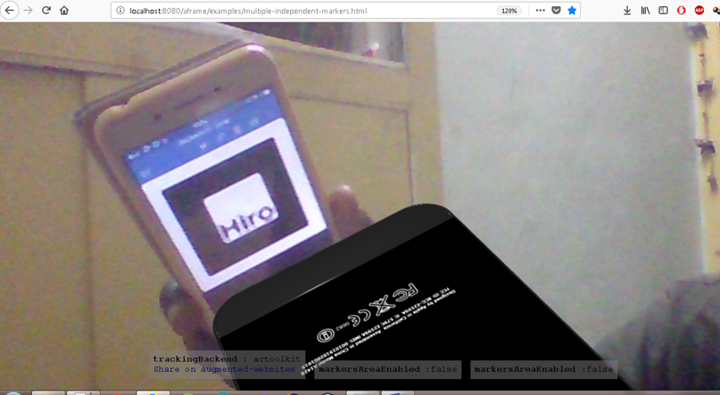
PHONE

Slide 5
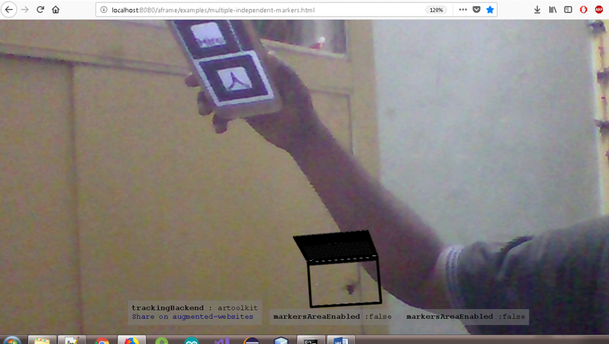
Laptop

Slide 6
LIMITATIONS
The idea is being restricted to one AR model(either laptop or phone)
If time permits, project will be completed for both phone and laptop AR models

