Slide 1
Social Advertisement
TEAM NAME:
PIKACHU
TEAM MEMBERS:
MD USMAN GANI SYED (LabId: 3-1)
MADHUKAR REDDY VURADI (LabId: 3-1)
CHAITANYA SAILESH TONDEPU (LabId: 3-2)
SAI KRISHNA TEJA KUNISETTY (LabId: 3-2)

Slide 2
Done and To be Done
Trained ibm cloud vision api using more than 250 models for laptop and phone.
Completed auto detection of objects Laptop and Phone
Improved UI with bootrap and Jquery compared to previous iteration.
Used nodeJs for asynchronous request and response.

Slide 3
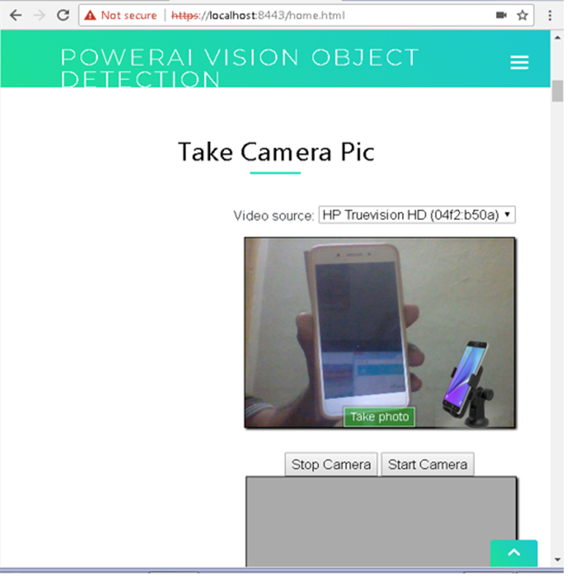

Slide 4
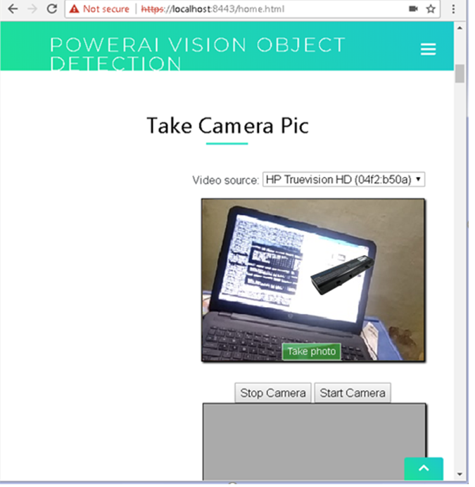

Slide 5
To be Done
Yet to improve a lot on UI which will be completed by next iteration.
Integrating with REST apis for dynamic listing of accessories list, displaying price and redirecting to ecommerce site.

Slide 6
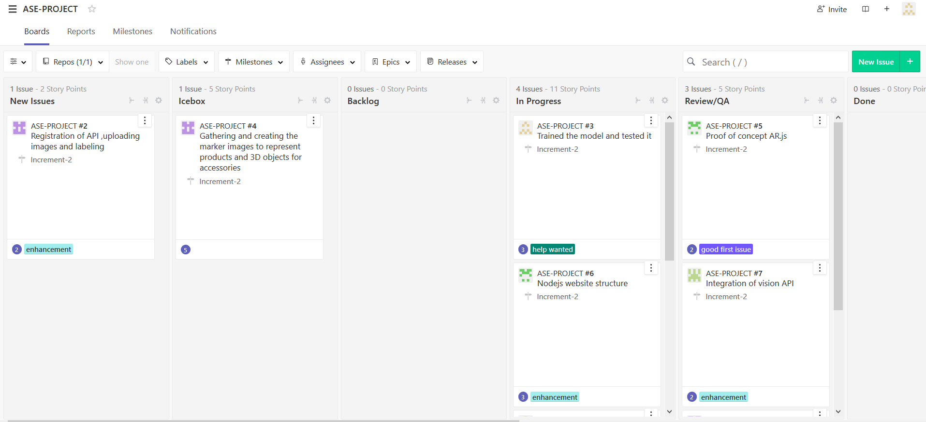
Iteration2 Plan

Slide 7
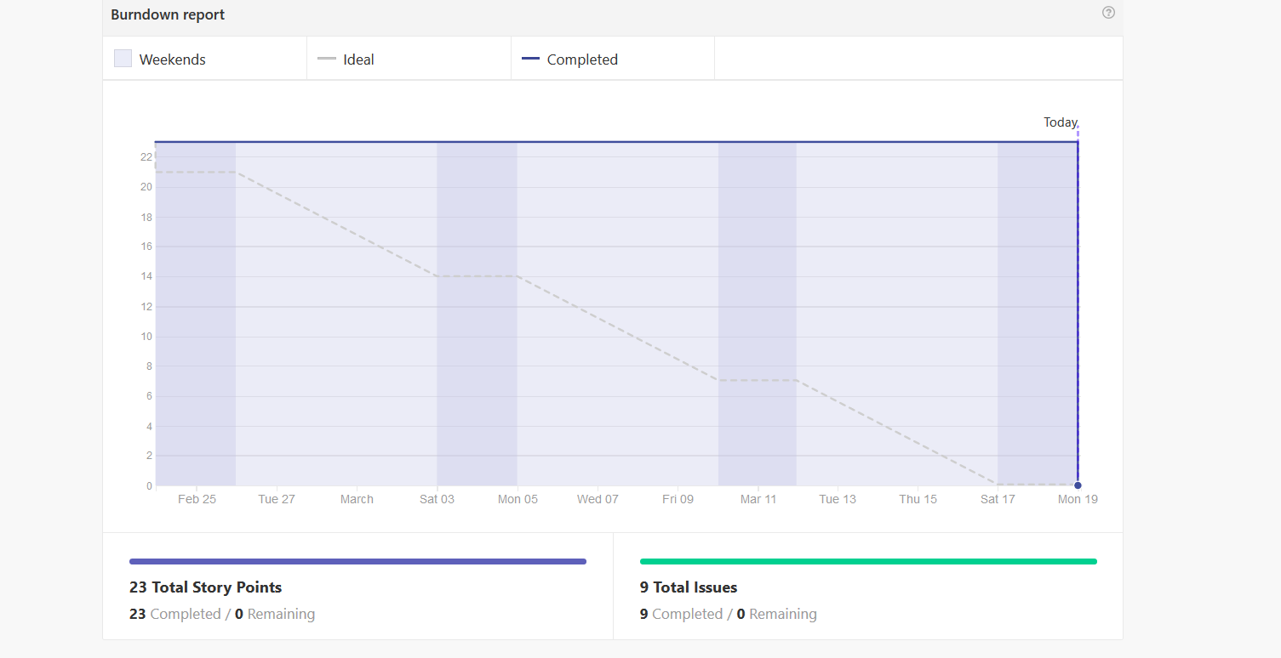

Slide 8
THANK YOU

