Slide 1
Advertisement
TEAM NAME:
PIKACHU
TEAM MEMBERS:
MD USMAN GANI SYED (LabId: 3-1)
MADHUKAR REDDY VURADI (LabId: 3-1)
CHAITANYA SAILESH TONDEPU (LabId: 3-2)
SAI KRISHNA TEJA KUNISETTY (LabId: 3-2)

Slide 2
Acknowledgement
The work has been completed under the guidance of Dr. Yugi Lee and TAs (Rohith Nagulapati, Sidrah Junaid, Nageswara Nandigam) in CS5551 Advanced Software Engineering, University of Missouri - Kansas City), Spring 2018.

Slide 3
WWW of our Project
Who am I?
I am a simple web application built on Augumented Reality
What can I do?
I can scan the surrounding areas
Detect objects
Give suggestions on what to buy based on objects detected
Why am I?
I will ease your process of online purchase

Slide 4
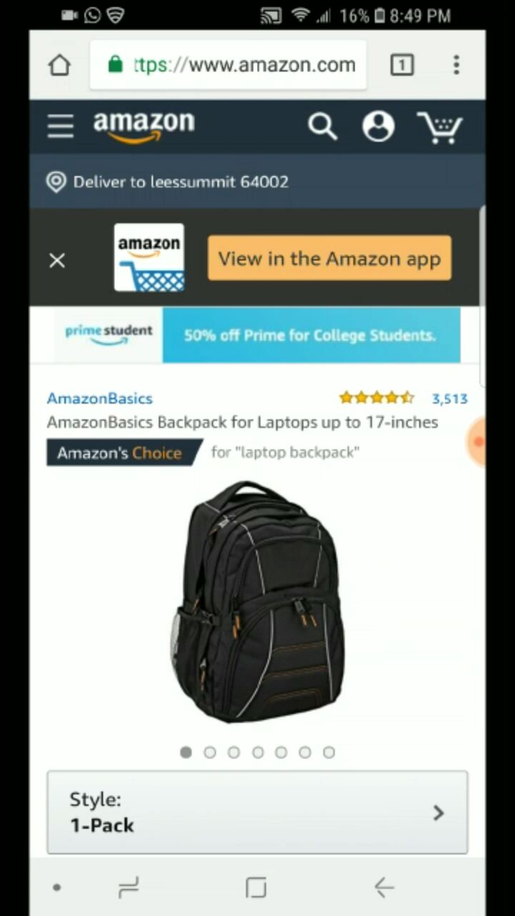
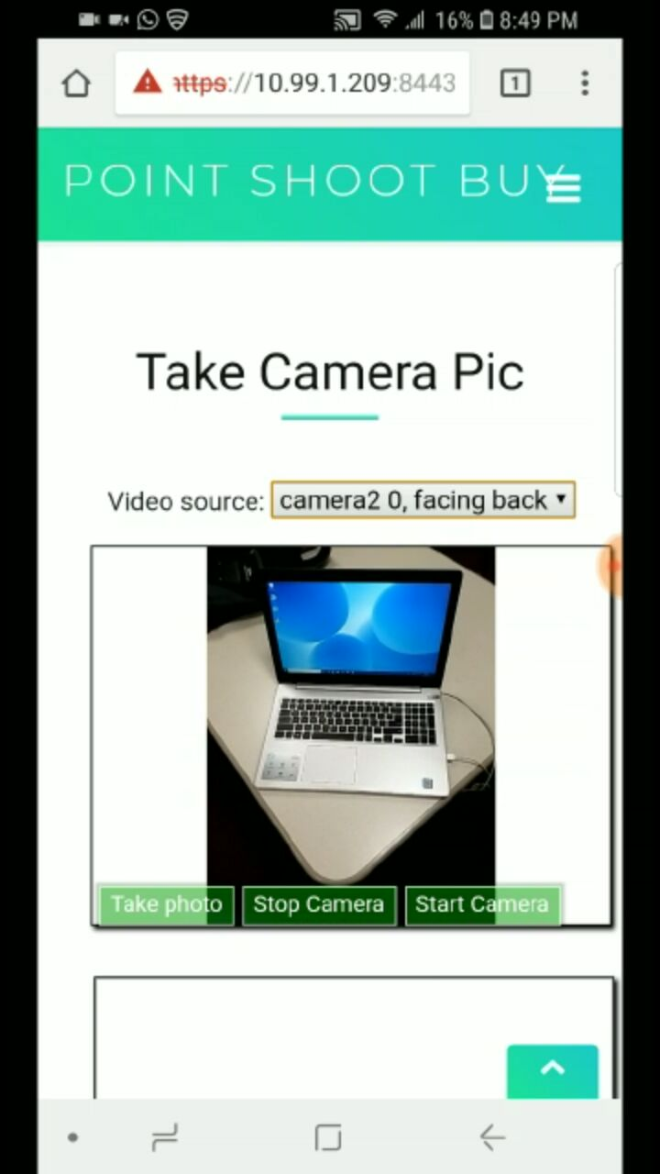
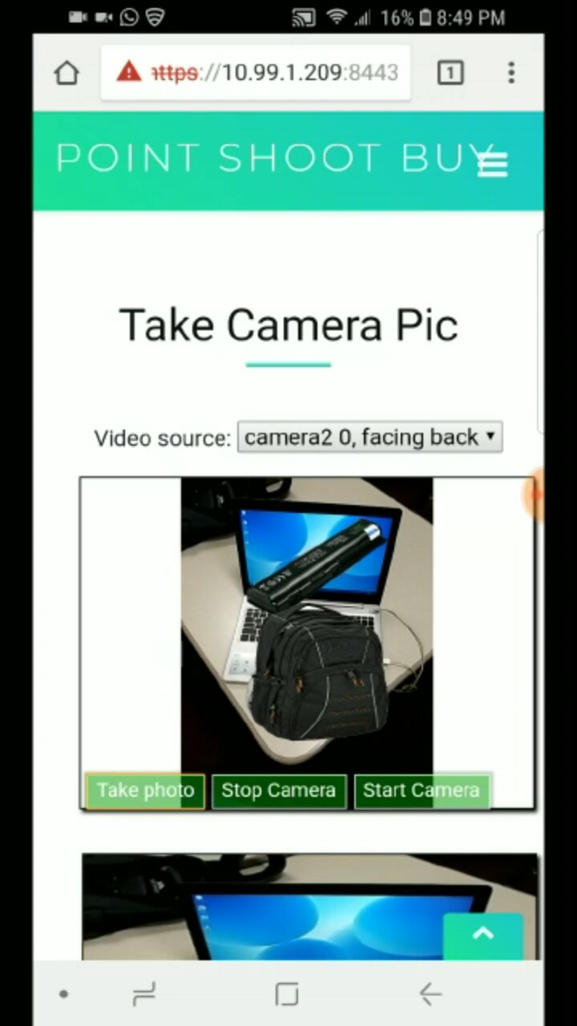
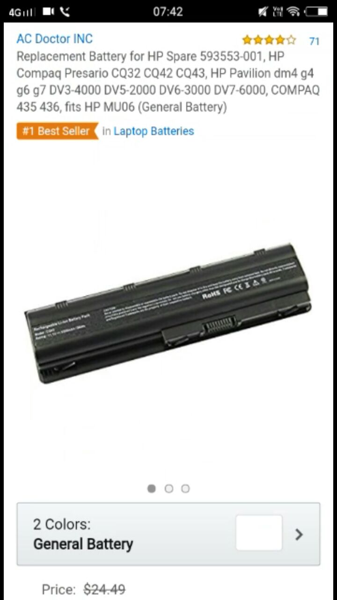

Slide 5
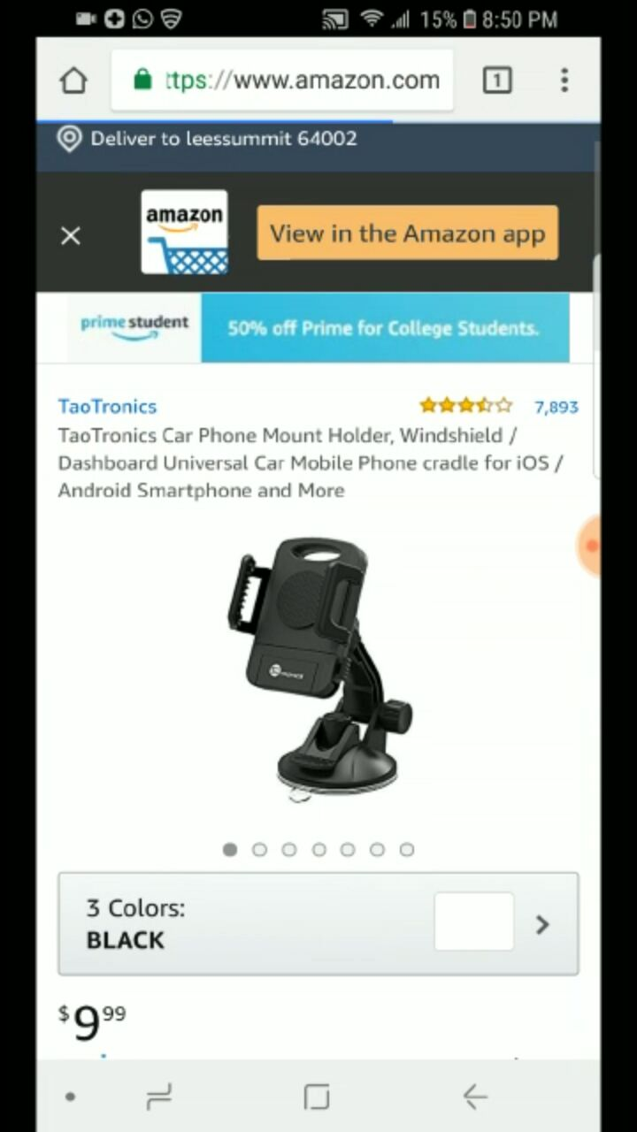
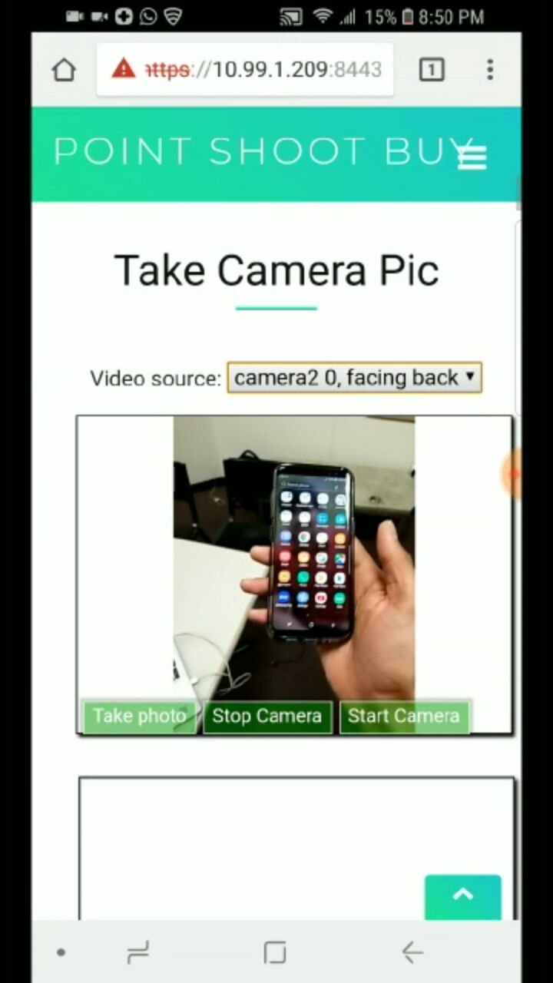
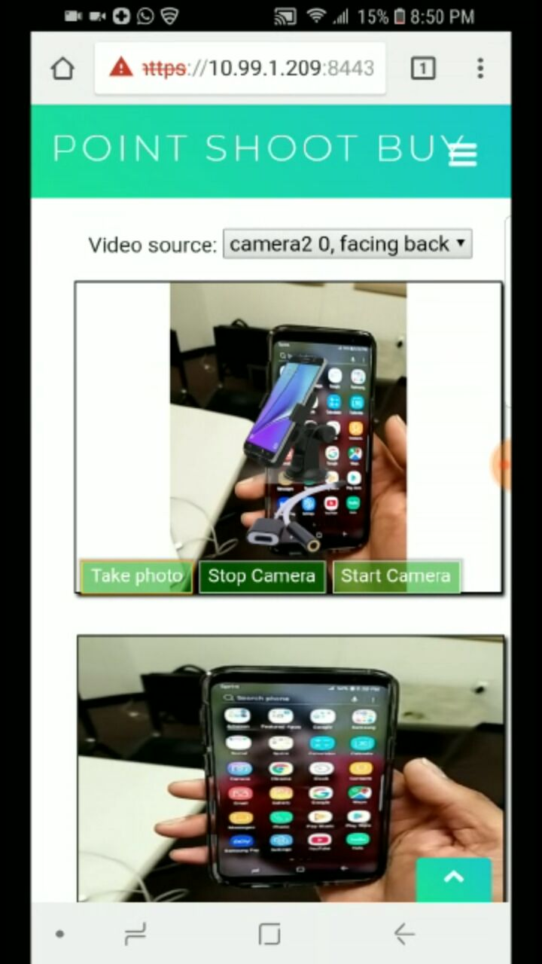
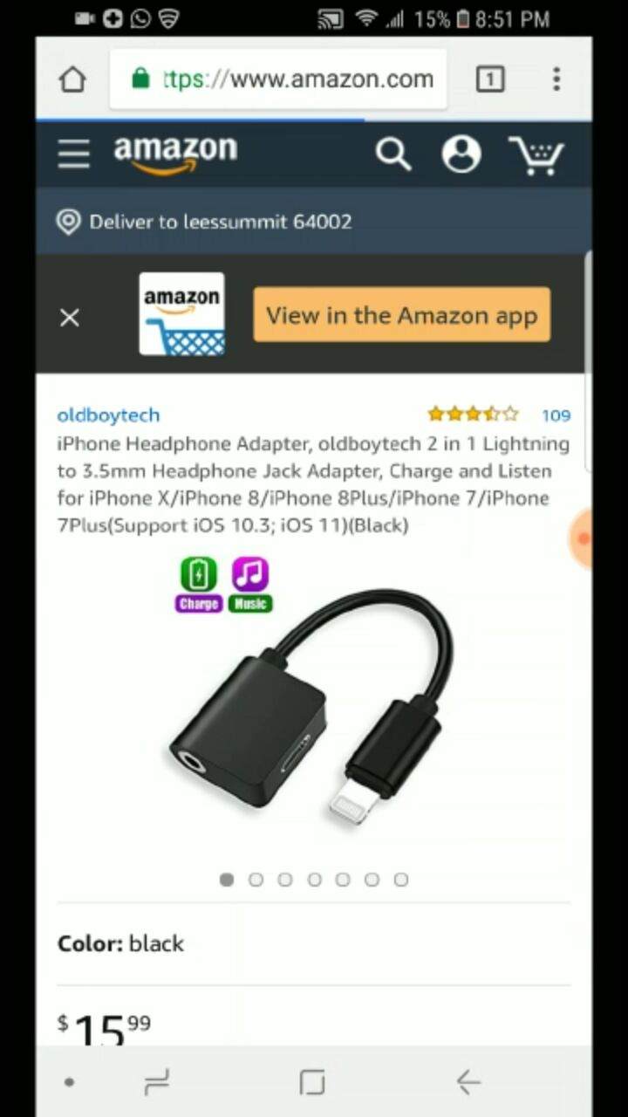

Slide 6
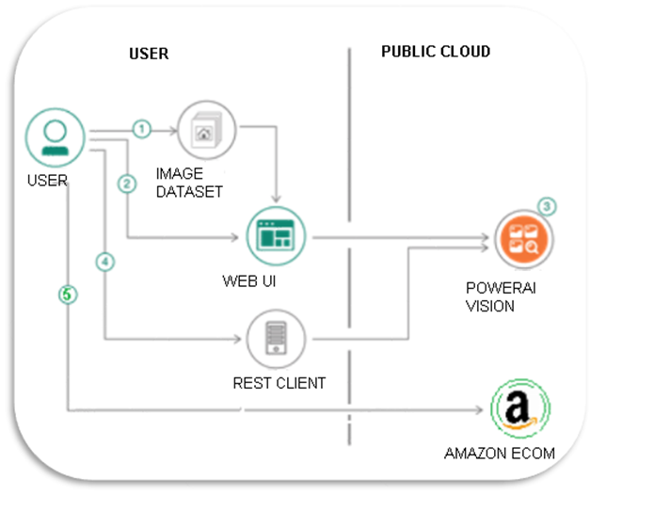
Architecture

Slide 7
Technologies Used
HTML
CSS
JS, NodeJs
IBM cloud vision Object detection

Slide 8
Limitation
Currently limited to detect only two objects.
The more training we give, the more number of objects we can detect.

Slide 9
VIDEO DEMO

