Slide 1
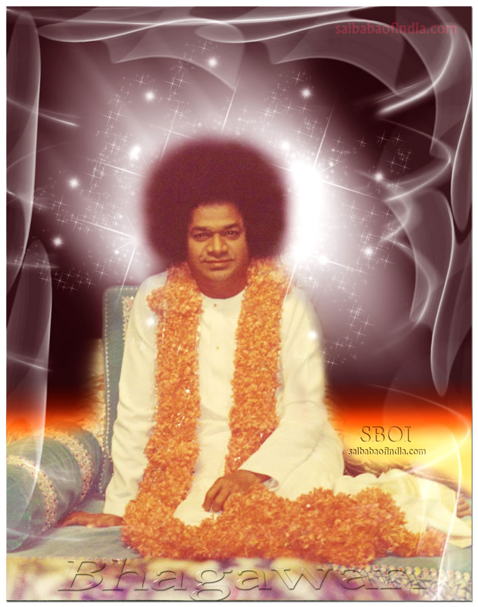
Offering My most humble pranams at the lotus feet of Bhagwan Baba

Slide 2
Motion Estimation from Cardiac Images
V.Sai Krishna
18565 , II M.Tech.(C.S)
Department of Mathematics And Computer Science (DMACS)
Project Guide and Supervisor :
Dr. N.Uday Kiran (Asst. Professor , DMACS )

Slide 3
Introduction
Coronary heart disease (CHD), or coronary artery disease
The coronary arteries run along the surface of the heart and provide oxygen-rich blood to the heart muscle.
Over the years, cholesterol plaques can narrow the arteries supplying blood to the heart. The narrowed arteries are at higher risk for complete blockage from a sudden blood clot (this blockage is called a heart attack).
Coronary Vascular Disease(CVD) - accounting for 30% of deaths. Of these more than three quarters are a result of coronary artery disease and stroke.

Slide 4
Cardiac Motion Estimation
Purpose : can be used as a better diagnostic tool for CHD.
Systolic pressure - contraction
Diastolic pressure - relaxation
Challenges:
Structure (Rigid body motion Ex: Tissues,Valves)
Fluid (Fluid body motion Ex: blood)

Slide 5
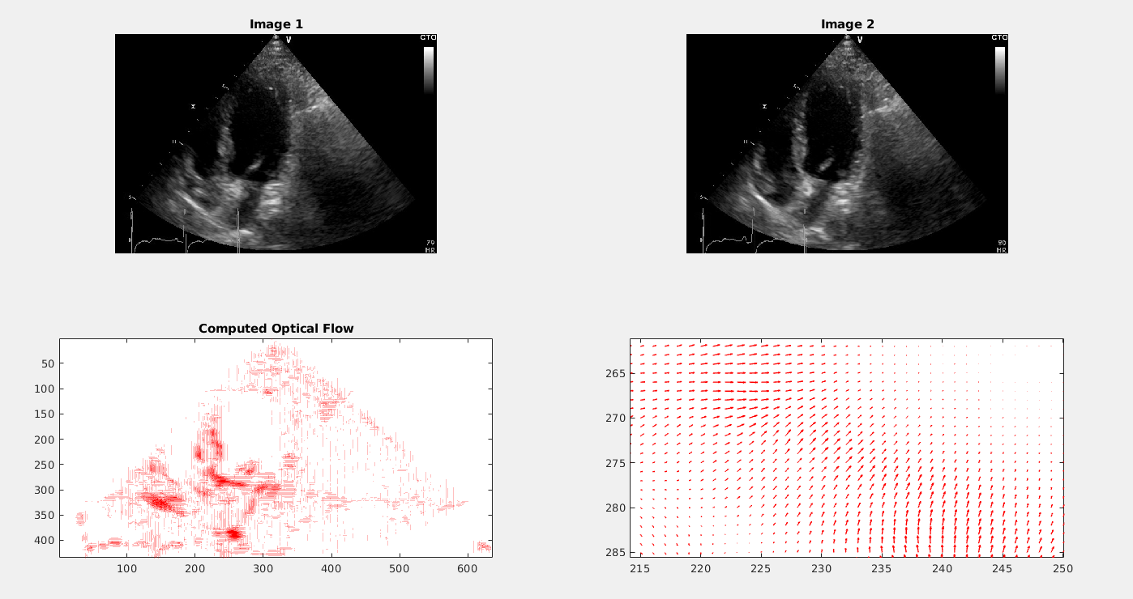
Sri Hirak Doshi brother’s work on Cardiac Motion Optical Flow Computation.

Slide 6
Aim
Basic Image Processing 3D cardiac images
DICOM format
3D slicer and ITK library
3D image segmentation and 3D reconstruction
To estimate the motion from cardiac images through Optical Flow:
Structure movement: Optical Flow Constraints (implementing for 3D images)
Fluid movement: Continuity Model based on fluid Dynamics
To estimate the motion from cardiac images through learning paradigm:
LiteFlowNet: for rigid body motion (reimplementation in PyTorch)
Adapt the LiteFlowNet to cardiac images with the symplectic gradient descent constraint

Slide 7
Modules
•3D Image Processing
Working with 3D images (DICOM format)
Volumetric Segmentation (adding a module into 3D Slicer)
•Optical Flow
Horn-Schunk Optical Flow model for 2D images
William Harvey code for 3D cardiac images (done for 2D, will extend to 3D)
•Deep Learning based:
LiteFlowNet (given for 2D, we extend for 3D)
Learning the stream and potential functions in the context of continuity equation based model for optical flow

Slide 8
Datasets
4D CT scans (data provided by SSSIHMS)
Kaggle Cardiac Dataset
Middlebury Datasets (used in Horn and Schunck and WHC implementation)
Sintel Dataset(pre-trained LiteFlowNet models)
KITTI 2012 , 2015 Datasets(pre-trained LiteFlowNet models)

Slide 9
3D SLICER
Working with DICOM : Digital Imaging and Communications in Medicine cardiac ultrasound data in 3D slicer
Exploring Volumetric Segmentation Module in 3D slicer through ITK library
Adding a module into 3D slicer.
Basic Module implementation
William Harvey Code optical flow implementation module.

Slide 10
IMPLEMENTATIONS

Slide 11
Optical Flow
Optical flow captures pixel/voxel motion between time adjacent image frames.
Pixels (2D images).
Voxels (3D images).
Two Assumptions :
1. Brightness Constancy
2. Small Motion

Slide 12
Aperture problem

Slide 13

Brightness Constancy
The moving patterns cause temporal varieties of the image brightness.
It is assumed that all temporal intensity changes are due to motion only.
The above equation is called as Brightness Constancy Equation.

Slide 14


2D Optical Flow Estimation
One Equation 2 unknowns : ILL POSED PROBLEM

Slide 15

3D Optical Flow Estimation
One Equation 3 unknowns : ILL POSED PROBLEM

Slide 16
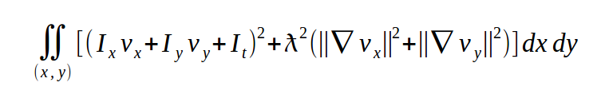
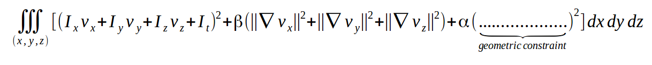
Horn and Schunck method:
OF constraint
Smoothness constraint
OF constraint
Smoothness constraint

Slide 17
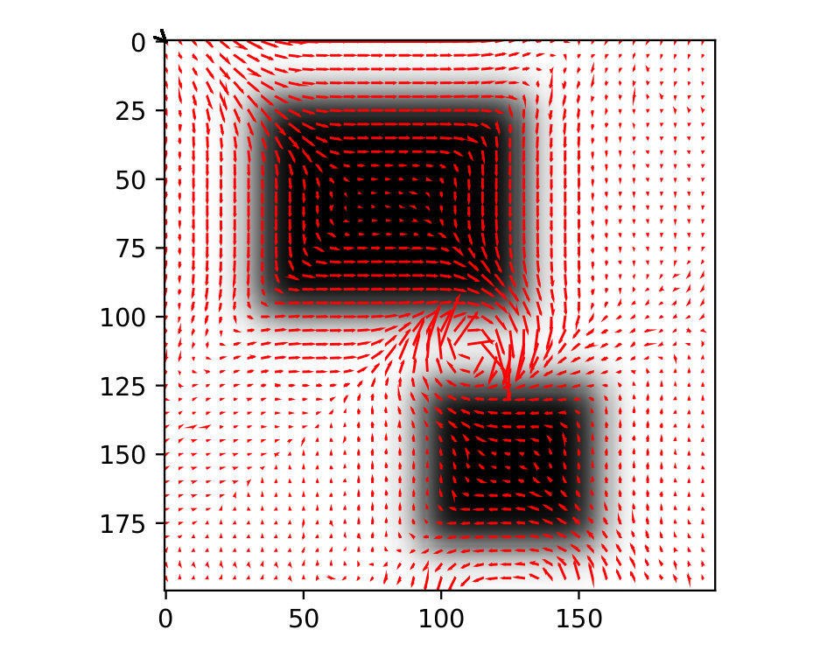
OUTPUT

Slide 18
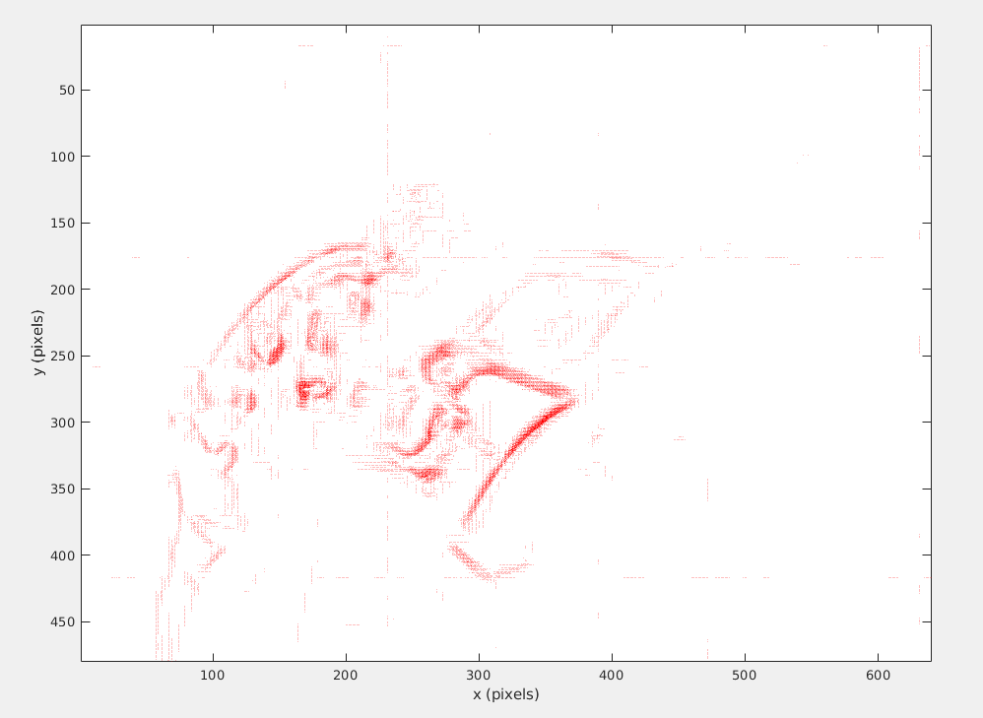
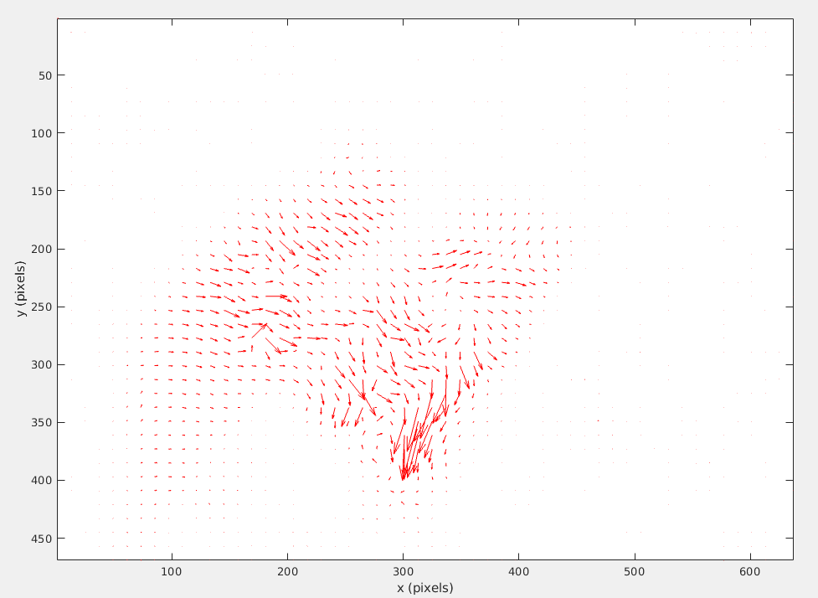
Comparison between Rigid Motion model and Fluid Motion model
Rigid Motion model
Fluid Motion model

Slide 19
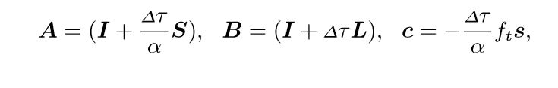
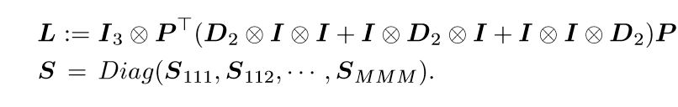

William Harvey Code
Constraints: (motion based constraint)+(smoothness constraint)+ (geometric constraint)
Initialization : Delta tou = 0.1 , Alpha = 25

Slide 20
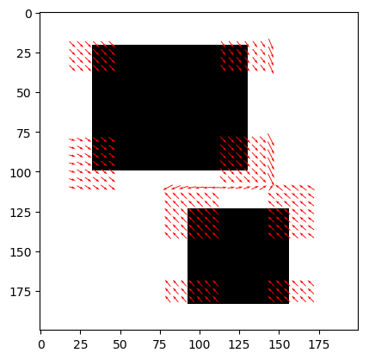
OUTPUT

Slide 21
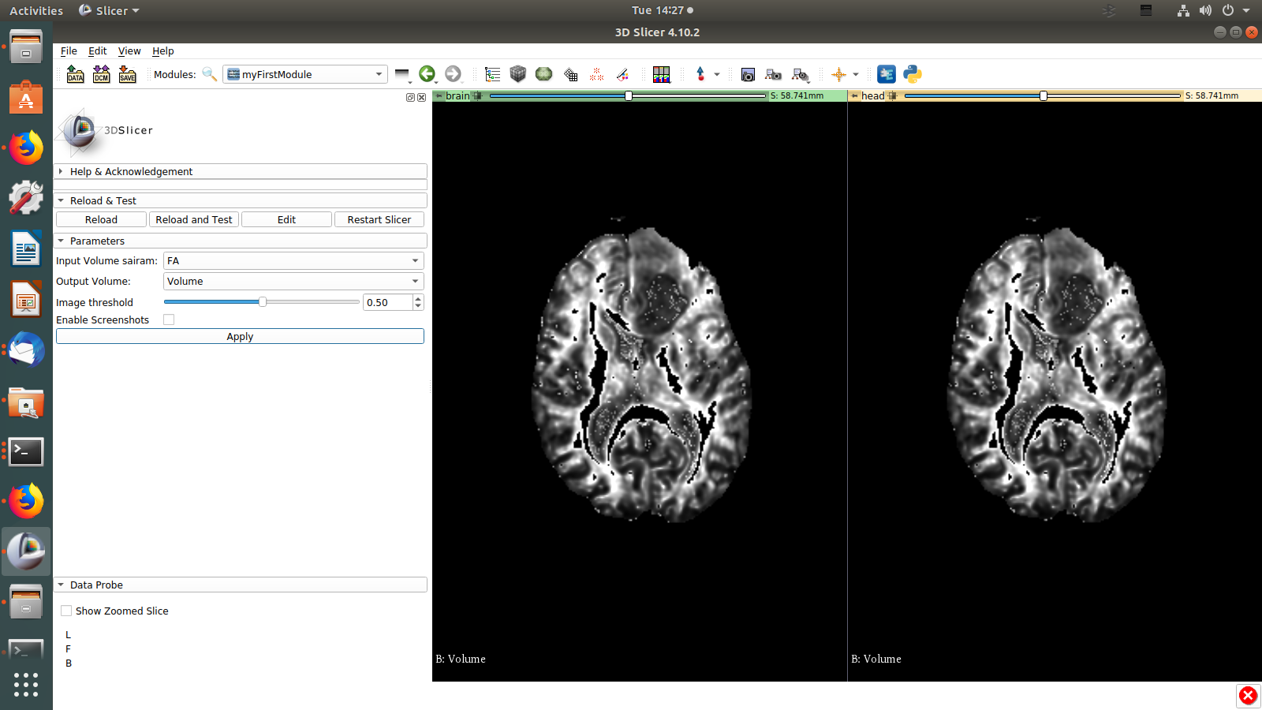
Adding a Module into 3D slicer

Slide 22
IMMEDIATE GOAL

Slide 23
LiteFlowNet: A Light weight Convolutional Neural Network for Optical Flow Estimation [CVPR 2018]
To implement LiteFlowNet in PyTorch
Steps to be taken during implementation of LiteFlowNet:
Reimplement with kaggle dataset
Check on cardiac images
Symplectic gradient optimizer

Slide 24
LiteFlowNet
State of the art model for computing optical flow.
Can also take videos as input.
DICOM format images are sequences of image frames(similar to videos) .
outputs color coded optical flow
Incorporates many advanced features to
Compute optical Flow
Produce the accurate optical flow in high intensity colors

Slide 25
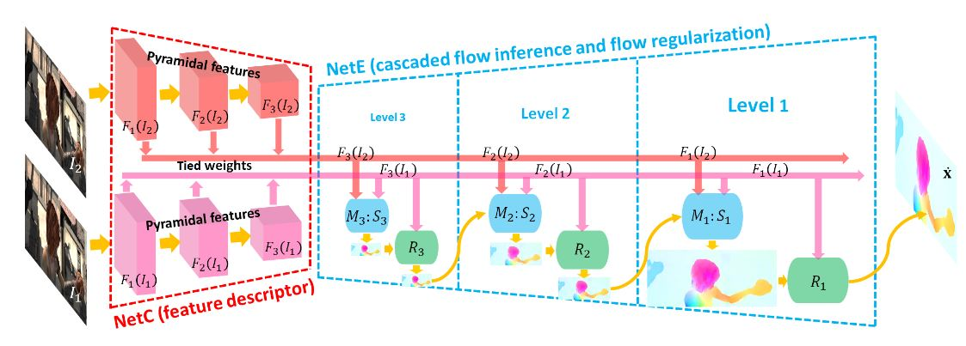
LiteFlowNet Architecture

Slide 26
Timeline
April-May
ML course (basics)
Became clear with the objectives of the project
June
Horn and Schunck(HS) optical flow C++ implementation
DL Course
Learning Python

Slide 27
Timeline
July
Horn and Schunck(HS) optical flow Python implementation
Understanding William Harvey Code paper
Implementing WHC optical flow
August
Implementing WHC optical flow
Exploring 3D slicer modules, tools, python interpreter
September
Adding a module into 3d slicer, Volumetric Segmentation
LiteFlowNet

Slide 28
References :
[1] en.wikipedia.org
Generative adversarial network
Image segmentation
Optical flow
[2] Stack Overflow
[3] The William Harvey Code: Mathematical Analysis of Optical Flow Computation for Cardiac Motion Yusuke Kameda , Atsushi Imiya
[4] B.K.P. Horn and B.G. Schunck, "Determining optical flow." Artificial Intelligence, vol 17, pp 185–203, 1981. Manuscript available on MIT server.
[5] 3D Slicer Documentation
[6] LiteFlowNet Tak-Wai Hui, Xiaoou Tang, Chen Change Loy , CUHK-SenseTime Joint Lab, The Chinese University of Hong Kong

Slide 29
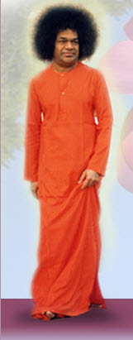
Thank You
Those who leave everything in God’s hand will eventually see God’s hand in everything.

