Slide 1
Teradata is a Relational Database Management System (RDBMS):
Designed to run the world’s largest commercial databases.
Preferred solution for enterprise data warehousing (OLAP).
Executes on UNIX-MP-RAS or NT-based system platforms
Compliant with ANSI industry standards
Runs on single Symmetric Multi Processing (SMP) or multiple massively parallel processing (MPP) nodes
Acts as “Database server” to client applications throughout the enterprise
Uses Parallelism to manage Terabytes of data
“Shared-Nothing Architecture”

Slide 2
Advantage Teradata
Unlimited, Proven Scalability
Unlimited Parallelism - Parallel sorts/aggregations, temporary tables –
“Shared-Nothing” architecture
Mature Optimizer - Complex queries, joins per query, ad-hoc processing
It’s a “Cost Based Optimizer”.
Model the Business - 3NF, robust view processing, star schema
Lowest TCO - ease of setup & maintenance, robust parallel utilities, no re-orgs, lowest disk to data ratio, robust expansion utility
High Availability - No single point of failure, scalable data loading, parallel load utilities

Slide 3
Advantage Teradata
Enormous capacity
Billions of rows
Terabytes of data
High-performance parallel processing
Single database server for multiple clients “Single Version of the Truth”
Network and Mainframe connectivity
Industry standard access language (SQL)
Manageable growth via modularity
Fault tolerance at all levels of hardware and software
Data integrity and reliability

Slide 4
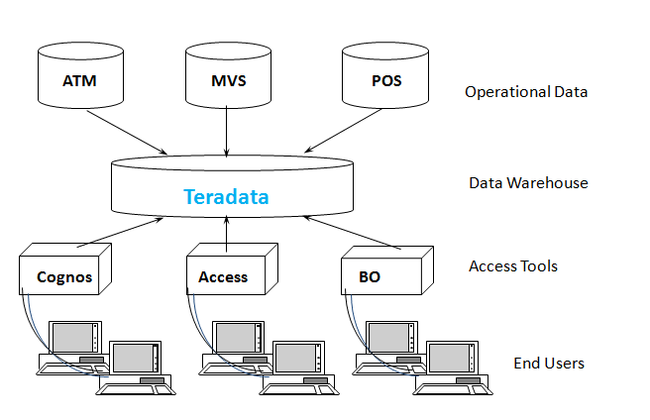
Advantage Teradata Warehouse

Slide 5
History of Teradata
Following is a quick summary of the history of Teradata, listing major milestones.
1979 – Teradata was incorporated
1984 – Release of first database computer DBC/1012
1986 – Fortune magazine names Teradata as ‘Product of the Year’
1999 – Largest database in the world using Teradata with 130 Terabytes
2002 – Teradata V2R5 released with Partition Primary Index and compression
2006 – Launch of Teradata Master Data Management solution
2008 – Teradata 13.0 released with Active Data Warehousing
2011 – Acquires Teradata Aster and enters into Advanced Analytics Space
2012 – Teradata 14.0 introduced
2014 – Teradata 15.0 introduced

Slide 6
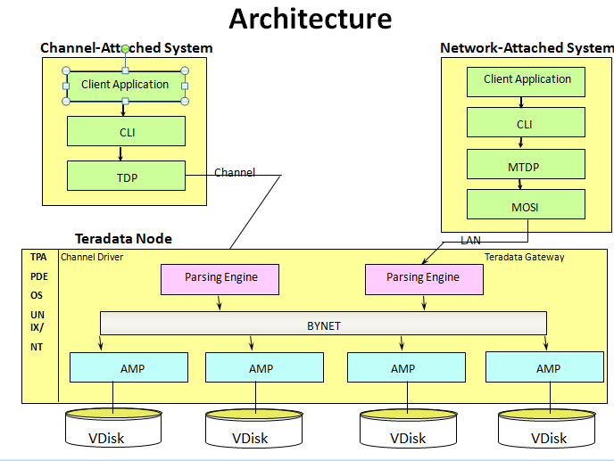

Slide 7
Understanding Node
Parsing Engine
BYNET
AMP
AMP
AMP
AMP
Vdisk
Vdisk
Vdisk
Vdisk

Slide 8
Node Components
Component | Functionality
Parsing Engine | Managing individual sessions (up to 120) Parsing and optimizing your SQL requests Dispatching the optimized plan to the AMPs ASCII / EBCDIC conversion (if necessary) Sending the answer set response back to the requesting client
AMP | Storing and retrieving rows to and from the disks Lock management Sorting rows and Aggregating columns Join processing Output conversion and formatting Creating answer sets for clients Disk space management and Accounting Special utility protocols Recovery processing
Vdisk | A vdisk (pronounced, "VEE-disk") is the logical disk space that is managed by an AMP.

Slide 9
Teradata relies on three architectural components that have set the rules for parallel processing.
PE or the Optimizer(Parse Engine
The PE is the boss and tells the AMPs exactly what to do.
When a user logon to Teradata their logon is accepted or rejected by a Parsing Engine
The Parsing Engine will accept each query from that user and come up with a plan for the AMPs to satisfy the request.
The PE‘s plan is passed to the AMPs via the BYNET
The AMPs will retrieve the data requested from their virtual disks and pass it back up the BYNET to the PE.
The PE will then deliver the data to the user
The Parsing Engines having the capability to handle up to 120 users at a time

Slide 10
The AMPs
The PE passes the PLAN to the AMPs over the BYNET. The AMPs then retrieve the rows they own from their disks and pass it back to the PE over the BYNET
The AMPs organize every table in separate blocks just like you might organize your clothes in separate dresser drawers
When a table is first created each AMP creates a table header on their disk
When the table is loaded each AMP receives rows for that table that they and only they own.

Slide 11
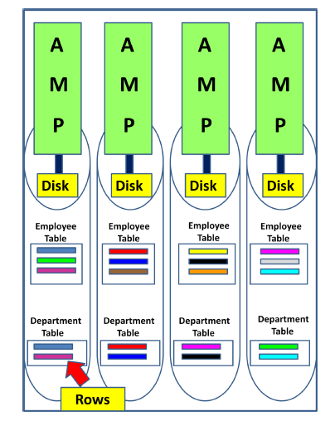

Slide 12
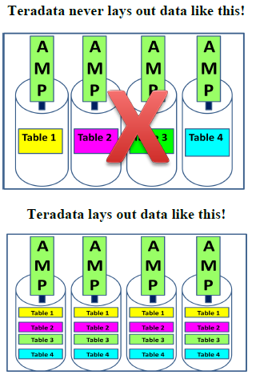

Slide 13
The BYNET
The BYNET gets its name from the Banyan tree. The Banyan tree has the ability to continually plant new roots to grow forever
The BYNET is the communication network between AMPs and PE‘s.
The AMPs then retrieve the data requested by the PE and they deliver their portion of the answer set to the PE over the BYNET.
There are always two BYNETs for redundancy and extra bandwidth.

Slide 14
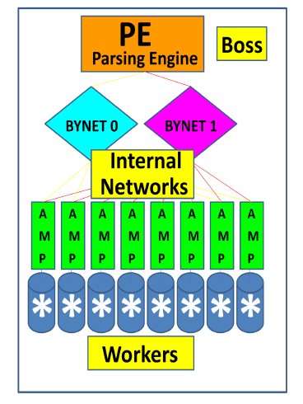

Slide 15
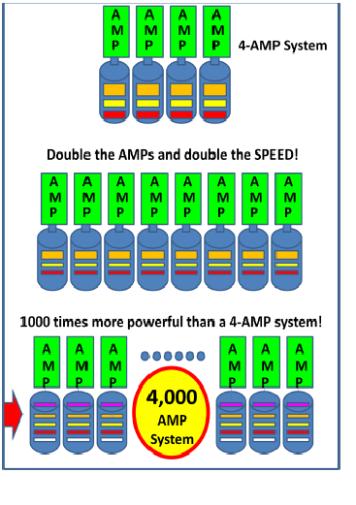

Slide 16
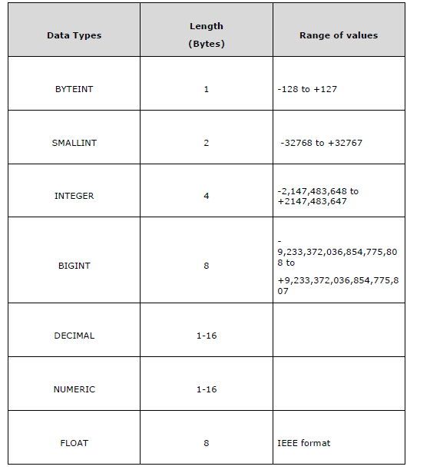
Teradata Data types

Slide 17
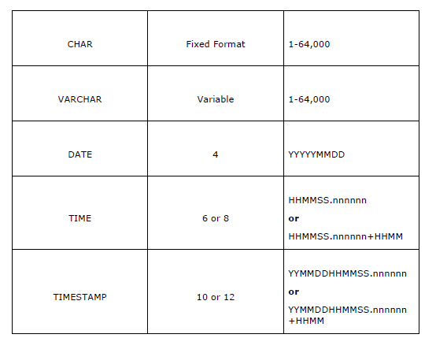

Slide 18
Determining the Release of Your Teradata System:
SELECT * FROM DBC.DBCINFO;
InfoKey InfoData
RELEASE V2R.05.01.03.00
VERSION 05.01.03.00
Teradata Table
Tables in Relational model are defined as collection of data. They are represented as rows
and columns.
Table Types
Permanent Table: This is the default table and it contains data inserted by the
user and stores the data permanently.
Notes:
Teradata supports the following table types to hold temporary data.
Volatile Table
Global Temporary Table
Derived Table:Derived tables are created, used and dropped within a query. These are used to store intermediate results within a query.
SELECT Emp.EmployeeNo, Emp.FirstName, Empsal.NetPay FROM Employee Emp, (select EmployeeNo , NetPay from Salary where NetPay >= 75000) Empsal where Emp.EmployeeNo = Empsal.EmployeeNo;
Set multiset

Slide 19
Create Table
CREATE TABLE command is used to create tables in Teradata.
Following is the generic syntax of CREATE TABLE statement.
CREATE <SET/MULTISET> TABLE <Tablename>
< Table Options>
<Column Definitions>
<Index Definitions>;
Table Options – Specifies the physical attributes of the table such as Journal and
Fallback.
Column Definition – Specifies the list of columns, data types and their attributes.
Index Definition – Additional indexing options such as Primary Index, Secondary
Index and Partitioned Primary Index.

Slide 20
CREATE TABLE EMPLOYEE
(
EmployeeNo INTEGER,
FirstName VARCHAR(30) ,
LastName VARCHAR(30) ,
DeptNo BYTEINT
)
SHOW TABLE command to view the Definition of the table.
SHOW TABLE Employee;
INSERT INTO EMPLOYEES VALUES (1,’Raja’,’Ram’,10)
SELECT * FROM EMPLOYEES;

Slide 21
Set Versus Multiset
Teradata classifies the tables as SET or MULTISET tables based on how the duplicate
records are handled. A table defined as SET table doesn’t store the duplicate records,
whereas the MULTISET table can store duplicate records.
CREATE SET TABLE EMPLOYEE_SET
(
EmployeeNo INTEGER,
FirstName VARCHAR(30) ,
LastName VARCHAR(30) ,
DeptNo BYTEINT
)
INSERT INTO EMPLOYEES VALUES (1,’Raja’,’Ram’,10)

Slide 22
Multiset table
CREATE MULTISET TABLE EMPLOYEE_SET
(
EmployeeNo INTEGER,
FirstName VARCHAR(30) ,
LastName VARCHAR(30) ,
DeptNo BYTEINT
)
Volatile Table:
The data inserted into a volatile table is retained only during the
user session. The table and data is dropped at the end of the session. These tables
are mainly used to hold the intermediate data during data transformation.

Slide 23
CREATE VOLATILE TABLE dept
(
dept_no INTEGER,
avg_salary INTEGER,
max_salary INTEGER,
min_salary INTEGER
)
INSERT INTO DEPT VALUES(1,10000,1000000,20000)
SELECT * FROM dbc.tables WHERE tablekind = 'T‘
HELP TABLE <tablename>

Slide 24
Global Temporary Table
The definition of Global Temporary table is stored in data dictionary and they can be used by many users/sessions.
But the data loaded into global temporary table is retained only during the session.
CREATE SET GLOBAL TEMPORARY TABLE dept_GTB
(
dept_no INTEGER,
avg_salary INTEGER,
max_salary INTEGER,
min_salary INTEGER
)
List of table in database
Select tablename from dbc.tables where tablekind=‘T’

Slide 25
CREATE SET TABLE EMP
(
EmployeeNo INTEGER,
FirstName VARCHAR(30) ,
LastName VARCHAR(30) ,
DOB DATE FORMAT 'YYYY-MM-DD',
DepartmentNo BYTEINT
)
INSERT INTO EMP VALUES(200,’Raja’,’Ram’,’2001-10-2016’,20)

Slide 26
ALTER TABLE COMMAND
ALTER TABLE emp
ADD BirthDate DATE FORMAT 'YYYY-MM-DD',
DROP DOB;
DROP TABLE COMMAND
DROP TABLE EMP
SHOW TABLE EMP

Slide 27
CREATE TABLE STUDENTS (STUDENT_ID INTEGER,LAST_NAME VARCHAR(40),FIRST_NAME VARCHAR(40),CLASS_CODE
VARCHAR(2),GRADE_PT FLOAT)
INSERT INTO STUDENTS VALUES(123250, 'Phillips' ,'Martin‘,'SR‘, 3.00)
INSERT INTO STUDENTS VALUES(125634, 'Hanson', 'Henry', 'FR‘, 2.88)
INSERT INTO STUDENTS VALUES(234121 , 'Thomas', 'Wendy', 'FR‘, 4.00)
INSERT INTO STUDENTS VALUES(231222, 'Wilson', 'Susie' ,'SO', 3.80)
INSERT INTO STUDENTS VALUES(260000, 'Johnson', 'Stanley',NULL,NULL)
INSERT INTO STUDENTS VALUES(280023, 'McRoberts', 'Richard', 'JR', 1.90)
INSERT INTO STUDENTS VALUES(322133, 'Bond', 'Jimmy', 'JR‘, 3.95)
INSERT INTO STUDENTS VALUES(324652, 'Delaney', 'Danny', 'SR', 3.35)
INSERT INTO STUDENTS VALUES(333450, 'Smith', 'Andy','SO' ,2.00)
INSERT INTO STUDENTS VALUES(423400, 'Larkins' ,'Michael', 'FR', 0.00)

Slide 28
SELECTING REQUIRED COLUMS
SELECT First_name
,Last_name
,Class_Code
,Grade_Pt
FROM Student_Table ;
WHERE Clause
By adding a WHERE clause to the SELECT, a constraint is established to potentially limit which rows are returned based on a TRUE comparison to specific criteria or set of conditions.
The following SELECT can be used to return the students with a B (3.0) average or better from the Student table:
SELECT Student_ID
,Last_Name
,Grade_Pt
FROM Student_Table
WHERE Grade_Pt >= 3.0 ;

Slide 29
Compound Comparisons (AND / OR)
SELECT Last_Name
,First_Name
FROM Student_Table
WHERE Grade_Pt = 3.0 AND Grade_Pt = 4.0;
SELECT Student_ID
,Last_Name
,First_Name
,Grade_Pt
FROM Student_Table
WHERE Grade_Pt = 3.0 OR Grade_Pt = 4.0 ;
SELECT *
FROM Student_Table
WHERE Grade_Pt = 3.0 OR Grade_Pt = 4.0 AND Class_Code = 'FR' ;

Slide 30
SELECT Last_Name
,Class_Code
,Grade_Pt
FROM Student_Table
WHERE (Grade_Pt = 3.0 OR Grade_Pt = 4.0) AND Class_Code = 'FR' ;
SELECT *
FROM Student_Table
WHERE Grade_Pt = NULL AND Class_Code = NULL ;
SELECT *
FROM Student_Table
WHERE Grade_Pt IS NULL AND Class_Code IS NULL ;

Slide 31
Using NOT in SQL Comparisons
SELECT Last_Name
,First_Name
,Class_Code
,Grade_Pt
FROM Student_Table
WHERE NOT (Grade_Pt >= 3.0 AND Class_Code <> 'SR') ;
SELECT Last_Name, First_Name
,Class_Code
,Grade_Pt
FROM Student_Table
WHERE NOT (Grade_Pt >= 3.0 AND Grade_Pt IS NOT NULL AND
Class_Code <> 'SR' AND Class_Code IS NOT NULL) ;

Slide 32
USING IN OPERATOR
SELECT Last_Name
,Class_Code
,Grade_Pt
FROM Student_Table
WHERE Grade_Pt IN (2.0, 3.0, 4.0) ;
USING NOT IN OPERATOR
SELECT Last_Name
,Class_Code
,Grade_Pt
FROM Student_Table
WHERE Grade_Pt NOTIN (2.0, 3.0, 4.0) ;

Slide 33
Using Quantifiers Versus IN
SELECT Last_Name
,Class_Code
,Grade_Pt
FROM Student_Table
WHERE Grade_Pt = ANY (2.0, 3.0, 4.0) ;
SELECT Last_Name
,Grade_Pt
FROM Student_Table
WHERE Grade_Pt NOT = ALL (2.0, 3.0, 4.0) ;
USING BETWEEN
SELECT Grade_Pt
FROM Student_Table
WHERE Grade_Pt BETWEEN 2.0 and 4.0 ;
Notes:
The ALL and ANY is quantifiers for 'LIKE' operator, these quantifiers are used to indicate how many string patterns must be found in the string expression.
CREATE TABLE t (x INTEGER);
INSERT t (1);
INSERT t (2);
INSERT t (3);
INSERT t (4);
INSERT t (5);
IF you use this query …
THEN the result is …
SELECT * FROM t WHERE x IN ANY (1,2)
1, 2
SELECT * FROM t WHERE x = SOME (1,2)
1, 2
SELECT * FROM t WHERE x NOT IN ALL (1,2)
3, 4, 5
SELECT * FROM t WHERE NOT (x IN ANY (1,2))
3, 4, 5
SELECT * FROM t WHERE NOT (x = SOME (1,2))
3, 4, 5
SELECT * FROM t WHERE x NOT IN SOME (1, 2)
1, 2, 3, 4, 5
SELECT * FROM t WHERE x NOT = ANY (1, 2)
1, 2, 3, 4, 5
SELECT * FROM t WHERE x IN ALL (1,2)
no rows
SELECT * FROM t WHERE NOT (x NOT IN SOME (1,2))
no rows
SELECT * FROM t WHERE x = ALL (1,2)
no rows
SELECT * FROM t WHERE NOT (x NOT = ANY (1,2))
no rows
ANY - one or more pattern should match in the string expression ALL - All patterns in the list should be match.
first_name like ANY ('ad%', 'w%', 'e%') will find adrian, william and eleanor first_name like ALL ('ad%', 'w%', 'e%') will not find anything because you cannot build a string which starts with AD, W and E! But first name like ALL ('%an%','%w%, '%e%') will find Andrew but not adrian, william or Eleanor.

Slide 34
Character String Search (LIKE)
SELECT *
FROM Student_Table
WHERE Last_Name LIKE 'sm%' ;
SELECT *
FROM Student_Table
WHERE Last_Name LIKE ('_a%') ;
SELECT *
FROM Student_Table
WHERE Last_Name LIKE ALL ('%S%', '%m%') ;
SELECT *
FROM Student_Table
WHERE Last_Name LIKE ALL ('%S%', '%m%') ;

Slide 35
String Functions
SELECT SUBSTR(‘warehouse’,1,4)
SELECT SUBSTR(‘warehouse’,1)
SELECT SUBSTR(‘warehouse’,4)
SELECT ‘data’ || ‘ ‘ || ‘warehouse’
SELECT UPPER(‘data’)
SELECT LOWER(‘DATA’)

Slide 36
EXTRACT- Date
EXTRACT function extracts portions of day, month and year from a DATE value.
SELECT DATE;
SELECT DATABASE;
SELECT TIME;
SELECT EXTRACT(YEAR FROM CURRENT_DATE);
SELECT EXTRACT(MONTH FROM CURRENT_DATE);
SELECT EXTRACT(DAY FROM CURRENT_DATE);
SELECT EXTRACT(HOUR FROM CURRENT_TIMESTAMP);
SELECT EXTRACT(MINUTE FROM CURRENT_TIMESTAMP);
SELECT EXTRACT(SECOND FROM CURRENT_TIMESTAMP);

Slide 37
INTERVAL
Teradata provides INTERVAL function to perform arithmetic operations on DATE and TIME values
There are two types of INTERVAL functions
Year-Month Interval
Day-Time Interval
SELECT CURRENT_DATE, CURRENT_DATE + INTERVAL '03' YEAR;
SELECT CURRENT_DATE, CURRENT_DATE + INTERVAL '03-01' YEAR TO MONTH;
SELECT CURRENT_TIMESTAMP;

Slide 38
CASE Expression
CASE expression evaluates each row against a condition or WHEN clause and returns the result of the first match.
CASE <expression>
WHEN <expression> THEN result-1
WHEN <expression> THEN result-2
ELSE
Result-n
END

Slide 39
SELECT EmployeeNo,CASE DepartmentNo
WHEN 1 THEN 'Admin'
WHEN 2 THEN 'IT'
ELSE 'Invalid Dept'
END AS Department
FROM Employee;
select LAST_NAME,CASE(GRADE_PT) when(3.95) then 'Hight' when(1.90) then 'LOW' ELSE 'MID' END from students;
Notes:
select LAST_NAME,CASE(GRADE_PT)
when(3.95) then 'Hight'
when(1.90) then 'LOW'
ELSE 'MID'
END
from students;

Slide 40
Derived Columns
SELECT 2+4*5, (2+4)*5
,2+4/5, (2+4)/5
,2+4.0/5, (2+4.0)/5
,10**9 ;
SELECT salary (format 'ZZZ,ZZ9.99')
,salary/12 (format 'Z,ZZ9.99')
FROM Pay_Table ;
SELECT salary (format 'ZZZ,ZZ9.99')
,salary/12 (format 'Z,ZZ9.99')
FROM Pay_Table
WHERE salary/12 > 1000 ;
SELECT salary AS Annual_salary
,salary/12 AS Monthly_salary
FROM Pay_Table ;
Notes:
create table pay_table (salary numeric);
insert into pay_table values(1200)
insert into pay_table values(10000);
insert into pay_table values(20000)

Slide 41
SELECT 200/100 AS Div200
,204 MOD 100 AS Last2
,2 MOD 2 AS Even
,3 MOD 2 AS Odd
,ABS(1) AS WasPositive
,ABS(-1) AS PositiveNow
,SQRT(4) AS SqRoot ;
Breaking Conventions
SELECT salary "Annual salary"
,salary/12 "Monthly salary"
FROM Pay_Table
ORDER BY "Annual Salary" ;

Slide 42
ORDER BY
SELECT *
FROM Student_Table
WHERE Grade_Pt > 3
ORDER BY Grade_Pt ;
SELECT *
FROM Student_Table
WHERE Grade_Pt > 3
ORDER BY Grade_Pt DESC;
SELECT *
FROM Student_Table
WHERE Grade_Pt > 3
ORDER BY 5 DESC ;
SELECT Last_Name
,Class_Code
,Grade_Pt
FROM Student_Table
ORDER BY 2 DESC, 1 ;

Slide 43
TOP Rows Option
TOP {decimal | integer} [PERCENT] [WITH TIES]
SELECT TOP 3 Last_Name
,Class_Code, Grade_Pt
FROM Student_Table
ORDER BY 2 DESC, 1 ;
DISTINCT
SELECT DISTINCT Class_code
FROM student_table
ORDER BY class_code;
SELECT DISTINCT class_code, grade_pt
FROM student_table
ORDER BY class_code, grade_pt;
Notes:
The TOP N function produces The top (or bottom) N rows of results based on specified criteria.
The top (or bottom) N percentage of rows based on specified criteria.
These results either with or without ties (more than one row has identical criteria values).
Sample rows arbitrarily without regard to rankings or order.
New syntax to the SQL lexicon: TOP {decimal | integer} [PERCENT] [WITH TIES]
Below are the options with TOP. TOP 10 – Return the top ten rows according to criteria
TOP 15 PERCENT – Return the top 15% of rows according to criteria
TOP 10 WITH TIES – If more that one row has the same criteria value, return all
TOP 15 PERCENT WITH TIES – If more than one row has the same criteria value, return all
Example 1: SELECT TOP 5 department_number ,budget_amount FROM department ORDER BY 2 DESC; Result department_number budget_amount ------------------------- ------------- 401 982300.00 403 932000.00 301 465600.00 100 400000.00 501 308000.00 Example 2: SELECT TOP 5 WITH TIES department_number , budget_amount FROM department ORDER BY 2 DESC; department_number budget_amount -------------------------- ------------- 401 982300.00 403 932000.00 301 465600.00 100 400000.00 501 308000.00 402 308000.00
Using the PERCENT Option The TOP N function can also produce a percentage of rows in addition to an absolute number of rows. Return employees whose salaries represent the top ten percent. SELECT TOP 10 PERCENT employee_number ,salary_amount FROM employee ORDER BY salary_amount DESC; employee_number salary_amount ------------------- ------------- 801 100000.00 1017 66000.00 1019 57700.00 Things to notice: 10% of 26 rows is 2.6 rows rounded to 3. PERCENT must be a number between 0 and 100. At least one row is always returned (if there is at least one row in the table). A percentage resulting in a fractional number of rows is always rounded up:10% of 6 rows = .6 rows = 1 row output 20% of 6 rows = 1.2 rows = 2 rows output 30% of 6 rows = 1.8 rows = 2 rows output

Slide 44
HELP commands
HELP DATABASE <database-name> ; This command is used to display the names of all the tables (T), views (V), macros (M),
and triggers (G) stored in a database and table comments
HELP USER <user-name> ; This command is used to display the names of all the tables (T), views (V), macros (M), and
triggers (G) stored in a user area and table comments
HELP 'SQL'; This command is used to display a list of all available SQL commands and functions.
HELP SESSION; This command is used to display the user name, account name, logon date and time,
current database name, collation code set and character set being used and also ,
transaction semantics, time zone and character set data.
HELP TABLE <table-name> ; This command is used to display the column names, type identifier, and any user written comments on
the columns within a table.
HELP VIEW My_View ;
HELP INDEX <table-name> ;

Slide 45
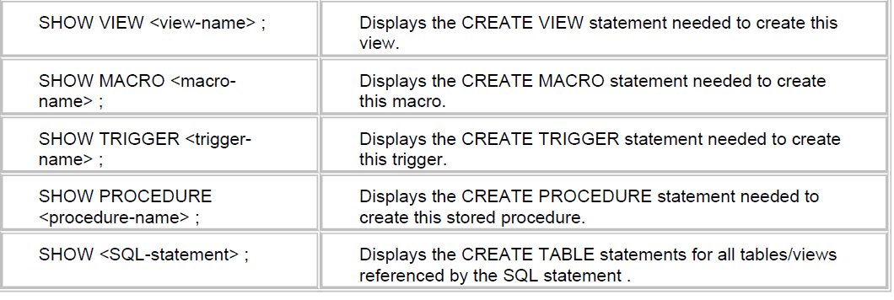
SHOW COMMAND
SHOW TABLE <TABLE-NAME> Displays the create table statement need to create table
SHOW TABLE Employee ;

