Slide 1

AI Career Guidance System
Helping students make smart choices

Slide 2
The Problem Students Face
Career-Interest Gap
Market Overwhelm
Need for Automation
Students often find it hard to match their grades and interests with real jobs.
There are so many new tech fields that students may not know which one to choose.
Students need a quick, automated way to sort career options by their skills.

Slide 3
Technologies Used
Python – Main programming language
Pandas – To handle and process data
Scikit-learn – For machine learning (Decision Tree & Label Encoding)
CSV File – To store student data
Command Line Input/Output – For user interaction

Slide 4




Project Objective
This smart system turns student profiles into personal career suggestions through automatic review.
Collect School Details
Gather Skills & Interests
Student info, grades, and school background
Useful skills and career interests
Review Profile
Suggest Careers
Check and study all the information
Show good career options
Example Career Paths
AI Engineer
Software Developer
Data Scientist
Cybersecurity Analyst
Build smart systems and learning models
Create apps and solve tech problems
Study data to help make business choices
Protect systems from online threats

Slide 5

Student Profile Data Points
The system collects key details to build a full student profile for better recommendations.
Personal Info
Name and age
School Results
12th marks and BTech CGPA
Education Background
BTech stream like CSE, IT, or ECE
Technical Skills
Programming languages and tools
Career Interests
Fields and areas they like

Slide 6
Smart Career Matching
The system uses a smart matching method that links student interests to the right career groups.
AI & Machine Learning
Cybersecurity
Careers: Data Scientist, Machine Learning Engineer, AI Engineer
Careers: Cyber Security Analyst, Network Security Engineer, Ethical Hacker
Keywords: AI, Data, Machine Learning, Analytics
Keywords: Security, Network, Ethical Hacking
DevOps & Cloud
Robotics & Systems
Careers: Cloud Engineer, DevOps Engineer
Careers: Robotics Engineer, Embedded Systems Engineer
Keywords: DevOps, Cloud, Infrastructure
Keywords: Robotics, Embedded Systems, IoT

Slide 7
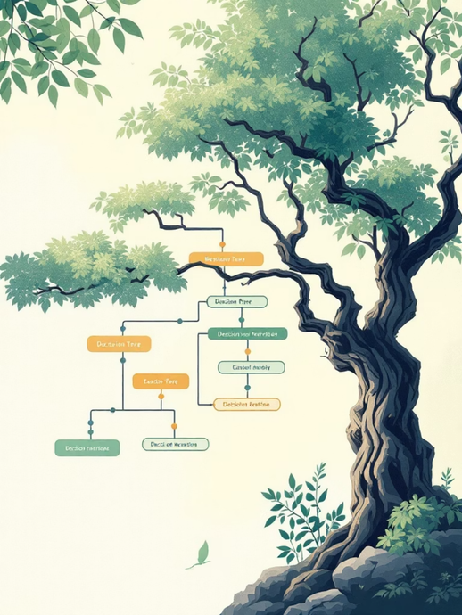
Decision Tree Classifier
How It Works
A supervised model that looks at student details like age
stream, CGPA, skills, and interests. It follows simple rules
to find the best career path.
Why We Chose Decision Trees
1
2
3
Mixed Data Types
Easy to Understand
Good for Small Data
It can handle both number data and category data without extra setup.
Each step is visible, so the results are easy to follow and trust.
It works well even when there is not much training data, which is common early on.
4
5
6
No Scaling Needed
Handles Complex Rules
Fast Predictions
It uses simple rule splits, so the data does not need extra adjustment.
It can follow several if-then steps, like real student-to-career choices.
After training, it quickly moves inputs through the tree for instant results.
7
Easy to Check and Improve
Problem areas are easy to spot, fix, and train again for better results.
Fast, Rule-Based Decisions
Handles Mixed Data Easily
Built for Trust
Clear feature splits give quick and steady recommendations with little confusion.
It works well with both number data and category data.
Its clear path from input to result makes every recommendation easy to explain.

Slide 8

System Flow Diagram
Start
Preprocessing
Begin the input process
Change labels and match skills
Data Collection
Classification
Collect name, age, marks, interests
The decision tree picks a career
The system takes student details and turns them into a career suggestion step by step.

Slide 9
Training Data Structure
A carefully chosen dataset of 14 student profiles with different backgrounds and matching career suggestions.
Age
12th %
Stream
CGPA
Interest
Python
Web
Security
Data
Career
18
95
CSE
8.5
AI
1
0
0
1
ML Engineer
19
90
CSE
8.2
AI
1
0
0
1
AI Engineer
20
85
IT
7.5
Development
1
1
0
0
Software Engineer
20
82
CSE
7.8
Security
0
0
1
0
Cyber Security Analyst
21
84
IT
7.9
DevOps
1
0
0
0
Cloud Engineer
22
83
ECE
7.6
Robotics
1
0
0
0
Robotics Engineer

Slide 10
Advantages
Helps students choose the right career
Easy to use
Instant recommendations
Supports multiple technology fields

Slide 11
Limitations
Fixed Career Options
It can suggest only a few careers. New or trending jobs are not included.
No Updates
The system does not learn from new data or changing job trends. It stays the same.
Decision Tree Issues
The algorithm may:
Memorize data (overfitting)
Miss complex patterns
No Personalization
It gives only one-time suggestions. It does not improve based on user feedback.
Low Accuracy
Because of less data, predictions may not be reliable.
No Job Market Check
It does not consider demand, salary, or job availability.

Slide 12

Live System Access
AI Career Guidance System is deployed online.
Users can access the system through the link below.
LINK2:https://euphonious-snickerdoodle-930e8b.netlify.app

Slide 13
THANK YOU

