Slide 1
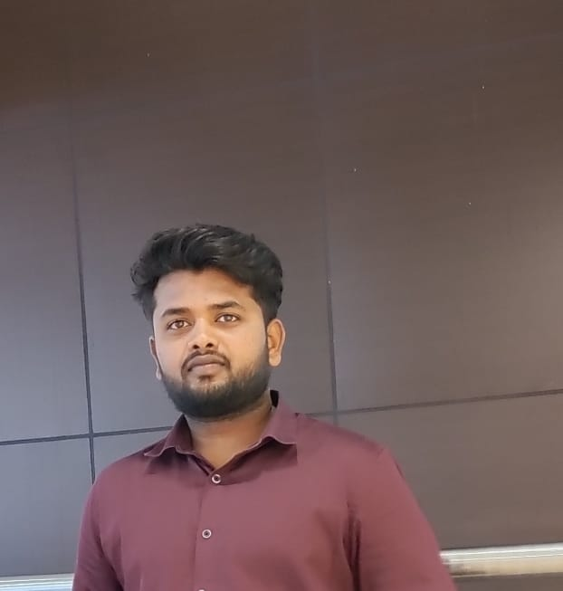
Sai Kumar Enagandula (Backend Developer)
Primary Skill: Backend Developer
Contact Number: +91 7337569784
saikumarenagandula1999@gmail.com
Client: ARTINHUM Project: AI-Driven Deployment Automation (Apr 2023 – Aug 2024)
Role: Associate software Engineer
The project aims to automate deployment processes by accepting user input in the form of voice or text, which is processed by an AI engine written in Go Lang. The AI engine generates a response in YAML format, which is then validated against a user-provided schema by a schema engine. Once validated, the YAML file is stored in a Git repository by a configuration engine. Subsequently, the YAML file is forwarded to a service engine, where a backend client orchestrator, implemented using Go Lang and utilizing gRPC and Protocol Buffers, executes workflows and activities, ensuring efficient and streamlined deployment procedures. The entire deployment automation process is built using Go Lang, ensuring reliability and scalability across the system
Responsibilities:
Collaborated with stakeholders to understand business requirements and create application documents, converting them into functional and technical design documents. Involve in implementing changes and deployed the changes.
Implemented changes and deployed them to the system.
Created workflows and activities based on project requirements.
Utilized gRPC and Protocol Buffers for efficient communication between system components.
Ensured deployment procedures were streamlined and efficient.
Evaluated and recommended tools and technologies to enhance project efficiency.
Collaborated with team members to design and implement various project components.
Conducted testing and debugging to ensure system reliability and performance.
Documented the system architecture, design decisions, and implementation details.
Provided technical guidance and mentorship to team members.
Participated in team meetings and presented project updates to stakeholders.
Client: Internal Project: Healthcare Management System
The Healthcare Management System project aimed to enhance patient data management and streamline workflows for better operational efficiency. The project involved designing Java backend services and optimizing schema designs, ultimately achieving a 15% improvement in efficiency. The use of Java technologies enabled the creation of efficient API endpoints and data management solutions, improving the overall operational workflow.
Responsibilities:
Developed API endpoints for managing user data, appointments, and consultant availability. Implemented Page Object Model, Hybrid framework for different web pages
Led schema design for key entities like patient data and appointments to ensure accuracy and efficiency.
Optimized database queries to improve performance and reduce response time.
Integrated third-party services for appointment scheduling and notifications.
Conducted unit and integration testing to ensure the quality and reliability of the backend services.
Managed database migrations and version control using Hibernate and MySQL.
Worked with front-end teams to ensure seamless integration between the backend and UI components.
Monitored system performance and resolved any performance bottlenecks or issues.
Participated in code reviews to maintain code quality and adherence to best practices.
Documented API endpoints, database schema, and system architecture for future reference and team collaboration
_{Professional Background:}
Innovative and team-spirited IT professional with over 1.5 years of Go Lang experience
Specializes in designing and developing software solutions.
Expertise in Go Lang and Java for creating, testing, and deploying software.
Focused on delivering solutions that meet business requirements.
Seeking challenging assignments to utilize skills and contribute to organizational growth. And Aims for personal and professional growth through meaningful contributions.
Technical Skills:
Programming Languages: Go Lang, Java, JavaScript
Web Technologies: HTML, CSS, Tailwind CSS
Frameworks: Spring Boot, Hibernate, Beego
Database Management: SQL, NoSQL (MongoDB)
API Technologies: REST API, gRPC, Protocol Buffers
Cloud Technologies: AWS (Lambda, S3, EC2), GCP, Azure
IDE/Development Tools: Eclipse, Spring Tool Suite, Visual Studio Code
Build Tools: Maven, Gradle
Other Tools: Postman
Operating Systems: Windows, Linux
Software Testing: Unit Testing, Smoke Testing, System Integration Testing, User Acceptance Testing

